Slide 1
Summary of
Protocol for the Collection, Transfer and Measurement of Radon in Water
(Designation: MW-RN)
AARST CONSORTIUM ON NATIONAL RADON STANDARDS
Michael Kitto, Committee Chairman
2019 International Radon Symposium Denver, Colorado

Slide 2
Surficial radon levels are NOT related to groundwater radon
2019 International Radon Symposium Denver, Colorado

Slide 3
FIELD OPERATIONS
PREPARE FOR COLLECTING WATER SAMPLES
Identify purpose as a) initial
b) confirmatory
c) seasonal
d) post-mitigation
Name of the sample collector, collection device, and method of collection
Address and exact location of water spigot
Volume of water expelled prior to collection
How was fresh water supply confirmed (i.e, temperature gun)
Exact collection date and time
2019 International Radon Symposium Denver, Colorado

Slide 4
FIELD OPERATIONS
LOCATIONS FOR COLLECTING WATER SAMPLES
faucet or spigot with slow flow rate
removal aeration device from spigot
guidance on use of clear hose
guidance on pressure/holding tank
2019 International Radon Symposium Denver, Colorado

Slide 5
FIELD OPERATIONS
SAMPLE collection
collect water samples using approved methods
use only glass bottles with Teflon™ (PTFE) or aluminum-lined septum
collect immediately following the purging of water from piping and tanks
minimize water turbulence
collect duplicate sample bottles
check samples for air bubbles
forward water samples to the laboratory
Avoid collecting any water that contacts air
2019 International Radon Symposium Denver, Colorado

Slide 6
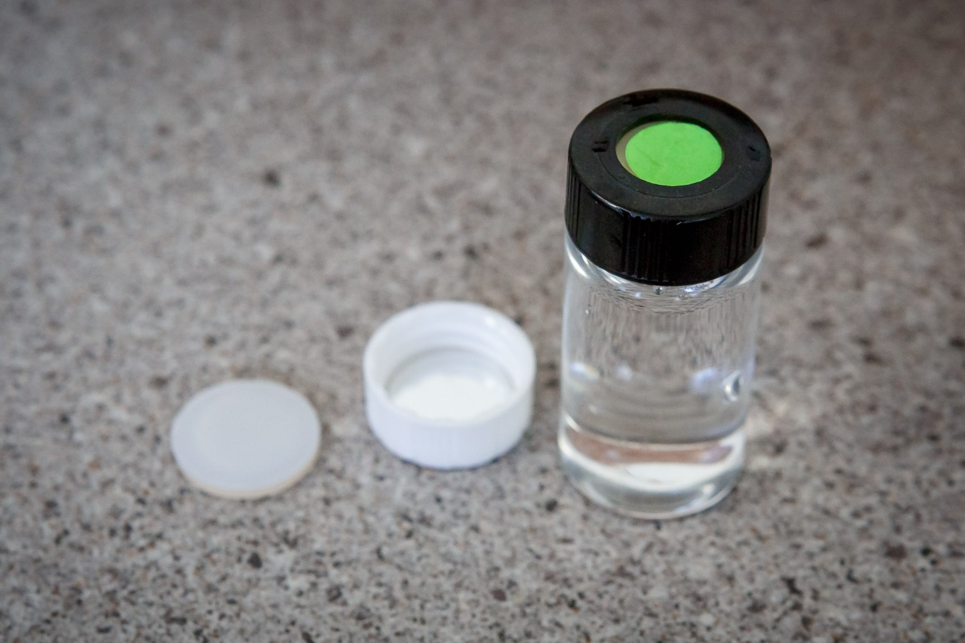
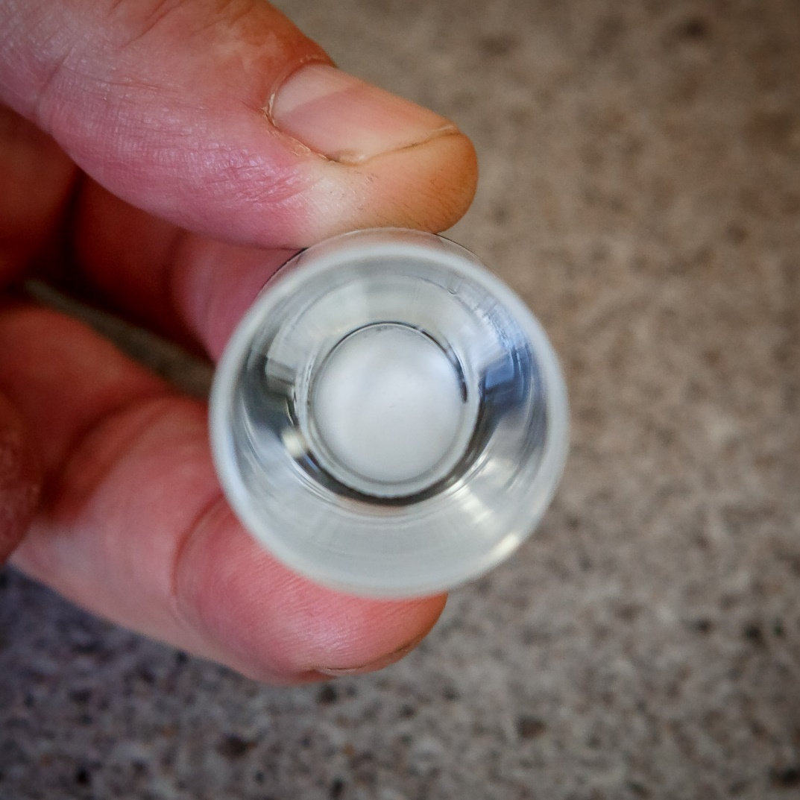
Aluminum lined septum >
Teflon lined septum
Inspect water sample for bubbles

Slide 7
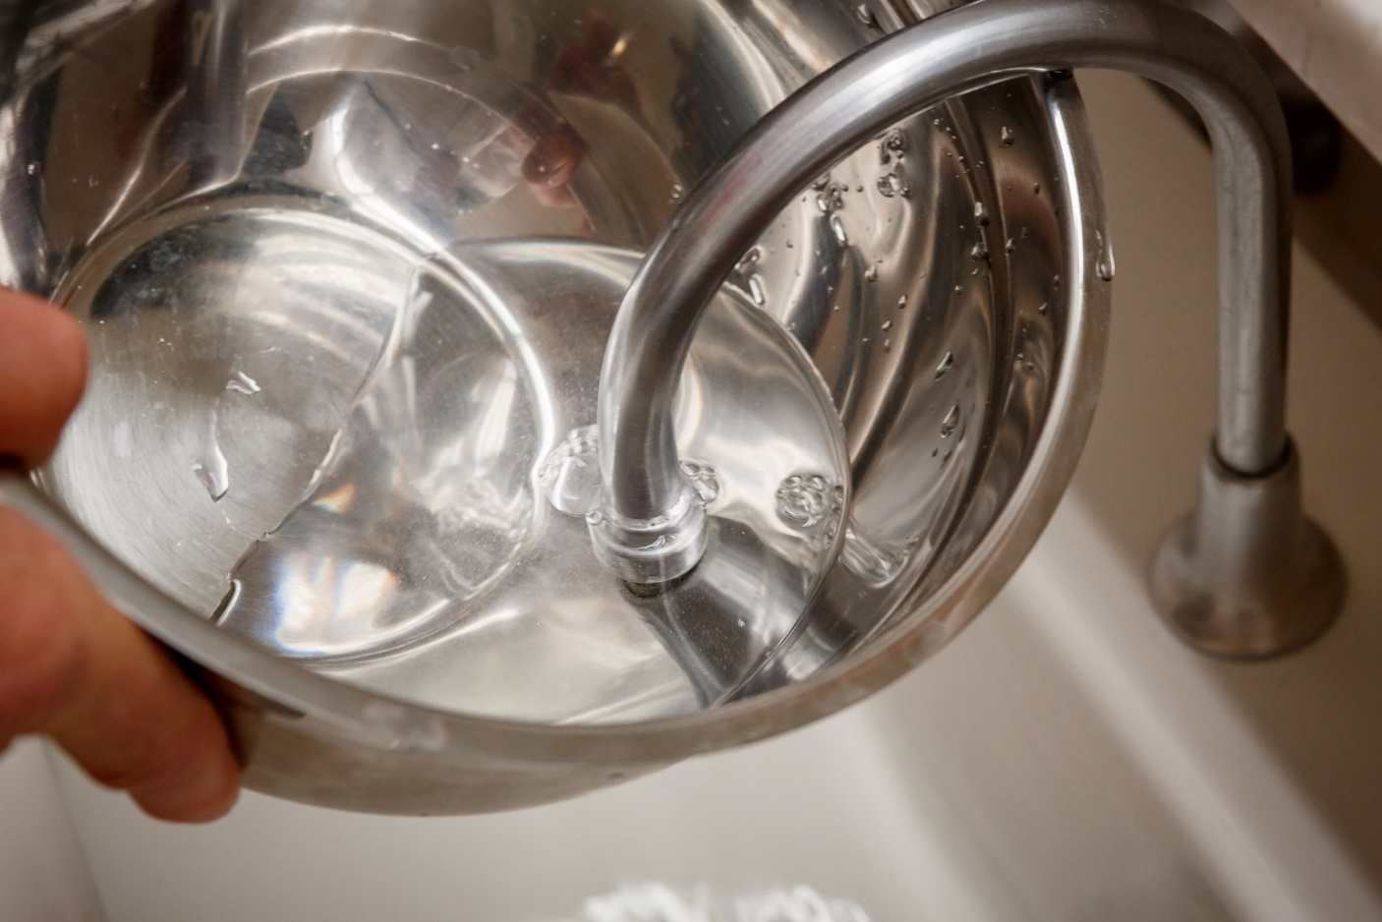
Bottle method—Filled bowl or small bucket
2019 International Radon Symposium Denver, Colorado

Slide 8
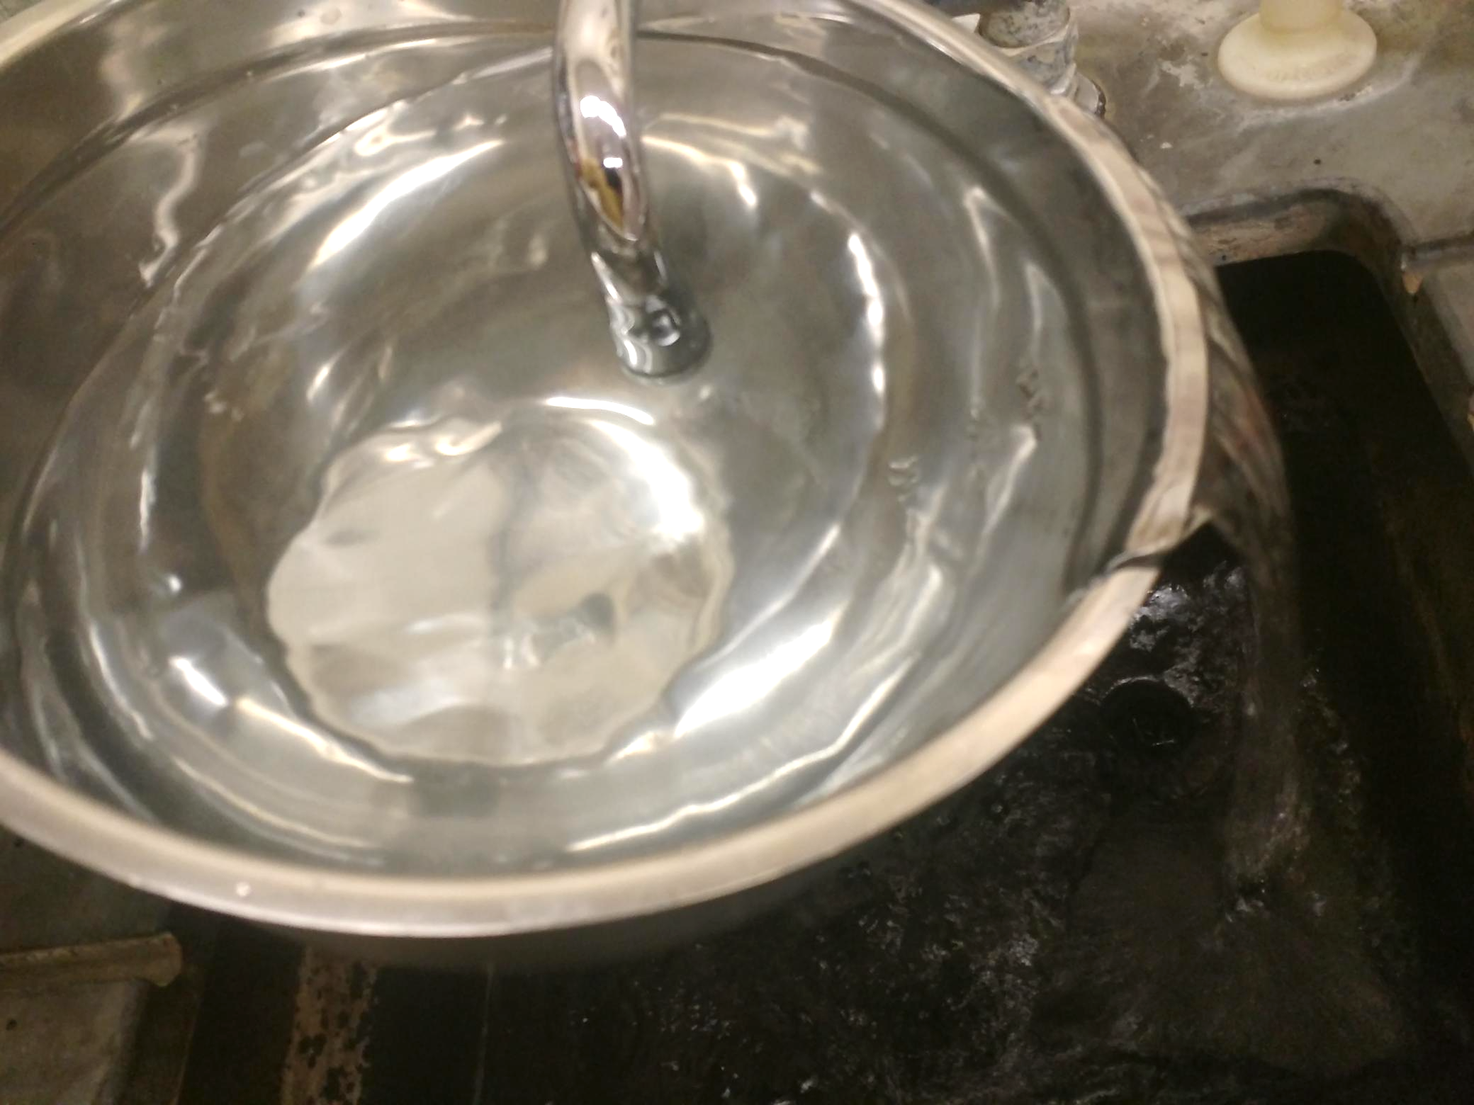
Overflow the bowl or small bucket
2019 International Radon Symposium Denver, Colorado

Slide 9
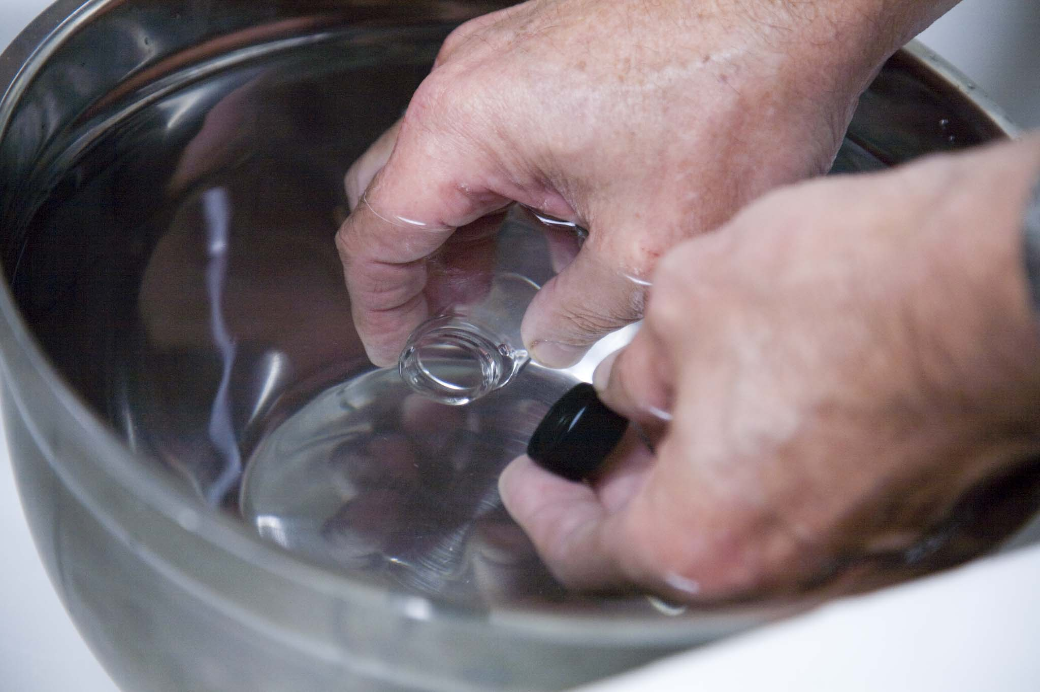
Filling bottle from a container filled with water.
2019 International Radon Symposium Denver, Colorado

Slide 10
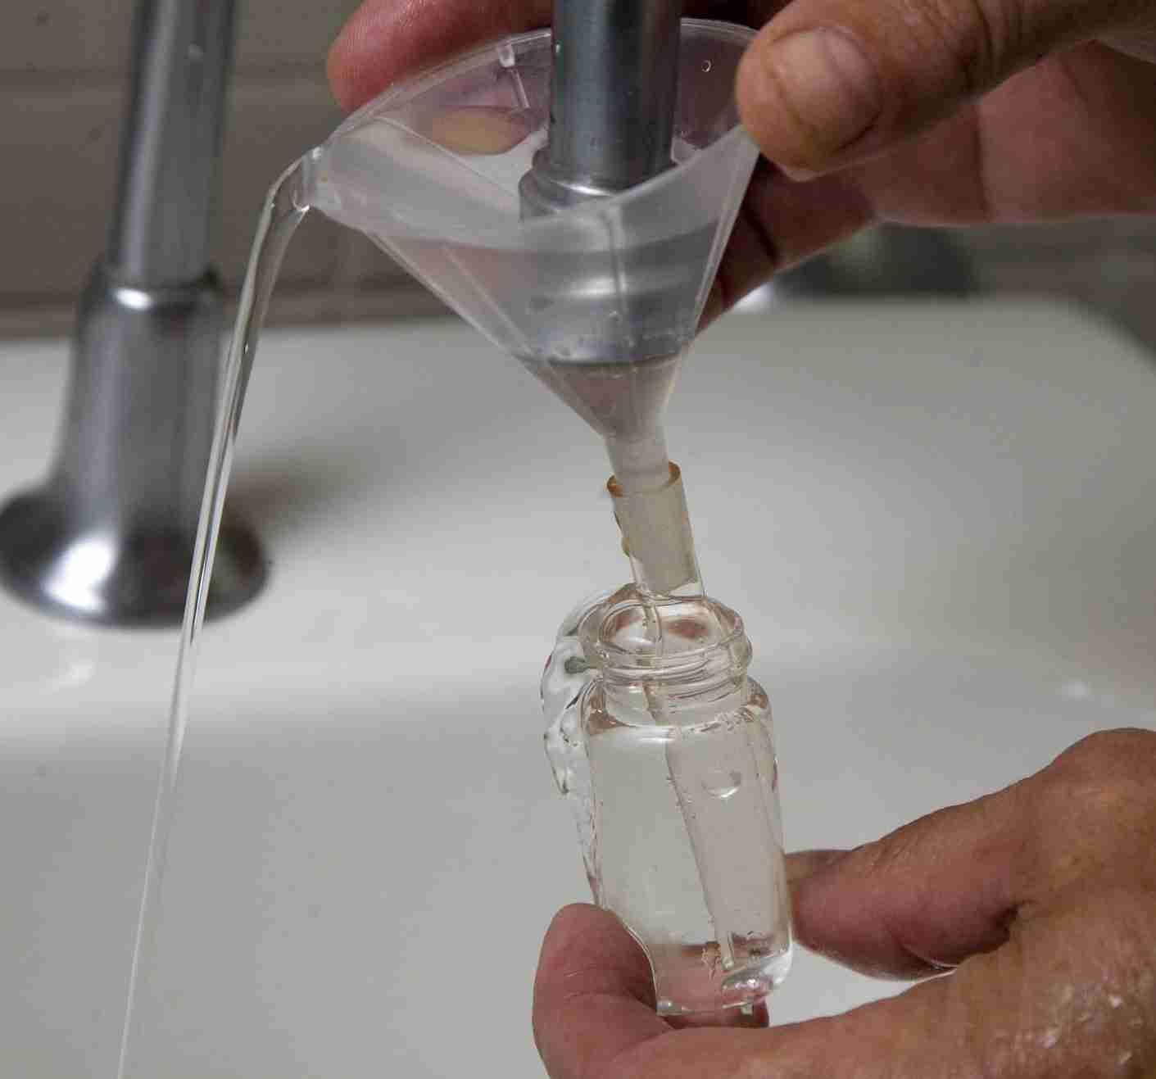
Filling bottle using submerged upright funnel.
2019 International Radon Symposium Denver, Colorado

Slide 11
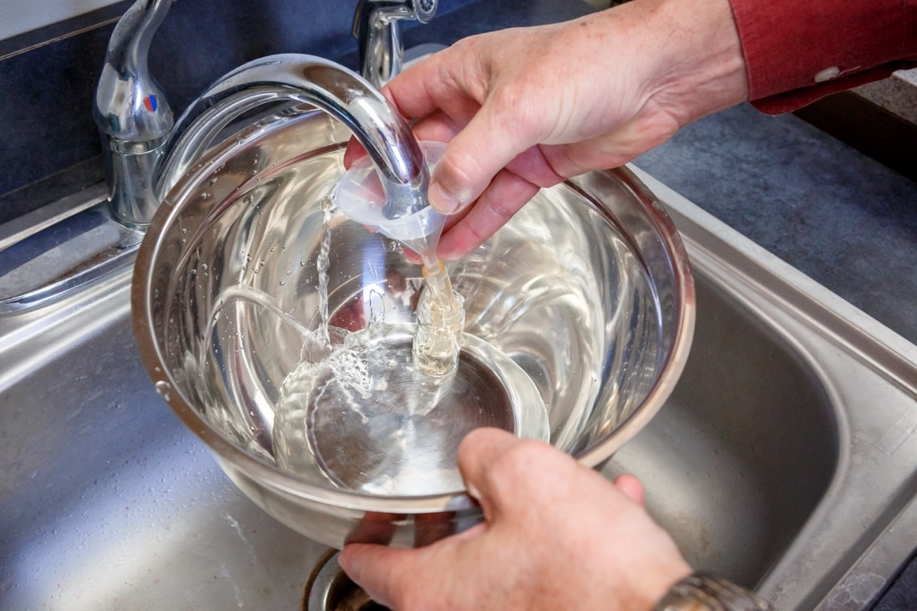
Filling an underwater sample bottle in a container using a funnel.
2019 International Radon Symposium Denver, Colorado

Slide 12
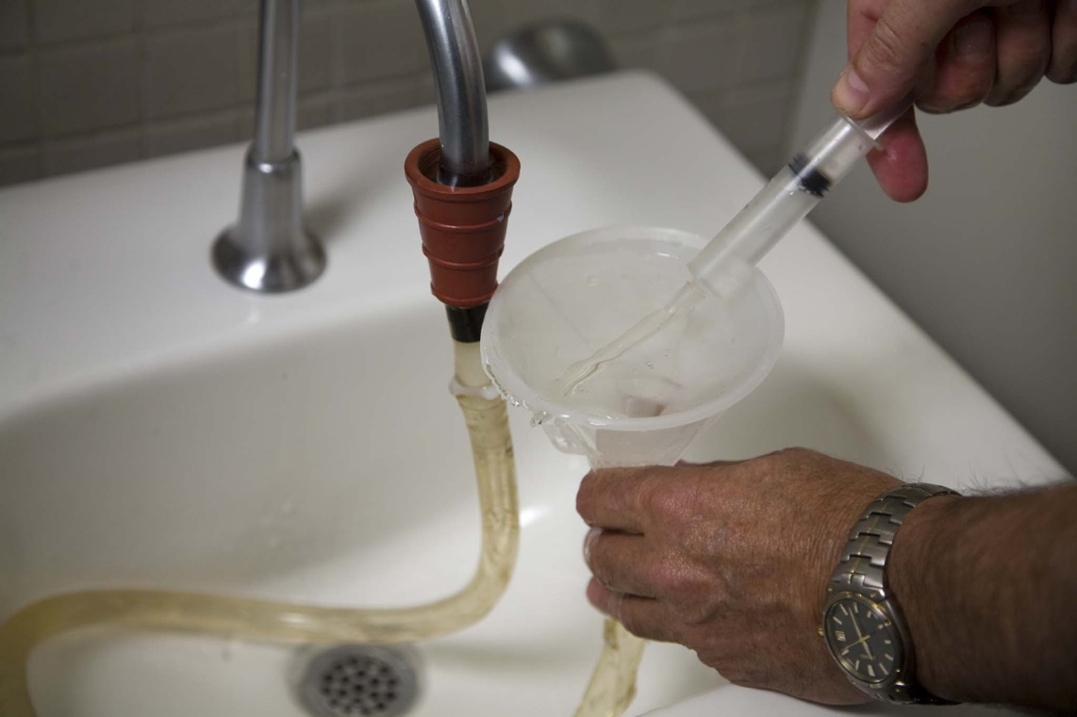
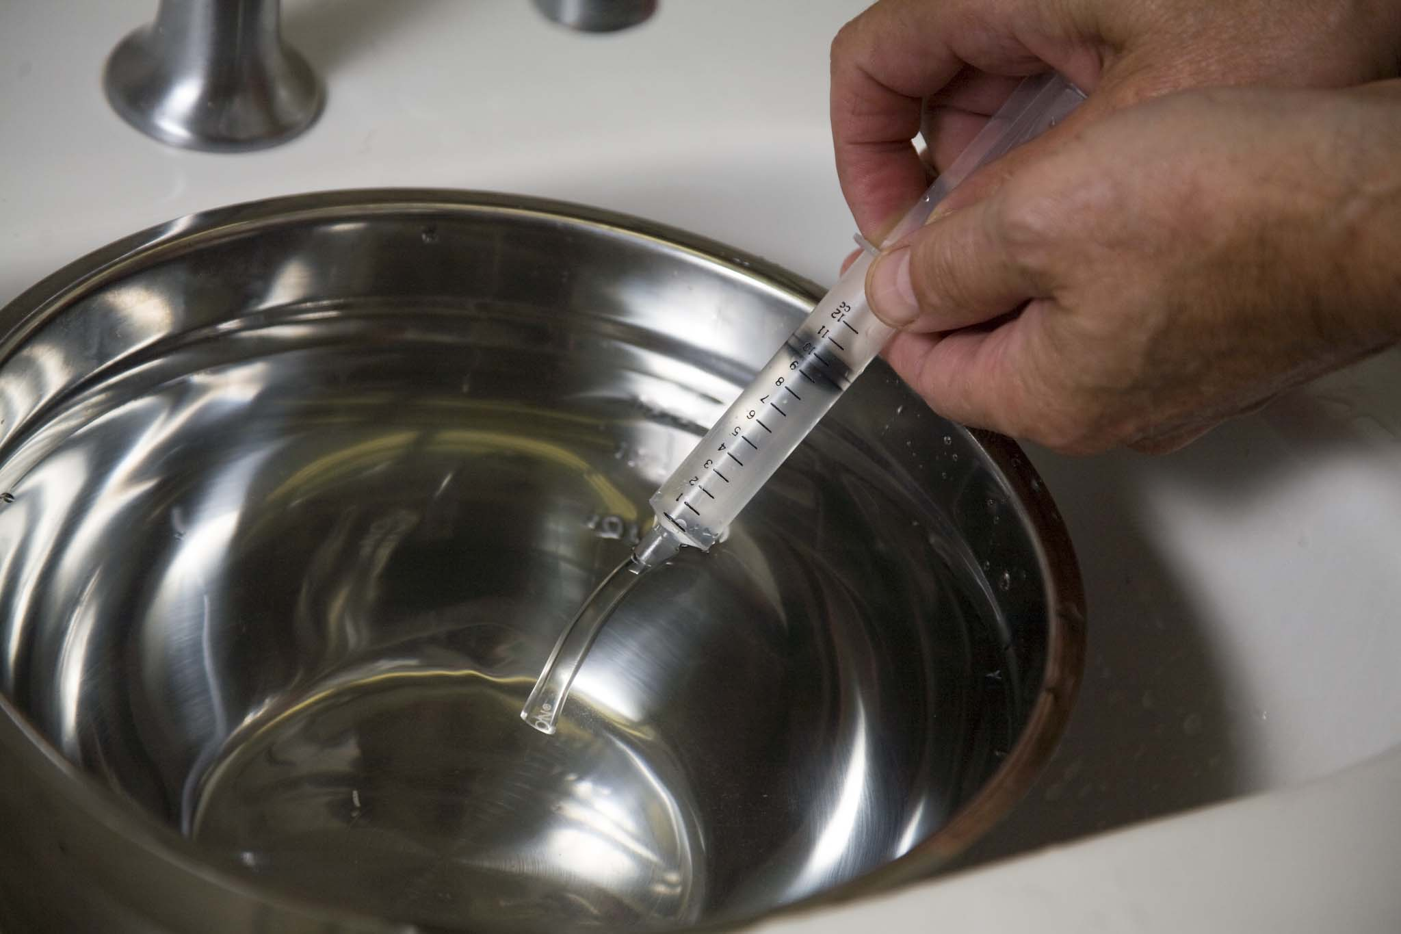
Collection Method 2 – Syringe Method
Only for adding to liquid scintillation fluid onsite.
2019 International Radon Symposium Denver, Colorado

Slide 13
FIELD OPERATIONS
Handling Water Samples
Check for Bubbles following collection
Forward samples to the Laboratory within 24 hours of collection
Sample Transport
  Packaging of water samples
  Avoid extreme temperatures
2019 International Radon Symposium Denver, Colorado

Slide 14
ACTIONS BASED ON TEST RESULTS
Action Level Guidance
no federally mandated action level for radon in water
several states have current/proposed max. conc. limits
Recommended Action Level > 4,000 pCi/L (150 Bq/L)
Mitigation Methods
aeration
filtration with Granular Activated Charcoal (GAC)
Recommended when <4,000 pCi/L (150 Bq/L)
Post-Mitigation Testing
2 untreated samples within 96 hours before mitigation
except when initial tests >40,000 pCi/L (1500 Bq/L)
2 post-mitigated water samples collected within 30 days
Mitigation Maintenance and Monitoring
maintenance of aeration and GAC systems
ongoing water testing to verify continued effectiveness
postings on the perimeter of the GAC system
2019 International Radon Symposium Denver, Colorado

Slide 15
Existing and planned maximum contaminant
levels (MCLs) for radon in water
State Recommended MCL (pCi/L)
Massachusetts 10,000
Wisconsin 5,000
Connecticut 5,000
Vermont 5,000
Maine 4,000
Rhode Island 4,000
New Hampshire 2,000
New Jersey 800

Slide 16
REPORTING RESULTS
Essential information
address of the building measured
names of collector & measurement professionals
Measurement results
each measurement result and associated error
average of duplicate measurement samples
Required Guidance Based Upon Concentrations
results exceed 4,000 pCi/L (150 Bq/L)
results are less than 4,000 pCi/L (150 Bq/L)
Other Health Guidance Advisories
tested for radon in indoor air
other dissolved radioisotopes (Ra and U)
bacteria
2019 International Radon Symposium Denver, Colorado

Slide 17
PROFESSIONAL SERVICES –
QUALIFIED Sample COLLECTorS
has satisfactorily completed an accredited water measurement training course
collects water samples properly
establishes and maintains a quality assurance management system for tasks they perform
2019 International Radon Symposium Denver, Colorado

Slide 18
PROFESSIONAL SERVICES
QUALIFIED LABORATORIES
Laboratory analyzes a water sample for radon and provides the result to a radon professional or directly to the public.
Sufficient training
Use approved method
External testing programs—intercomparisons and performance testing
2019 International Radon Symposium Denver, Colorado

Slide 19
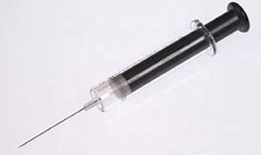
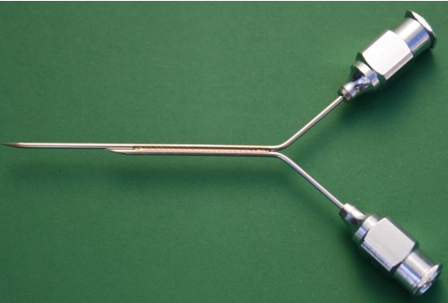
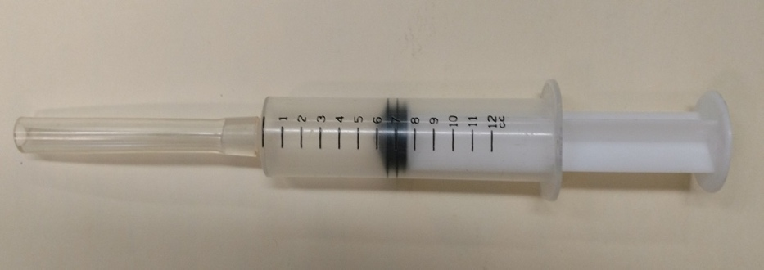
LABORATORY PROCESSING
Recommend:
start measurement within 4 days of collection
complete measurement <8 days of collection
Sample measurement period
maximum error (95% CL) of 25% or less for radon >300 pCi/L (11 Bq/L)
LIQUID SCINTILLATION
Transfer Methods
use airtight graduated syringe or transfer pipet
2019 International Radon Symposium Denver, Colorado

Slide 20
ALPHA SCINTILLATION CELL
Transfer procedure
Vacuum in alpha-scintillation cell
ELECTRET ION CHAMBER (EIC) METHOD
Adhere to manufacturers practices and calculations
CONTINUOUS MONITOR (CRM)
Adhere to manufacturers practices and calculations
New methodology development
All laboratories must successful participate in proficiency testing and/or laboratory intercomparison programs for radon in water, both initially and annually thereafter.
2019 International Radon Symposium Denver, Colorado

Slide 21
Conclusions
This document provides guidance and requirements
Use of trained sample collector
Use of proper collection technique
Measurement by qualified lab
Reporting of results
Mitigation recommendations
2019 International Radon Symposium Denver, Colorado

