Slide 1


Seasonality, Weather Conditions and Indoor Short-Term Radon Measurements
Nicholas CONLEY, MPH
Mary Kay rayens, PhD
Ellen Hahn, PhD, RN, faan
2019 International Radon Symposium Denver, Colorado

Slide 2
Outline
Summary and Objectives
Background
Methods
Observations
Results
Strengths and Limitations
Conclusions

Slide 3
Summary
Seasonality
  Higher radon levels in colder months
Precipitation
  Less rainfall associated with higher values
Wind
  Higher wind speeds associated with lower values
Seasonality studies
  Majority outside of the U.S
  Inconsistent findings

Slide 4
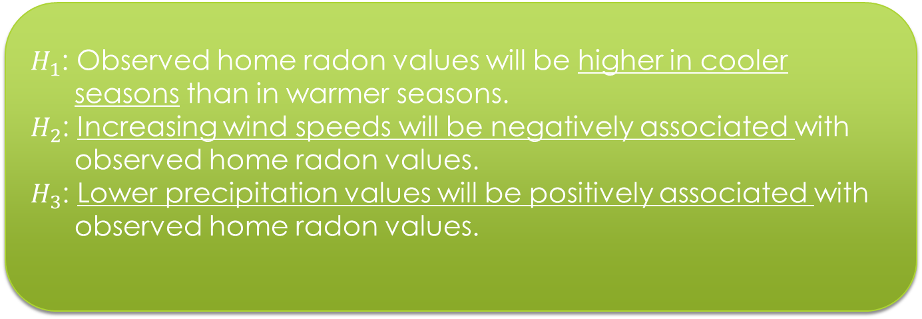
Objectives
Objective 1:
To determine if season, wind and precipitation were predictive of observed home radon values
Objective 2:
Determine best time for radon testing
$H_{1}$: Observed home radon values will be higher in cooler seasons than in warmer seasons.
$H_{2}$: Increasing wind speeds will be negatively associated with observed home radon values.
$H_{3}$: Lower precipitation values will be positively associated with observed home radon values.

Slide 5
Background
Kentucky experiences all 4 distinct seasons
New studies suggest radon exposure associated with skin cancer mortality and breast cancer
Synergistic relationship with tobacco smoke
“The most serious environmental health hazard threatening American households”
Notes:
-Kentucky is the perfect place to study how radon differs by season because it experiences all 4 distinct seasons.

Slide 6
Methods-Design
Secondary analysis of existing data sources
BREATHE
  Home radon values from short term test kits,1990-2015
National Oceanic and Atmospheric Association Data
  Wind, Temperature and Precipitation
119 Counties with Temperature and Precipitation data
8 Counties with Wind data
Notes:
Wind and precipitation datasets provided just one value (MPH and daily rainfall in inches)
Temperature provided 3-observation, min, and max. Observation was used unless it was missing then MAX.

Slide 7
Methods-Measurement
Medians used as summary scores
Variability and potential for out-of-range values
Medians not influenced by extreme values on either end

Slide 8
Season
January-March
April-June
July-September
October-December
Notes:
-We decided that because of Kentucky’s weather patterns
-This strategy is appropriate for summarizing quarterly measures because of the variability and potential for out-of-range values in the full dataset

Slide 9
Methods-Statistical Analysis
SAS Version 9.4
An alpha of .05 used in inferential testing
Median radon values log transformed
Longitudinal Mixed Model for repeated measures
Post-hoc pairwise comparisons of geometric means
Notes:
-Used to assess the association between log radon level and other variables
-Used mixed model because of the repeated measures are being made on the same radon unit.
-To determine if there were significant differences among seasons

Slide 10
Two Models
116-County Model
Precipitation
Season
8-County Model
Precipitation
Season
Wind
Time Variable
Time Variable
Notes:
These models represent all counties with non missing data.
-Temperature was omitted due to multicollinearity between the seasonality factor and ambient temperature.
-Comparisons are more intuitive among seasons with models that contain the seasonality variable.
Rather than the continuous temperature variable.
-Time variable ranges from 1-104, this measures the linear trend of radon levels from 1990-2015.

Slide 11
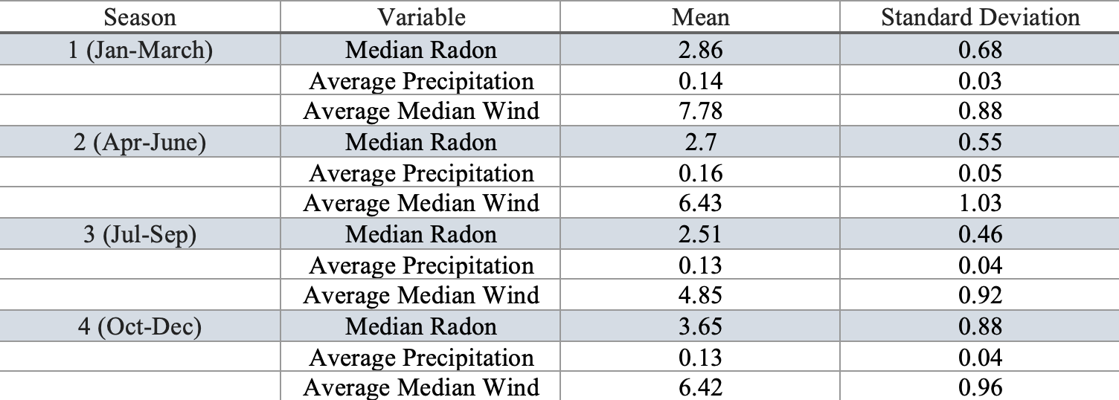
Observations
Notes:
-We observed lower radon levels in seasons 2 and 3, months April-September.
-Precipitation demonstrated little variability through out the 4 seasons.

Slide 12
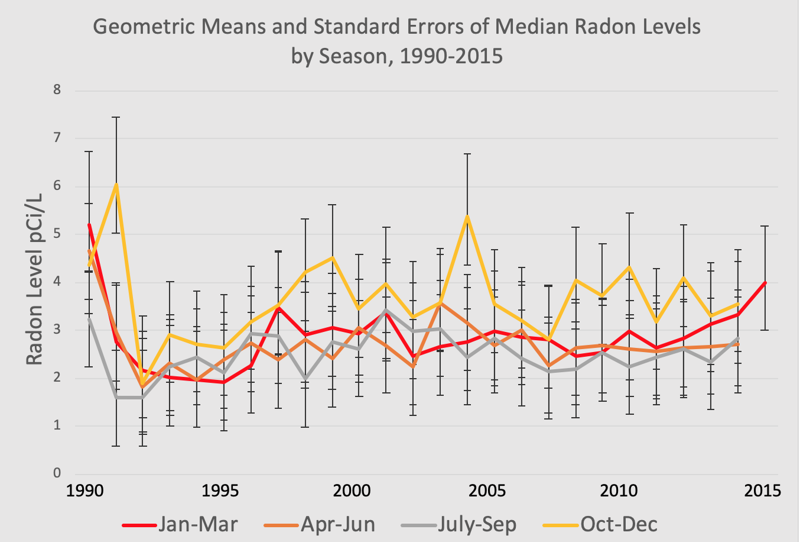
Observations
Notes:
-The trend is for season 4, October-December, to continue to see higher radon levels through out any fixed year.

Slide 13
Results
116-County Model
  Seasonality
  Time
8-County Model
  Seasonality
  Wind
Precipitation not significant (p>0.05) in either model
Positive trend
Notes:
Seasonality
Consistent with literature
Wind
-Associated with higher radon values
-Consistent with findings in table 1 with higher wind values in colder months
-Not consistent with literature

Slide 14
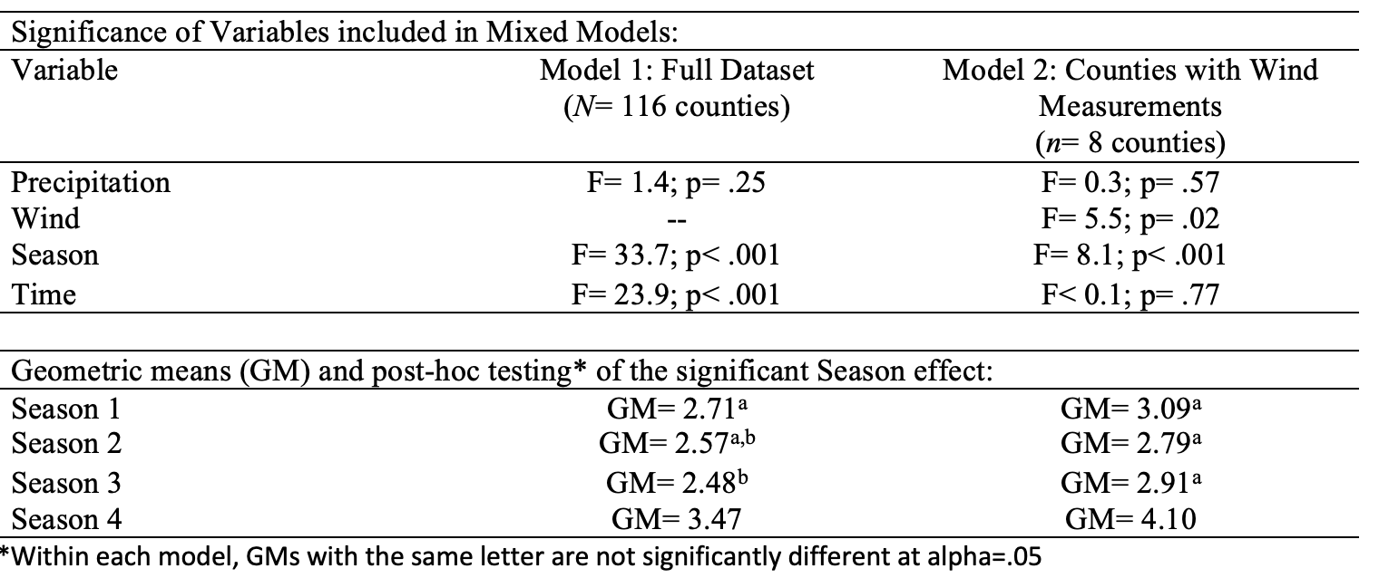
Results
Notes:
116 county model- season and time were significant
8 County model- Wind and Season were significant
The significant time effect indicated a trend in increasing radon values over the 26-year period (p< .001).
post-hoc pairwise comparisons of the seasonality factor were consistent with other studies in the literature.
there was a significant difference in average median radon level between seasons 1 vs. 4 , 1 vs. 3 (p= .02), 2 vs. 4 and 3 vs. 4
The differences between seasons 2 vs. 3 and 1 vs. 2 were not significant.

Slide 15
Strengths and Limitations
Primary Strengths
  Large radon value dataset over a 26-year time period.
  Inclusion of weather data during the same 26 year time period.
Primary limitations
  Lack of wind data, n=8 counties
  Lack of consistently reliable data for all study variables
Notes:
Wind and precipitation only had one value per day while temperature had three.

Slide 16
Conclusions
Radon testing should be performed during typical weather conditions.
It is beneficial to test for radon during the months of October-March (in a place like Kentucky)
The observations made in this study are valuable to public health practitioners, environmentalists, radon testers and mitigators, and homeowners.
Notes:
-Homeowners concerned with their health.
-Test during known higher radon levels.
-Wind could exaggerate true radon levels.

Slide 17
Sources
1. Khan MS. Radon in the Dwellings: Causes and Prevention. International Annals of Science. 2017;3(1):1-5.
2. Centers for Disease Control and Prevention. Lung cancer and the environment. 2016.
3. Butler KM. Access to Free Home Test Kits for Radon and Secondhand Smoke to Reduce Environmental Risks for Lung Cancer. Journal of Environmental Health. 2018;81(3).
4. Citizen's Guide to Radon: The Guide to Protecting Yourself and Your Family from Radon. 2005.
5. Hahn EJ, Gokun Y, Andrews Jr WM, et al. Radon potential, geologic formations, and lung cancer risk. Preventive medicine reports. 2015;2:342-346.
6. Sharman G. Seasonal and spatial variations in Rn-222 and Rn-220 in soil gas, and implications for indoor radon levels. Environmental geochemistry and health. 1992;14(4):113-120.
7. Ball T, Cameron D, Colman T, Roberts P. Behaviour of radon in the geological environment: a review. Quarterly Journal of Engineering Geology and Hydrogeology. 1991;24(2):169-182.
8. Denman AR, Crockett RGM, Groves-Kirkby CJ, Phillips PS, Gillmore GK, Woolridge AC. The value of Seasonal Correction Factors in assessing the health risk from domestic radon—A case study in Northamptonshire, UK. Environment International. 2007;33(1):34-44.
9. Shleien B, Ruttenber AJ, Sage M. Epidemiologic Studies of Cancer in Populations Near Nuclear Facilities. Health Physics. 1991;61(6):699-713.
10. Chattopadhyay S, Edwards DR. Long-term trend analysis of precipitation and air temperature for Kentucky, United States. Climate. 2016;4(1):10.
11. BREATHE Radon Policy Division University of Kentucky College of Nursing. Radon data by county 2019; http://www.uky.edu/breathe/radon/radon-data-county.
12. Casey JA, Ogburn EL, Rasmussen SG, et al. Predictors of indoor radon concentrations in Pennsylvania, 1989–2013. Environmental health perspectives. 2015;123(11):1130.
13. Xie D, Liao M, Kearfott KJ. Influence of environmental factors on indoor radon concentration levels in the basement and ground floor of a building–a case study. Radiation Measurements. 2015;82:52-58.
14. Vogeltanz-Holm N, Schwartz GG. Radon and lung cancer: What does the public really know? Journal of Environmental Radioactivity. 2018;192:26-31.
15. Rigby JG, La Pointe DD. Wind and barometric pressure effects on radon in two mitigated houses. Paper presented at: The 1993 International Radon Conference1993.

Slide 18

Thank you!
Questions?
www.breathe.uky.edu

