Slide 1
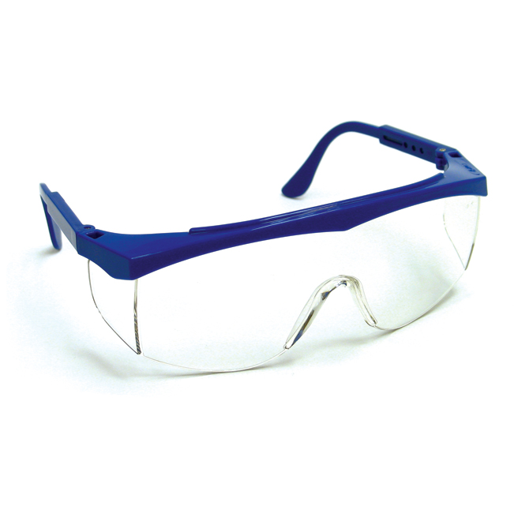
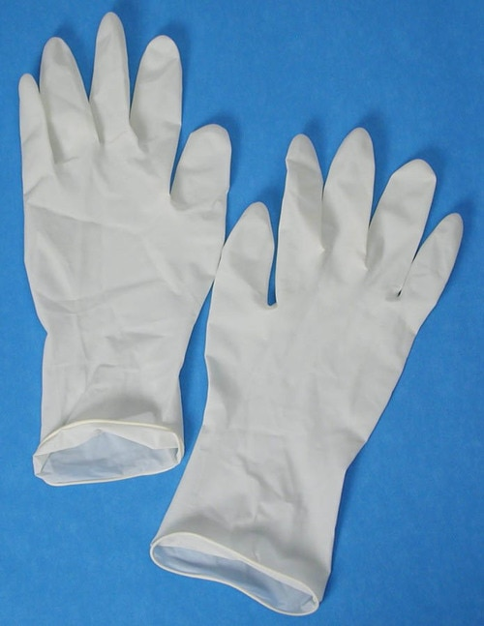
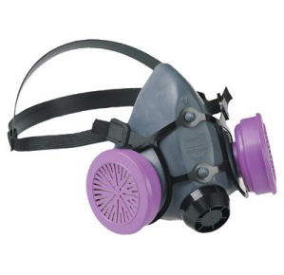
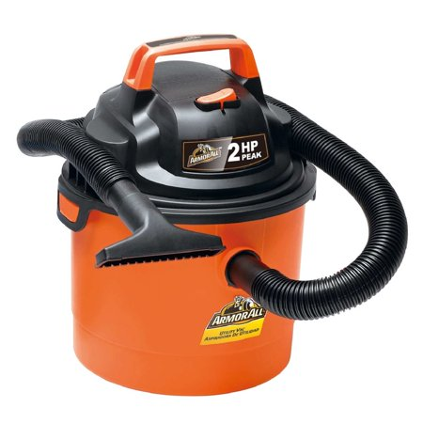
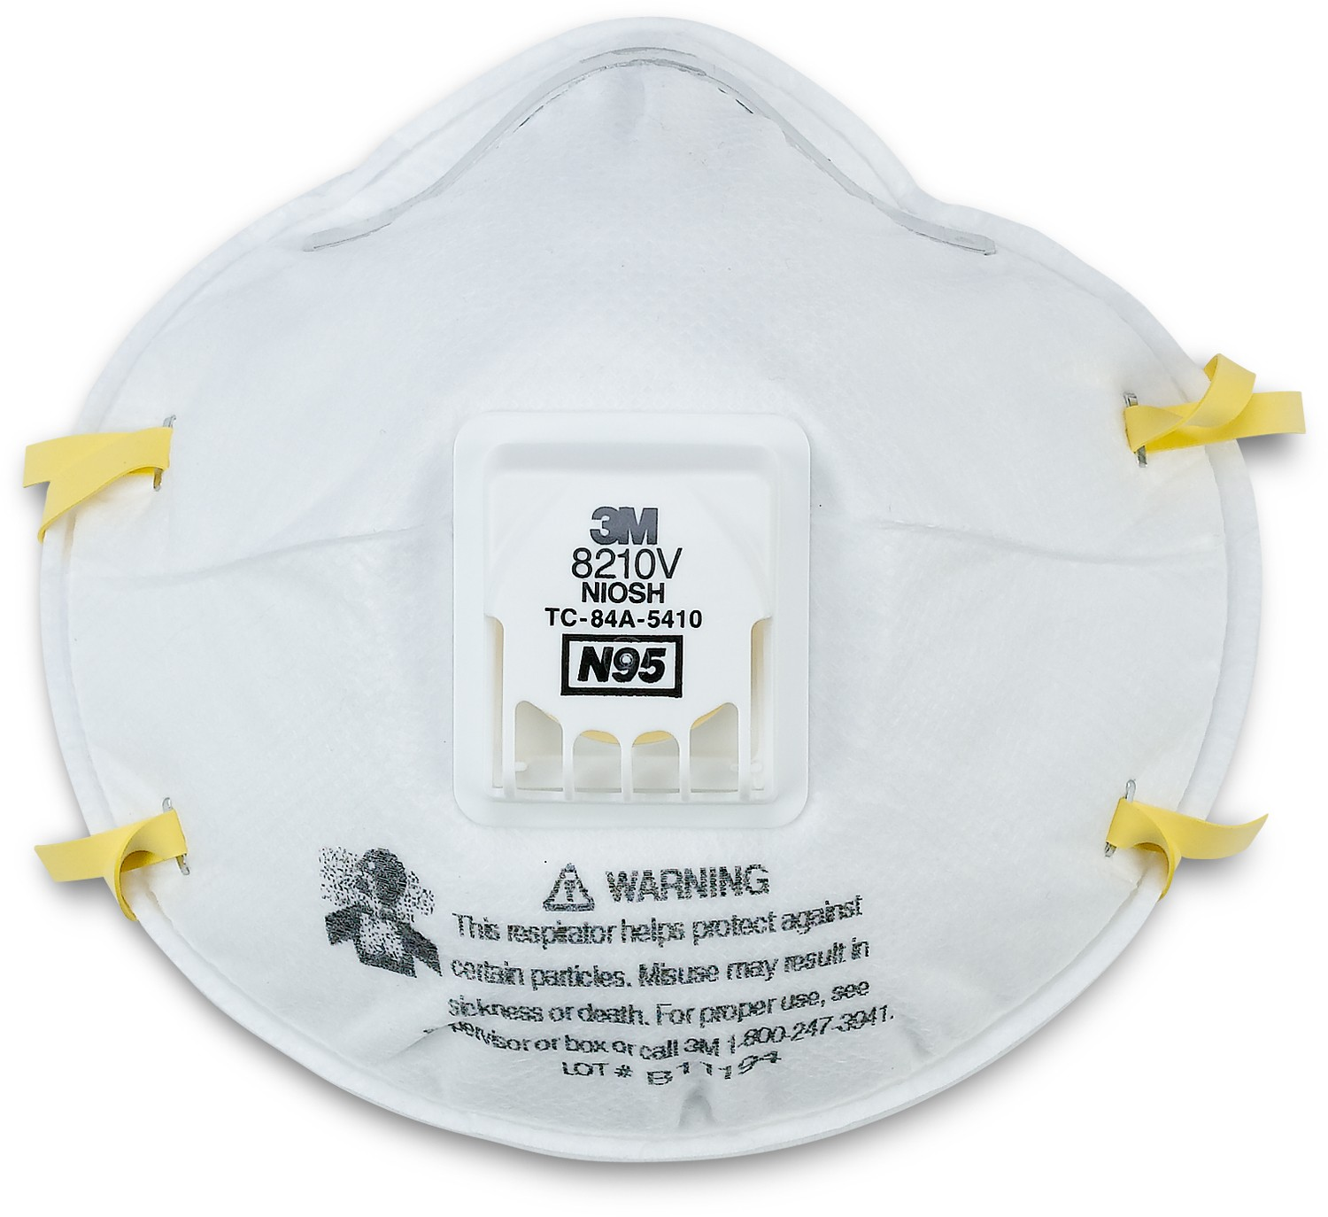
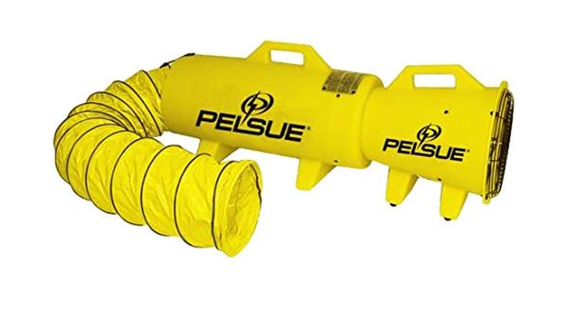
PPE FOR RADON MITIGATORS AND OTHER SAFETY PRATICALITIES
What every radon professional should know
Presented by Nathaniel L. Burden, Jr. – PA Chapter AARST President/SPRUCE Instructor/Consultant
2019 International Radon Symposium Denver, Colorado
T
AARS

Slide 2
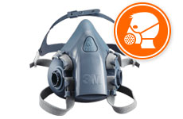
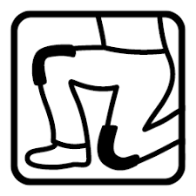
PPE (PERSONAL PROTECTIVE EQUIPMENT)
What is Personal Protective Equipment?
Personal protective wear, known in the United States as Personal Protective Equipment (PPE), protects workers from injury or illness resulting from contact with physical, mechanical, chemical, electrical, radiological, and other workplace hazards. PPE includes face shields, safety glasses, hard hats (helmets), gloves, earplugs, respirators, protective clothing, safety shoes, and more.
2019 International Radon Symposium Denver, Colorado
T
AARS

Slide 3
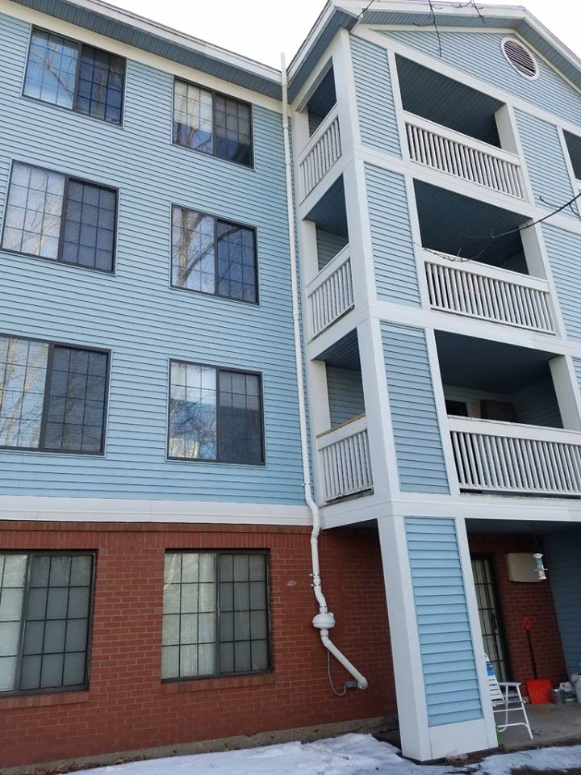
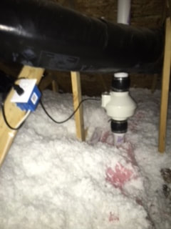
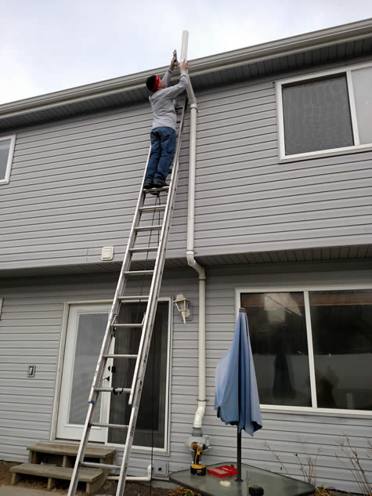
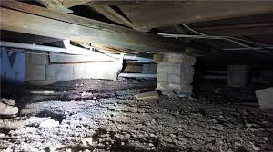
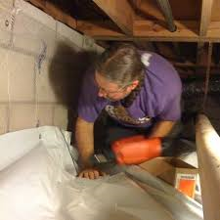
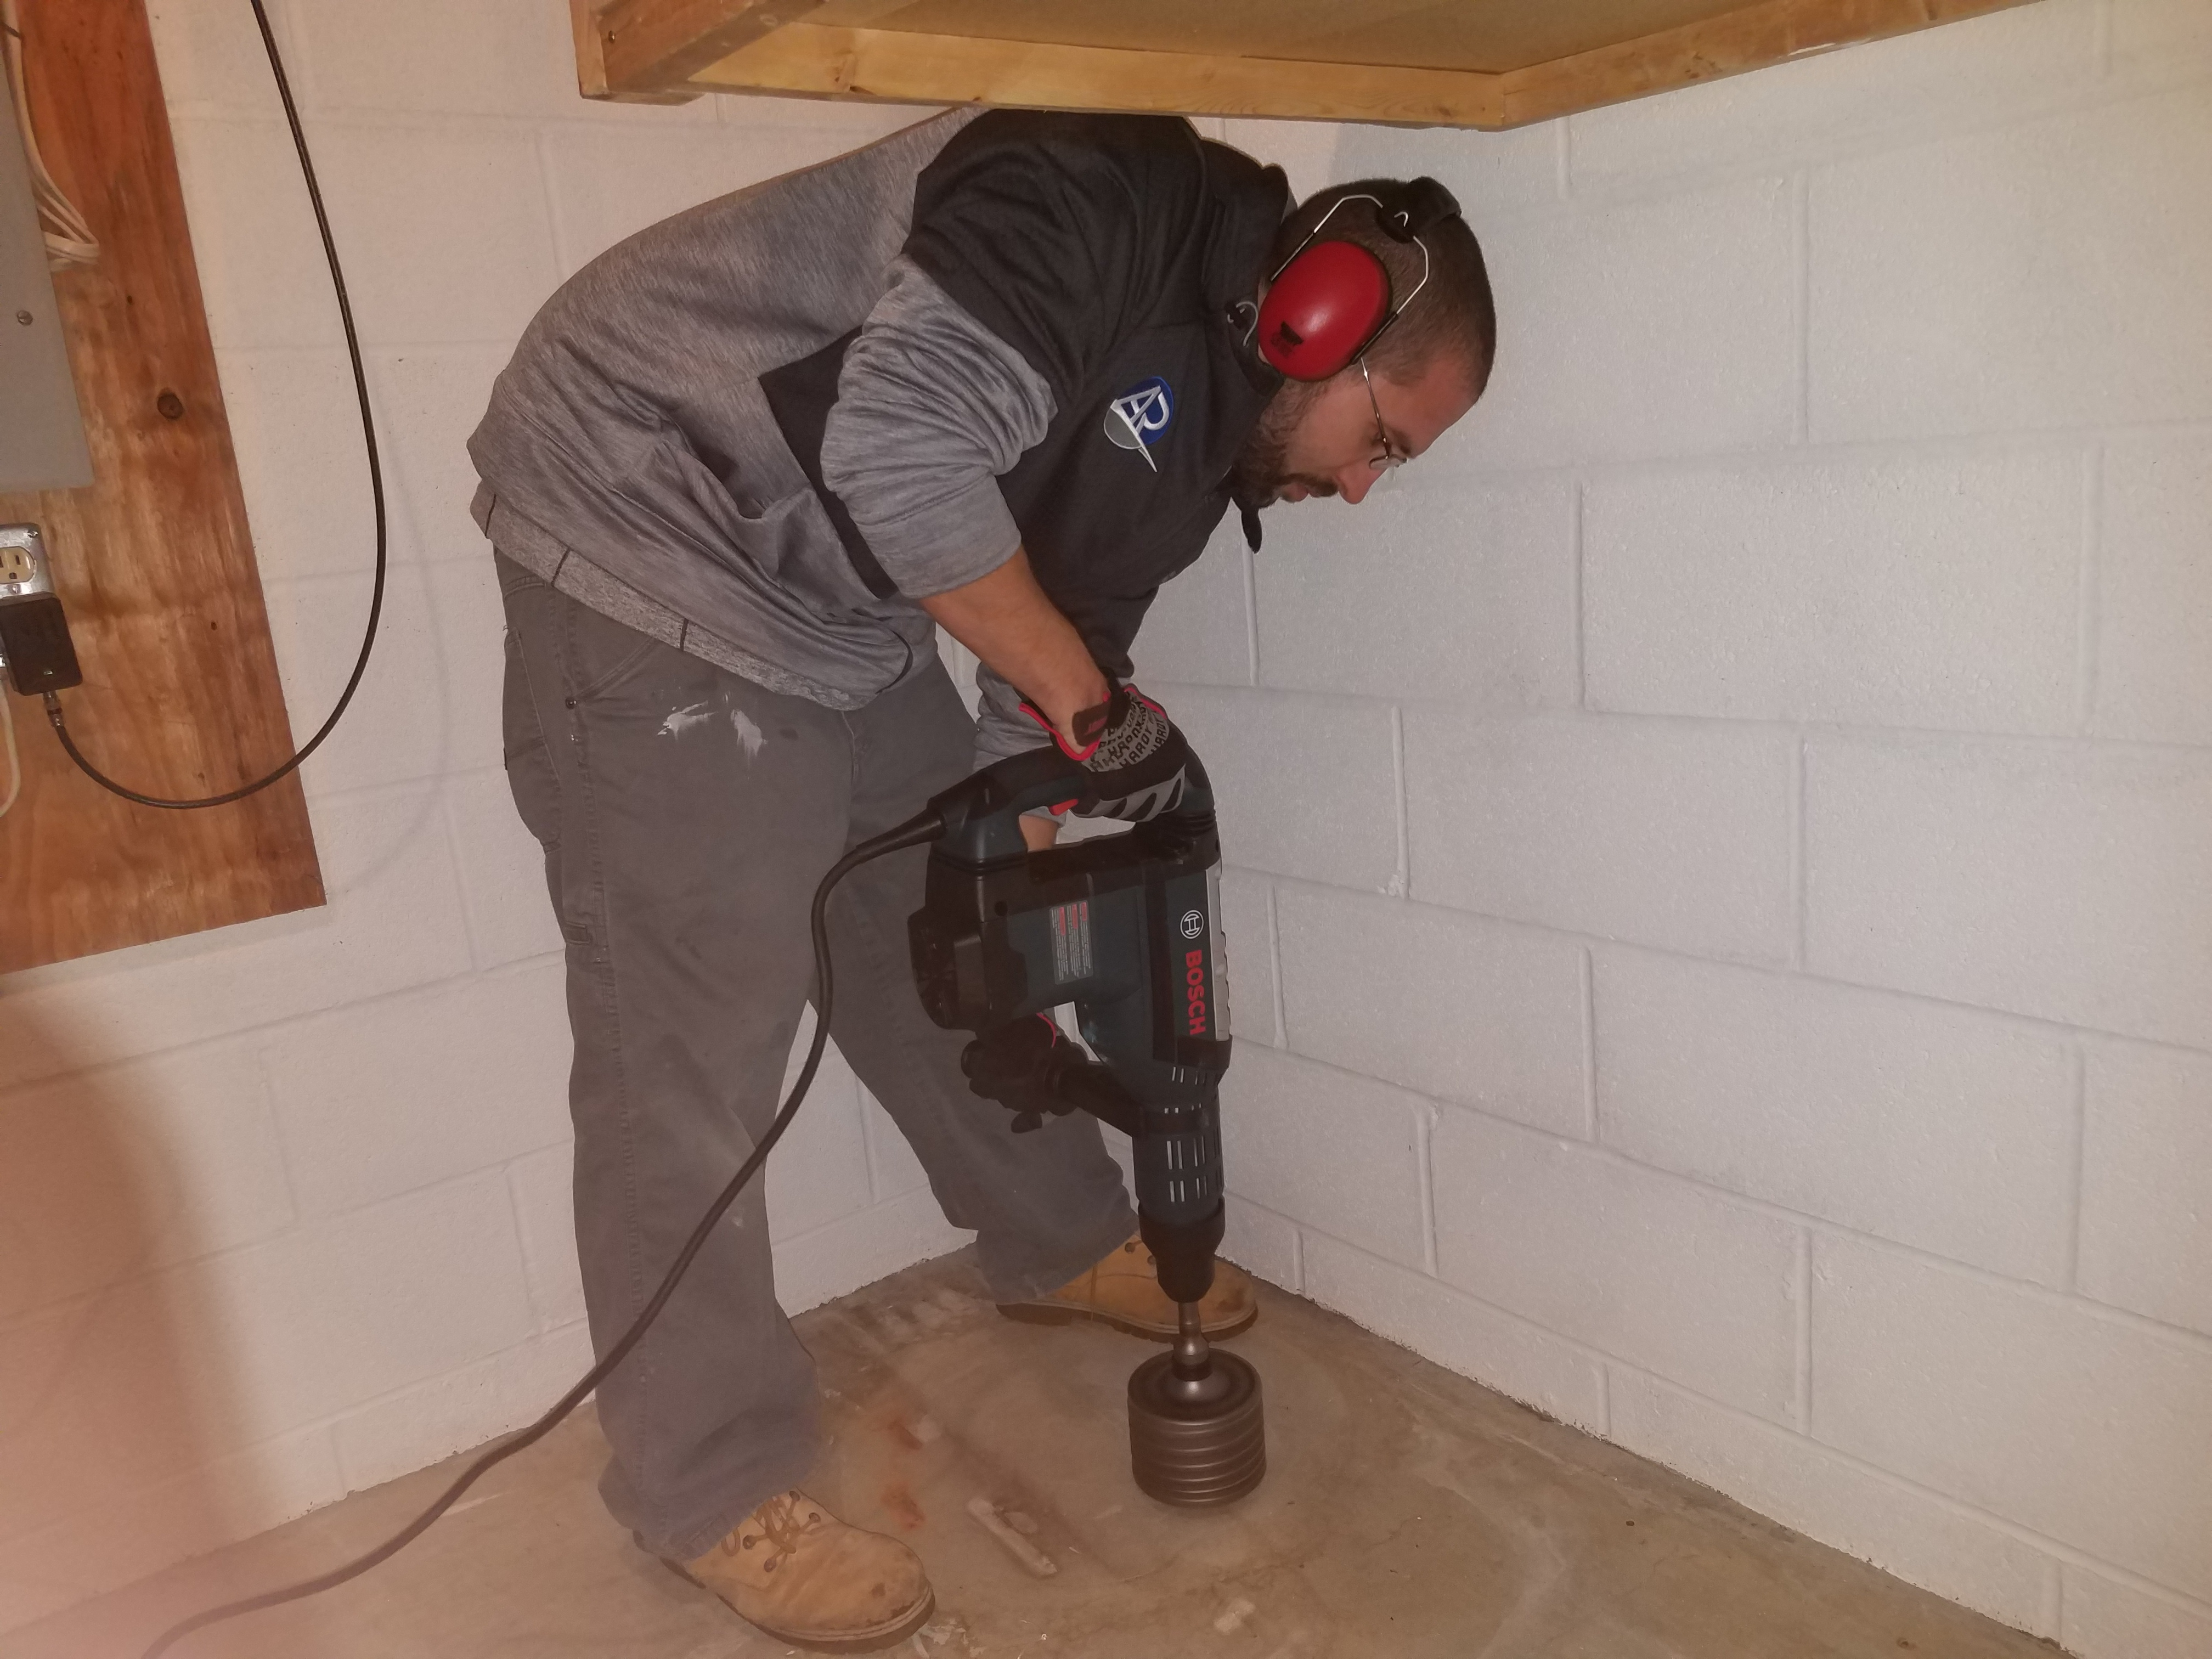
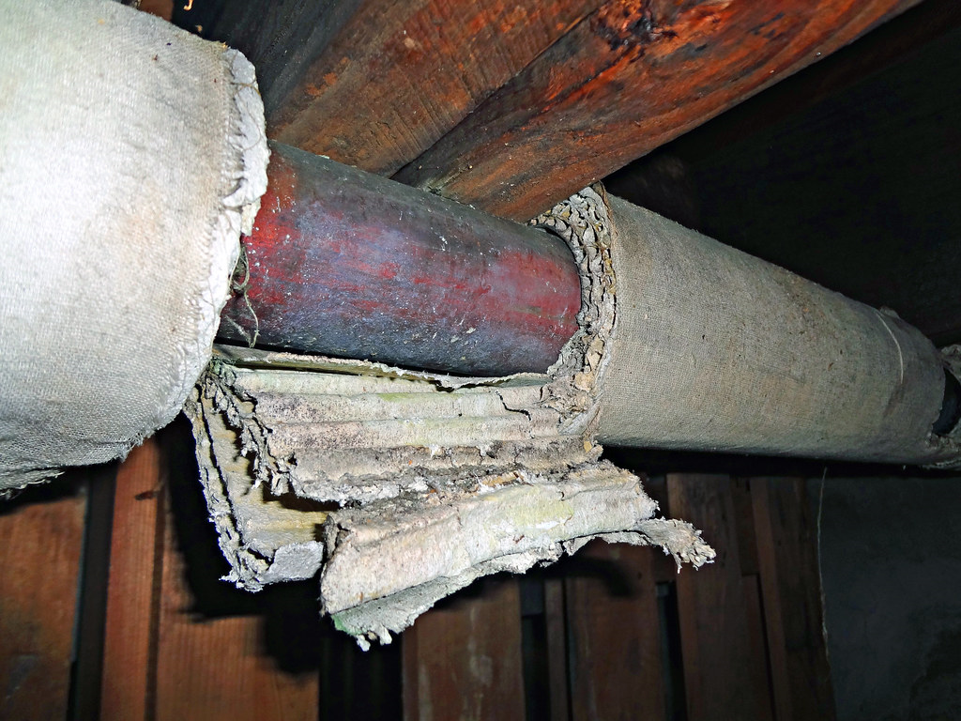
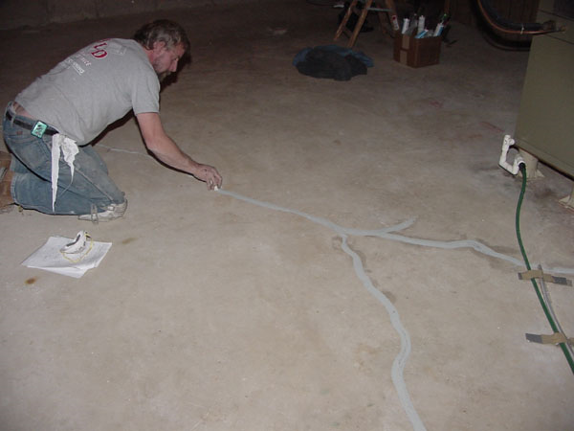
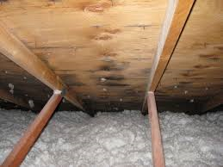
Why would you need PPE?
2019 International Radon Symposium Denver, Colorado
T
AARS

Slide 4
Health & Safety Program: Just a simple guidance overview
PPE is only a part of a Health and Safety Plan/Program for the Radon Mitigation Professional.
Radon mitigation professionals need a written HSP
Testers may also need PPE under certain testing site conditions (construction/renovation sites, military sites, older buildings, tunnels, mines, etc.)
2019 International Radon Symposium Denver, Colorado
T
AARS

Slide 5
Did You Know How OSHA Views the Radon Mitigation Industry?
OSHA considers radon mitigation workers as part of the construction industry, not the general work industry.
OSHA defines "construction work" as work for construction, alteration and/or repair, including painting and decorating.
https://www.osha.gov/laws-regs/standardinterpretations/1994-08-11-3
2019 International Radon Symposium Denver, Colorado
T
AARS

Slide 6
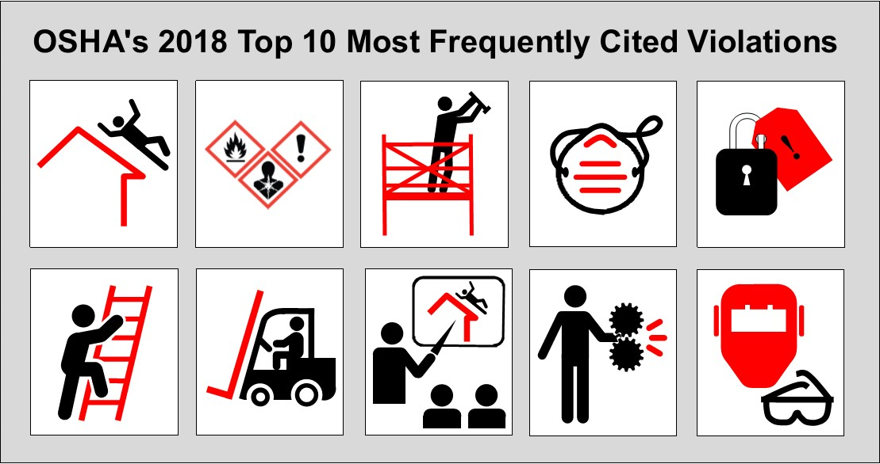
2019 International Radon Symposium Denver, Colorado
T
AARS

Slide 7
OSHA Top 10 Cited Violations
Most Cited Violations of 2018 1. Fall Protection (1926.501) 2. Hazard Communication (1910.1200) 3. Scaffolding - General Requirements (1926.451) 4. Respiratory Protection (1910.134) 5. Control of Hazardous Energy - Lockout/Tagout (1910.147) 6. Ladders (1926.1053) 7. Powered Industrial Trucks (1910.178) 8. Fall Protection – Training Requirements (1926.503) 9. Machine Guarding– General Requirement (1910.212) 10. Personal Protective and Lifesaving Equipment – Eye and Face Protection (1926.102)
2019 International Radon Symposium Denver, Colorado
T
AARS

Slide 8
Don’t Be Part of the Statistics: Fall Protection
2019 International Radon Symposium Denver, Colorado
T
AARS

Slide 9
Health & Safety Program: Just a simple guidance overview
Training for the Radon Mitigation Professional and Workers by a recognized training group with documentation and sign-off.
SDS for all chemical products used at site or workplace with safe usage training (caulks, primers, pipe glue, foam, etc.)
Hazards Recognition: (electrical, gas lines, oil lines, underground utilities, asbestos, vermiculite attic insulation-asbestos, confined spaces, fire/flammable, temperature, slip/fall issues, weather, head injury (nail throughs, structures, site items), ladders, crawl spaces (height, surface conditions, IAQ), mold, heat sources, entry/exit, vermin, etc.)
2019 International Radon Symposium Denver, Colorado
T
AARS

Slide 10
Health & Safety Program: Just a simple guidance overview
Hazards/IAQ issues assessment/elimination/reduction controls (work site ventilation/dilution)
ALARA (As Low As Reasonable Achievable) for mitigators
Estimated dose-exposure tracking from radon gas/radon decay products exposure at the worksite with units of Working Level Months conversion at a 50% ER for all work personnel.
Dust control/reduction/elimination for concrete floors to control/manage silica dust in adherence to OSHA Silica Regulations for work space and personnel
OSHA safe practices---Specific Training (confined spaces, respirator program, electrical, ladder, etc.)
2019 International Radon Symposium Denver, Colorado
T
AARS

Slide 11
Health & Safety Program: Just a simple guidance overview
Operational Equipment/Tools: rotor hammers, drills, saws, lighting, electrical power, shop vacs, core drills, ladders, lifts
Other Tools: Digital manometer, alpha track dosimeters, photo-documentation, non-thermal smoke sticks, radon sniffer, CRM calibrated, Infrared camera, ladders, electrical meters (voltage/current), GFIs
Storage/Secure Management of mitigation materials:
2019 International Radon Symposium Denver, Colorado
T
AARS

Slide 12
Health & Safety Program: Just a simple guidance overview
Pre-Determined Emergency Planning for Each Worksite: Why would you do that? Primary contact phone numbers, quickest route to the hospital/urgent care centers
Medical Physical Evaluation for all mitigation workers,(may include chest x-ray)
First Aid Kit and Fire Extinguisher with every jobsite.
Consideration of having team leaders/personnel trained by Red Cross for AED/CPR and Basic First Aid
2019 International Radon Symposium Denver, Colorado
T
AARS

Slide 13
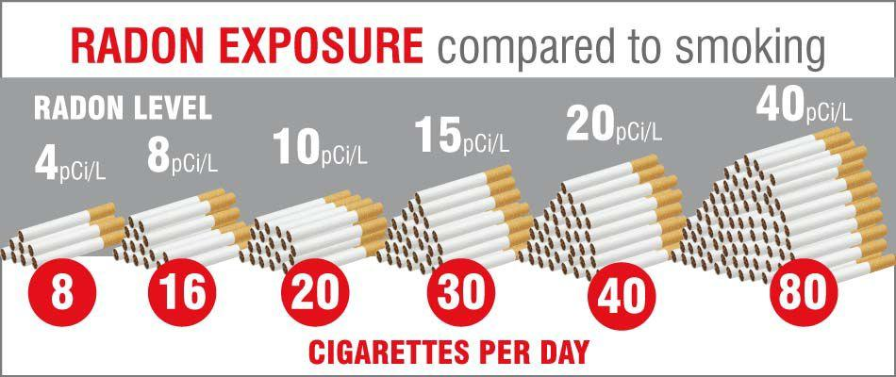
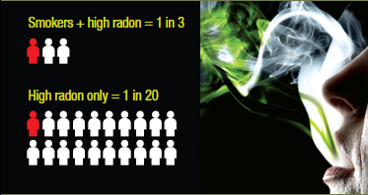
THE OXYMORON
Stop Smoking Promotion Program for any work personnel.
Radon mitigators should not be smoking!
Considering the fact there is a synergistic effect on persons who are exposed to radon and who also smoke.
https://web.uvic.ca/~ssrl01/CAREXtemp/Miss%20Radon.pdf
2019 International Radon Symposium Denver, Colorado
T
AARS

Slide 14
Health & Safety Program: Just a simple guidance overview
Radon Testing Program for all work personnel homes .
Backdraft concerns initial conditions before work begins and after mitigation system is activated.
Protection of all occupants and pedestrians from the workspace activities. Even more important for commercial, daycare, and school projects. (May include containment, dust control, VOC/odor controls)
And now we can talk about PPE, which is only part of a workers’ health & safety plan/program
2019 International Radon Symposium Denver, Colorado
T
AARS

Slide 15
PPE For Radon Mitigators from an OSHA View
Employers must protect employees:
Assess the workplace
Eliminate and reduce the hazards found using engineering and administrative controls
Then use appropriate personal protective equipment
Remember, Personal Protective Equipment is the last level of control.
2019 International Radon Symposium Denver, Colorado
T
AARS

Slide 16
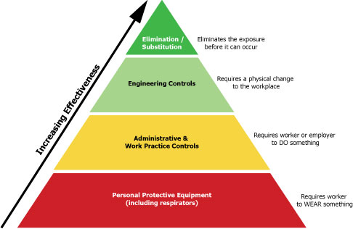
Hierarchy Logistics of Controls for Worker Safety/Protection
Use Priority
2019 International Radon Symposium Denver, Colorado
T
AARS

Slide 17
Responsibilities
The employer is required to:
Perform hazard assessment
Provide appropriate PPE
Train employees
Maintain/replace PPE
Review/update/evaluate PPE/Health & Safety Program
2019 International Radon Symposium Denver, Colorado
T
AARS
Notes:
Source: Personal Protective Equipment (2004), OSHA 3151-12R, https://www.osha.gov/Publications/osha3151.pdf
“To ensure the greatest possible protection for employees in the workplace, the cooperative efforts of both employers and employees will help in establishing and maintaining a safe and healthful work environment.
In general, employers are responsible for:
Performing a “hazard assessment” of the workplace to identify and control physical and health hazards.
Identifying and providing appropriate PPE for employees.
Training employees in the use and care of the PPE.
Maintaining PPE, including replacing worn or damaged PPE.
Periodically reviewing, updating and evaluating the effectiveness of the PPE program.”

Slide 18
Responsibilities
$
The employer is required to pay for PPE used to comply with OSHA standards
Examples
Metatarsal foot protection
Rubber boots with steel toes
Non-prescription eye protection
Prescription eyewear inserts/lenses for full face respirators
Goggles and face shields
Fire fighting PPE
Hard hats
Hearing protection
Welding PPE
2019 International Radon Symposium Denver, Colorado
T
AARS
Notes:
Source: Employers Must Provide and Pay for PPE, OSHA Outreach Training Handout, https://www.osha.gov/dte/outreach/intro_osha/7_employee_ppe.pdf
“On May 15, 2008, a new OSHA rule about employer payment for PPE went into effect. With few exceptions, OSHA now requires employers to pay for personal protective equipment used to comply with OSHA standards. The final rule does not create new requirements regarding what PPE employers must provide.
The standard makes clear that employers cannot require workers to provide their own PPE and the worker’s use of PPE they already own must be completely voluntary. Even when a worker provides his or her own PPE, the employer must ensure that the equipment is adequate to protect the worker from hazards at the workplace.
Examples of PPE that Employers Must Pay for Include:
Metatarsal foot protection
Rubber boots with steel toes
Non-prescription eye protection
Prescription eyewear inserts/lenses for full face respirators
Goggles and face shields
Fire fighting PPE (helmet, gloves, boots, proximity suits, full gear)
Hard hats
Hearing protection
Welding PPE”

Slide 19
Responsibilities
The employee is required to:
Properly wear PPE
Attend PPE training
Care for, clean, and maintain PPE
Inform supervisor of needs for repair/replacement
Source: OSHA
2019 International Radon Symposium Denver, Colorado
T
AARS
Notes:
Source: Personal Protective Equipment (2004), OSHA 3151-12R, https://www.osha.gov/Publications/osha3151.pdf
“In general, employees should:
Properly wear PPE,
Attend training sessions on PPE,
Care for, clean and maintain PPE, and
Inform a supervisor of the need to repair or replace PPE.”

Slide 20
Types of PPE
Head protection: Hard Hats
Frequent causes of head injuries
Falling objects from above striking on the head;
Bump head against fixed objects, such as exposed pipes or beams; or
Accidental head contact with electrical hazards.
Source: OSHA
2019 International Radon Symposium Denver, Colorado
T
AARS
Notes:
“Wearing a safety helmet or hard hat is one of the easiest ways to protect an employee's head from injury. Hard hats can protect employees from impact and penetration hazards as well as from electrical shock and burn hazards. Employers must ensure that their employees wear head protection if any of the following apply:
Objects might fall from above and strike them on the head;
They might bump their heads against fixed objects, such as exposed pipes or beams; or
There is a possibility of accidental head contact with electrical hazards.” (OSHA Publication 3151-12R, 2003)

Slide 21
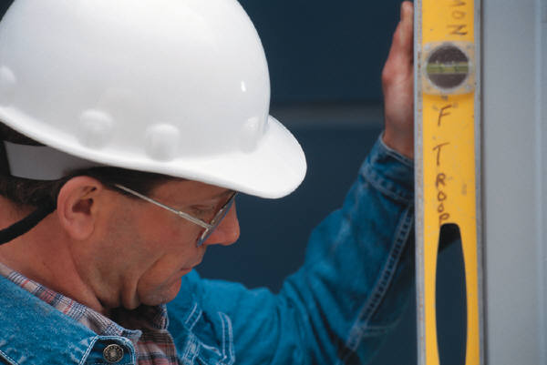
Types of PPE: Hard Hat
ANSI Z89.1-2014
Type I: provides protection from objects fall directly on top of the helmet, but not from objects that strike the side, front, or back of the head.
Type II: provides protection from strikes to the top of the head and also provides protection from blows to the sides, front, and back of the head. More suitable for workers who are not always in a standing position
Hard hats have generally a 5 year life usage.
Key: is cleaning and maintaining the hart hat, including the head suspension support straps.
Source of photos: OSHA
2019 International Radon Symposium Denver, Colorado
T
AARS

Slide 22
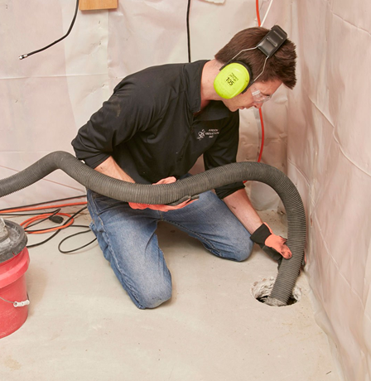
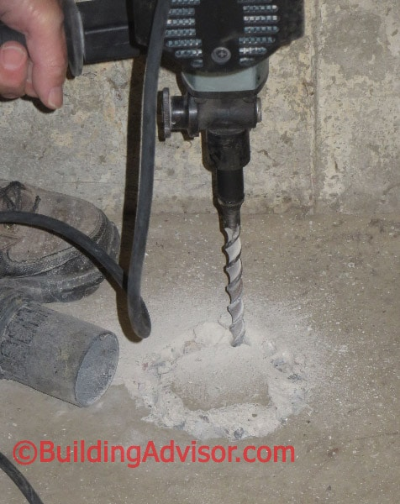
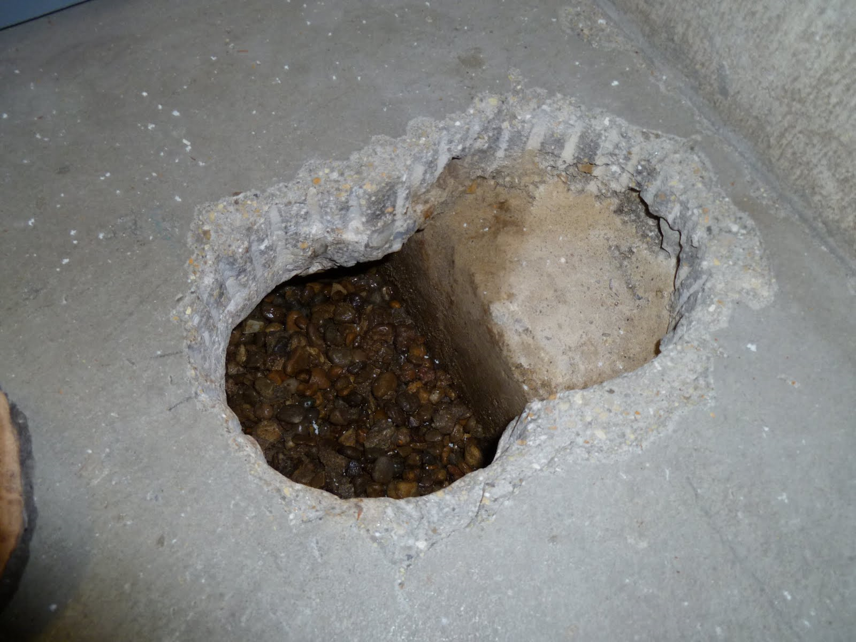
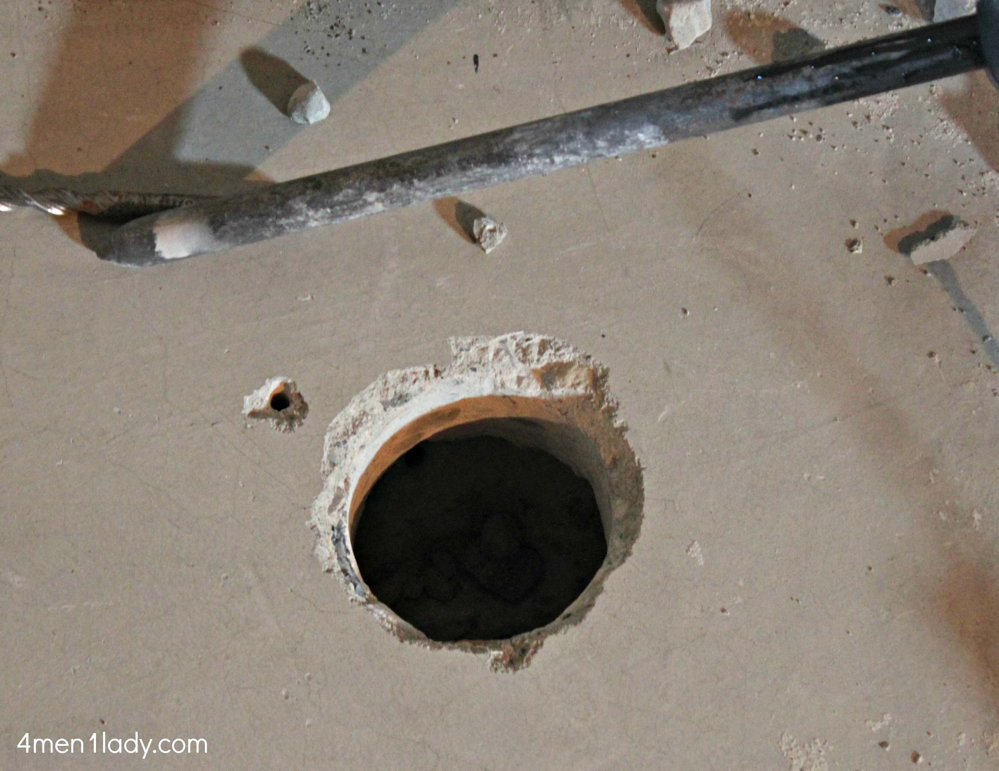
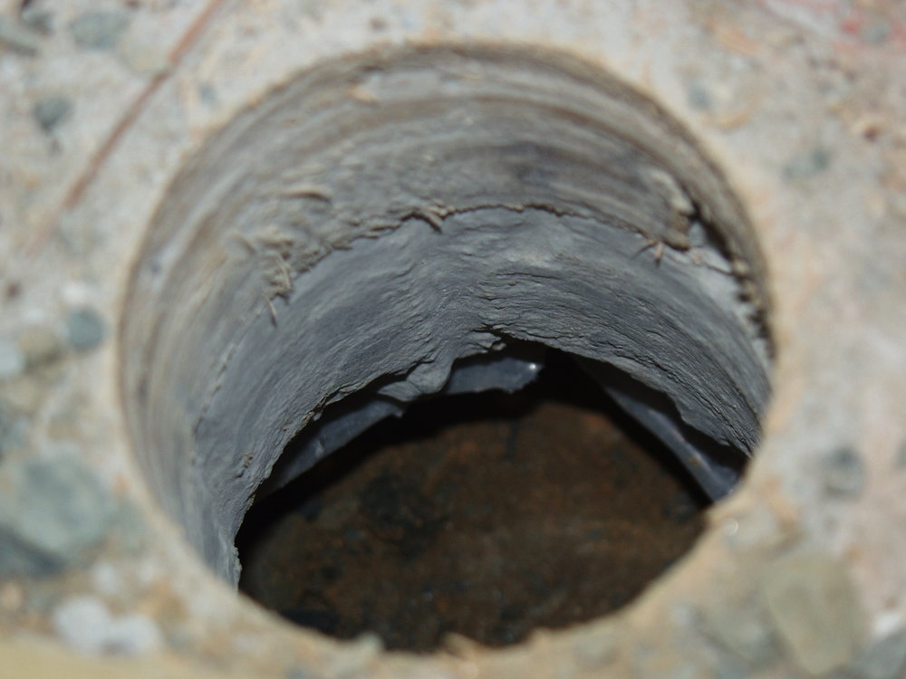
Radon Mitigators IAQ Risk Exposures

Slide 23
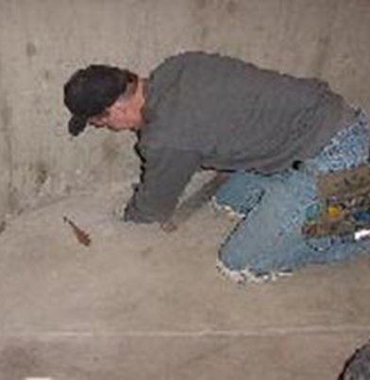
Radon Mitigators IAQ Risk Exposures
Radon mitigators have the potential to be exposed repeatedly to elevated radon levels, even though for short periods of time
Especially at the suction pit hole activities and diagnostics
Exposure through drilling/coring the suction holes to generation of airborne concrete silica dusts/particulates. Can cause silicosis (Separate OSHA regulations)
When working, inhalation rates can increase, along with the potential of bloodstream gas absorption
2019 International Radon Symposium Denver, Colorado
T
AARS

Slide 24
When Should Radon Mitigation Professionals/Workers Use Respiratory Protection? HARD QUESTIONS
If radon is the second leading cause of lung cancer deaths, shouldn’t radon professionals be just as concerned in reducing their risks and saving their own lives?
Quantified dose exposure and dose models are basically undefined for radon mitigators? No ongoing aggressive research?
What about the radon mitigator who smokes?
What about beards and facial hair and the use of respirators?
Radon diagnostics can increase radon levels in workplace. What should be done from an ALARA view?
Is mitigating a house at 6.0 pCi/L just as much a concern as a house with 50.0 pCi/L.
Do we really take ALARA seriously for this industry?
Do most radon mitigation professionals have a written OSHA compliant respirator program with a proper medical exam?
Were you aware that under exertion and increased respiration, while performing mitigation work actions, that inhalation blood gas absorption can occur, including radon gas?
Should there not be a national organized estimated dose tracking database for radon mitigators as a forward looking study. A challenge to AARST?
2019 International Radon Symposium Denver, Colorado
T
AARS

Slide 25
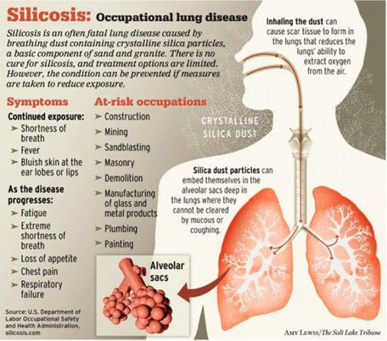
Inhaling Silica Dust Exposure
Inhaling concrete dust is a potential IAQ risk exposure to radon mitigation workers.
Engineering controls and PPE is needed to reduce this hazard.
It is and OSHA regulation that impacts radon mitigators.
Every radon mitigator should understand and meet the requirements of the OSHA silica regulations.
2019 International Radon Symposium Denver, Colorado
T
AARS

Slide 26
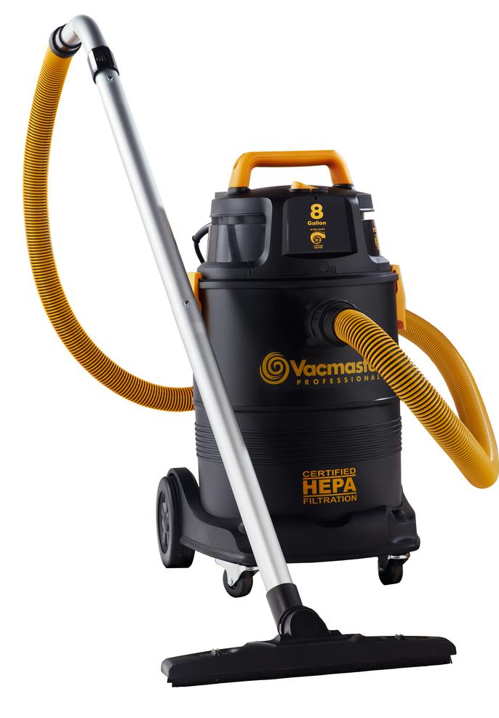
Worker Risk Reduction Best Practice
Every radon mitigator should have an adequate ventilation fan and ducting for ventilating the workspace.
Use of point source capture/control of concrete dust (silica) generation HEPA vac.
Use of respiratory protection, last action
2019 International Radon Symposium Denver, Colorado
T
AARS

Slide 27
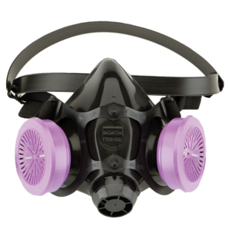
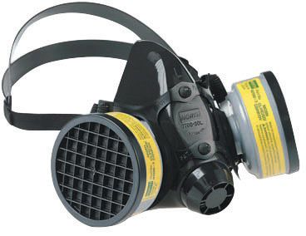
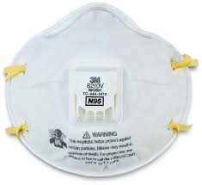
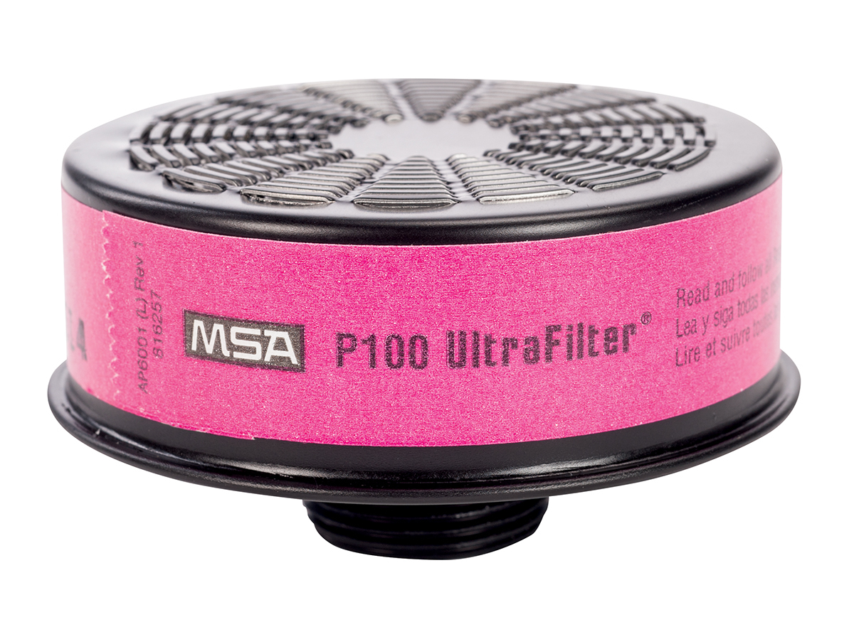
Types of PPE: Respirators
T
AARS
2019 International Radon Symposium Denver, Colorado

Slide 28
Old Document: Good Reading, but dated
EPA Radon Mitigation Employee Health & Safety: A Student Manual
(171-R-92-001 1992
Written with the purview of OSHA, NIOSH, MURC regional training center, and some radon mitigation and radon scientist stakeholders
Has not been updated since. 100 pCi/L was recommended for respiratory protection.
Can review at the EPA NSCEP/NEPIS PUBLICATIONS
NSCEP= National Service Center for Environmental Publications
NEPIS=National Environmental Publications Internet Site (See URL reference below)
https://nepis.epa.gov/Exe/ZyPDF.cgi/20006B8T.PDF?Dockey=20006B8T.PDF
2019 International Radon Symposium Denver, Colorado
T
AARS

Slide 29
Excerpt: Radon Mitigation Employee Health and Safety
“However, the use of respirators in radon mitigation work is no substitute for ventilating the workspace and other proper work practices. The first thing that you should do on entering the basement or crawl space, unless there is friable asbestos containing material ---- is to set up ventilation equipment and pressurize the space with outside air to ensure worker exposure is as low as reasonably achievable.” (ALARA)
2019 International Radon Symposium Denver, Colorado
T
AARS

Slide 30
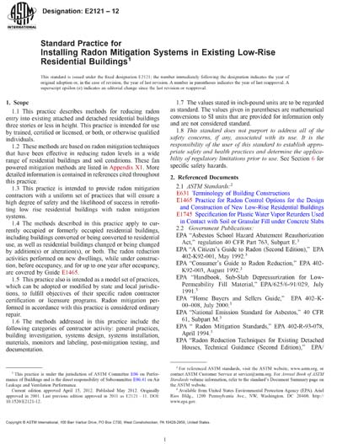
ASTM E-2121
6.2.6 Where ventilation cannot reduce radon levels to less than 0.3 WL, contractors shall provide the respiratory protection that is required to comply with 6.2.4. When unable to make working level measurements, a radon concentration of 30 pCi/L (1 100 Bq/m3) shall be used in lieu of 0.3 WL. The contractor should provide respiratory protection that conforms with NIOSH “Guide to Industrial Respiratory Protection,” and the OSHA “Respiratory Protection Standard,” which covers ﬁt tests for employees and other items related to respirators.
2019 International Radon Symposium Denver, Colorado
T
AARS

Slide 31
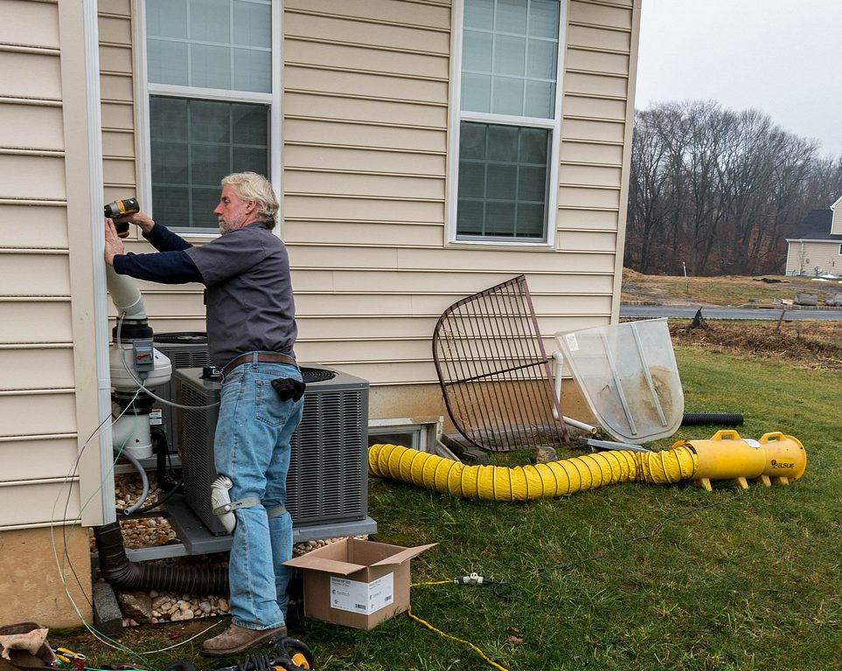
REMEMBER! PPE IS THE LAST LINE OF DEFENSE!
Engineering controls before PPE
Before you put on a respirator, ventilate the basement or slab-on-grade work site first.
Ensure ventilation does not backdraft the home.
Be aware that respirators with HEPA filter cartridges can stop in-air radon decay products
Be aware that respirators with HEPA filter cartridges do not prevent or stop the inhalation of radon gas.
http://www.wpb-radon.com/Highest_PA_radon.html
2019 International Radon Symposium Denver, Colorado
T
AARS

Slide 32
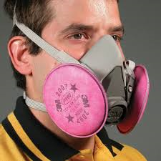
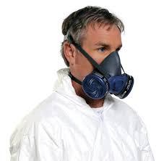
Type of PPE: Half-face Respirator with HEPA filtration
Key Points:
Requires a medical exam by a qualified medical person for worker to wear a respirator, meeting OSHA requirements.
Requires at a minimum a qualitative fit test, even for a N-95 respirator
Facial hair cannot block seal components of respirator
Person/firm administering the fit test must be qualified and follow OSHA regulations/scope.
Training must be provided to workers on use, limitations, safety, and maintenance.
A written OSHA respirator program meeting OSHA requirements (Employer requirement).
There must be proper maintenance, cleaning, and inspection of each worker’s respirator
2019 International Radon Symposium Denver, Colorado
T
AARS

Slide 33
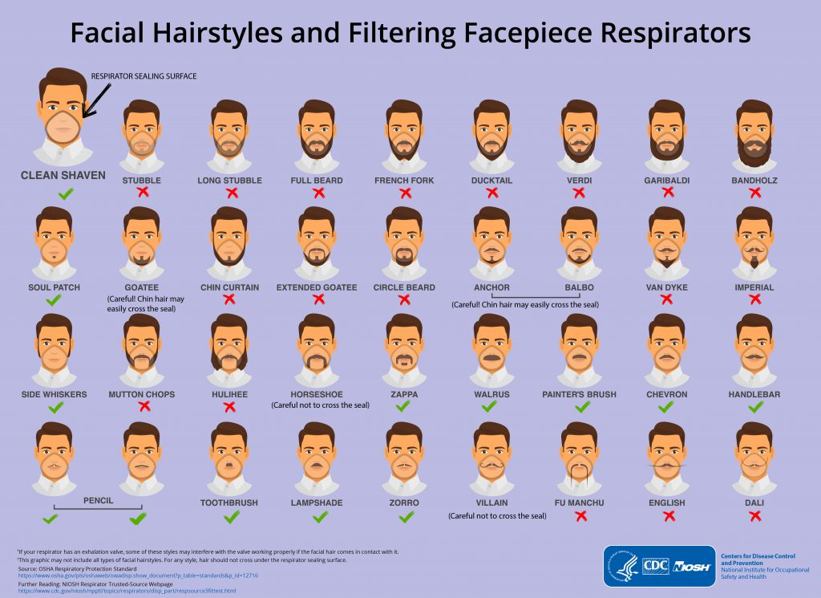
Beards and Respirators: Facing Reality, if You Wear A Respirator: You May Need To Shave
Remember why you are donning a respirator!
https://blogs.cdc.gov/niosh-science-blog/2017/11/02/noshave/
2019 International Radon Symposium Denver, Colorado
T
AARS

Slide 34
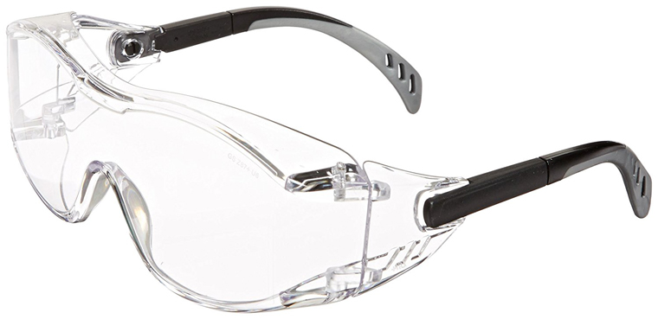
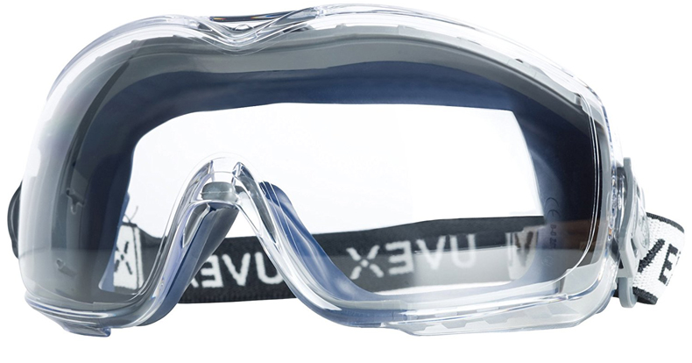
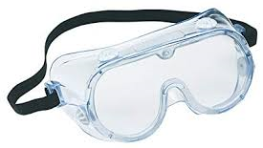
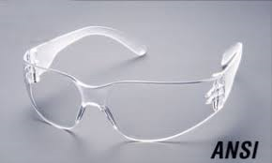
Types of PPE: Eye Protection (Safety Glasses and Googles
Protect eyes against object impact and also from harmful liquid impact (primers and glues)
2019 International Radon Symposium Denver, Colorado
T
AARS

Slide 35
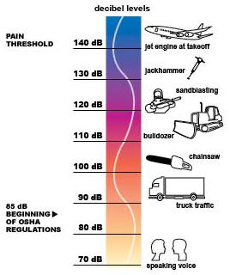
Types of PPE: Hearing Protection
Exposure to noise levels over 85 dB can cause hearing loss
Hearing protection required at 90 dB
Implement effective Hearing Conservation Program
Source: OSHA
2019 International Radon Symposium Denver, Colorado
T
AARS
Notes:
https://www.osha.gov/dts/osta/otm/noise/index.html
“Noise, or unwanted sound, is one of the most common health problems in American workplaces. The National Institute for Occupational Safety and Health (NIOSH) estimates that 30 million workers in the U.S. are exposed to hazardous noise. Exposure to high levels of noise may cause hearing loss, create physical and psychological stress, reduce productivity, interfere with communication, and contribute to accidents and injuries by making it difficult to hear warning signals.
OSHA requires employers to determine if workers are exposed to excessive noise in the workplace. If so, the employers must implement feasible engineering or administrative controls to eliminate or reduce hazardous levels of noise. Where controls are not sufficient, employers must implement an effective hearing conservation program.” (OSHA Noise and Hearing Conservation eTool, 2005)

Slide 36
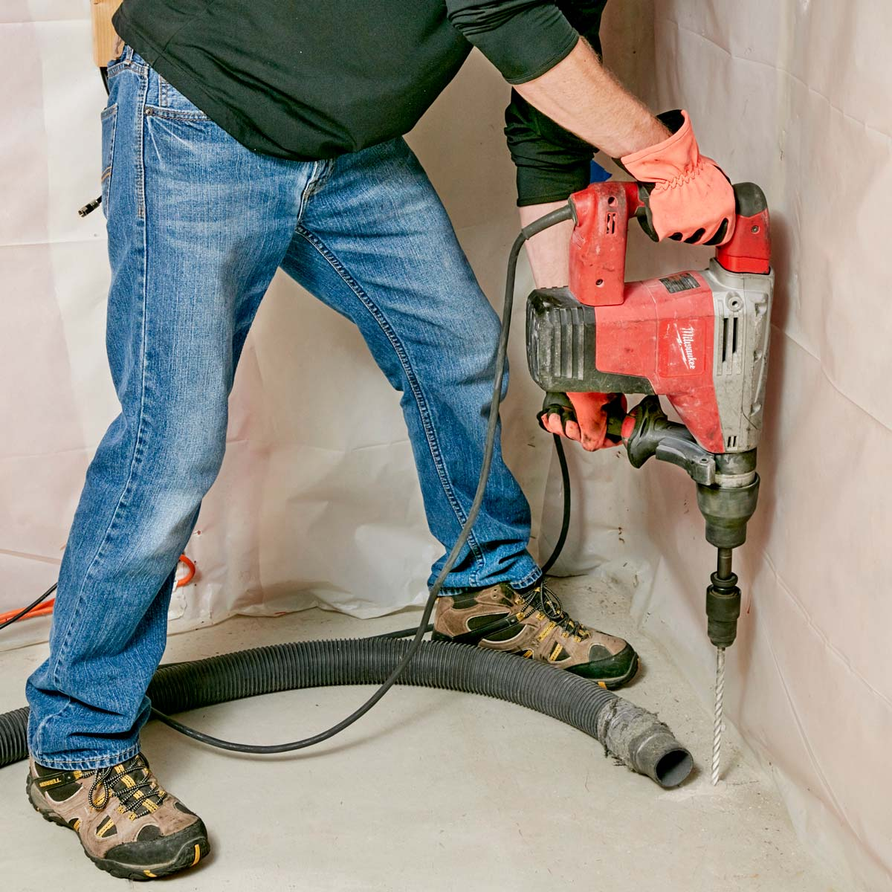
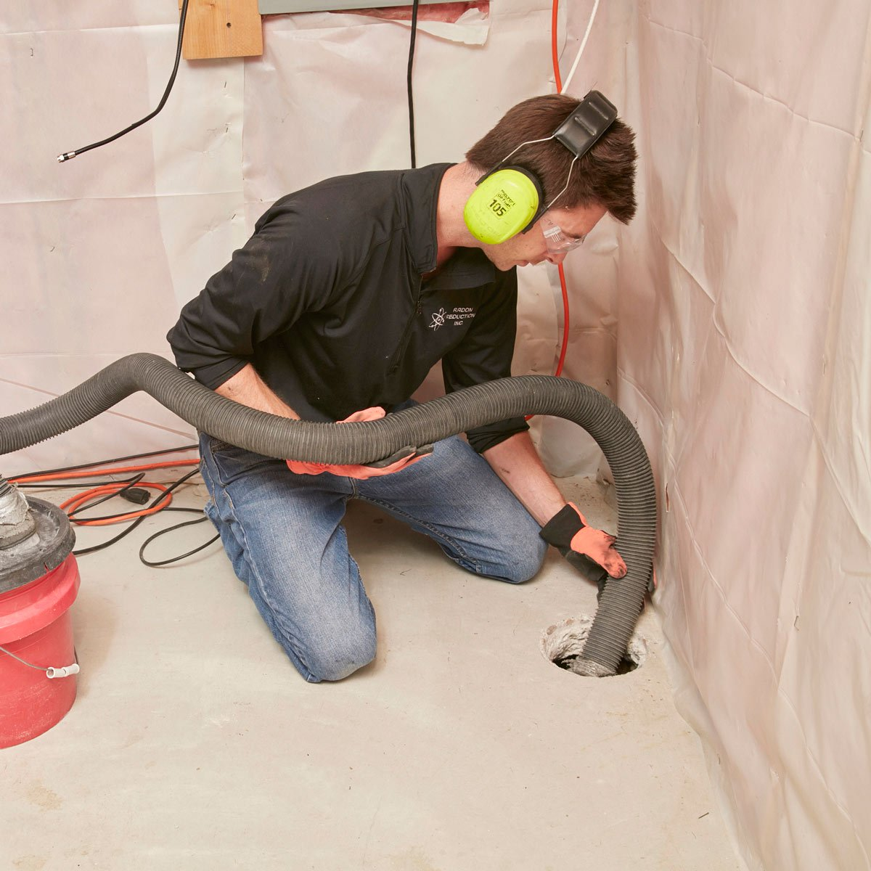
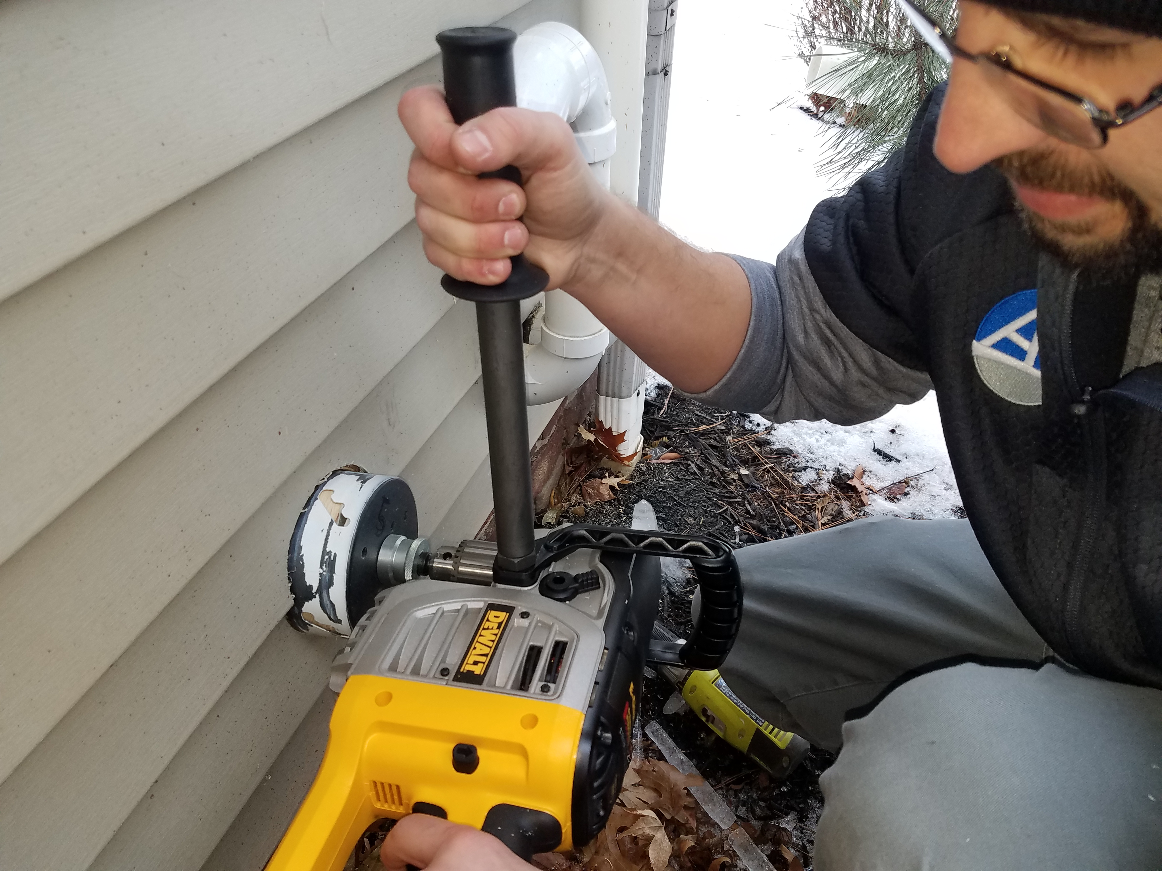
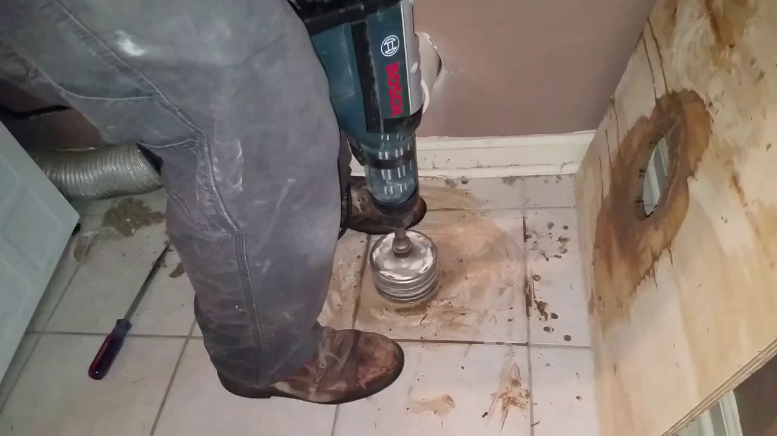
Mitigation activities noise generation can be in range 80-110 decibels or more
2019 International Radon Symposium Denver, Colorado
T
AARS

Slide 37
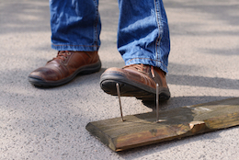
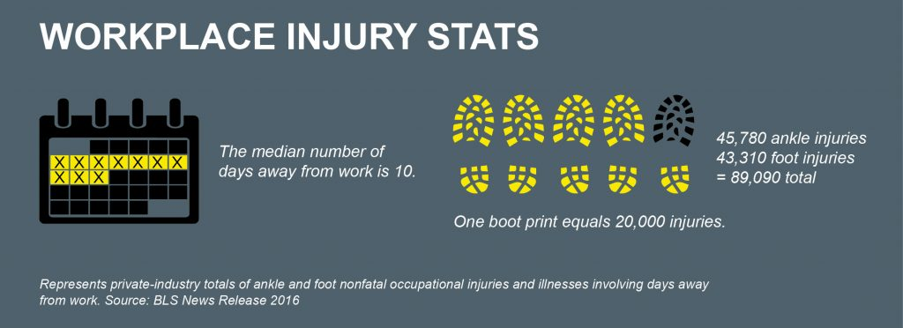
Type of PPE: Foot Protection: THINK ABOUT IT!
Ever drop a rotor hammer on your foot?
Have a schedule 40 PVC pipe hit your foot?
Something fall/drop unexpectantly and hit your foot?
How many workers wear tennis shoes?
Step on a nail?
2019 International Radon Symposium Denver, Colorado
T
AARS

Slide 38
Protect the Knees
Type of PPE: Knee Protection
Speaking from experience: You need to protect the knees
http://blog.radonkc.com/2015/05/radon-mitigation-saves-lives.html
2019 International Radon Symposium Denver, Colorado
T
AARS
Protecting the knees in a crawl space with knee pads

Slide 39
Crawl Space Protection
https://www.doityourself.com/stry/how-to-install-a-crawl-space-vapor-barrier
http://www.ashireporter.org/HomeInspection/Articles/Crawl-Space-Inspections-Practical-Information-and-Tips-for-Inspections/15185
2019 International Radon Symposium Denver, Colorado
T
AARS

Slide 40
Crawl Space Protection Recommendation
Assessment of confined space with proper OSHA safety considerations
Minimum: Use of at least a N-95 respirator for workers to protect against mold, dust, and other airborne particulates
Consideration of using a disposable Tyvek suits. (Relatively economical-Protects clothes from potential mold and other contamination)
Wear knee pads, protective gloves and eye protection
Hard hat consideration
OSHA confined space safety practices
Serious concern for 1-person mitigation
2019 International Radon Symposium Denver, Colorado
T
AARS

Slide 41
Presence of Asbestos on Property: Crawl Space
2019 International Radon Symposium Denver, Colorado
T
AARS

Slide 42
Presence of Asbestos in the Basement (Mainly pre-1982)
2019 International Radon Symposium Denver, Colorado
T
AARS

Slide 43
Presence of Asbestos: Vermiculite Attic Insulation
Vermiculite Attic Insulation (VAI) is considered “assumed ACM by EPA.
2019 International Radon Symposium Denver, Colorado
T
AARS

Slide 44
Are you aware of EPA RRP Lead-base Paint Regulations?
If you are going to disturb more 6 square feet of interior painted surface in a pre 1978 house, you must follow RRP Regulations for lead-base paint.
If you are going to disturb more 20 square feet of exterior painted surfaces, you must follow RRP Regulations for lead-base paint.
You must then be RRP certified by EPA.
Violations: $37,500 fine per violation
If you were to seal a pre-1978 painted basement wall or removed 6 sq. ft. of sheetrock, then under EPA RRP rule.
2019 International Radon Symposium Denver, Colorado
T
AARS

Slide 45
CONCLUDING THOUGHTS
The radon mitigation industry needs to focus and implement proper PPE and health and safety.
ALARA should be the spine of any PPE and health safety program.
Strongly recommended that mitigation workers take the OSHA 10-hr construction health and safety training with accreditation. Many projects require this training. This training is very economical. Could reduce your insurance premium.
Radon diagnostics should incorporate appropriate ALARA engineering controls
All radon mitigation firms should have basic PPE, including head, eye and foot protection.
All radon mitigation firms should have a written and implemented respirator program for their workers, even for N-95 masks. Ventilate workspace, then respiratory protection.
Mitigation firms must meet the OSHA silica regulations (monitoring, controls).
Crawl spaces should be carefully reviewed for hazard recognition (asbestos, etc.)
AARST should consider a national mitigator estimated dose database, setup with proper controls. THIS IS A FORWARD-LOOKING AND PREVENTATIVE ACTION FROM AN EPIDEMOLOGICAL VIEW.
T
AARS
2019 International Radon Symposium Denver, Colorado

Slide 46
Radon Professionals Must Do PPE!
https://otfacilitiessuppliesteam.co.uk/blog/work-safe-with-ppe-infographic/
Thank You! If you want more information on PPE for the radon industry, please contact me. I will be glad to assist.
Nathaniel L. Burden, Jr. nateburden@msn.com
2019 International Radon Symposium Denver, Colorado
T
AARS

