Slide 1
RADON DECAY PRODUCTS: PARTICLE SIZE REALLY MATTERS…OR DOES IT?
Lisa Gregory, PhD
AARST Symposium
September 10, 2019
2019 International Radon Symposium Denver, Colorado

Slide 2
Review: What We Know and Accept
Radon-induced lung cancer is the second leading cause of lung cancer in the U.S. with over 10% of cases occurring in never-smokers.
The alpha particles emitted by radon decay products (RDPs) provide over 95% of the radiation dose to the lungs (mainly from Polonium-218 and Polonium-214).
RDPs are measured in Working Level (WL). The “not to exceed” level for indoor radiation is 0.02 WL and is codified in U.S. law.
In the 1970s, the U.S. EPA used an equation to derive its radon gas action level of 4 pCi/L from a WL 0.02 and assumed equilibrium factor (EF) of 50%. EPA maintained the 0.02 WL of RDPs in radon protocols through early 1990s.
After the radon program was privatized and due to the ease of measuring radon gas compared to its progeny, radon gas was used as a substitute for measuring RDPs and the RDP guidance was removed from radon protocols for about 20 years.
2019 International Radon Symposium Denver, Colorado

Slide 3
Review: What We Know and Accept
RDPs come from the radioactive decay (“breakdown”) of radon gas.
A portion of RPDs “plate-out” by attaching to solid surfaces and are not inhaled.
The other portion of RDPs stay suspended in the air and may be inhaled.
The legal action level for suspended RDPs is 0.02 WL. However, EPA guidance reduced EF to 40% (0.016 WL).
Inhaled RDPs can adhere to lung tissue and release alpha particles that can damage cells and, over years of exposure, cause cancer.
RDPs contribute at least 95% of radiation dose to the lungs (NRC, 1988; BEIR IV).
3.8 Days
Radon-222
α γ
3 Minutes
Polonium-218
α γ
28.6 Minutes
Lead-214
β γ
19.7 Minutes
Bismuth-214
β γ
0.17 Milliseconds
Polonium-214
α γ
22 Years
Lead-210
2019 International Radon Symposium Denver, Colorado
Notes:
Note that RDPs do breakdown a bit more. Takes ~22 years from Lead 210 to become Bismuth 210. It takes 5 days for Bismuth 210 to become Polonium 210. It takes 138 days for Polonium 210 to become lead 206 which is stable. These times come from the EPA so we should use them in all future cases. https://www.epa.gov/sites/production/files/2018-12/documents/radon-22-decay-chain.pdf
Say over 95% of lung damage comes from RDPs. This comes from the BEIR IV paper.

Slide 4
Problems Discovered
Radon gas levels do not measure alpha radiation, exposure, or potential dose and can be misleading when the assumed EF is not 50%.
  Occupational buildings with robust HVAC often have EFs <30% because of good air quality and increased RDP plate-out due to increased air circulation. This means that these spaces can tolerate radon gas concentrations over 4 pCi/L and still not exceed the legal action level of 0.02 WL.
    Applying residential protocols to administrative and other types of occupational buildings is not appropriate, especially in spaces where ASD is not feasible.
  Homes in colder climates with active wood stoves the majority of the year may have more aerosols in the air that increase the EF over 50% because more RDPs will attach to these aerosols rather than plate-out. This also applies to any home with poor air quality (e.g., with second hand smoke). Any environment with an EF over the assumed 50% will exceed the legal action level of 0.02 WL when a radon test is below 4.0 pCi/L (e.g., (3.6 pCi/L * 0.7 EF)/100 = 0.0252 WL of alpha radiation).
2019 International Radon Symposium Denver, Colorado

Slide 5
Problems Discovered
The removal of RDP WL measurements from radon guidance for such a long period of time has had negative impacts.
  Reduced demand for WL measurements has stagnated RDP measurement technology in the U.S.
  Removal of WL information has increased ignorance of RDPs among the layperson and even some radon professionals.
  The focus on performing only radon gas measurements without radiation exposure data from WL measurements reduces predictive power of epidemiological studies and other studies focused on determining lung cancer risks due to radon progeny.
Desire to simplify the message and have a single radon gas action level for all cases may have seemed like a good idea and certainly sparked great innovation in the field of radon detection and mitigation. However, it is not the best solution if you want to be accurate, to know your radiation exposure and potential dose, and to save lives in a cost-effective manner. Only an RDP action level can do this.
2019 International Radon Symposium Denver, Colorado

Slide 6
Problems Discovered
Source reduction of radon gas is preferable, when feasible. Many radon issues can be fixed by simple HVAC investigation/alteration. However, the legal RDP action level should be re-instated so that owners of large occupational buildings where EFs are below 40% can be free to choose direct RDP mitigation (e.g., increasing air circulation) measurements when radon mitigation is not feasible.
A potential conflict of interest exists within the radon industry because wide-spread knowledge of how easy it is to maintain alpha radiation levels under 0.02 WL in the presence of radon gas levels between 4 and 10 pCi/L would reduce demand for more expensive radon mitigation techniques.
A literature review has uncovered inconsistencies in RDP information that have led to misinformation among radon professional and policy makers.
Objectives of this presentation:
  Point out inconsistencies among RDP literature, especially related to particle size.
  Address misconceptions about RDPs
2019 International Radon Symposium Denver, Colorado

Slide 7
“Unattached” and “Attached” RDPs
“Unattached” and “Attached” fraction terminology originated in a paper by Chamberlain and Dyson (1956). Inconsistent size description associated with these terms is common.
Publication Author | Publication Year | Unattached Fraction Size (nm) | Attached Fraction Size (nm)
Li et al. | 1998 | 0.5-5 | NA
Kontrappa et al. | 2003 | NA | ≤ 500
Gou et al. | 2012 | <5 | >5
ICRP | 2015 | ~1 | 10-1000
Trassierra et al. | 2016 | 0.5-1 | NA
Ramola et al. | 2016 | ~2 | ~150
Khalaf et al. | 2019 | 1-10 | 10-1000
Note: Unattached Fraction (UF) is the number of “Unattached” RDPs over the total number of RDPs emanating from radon gas present during measurement.
It is a proportion.
2019 International Radon Symposium Denver, Colorado
Notes:
Note that the ranges are because these fractions and aerosols obviously appear in a range of sizes. However, these different papers just seem to pick and choose the size ranges or exact sizes that they want. Even the different ranges are not super consistent.
“X” just means the paper failed to mention a size range for that particular fraction.
“~” means around or approximately

Slide 8
Unattached and Attached Fraction Formation
“Attached”RDPs
(>10 nm)
New ²¹⁸Po
(~0.3 nm)
“Unattached”
RDP cluster (~1 nm)
Radon Gas
Aerosol Attachment
(<100 seconds)
Cluster Formation
<1 second!
Decay
Going from “Unattached” to “Attached” takes
1-100 seconds!
Coarse
(>500 nm)
All ²¹⁴Po are in the Attached Fraction!
2019 International Radon Symposium Denver, Colorado

Slide 9
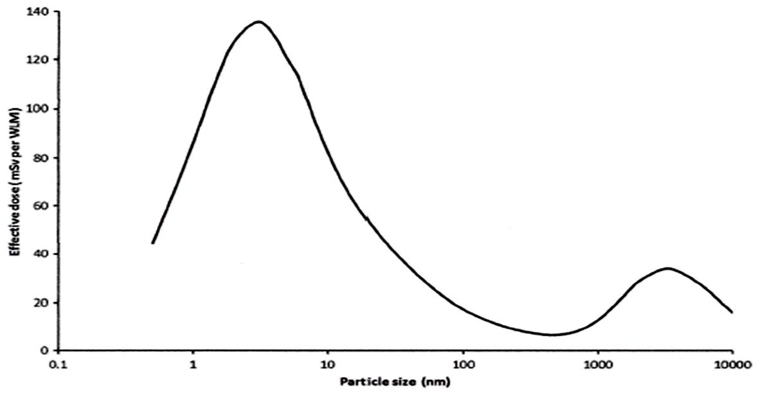
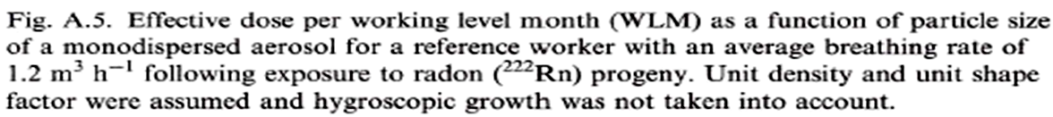
Problems with Dose Models
“Fig. A.5. Effective dose per working level month (WLM) as a function of particle size of a monodispersed aerosol for a reference worker with an average breathing rate of 1.2 m3h-1 following exposure to radon (222Rn) progeny. Unit density and unit shape factor were assumed and hygroscopic growth was not taken into account.”
ICRP, 2017. Annex A. Aerosol data and dose coefficients for radon progeny.
MODEL ASSUMPTIONS DO NOT DESCRIBE REALITY!
The air we breath is made up of particles with many different shapes and sizes!
The model assumes particle density and shape. A round shape is used but larger particles with RDPs are irregular shaped!
Water molecules have an enormous effect on particle size, shape, and chemical composition/reactivity!
2019 International Radon Symposium Denver, Colorado
Notes:
Note that the ranges are because these fractions and aerosols obviously appear in a range of sizes. However, these different papers just seem to pick and choose the size ranges or exact sizes that they want. Even the different ranges are not super consistent.
“X” just means the paper failed to mention a size range for that particular fraction.
“~” means around or approximately

Slide 10
Misinterpretation of Data:
Leads to Misconceptions and False Conclusions
Some radon professionals (and scientists) either ignore lung model assumptions or do not know about them, misinterpret the data, and spread information that has no basis in reality.
“In addition, it is well known and accepted that unattached RDPs have a 20–30 times greater efficiency in delivering a dose to lung tissue. Therefore, any increase in unattached RDP concentration, no matter how small, in the breathing zone would significantly increase the dose to lung tissue.”
False
  The dosage graph based on a lung model tells you nothing about which sized RDPs actually make it to the lungs after one inspires a volume of normal air (w/mixed particle sizes, water vapor, etc.).
  In reality, very few unattached RDPs pass the pharyngeal region and enter the lungs.
    Newly formed RDPs (~0.3 nm) attach to gas and water molecules in under 1 second.
    “Unattached” RDPs (~0.5 – 2 nm) become “Attached” to larger aerosols in under 100 seconds.
    In a home with constant radon gas and poor air ventilation, only about 8-12% of RDPs are unattached. This percentage decreases substantially with increased air circulation due to higher rates of molecular collisions and deposition.
    Of that small fraction of unattached RDPs remaining, maybe 10% make it past the nose or mouth.
2019 International Radon Symposium Denver, Colorado
Notes:
Note that the ranges are because these fractions and aerosols obviously appear in a range of sizes. However, these different papers just seem to pick and choose the size ranges or exact sizes that they want. Even the different ranges are not super consistent.
“X” just means the paper failed to mention a size range for that particular fraction.
“~” means around or approximately

Slide 11
Misinterpretation of Data:
Leads to Misconceptions and False Conclusions
Many incorrectly equate an increase in Unattached Fraction of RDPs with an increase in dose.
  Studies show that direct mitigation of RDPs by filtration or air cleaners (w/MERV 10 or 8; no HEPA) reduce alpha radiation exposure (and potential dose).
    The Unattached Fraction may increase because more of the larger particles are being deposited onto the filter than the ultra fine (the numerator is not decreasing as fast as the denominator). However, the number of “Unattached” particles decrease even when the proportion increases.
      Cleaner air reduces potential dose due to the reduction of inhalable aerosols.
    Most importantly, the higher rate of air circulation and movement cause significant reductions in alpha radiation exposure due to increased rates of RDP plate-out.
    Once RDPs plate-out to surfaces, they are hard to take off.
      A fan does NOT detach plated RDPs.
      RDPs downstream of Polonium-218 are hard to take off of surfaces even after elaborate cleaning methods due to embedding of atoms from recoil.
2019 International Radon Symposium Denver, Colorado
Notes:
Note that the ranges are because these fractions and aerosols obviously appear in a range of sizes. However, these different papers just seem to pick and choose the size ranges or exact sizes that they want. Even the different ranges are not super consistent.
“X” just means the paper failed to mention a size range for that particular fraction.
“~” means around or approximately

Slide 12
Misconception
Reality
“…under no circumstances should HEPA systems or other methods that alter the [RDP] equilibrium be used, because their efficacy in reducing risk is uncertain” (NAVRAMP, 2017).
“There is no reasonable likelihood that the use of an air cleaner will increase the hazards from indoor radon” (Hopke, 1996).
  While air cleaners are effective in reducing other airborne contaminants, they are truly most effective when paired with increased air circulation (Hopke, 1996).
After filtration, the overall potential dose decreases due to the reduction of inhalable aerosols (Kranrod et al., 2009; Yasuoka et al., 2009; Iwaoka et al., 2013).
Case studies show coarse filters (MERV 8) having a strong effect on suspended RDP reduction, especially when paired with forced air systems (CERTI, 2018).
  Author(s) attempt to make the reader think that reductions in WL in response to increased air circulation (e.g., from a fan) is due to increased molecular collisions dislodging RDPs from “Attached” particles and increasing the “Unattached” RDPs. The author(s) states that WL measuring devices can’t measure “Unattached” RDPs.
2019 International Radon Symposium Denver, Colorado
Notes:
First figure is from Kranrod et al., 2009
Performed in the field. Case I: Air cleaner OFF. Case II: Air cleaner ON
Equilibrium factor is 0.14 for Case I and 0.4 for Case II
HEPA + carbon filter were used.
Show that aerosols were substantially reduced through air filtration.
Second figure is from Yasuoka et al., 2009
-Performed in a house. Equilibrium factor was 0.42
-Control: Air cleaner OFF; Case I: Air cleaner ON (HEPA and Carbon Filter); Case II: Air cleaner ON (HEPA only)
Third figure is from Iwaoka et al., 2013
-This was performed in a chamber. Radon conc. Did not change due to the air cleaner
-Air cleaner is a type widely used in hospitals and offices. Used a HEPA filter.
-fp is the unattached fraction and EERC shows the equivalent value of RDPs.
-Effective dose was calculated to be 0.015 mSv with Air Cleaner OFF and 0.010 mSv with Air Cleaner ON.

Slide 13
Misconception
Reality
“Because these unattached RDPs…are small enough to pass through the filter paper on the WL meter and not become trapped, the instrument would not be able to measure the emitted alpha particles” (NAVRAMP, 2017).
200 mesh wire gauze collected airborne "unattached" ²¹⁸Po with an efficiency of more than 98%, at 10 Lpm air-sampling rate through an area of 14 cm² (James et al., 1972).
While surface collection varied between some filters, the overall collection efficiency was essentially 100% in most filters (Busigin, 1980).
By changing an RDP measurement device’s mesh filter size and air flow (their H Factor), collection efficiencies can reach essentially 100% (Canoba and Lopez, 2000).
2019 International Radon Symposium Denver, Colorado
Notes:
First figure is from Busigin, 1980
Second figure is from Canoba and Lopez, 2000
Quotation from NAVRAMP, see about adding another one

Slide 14
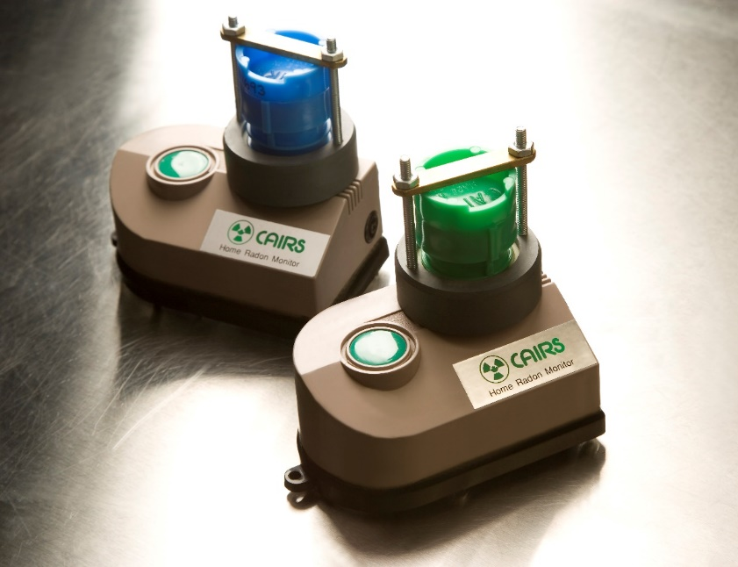
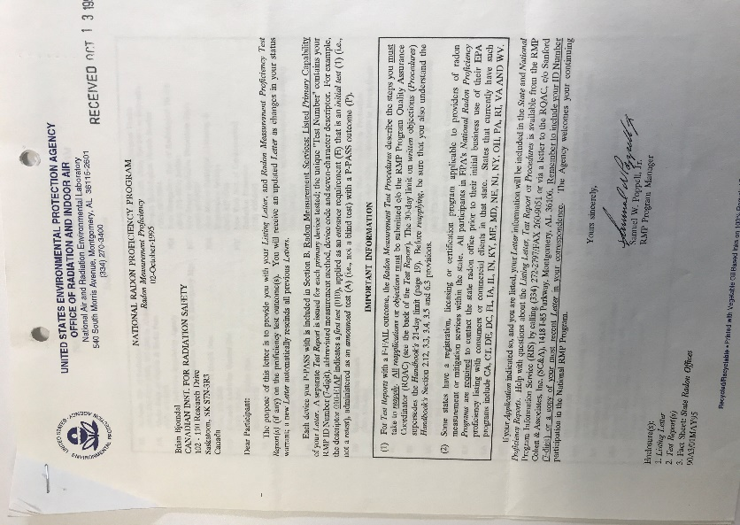
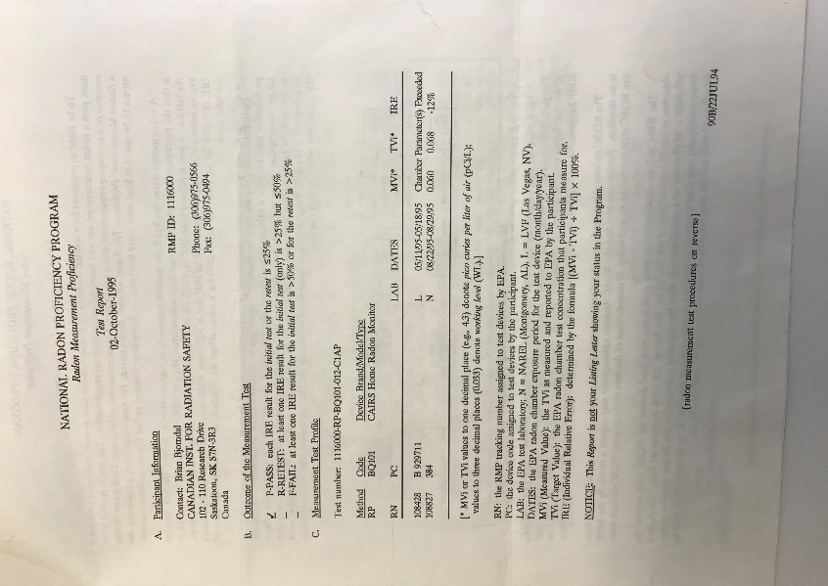
Radon Progeny Monitor
EPA Approved
2019 International Radon Symposium Denver, Colorado
Notes:
This is actually true. The misconception is that it still applies today. Nowadays RDP measurements can be done quickly and pretty cheaply as you’ll discuss.
I would like to find a source that says this misconception but I’ll have to do a bit of scrounging. The truth area will have a photo which can then lead into Brian’s slides (if we get them).
Synopsis of pricing. $70, 10% dups, 3% blanks

Slide 15
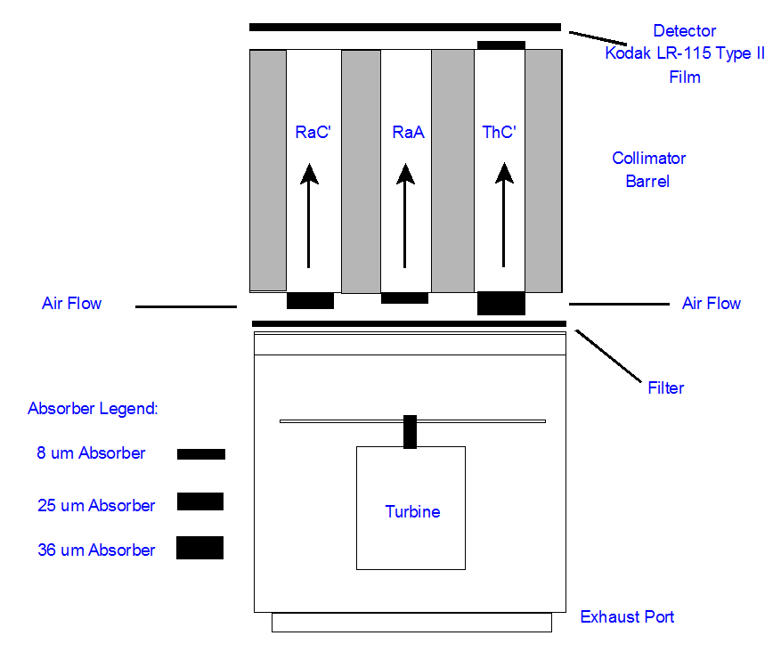
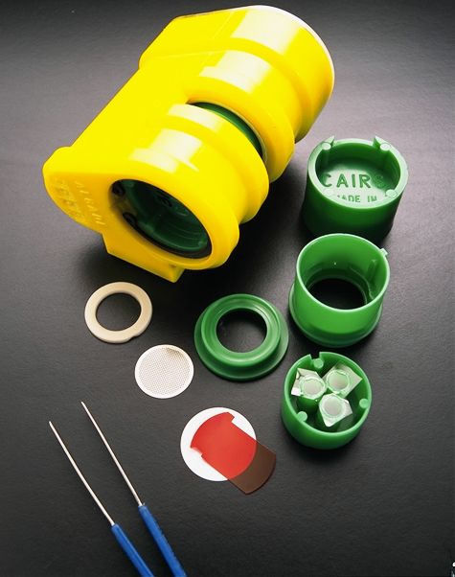
Personal Alpha Dosimeter
Developed by the French Alternative Energies and Atomic Energy Commission in the 1970s, the PAD is designed to measure:
  Radon Progeny
    ²¹⁸Po (RaA)
    ²¹⁴Po (RaC’)
  Thoron Progeny
    ²¹²Po (ThC’)
  Alpha emitting Long-Lived Radioactive Dust (LLRD)
Brian Bjorndal, MSc, PPhys, National Laboratories Radiation Safety Institute of Canada bbjorndal@radiationsafety.ca
2019 International Radon Symposium Denver, Colorado
Notes:
This is actually true. The misconception is that it still applies today. Nowadays RDP measurements can be done quickly and pretty cheaply as you’ll discuss.
I would like to find a source that says this misconception but I’ll have to do a bit of scrounging. The truth area will have a photo which can then lead into Brian’s slides (if we get them).
Synopsis of pricing. $70, 10% dups, 3% blanks

Slide 16
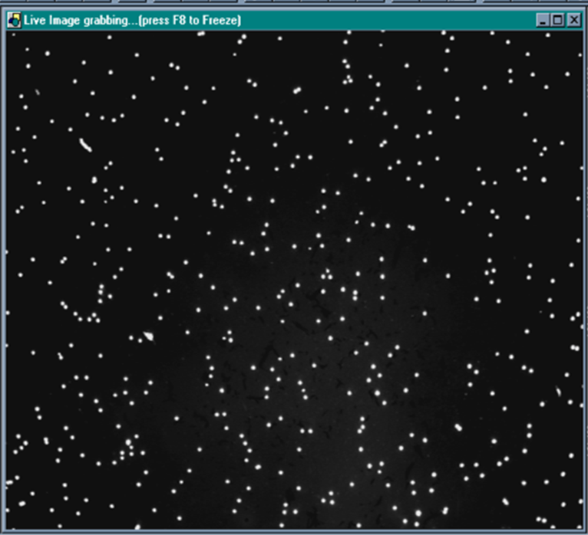
Personal Alpha Dosimeter
Screen shot through a microscope of alpha tracks on film (after processing).
Brian Bjorndal, MSc, PPhys, National Laboratories Radiation Safety Institute of Canada bbjorndal@radiationsafety.ca
2019 International Radon Symposium Denver, Colorado
Notes:
This is actually true. The misconception is that it still applies today. Nowadays RDP measurements can be done quickly and pretty cheaply as you’ll discuss.
I would like to find a source that says this misconception but I’ll have to do a bit of scrounging. The truth area will have a photo which can then lead into Brian’s slides (if we get them).
Synopsis of pricing. $70, 10% dups, 3% blanks

Slide 17
Notes and Recommendations
The radon industry needs to be very careful when it comes to discussions of RDP measurements and mitigation. Misinterpretations of data and false conclusions can appear to be self-serving.
The dose model assumptions related to the particles in the inhaled air are extreme. Dosage graphs tell us nothing about which particles are actually making it into the lungs when breathing normal air.
Scientists using dosage data need to be better at acknowledging model assumptions and refrain from discussing dosage information as if it is factual.
An analysis of the literature as well as a discussion with a world renowned particle physicist resulted in the conclusion that very few “Unattached” RDPs actually make it to the lungs.
2019 International Radon Symposium Denver, Colorado
Notes:
For RDP testing considerations, maybe discuss those short-term Canadian units that you talked to Ed Liu about. The big misconception is that RDPs measurements are difficult and expensive but clearly they can be done pretty easily and relatively cheaply in the grand scheme of things.

Slide 18
Notes and Recommendations
It is clear that there are RDP measurement devices that do a great job at capturing both “Unattached” and “Attached” RDPs and determining WL.
It is clear increased air circulation reduces WL (i.e., reduces alpha radiation exposure) by plate-out of RDPs to surfaces, which does reduce overall potential dose. Both “Unattached” and “Attached” RDPs decrease in this scenario.
For occupational spaces where EF can often be lower than 10%, a radon concentration of 4 pCi/L equates to a WL of 0.004 – extremely low alpha radiation exposure!
Radon policy makers should develop guidance for occupational buildings focused on HVAC investigation to try and reduce radon intrusion first and then more cost effective methods of RDP mitigation when EFs are low.
Radon policy makers need to bring back the legal WL action level to the forefront of the literature. Guidance should use the reduced action level of 0.016 WL to conform to the EPA’s reduced EF at 4 pCi/L.
2019 International Radon Symposium Denver, Colorado
Notes:
For RDP testing considerations, maybe discuss those short-term Canadian units that you talked to Ed Liu about. The big misconception is that RDPs measurements are difficult and expensive but clearly they can be done pretty easily and relatively cheaply in the grand scheme of things.

Slide 19
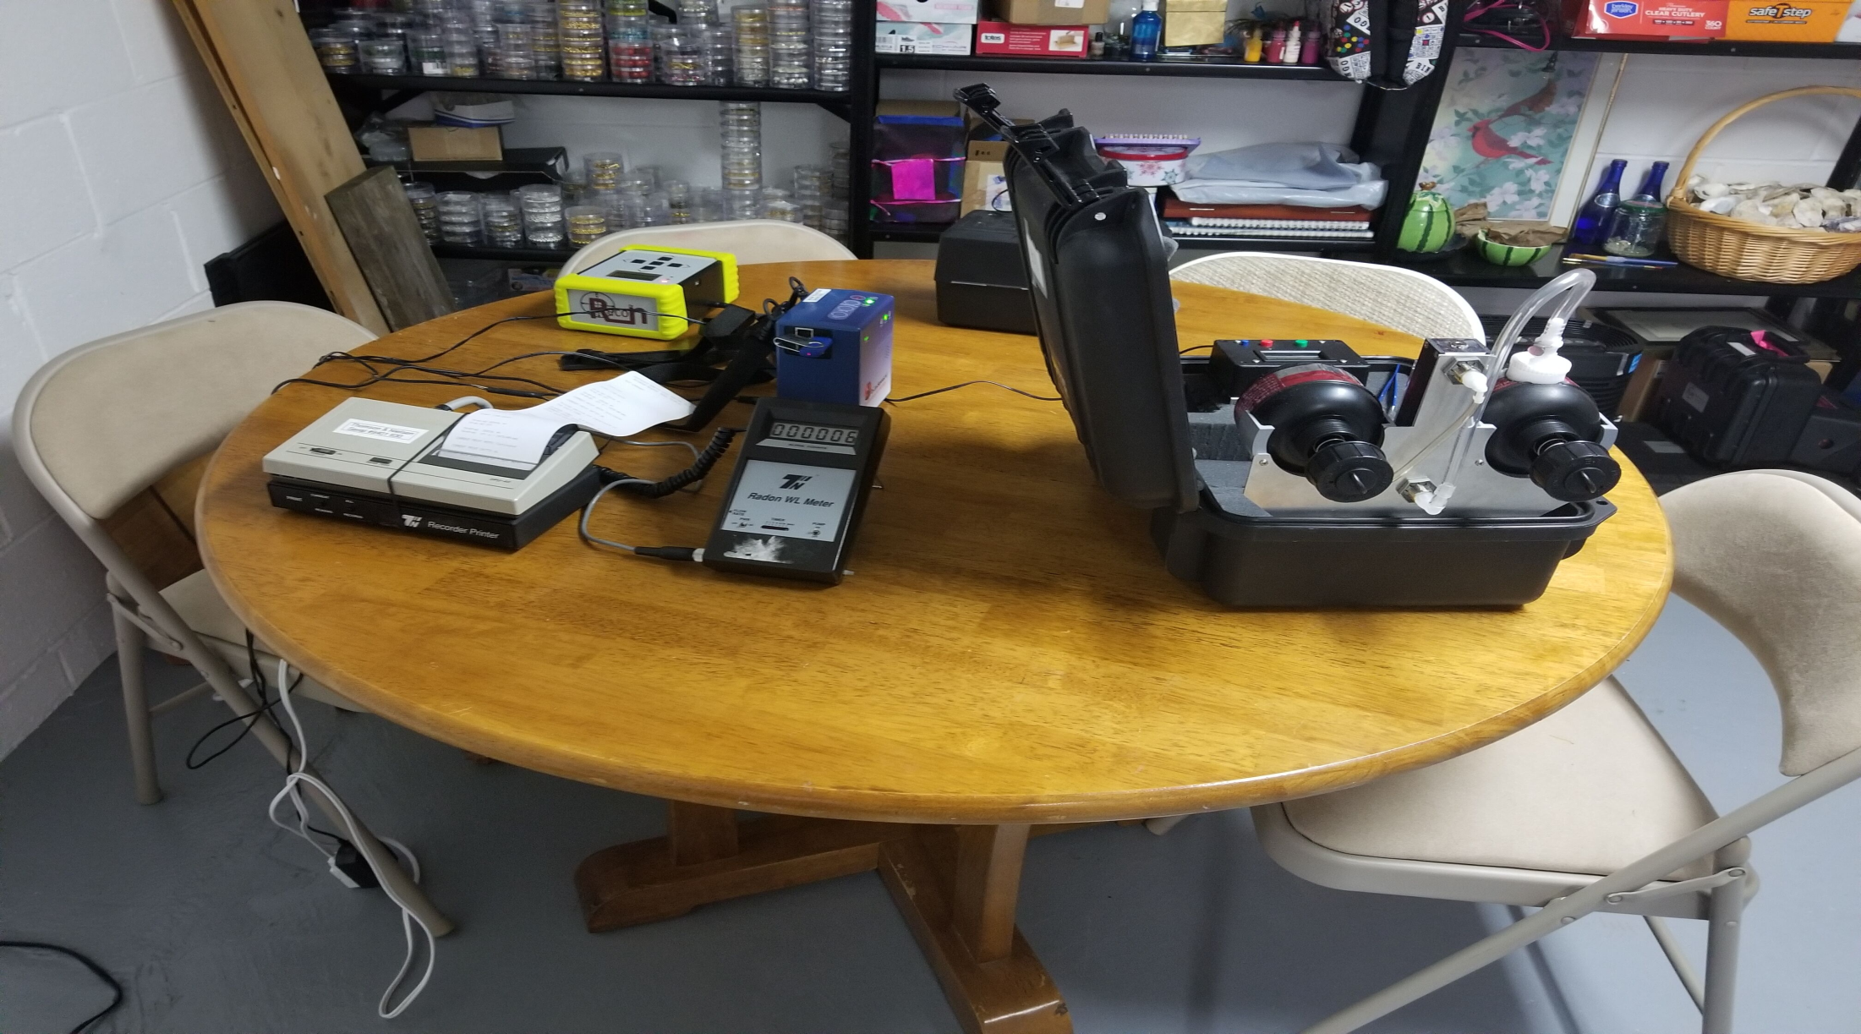
QUESTIONS???
BladeWerx EpeeCAM: Continuous RDP Monitor
Rad Elec CRM:
Continuous Radon Monitor
Rad Elec ERPISU:
Integrating RDP Monitor
Thompson Neilsen: Continuous RDP Monitor
Questions?
If you would like a copy of this presentation as well as this presentation’s reference lists, contact me at
lisaenvironmental@gmail.com
2019 International Radon Symposium Denver, Colorado
Notes:
-address inconsistencies in literature (bring out NAVRAMP quotes that show misinfo)
How are papers reaching their conclusions? What papers are they pulling from? What models and assumptions are they using?

