Slide 1
Much To Do About Radon: A Local Initiative
Dr. Megan DeMasters, Specialist, Environmental Services, City of Fort Collins
2019 International Radon Symposium Denver, Colorado
Notes:
Thank-you for having me here today.

Slide 2
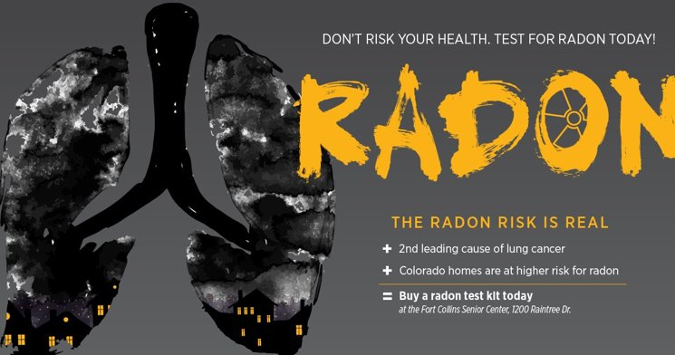
Roadmap
Provide a brief history of Radon program development
2017-2018 Radon policy work
  Summary of Working Group
  Community and participant questionnaires
What is happening now
Lessons learned
2019 International Radon Symposium Denver, Colorado
Notes:
The purpose of this presentation is to highlight some of the innovative policy work the City of Fort Collins has engaged in to increase testing and mitigation in the Fort Collins community. To do this during this presentation I will:
Provide a brief history of how the City of Fort Collins radon program has developed
Discuss 2017-2018 radon policy work and research, including discussion of forming a stakeholder working group, the results of that working group, and the results of two questionnaires
From there I will summarize some of the innovative work that we are continuing to do based on the results of the working group and policy research.
Finally, I will provide some lessons learned that we believe are valuable for practitioners, and radon specialists alike.

Slide 3

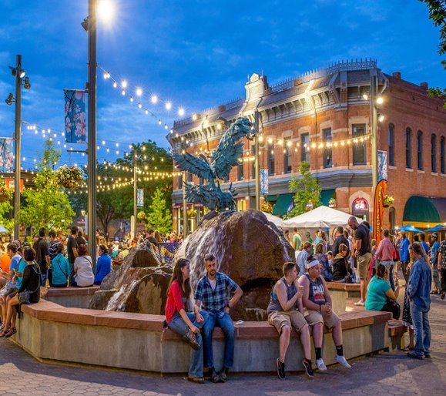
Fort Collins, Colorado
Sits against the Foothills of the Rocky Mountains
Population of ~170,000
Proud home of Colorado State University
Council-Manager form of government
Notes:
First, I’d like to provide a little bit of background on Fort Collins. Fort Collins is about an hour north of Denver and sits against the foothills of the Rocky Mountains. The population of Fort Collins is approximately 170,000, it is the proud home of CSU, and has many microbreweries to choose from.
Fort Collins has what we call a Council-Manager form of government which means that Council and the Mayor are elected and appoint a City Manager to oversee operations of the City. Staff then are required to implement programs and policies, research policies and provide Council with options that they may later adopt.

Slide 4
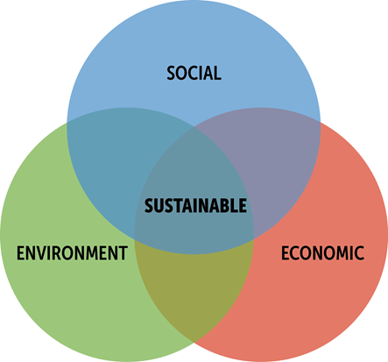
Sustainability and the Air Quality Programs
Outdoor Air
Ozone & particulates
GHG
Fugitive Dust
Mower rebates; Idling
Visibility and pollutant monitoring
Oil and gas
Indoor Air
Healthy Homes Program
Radon
Notes:
Fort Collins approaches Sustainability from the Triple Bottom Line: in 2011 the Sustainability Services Area was created and includes Social, Economic and Environmental—the triple bottom line. This is unique because we are the only municipal government that has a Sustainability Services Area set up in this way. Within the Environmental Services Department we have an Air Quality program that works on bot outdoor and indoor issues.

Slide 5
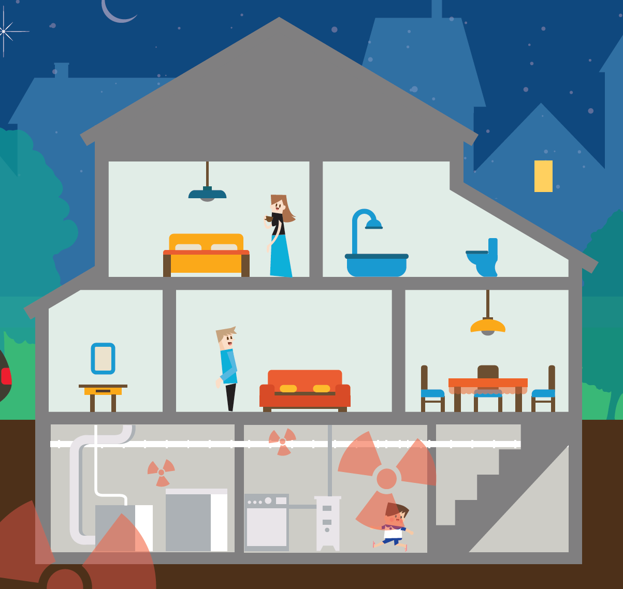
City of Fort Collins Radon Program
2005- RRNC requirements
Healthy Homes program
Sell short-term and long-term test kits at a discounted rate
Information required during real-estate transactions
2019 International Radon Symposium Denver, Colorado
Notes:
City of Fort Collins has a long history of programs and policies to improve air quality, especially as it relates to human health. With the City beginning to work on air quality issues in the 80s, the first air quality plan in 1994. Radon is no exception to this. In 1995 people in the Fort Collins community were aware of issues with radon and began educating about the risks of high radon exposure.
In 2005 the City of Fort Collins passed an ordinance requiring RRNC in all single-family homes and duplexes. As building codes in the IRC and IBC have caught up RRNC now applies to all homes in Fort Collins including multi-family
We also have an indoor air quality program through which we provide free radon tests as part of the assessment, sell kits at a discounted rate and have brochures that are required during real estate transactions.

Slide 6
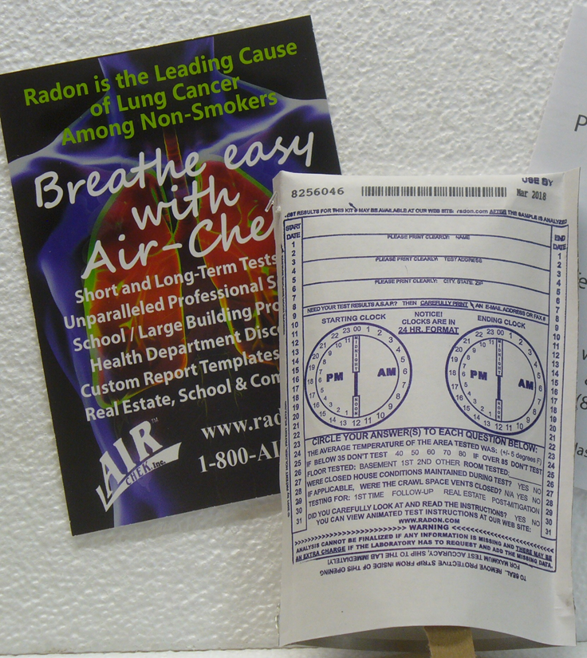
Review of council priority and overview of policy research
Council Priority 2017
  Enhance current programs
Key policy areas
  RRNC
  Testing Requirements
  Disclosure & Notification
  Certification
Community outreach
Stakeholder Working Group
Notes:
In 2017, with support from the Air Quality Advisory Board, our City Council named Radon a top priority for the Council term. The direction from Council was to enhance the current radon programs. City staff was then asked to research best practices in other communities and states. As many of you know to increase testing and mitigation best practices include 1: RRNC 2. Testing requirements 3. Disclosure and Notification and requiring that those doing mitigation work be certified. Based on the research done we decided to do some community outreach and develop a stakeholder working group to help identify ways in which we could improve our programs.

Slide 7
Radon in Fort Collins
What we know
Questions that remain
Fort Collins is in Zone 1 for Radon
Radon is the second leading cause of lung cancer in the United States
56% of homes tested in Fort Collins reported high levels (4pCi/L)
26% of survey respondents chose to mitigate
Why people choose not to mitigate?
  Awareness
  Cost
  Other barriers
Have mitigation rates changed?
How do we better communicate health risks and benefits?
Notes:
Fort Collins is in zone 1 for radon level
From 1996-2017, 56% of homes tested in Fort Collins reported high levels of radon
Above 4 pCi/L is when the EPA recommends mitigation
In the 2017 Air Quality survey 41% of respondents said they have tested and 26% of those respondents chose to mitigate
The questions that we had informed the research that was done, the questions we asked of the community and how we formed the Working Group

Slide 8
Project Overview
Goal:
Scope:
Objectives:
Increase awareness
Decrease misinformation
Increase testing and mitigation
Reduce the risk of exposure to radon gas to all Fort Collins residents
Residential
2019 International Radon Symposium Denver, Colorado
Notes:
Based on research done on best practices and direction to do more with current radon programs, we defined the following goal, scope and objectives:
Our goal is to reduce the risk of exposure to all Fort Collins residents
At this time we are limiting our scope to residential buildings. The reason we are limiting our scope to residential is because we are at the greatest for exposure to high radon levels in our own homes and when we examined our existing programs, data, etc., we find that our current programs are not reaching all residential groups
Based on research, best practices etc., the objectives to reach our goal to reduce risk in our community are to increase awareness, decrease the amount of misinformation out there and to increase testing and mitigation

Slide 9
2018 Radon Policy Work
Research Best Practices
Radon Working Group
General Knowledge Questionnaire
Mitigation
Questionnaire

Slide 10
Mitigation Questionnaire Results
Did you choose to mitigate after the radon test came back above the EPA
recommended action level of 4pCi/L?
2019 International Radon Symposium Denver, Colorado
Notes:
Residents who tested above the 4 pCi/l
Time frame: Last two years
367 emails sent
40 invalid emails
[129] of 327
Approximately [39%] response rate
Top barriers to mitigating 1. Cost 2. Didn’t feel it was necessary based on levels 3. Other
Lots of interesting data/information we just want to highlight the breakdown on choosing to mitigate and not (Working Group can get more into the details of that

Slide 11
General Questionnaire Results
Notes:
City Employee Health fair, Senior Center, Libraries across City
Along with knowledge, we asked questions about what they felt their level of risk was
52% said risk was high
34% moderate risk
13% low risk
Question on willing or able to take steps to mitigate
75% said yes, whatever it takes
15% other, not willing or able
10% other with some comments being that they didn’t think the risk was enough
We had a last question that asked about what could the City do more of and the answer was better education and outreach

Slide 12
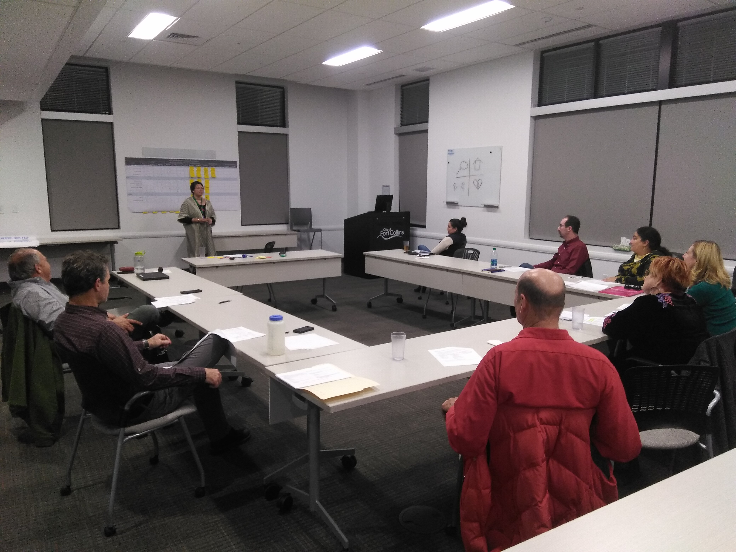
2018 Radon Working Group
Stakeholder Working Group met 5 times from Aug-Nov 2018
7 members representing different interests
  Social Sustainability
  Utilities
  Realtors
  Landlord/Property Management
  Radon Mitigator
  AQAB Members
Notes:
Purpose of Working group was to prioritize a list of options to enhance current radon programs . We had 7 members representing diverse interests and opinions in our community.

Slide 13
Alternative Areas
Working Group Purpose:
Prioritize list of options to enhance radon program
Testing Requirements
Certification
Requirements
Mitigation Assistance
Disclosure & Notification
Education & Outreach
Notes:
Each night of the Working Group was dedicated to discussion of different options under each of these alternative areas. The group discussed what current practices were (if any in FC), some best practices in other communities, and pros/cons to each option discussed.
During the final WG session, the group met and ranked each of the alternatives on a scale of High, Medium, Low on how well they felt each option discussed met the evaluative criteria.

Slide 14
Evaluative Criteria
Effectiveness
Equity
Feasibility
  Increase Knowledge
  Increase Testing
  Increase Mitigation
  Benefit
  Negatively affect
  Political
  Willingness to pay
Notes:
Effectiveness: How well does each option meet the objectives
Increase knowledge
Increase testing
Increase mitigation
Equity: How the perceived impacts of each option are distributed across different groups
Feasibility: Likelihood of being able to pursue as a policy option
Political feasibility: how well it is accepted by the City leadership, the community
Willingness to pay

Slide 15
Results of Working Group
Top 4 Prioritized Options
Require testing for all rental properties
Increase education and outreach to the general population
Require disclosure and notification for all residential property
Regulate testing for all residential properties
2019 International Radon Symposium Denver, Colorado

Slide 16
Overall Findings
Why people choose not to mitigate?
Awareness
Cost
Renter versus owner
Have mitigation rates in Fort Collins changed?
Beginning to track this
How do we better communicate health risks and benefits?
Outreach efforts that are more upfront about risks
2019 International Radon Symposium Denver, Colorado

Slide 17
Where Are We Now
Change in leadership
  New Council May 2019
Consider how to best leverage existing partnerships
  Efficiency Works Homes
  Look to other community partners
Bolster education and outreach in the community
Continue to gather information specific to Fort Collins Community
  Tracking mitigation in the community
Notes:
Some resource changes– which means we are trying to get more creative. One of the ways we are doing this is by leveraging our partnerships
Efficiency Works Homes
Offer energy assessments, have list of vetted contractors, contractors are beginning to become certified for radon mitigation so it can be “bundled” into other work they are doing. This allows for vetted list, one stop shopping for community member, right-size fan for energy efficiency, etc.
Other community partners such as the County—co-created a radon presentation in Spanish.
Over time, the rate of those who have tested high has gone down. While we can’t specify why that could be the case, we think it is because of our education/awareness efforts in addition to RRNC policy. What this means for contractors is working in a community that promotes awareness and uses policy tools such as building code can help reduce radon by increasing

Slide 18
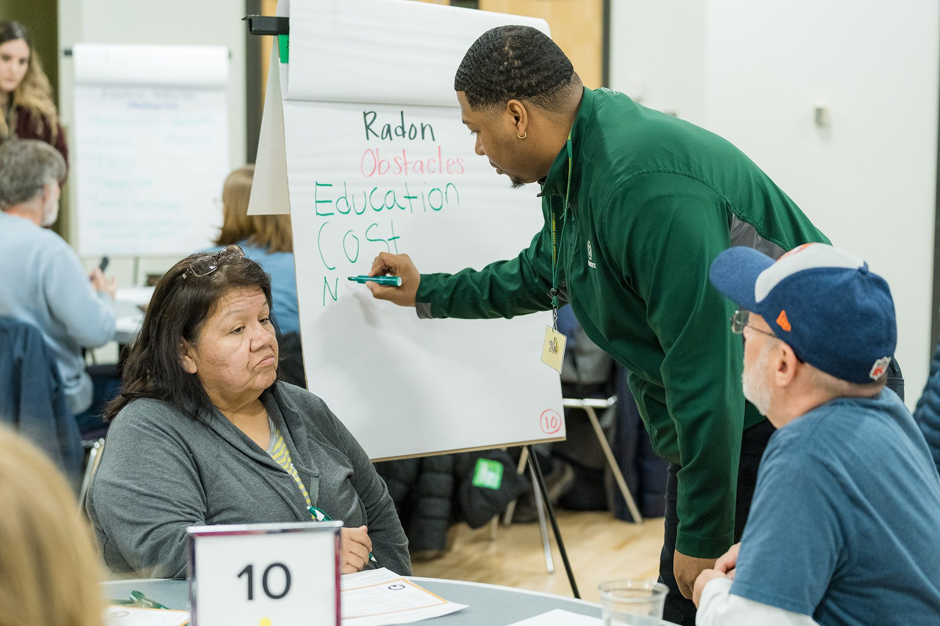
Lessons Learned & Best Practices
Be Inclusive
Understand your process
Be Adaptable
Take a Step Back
2019 International Radon Symposium Denver, Colorado
Notes:
Political buy-in: This was one of the biggest take aways for me. Fort Collins has been doing quite a bit with radon but we and still do more to increase our testing and mitigation rates. Having support from City leadership allows us to continue to explore and improve in this space.
Working in government I think there are several important lessons/best practices when working on policy:
Be Inclusive: diversity of opinions and voices helps the process of developing options, gives the process legitimacy and ultimately leads to better policy
Understand your process: As staff that takes direction from elected officials, it is necessary to understand what our elected officials expect from us and the process by which policies will be passed. Also along with this, recognizing we may have the technical expertise and knowledge i.e. we know mitigation significantly reduces the risk of radon but without political buy in, we aren’t going to be able to require certain things.
Be Adaptable: Understand that things in local government change quickly. React to changes as they come, and adjust direction as needed.
Take a step back: Leverage partnerships to help facilitate some of the more difficult conversations that are had in community engagement efforts
This allows you to be a subject expert without being perceived by others as trying to drive or influence the direction of the process
Taking a step back allows for different perspectives. As the staff leading a project it is easy to become near sighted and miss something.

Slide 19
CONTACT INFORMATION
Megan DeMasters
mdemasters@fcgov.com
970-416-2832
2019 International Radon Symposium Denver, Colorado

