Slide 1
Multi Housing Radon Dilution Retrofit
a Fresh Air Dilution solution
2019 International Radon Symposium Denver, Colorado

Slide 2
FACT:
Multi-Family Structures are constructed tight with low air exchange rates.
RESULT:
Radon from building materials accumulates to unacceptable health risk levels in breathing zones.
2019 International Radon Symposium Denver, Colorado

Slide 3
In Multi-Family Housing
Fresh Air / Ventilation has generally been sought by introducing conditioned air into Corridors (serving as fresh air ducts) with the expectation that pressurization would force corridor fresh air to trickle under the doors to provide occupants with sufficient fresh air.
Imagine the effect of a fire in the corridor
NOT SO GOOD IN PRACTICE . . . But they are still doing it!
There is a remarkable continuing opportunity for Radon Mitigators here
2019 International Radon Symposium Denver, Colorado

Slide 4
The Common, Traditional Multi-Housing Fresh Air Solution?
Pressurize the corridor “duct” with conditioned air to trickle “fresh” corridor air into each unit under the doors
Corridor
Pressurized
with rarely filtered
rooftop air
Bird Congregations, Nests, feather collections and bird Graveyards
Dwelling
Dwelling
2019 International Radon Symposium Denver, Colorado

Slide 5
The corridors’ “fresh” air trickling under the suite doors will satisfy occupants’ needs for fresh air and for radon reduction?
Really?
What are the FACTS?
2019 International Radon Symposium Denver, Colorado

Slide 6
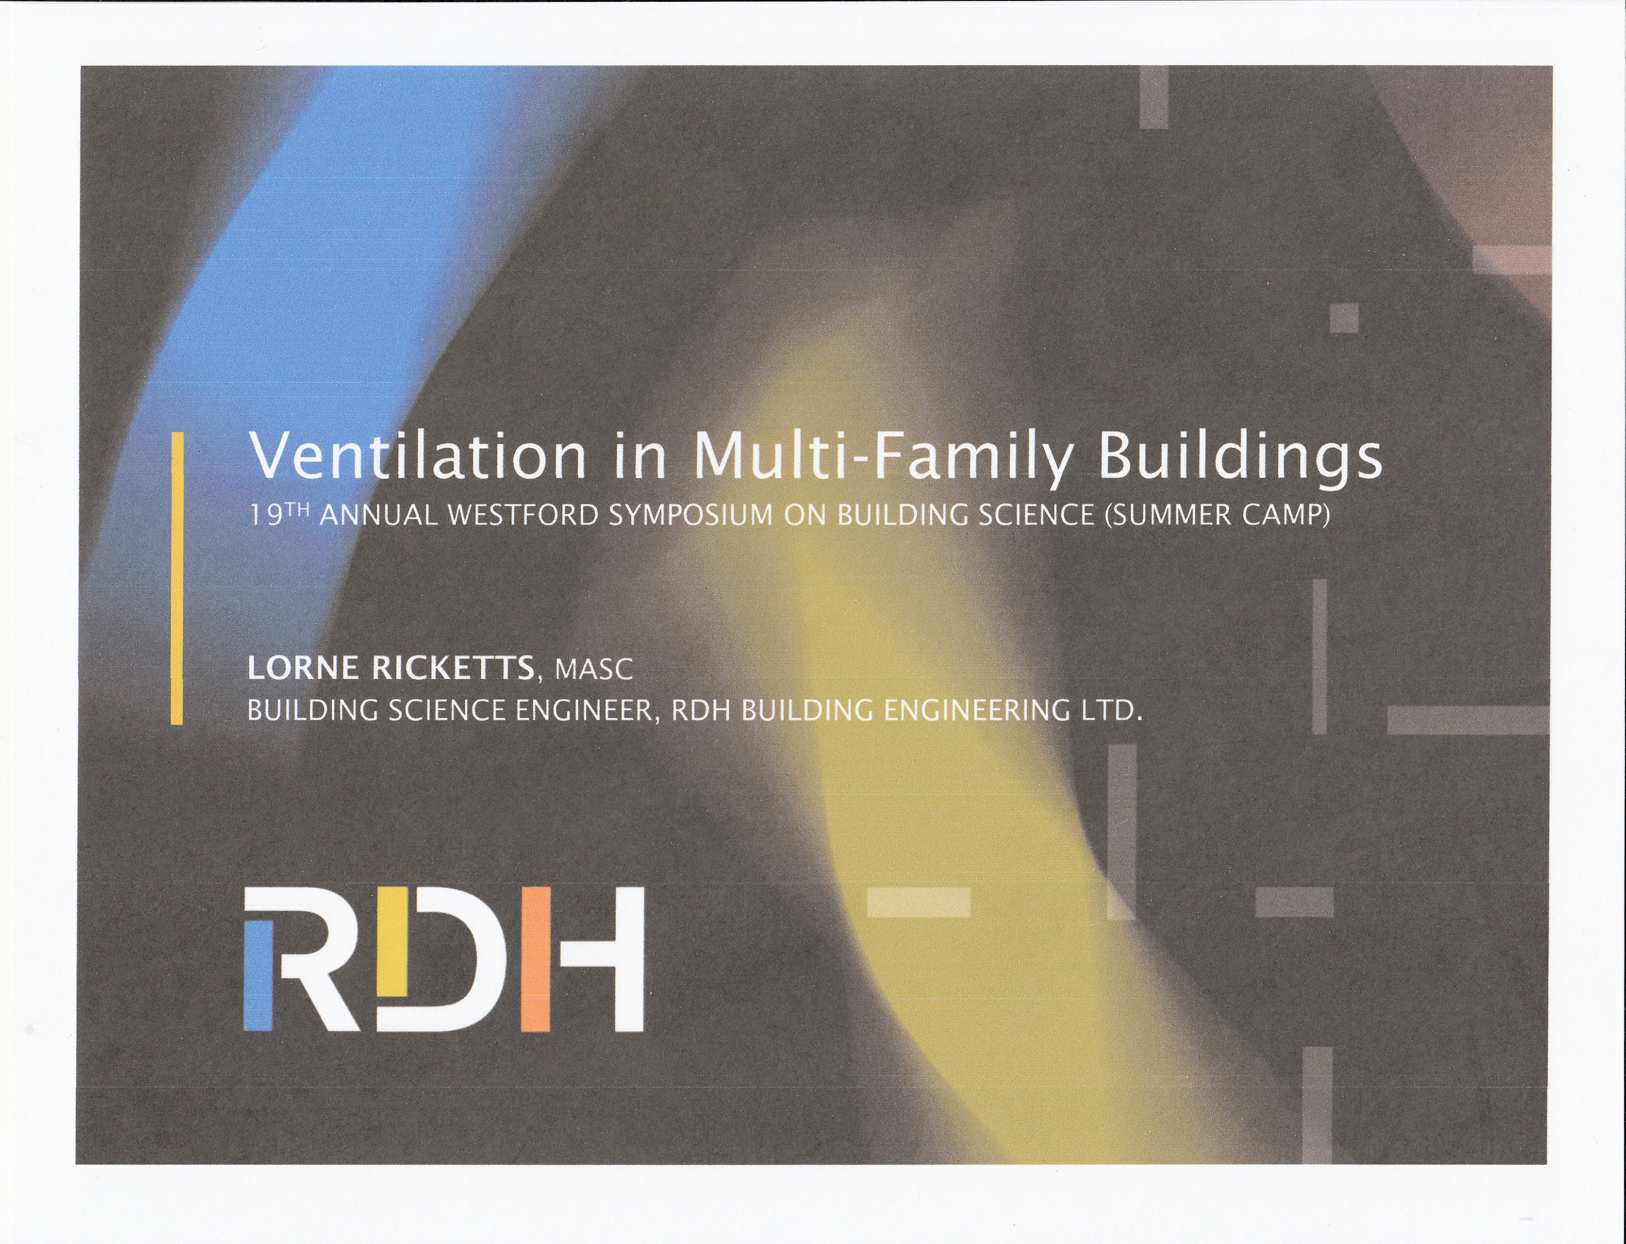
The FACTS:
Ventilation in Multi-Family Buildings 19th Annual Westford Symposium on Building Science
2019 International Radon Symposium Denver, Colorado

Slide 7
What does Lorne Ricketts MASC say the evidence means?
https://buildingscience.com/sites/default/files/01.03_2015-08
QUOTE:
Most Apartments / condos (multifamily buildings) are ventilated using pressurized corridor systems
Decades of anecdotal evidence indicates that this system likely does not work very well
Still most common system
Particularly relevant now, as newer more airtight buildings have less tolerance for poorly performing ventilation systems
Less infiltration and exfiltration to supplement ventilation
2019 International Radon Symposium Denver, Colorado

Slide 8
Lorne (the scientist) then concludes that research findings support the anecdotes
QUOTE:
Corridor pressurization does not provide intended ventilation rates to a large number of suites
Some significantly over ventilated while others significantly under ventilated
Significant leakage along the ventilation air flow path from the duct and the corridor (wasted ventilation)
Uncontrolled airflow wastes energy and provides poor ventilation
Stack effect and wind pressures are often similar or greater than mechanically-induced pressures
Ventilation system can not practically overwhelm nature
2019 International Radon Symposium Denver, Colorado

Slide 9
What Lorne Says it Means:
QUOTE:
Ventilation air should be directly supplied to suites to limit the potential of loss along the flow path and of the system being overwhelmed by stack effect and wind
The exterior enclosure should be airtight, and suites and verticalized shafts should be compartmentalized (airtight) to limit the impact of wind and stack effect on ventilation
2019 International Radon Symposium Denver, Colorado

Slide 10
CONTEXT
International Mechanical Code 2012
  601.2 Air movement in egress corridors shall not serve as supply, return, exhaust, relief or ventilation air ducts.
  Something similar in code since at least 1996
2019 International Radon Symposium Denver, Colorado

Slide 11
CONTEXT
CaGBC LEED Credit EQ11 Interpretation (#1126)
Supply of ventilation air from corridor is unlikely to meet the referenced ASHRAE 62.1 requirements for distribution
Likely to conflict with ETS and fire separation
Canada Green Building Council
2019 International Radon Symposium Denver, Colorado

Slide 12
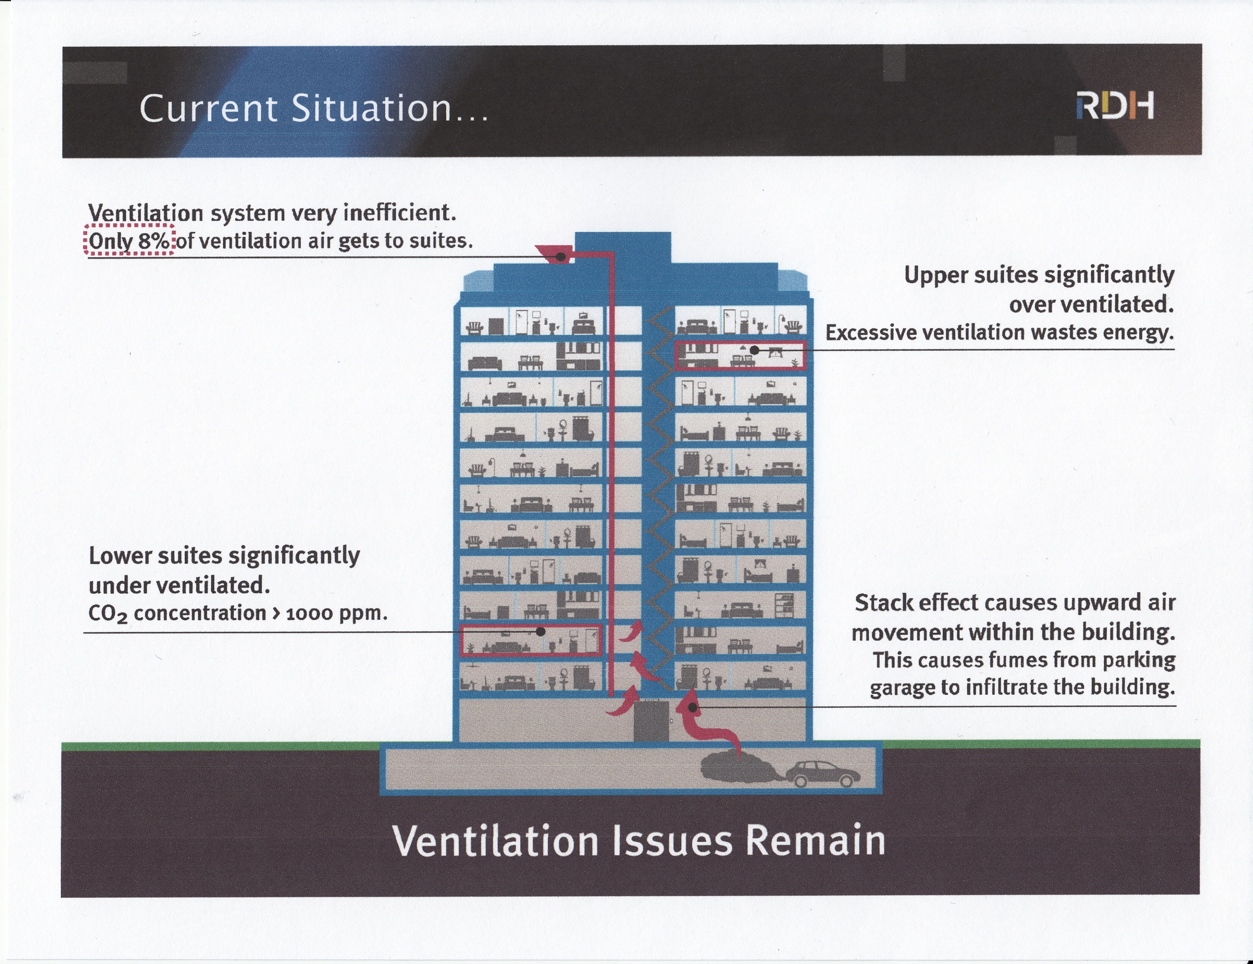
As presented by Lorne Ricketts
2019 International Radon Symposium Denver, Colorado

Slide 13
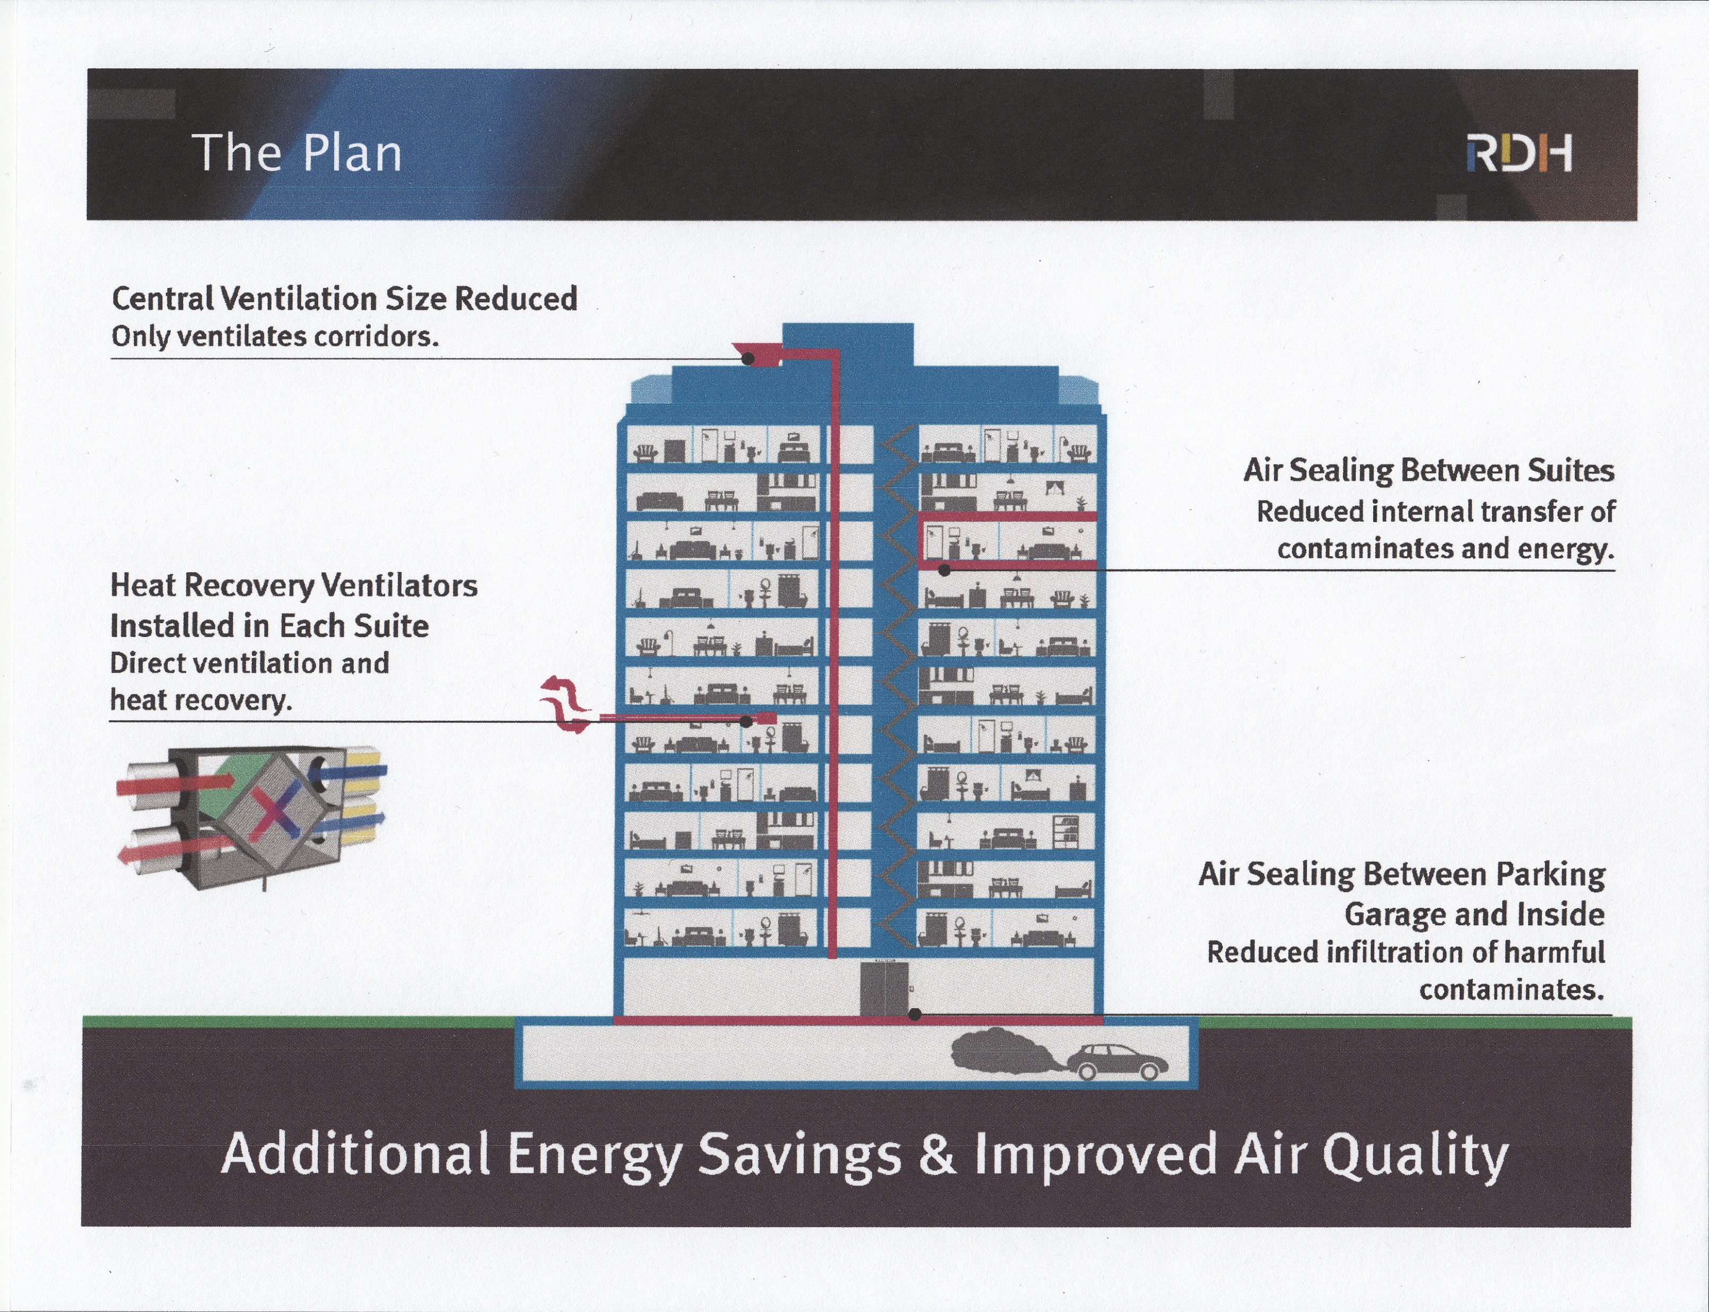
As presented by Lorne Ricketts MASC
2019 International Radon Symposium Denver, Colorado

Slide 14

My Conclusions?
Corridor Pressurization / Ventilation will successfully dilute radon in some of the units some of the time. Not Acceptable
Correct amounts of fresh air injected directly into a compartmentalized unit will always dilute radon in that unit

Slide 15
My Full Disclosure to Everyone
No Secrets, No Patents
Feel free to use any of this information in your own business and to develop your own products and systems
And to expand your business to add fresh air to SSD systems (a very good idea for improved IAQ and customer health, cognitive function and sleep)
Use it to operate your own mechanical ventilation retrofit business expansion to help anyone to meet ASHRAE 62.2-2016-7, IBC and IEC

Slide 16
This is What I Have Accomplished:
Make it simple: Plug ‘n Play simplicity
Special (no restoration) port boring rig with effective dust/slurry capture system
No Permits, no electrician, no HVAC or plumbing contractors
Long life, high MERV filter, serviceable from indoors
Adjustable radon level, automatic temperature humidity limiting
Quieter than an HVAC system
Completed from indoors, through masonry blocks, any weather, any floor. Outdoor access NOT needed
No cleanup, restoration of drywall, wall covering, crown moldings, new soffits or new 120 VAC wiring
In and out the door in 1.5 to 2.5 hours (experienced team)
CO2 control-ready
2019 International Radon Symposium Denver, Colorado
2019 International Radon Symposium Denver, Colorado

Slide 17
Radon Reduction Result
Radon levels were reduced from 4.4-18 pCi/l to acceptable levels in every case without over-ventilation
Outdoor Fresh Air Flows / Radon Levels were precisely adjustable from 5-70 CFM with a jeweler’s screwdriver
In most cases, 14-30 cfm constant pressurization / ventilation was all that was required. Usually, reductions in airflow were made following clearance testing
The pushbutton-adjustable temperature/humidity controller operated ventilation to maintain 76-78 degrees, < 60% RH without ever overpowering the HVAC system. It Worked

Slide 18
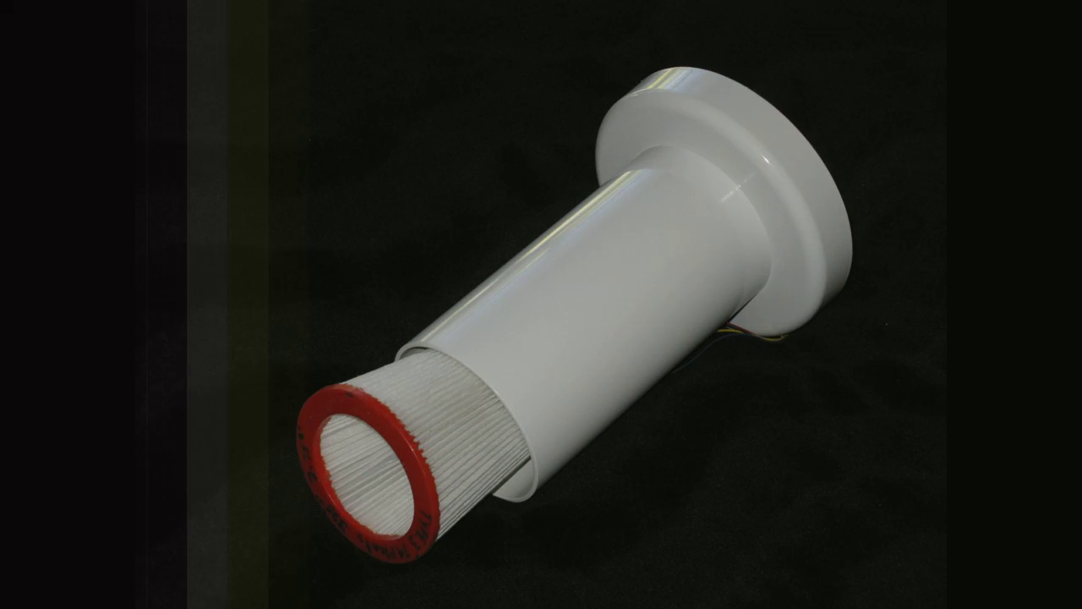
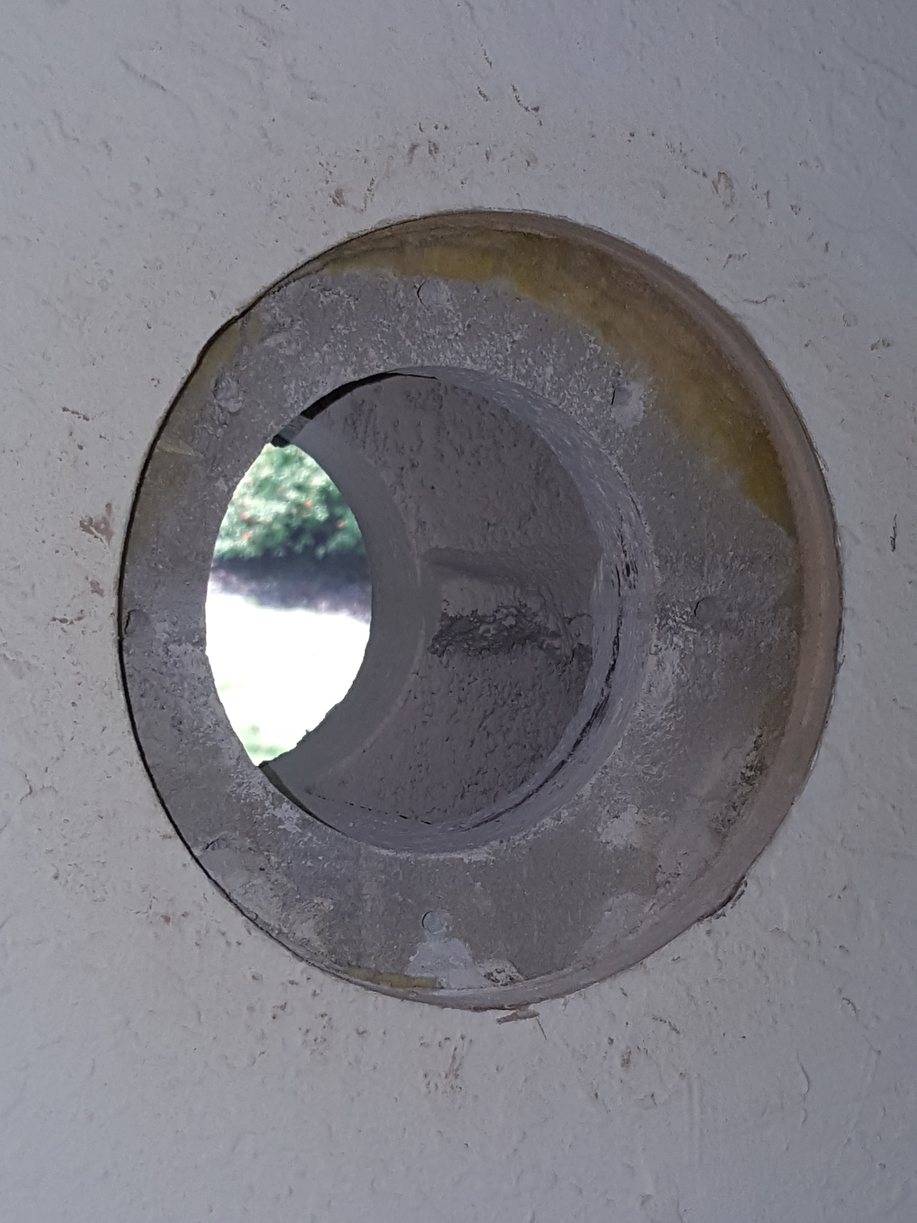
Wayne Dean’s Ideas #1-11 :
Idea #1 A system to provide each dwelling unit with filtered fresh air, delivered directly through a port in that unit’s exterior wall Unconditioned but Filtered Air delivered directly into the largest room

Slide 19
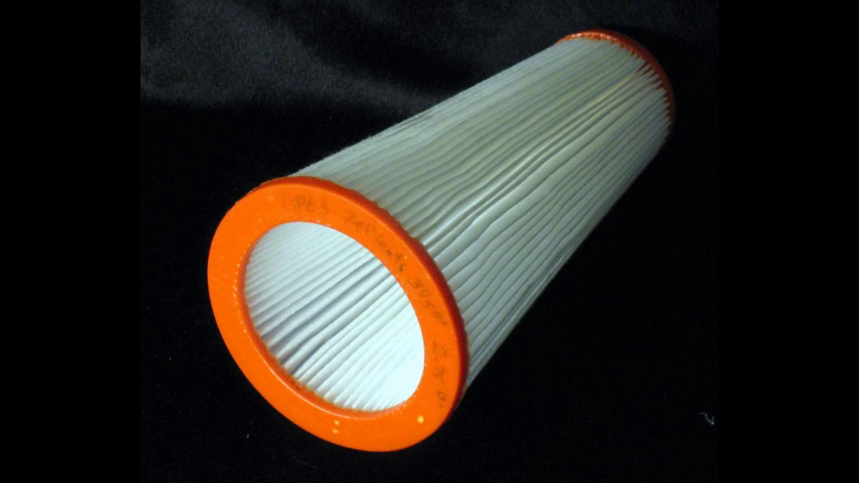
Idea #2 Fresh Air Intake Filter
Provide each unit with a long life, high MERV (14-25) air intake filter serviceable from indoors ASHRAE 62.2-2017

Slide 20
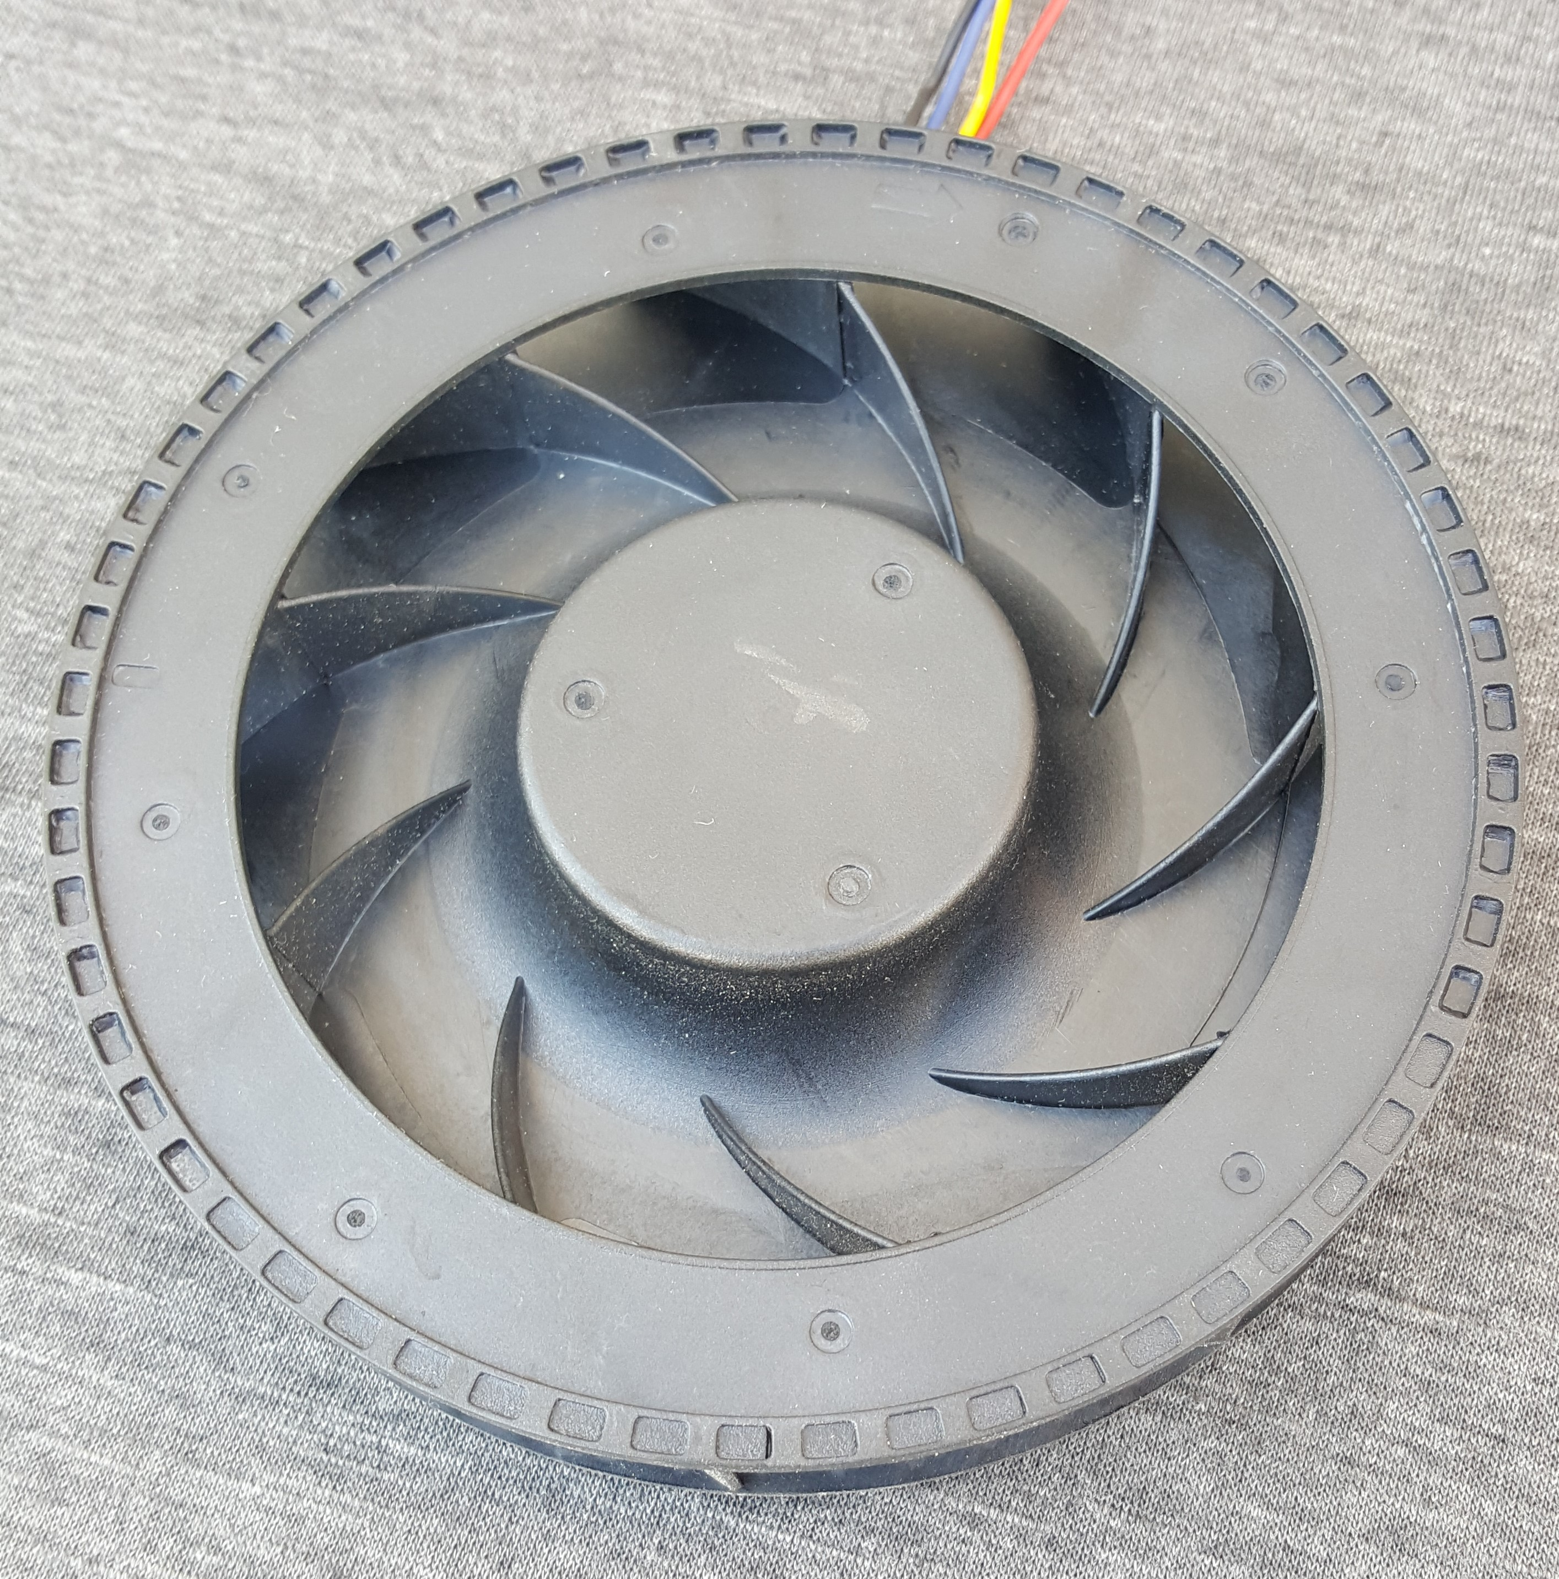
Idea #3 Low Voltage, Variable Speed, ECM Motorized Impeller

Slide 21
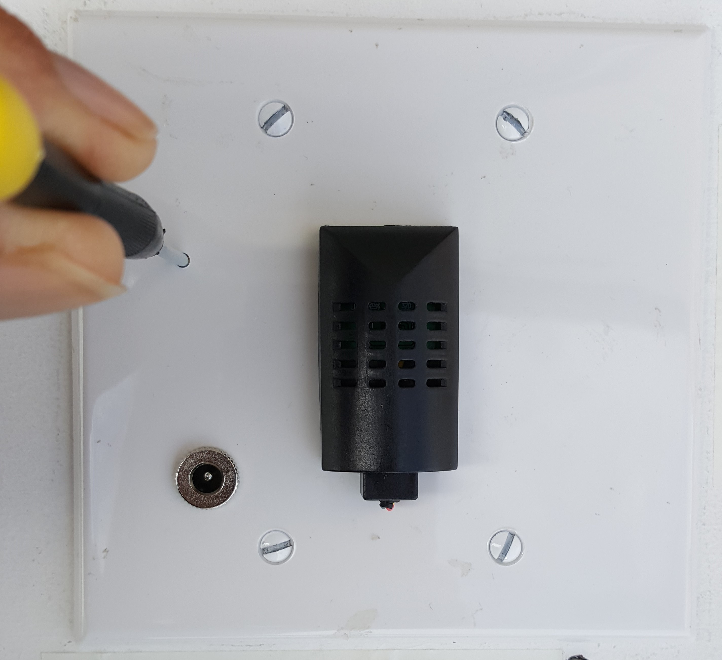
Idea #4 Manual Radon Level / Speed Adjustable by Jeweler’s Screwdriver

Slide 22
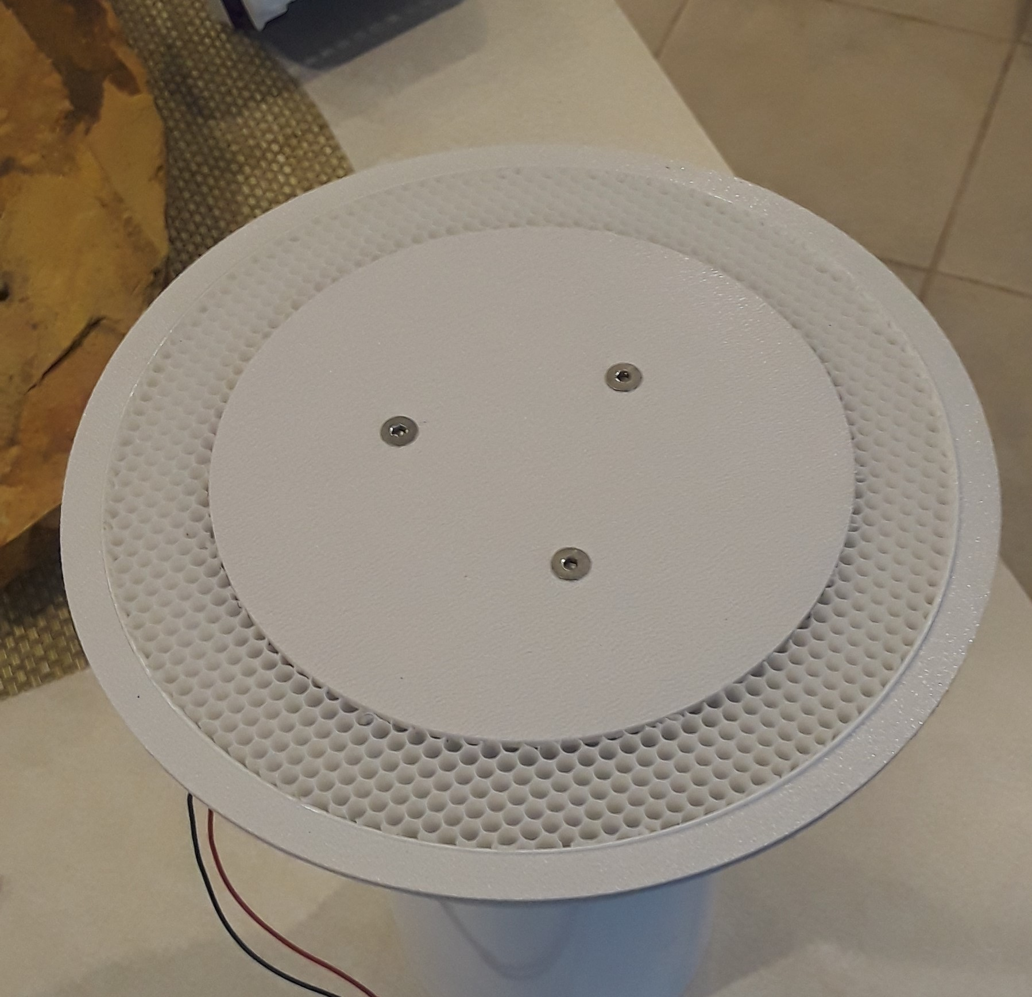
Idea #5 Deliver Fresh Air in a narrow beam, high in the room, to mix and temper with Indoor air, by way of 0.125” Honeycomb Laminar Air Flow Generator

Slide 23
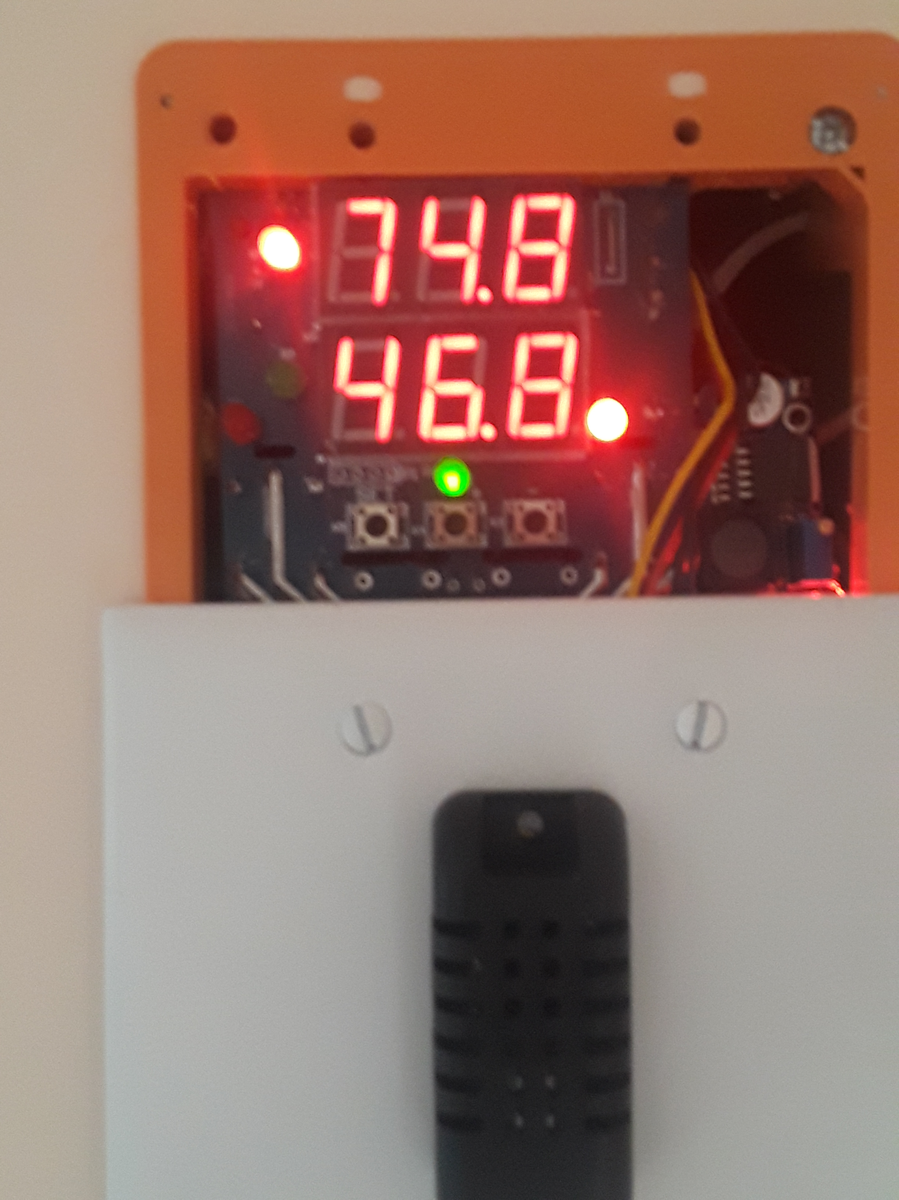
Idea #6 Control Temperature and Relative Humidity Automatically

Slide 24
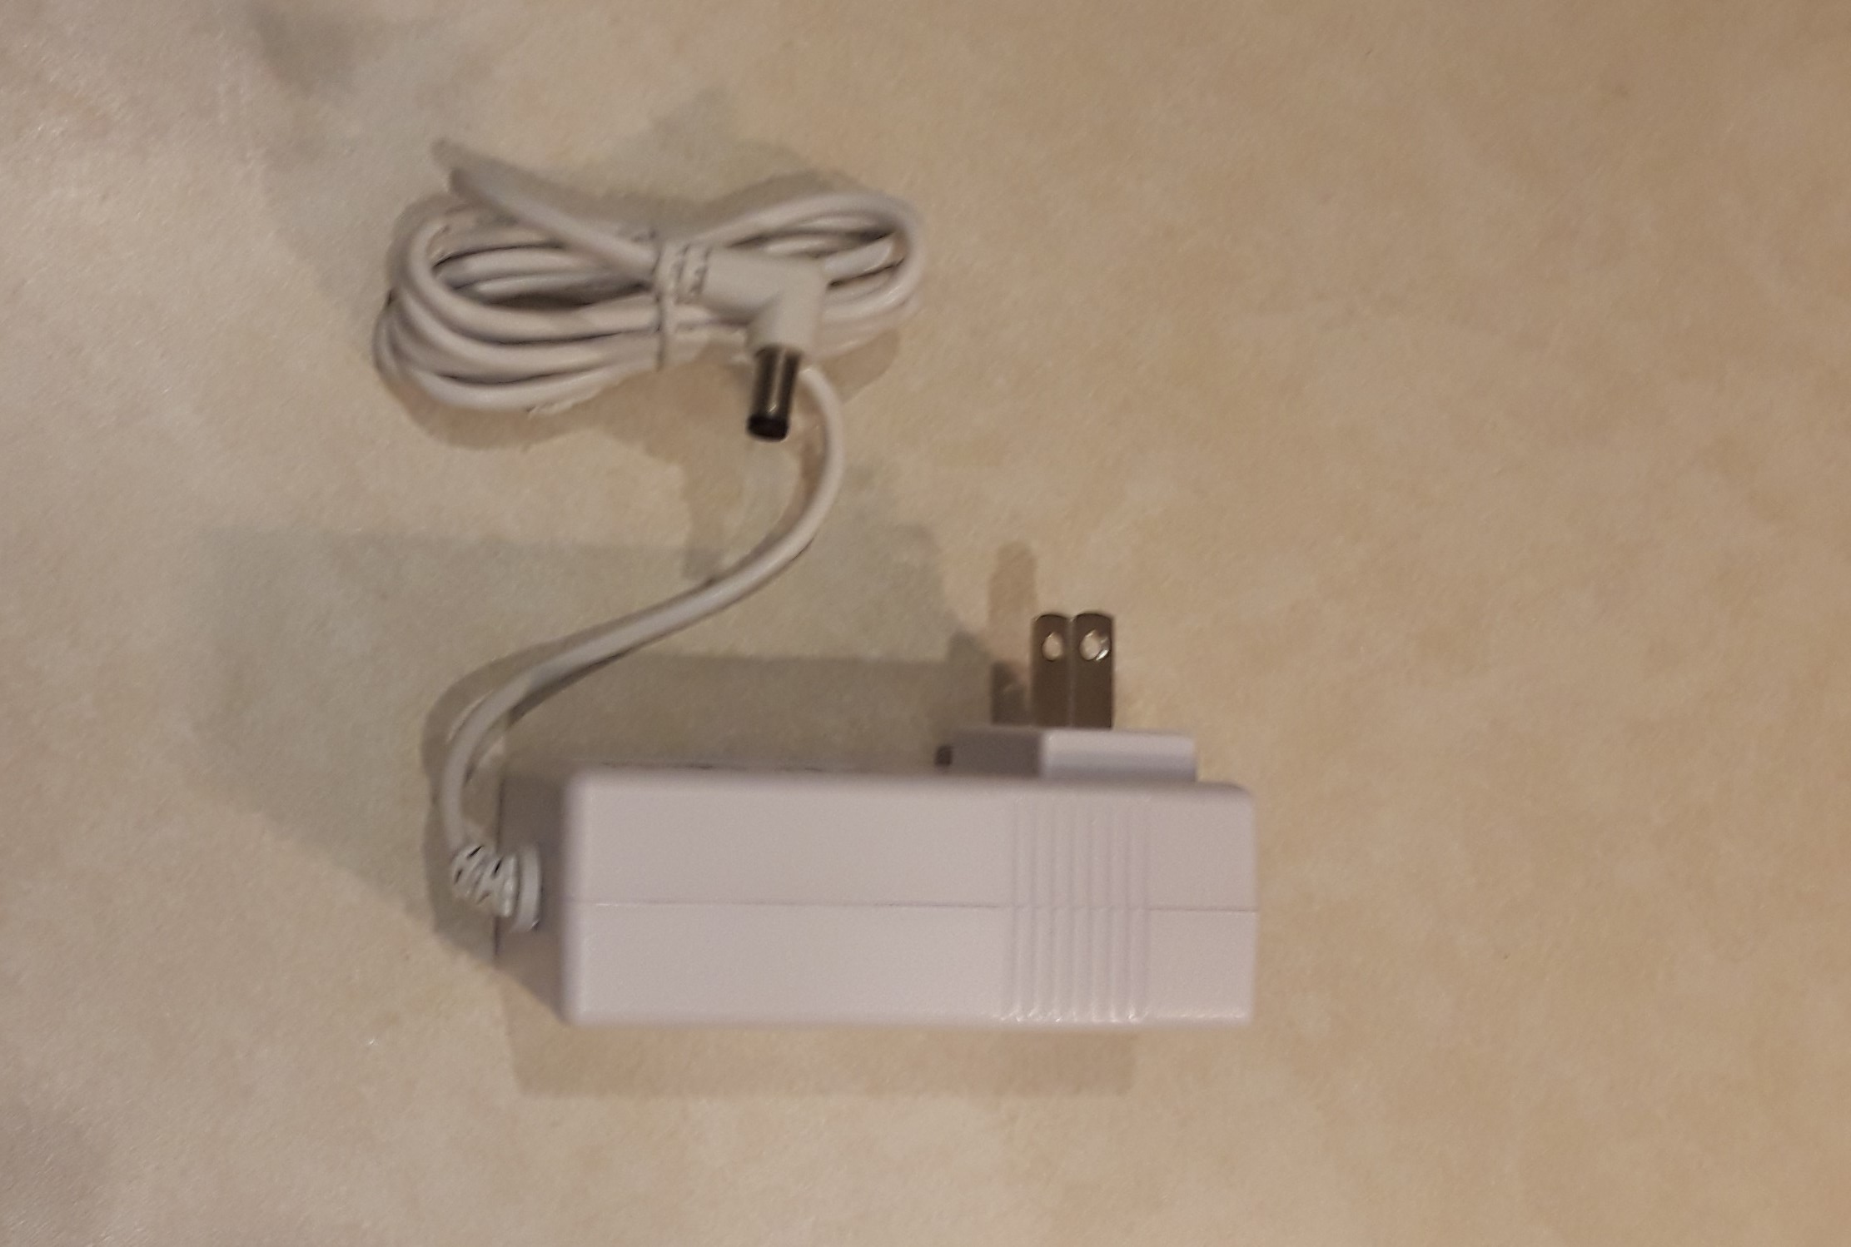
Idea #7 120 vac Wiring Unnecessary
Power system with 12vdc plug-in power pack
No electrician, permit application, cost, delays, inspections

Slide 25
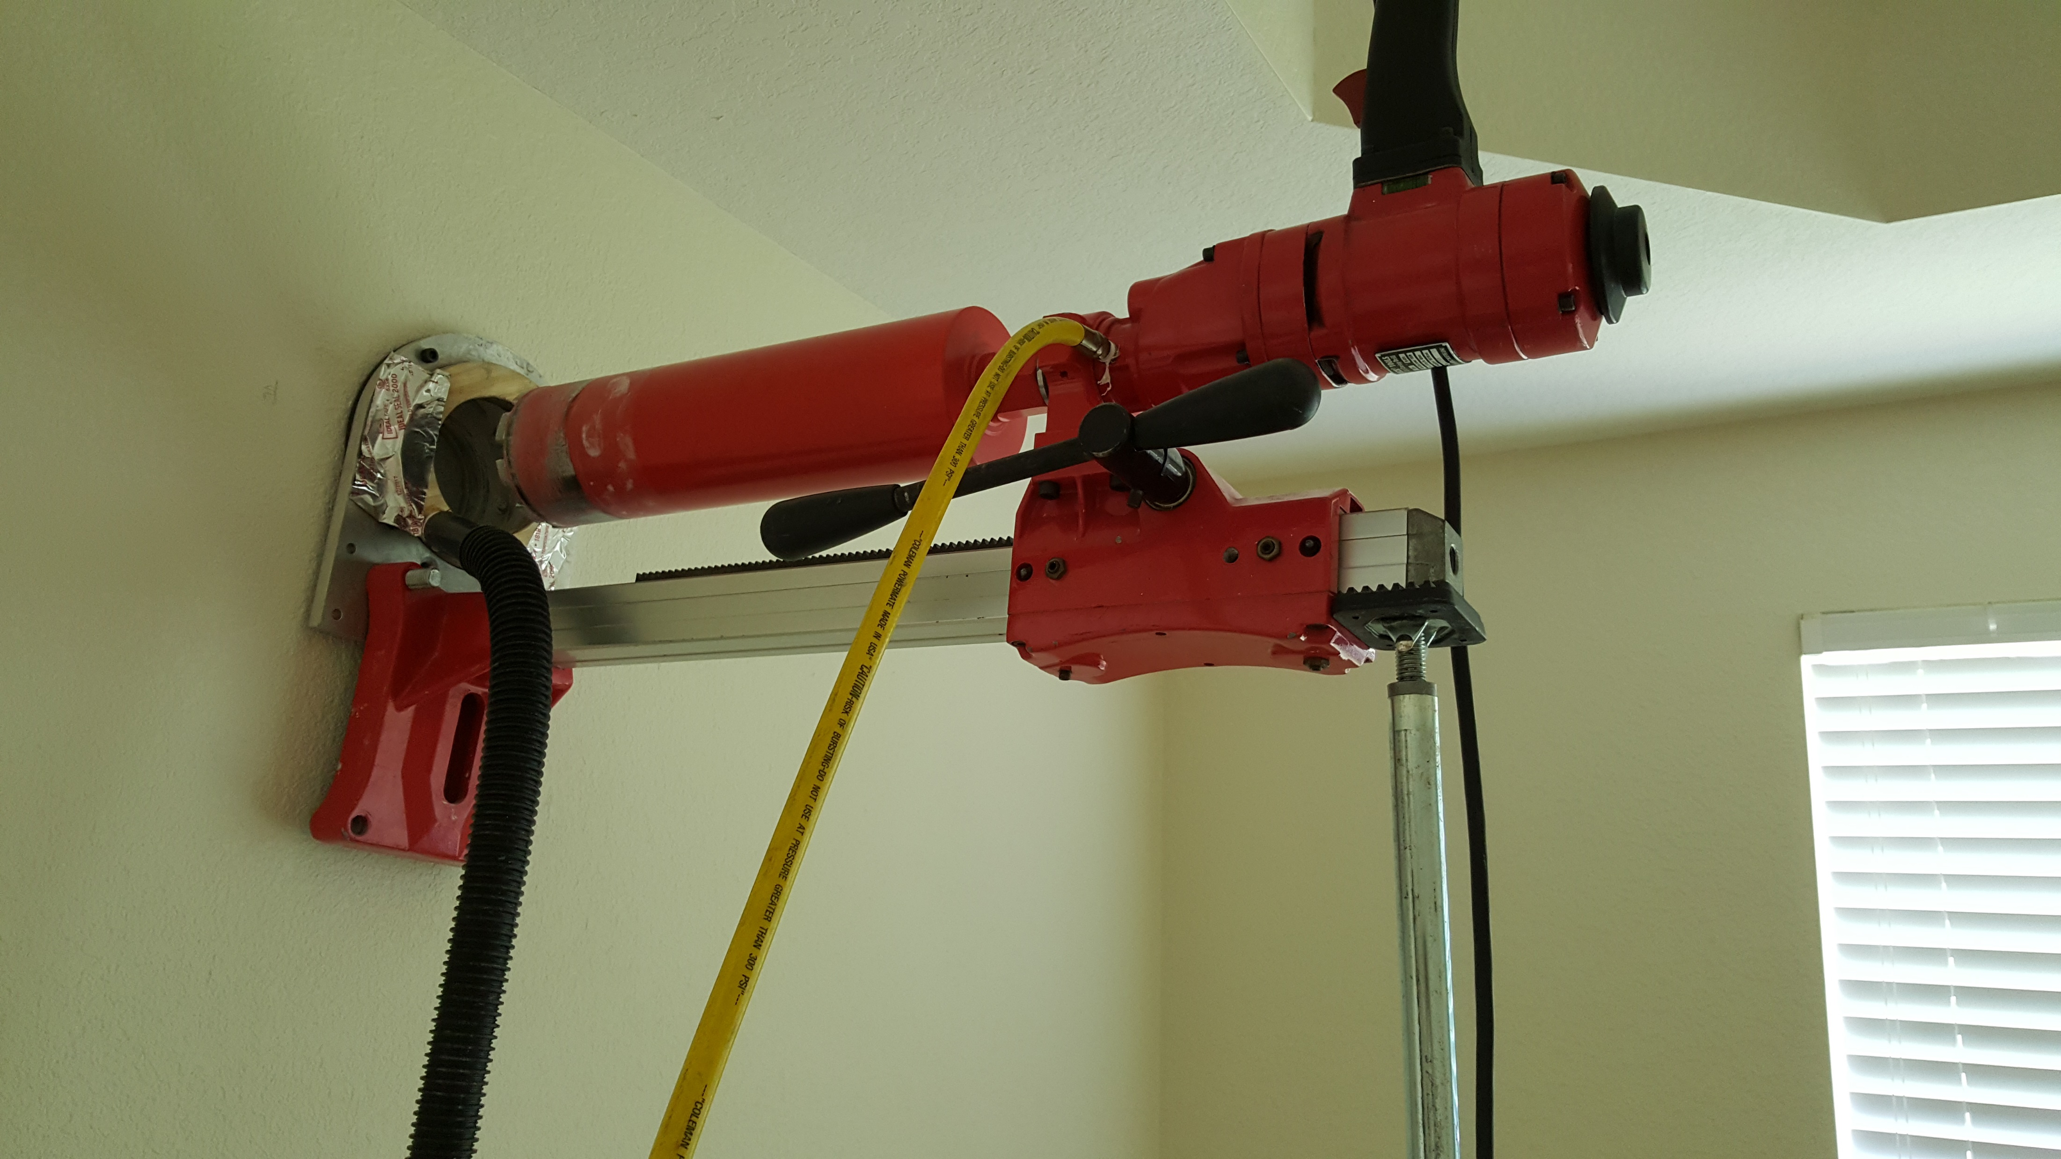
Idea #8 Built a Special Port-Boring Rig
Develop a diamond core rig that would bore a precision port through exterior walls
Fully captures all dust and slurry
Does not require any new construction, cleanup or restoration

Slide 26

Idea #9 Finished Air Intake Port
Unmarked, Undamaged Wall
No Restoration Necessary
Just wipe off a little dust

Slide 27
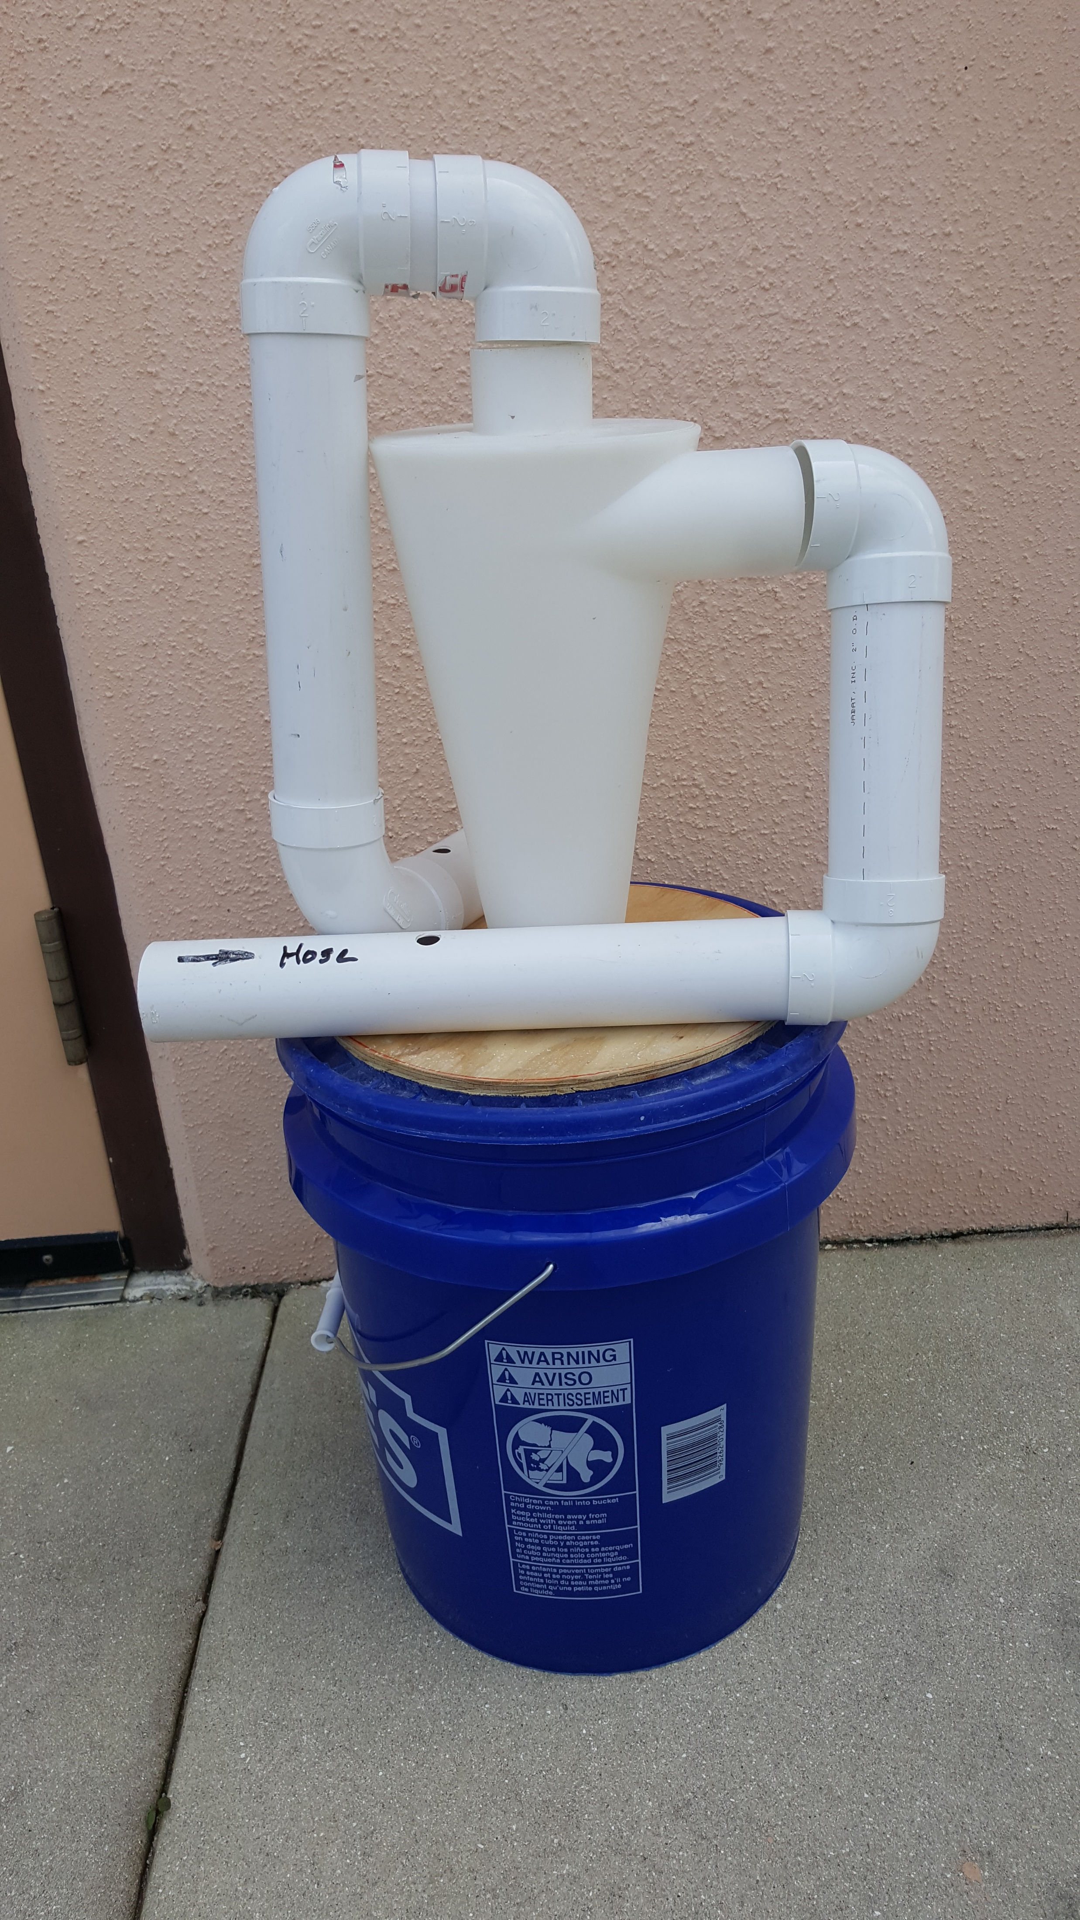
Idea #10 Cyclonic Dry Particle Separator
Keep Vac Filter from clogging for weeks, not hours
Requires High Air Velocity

Slide 28
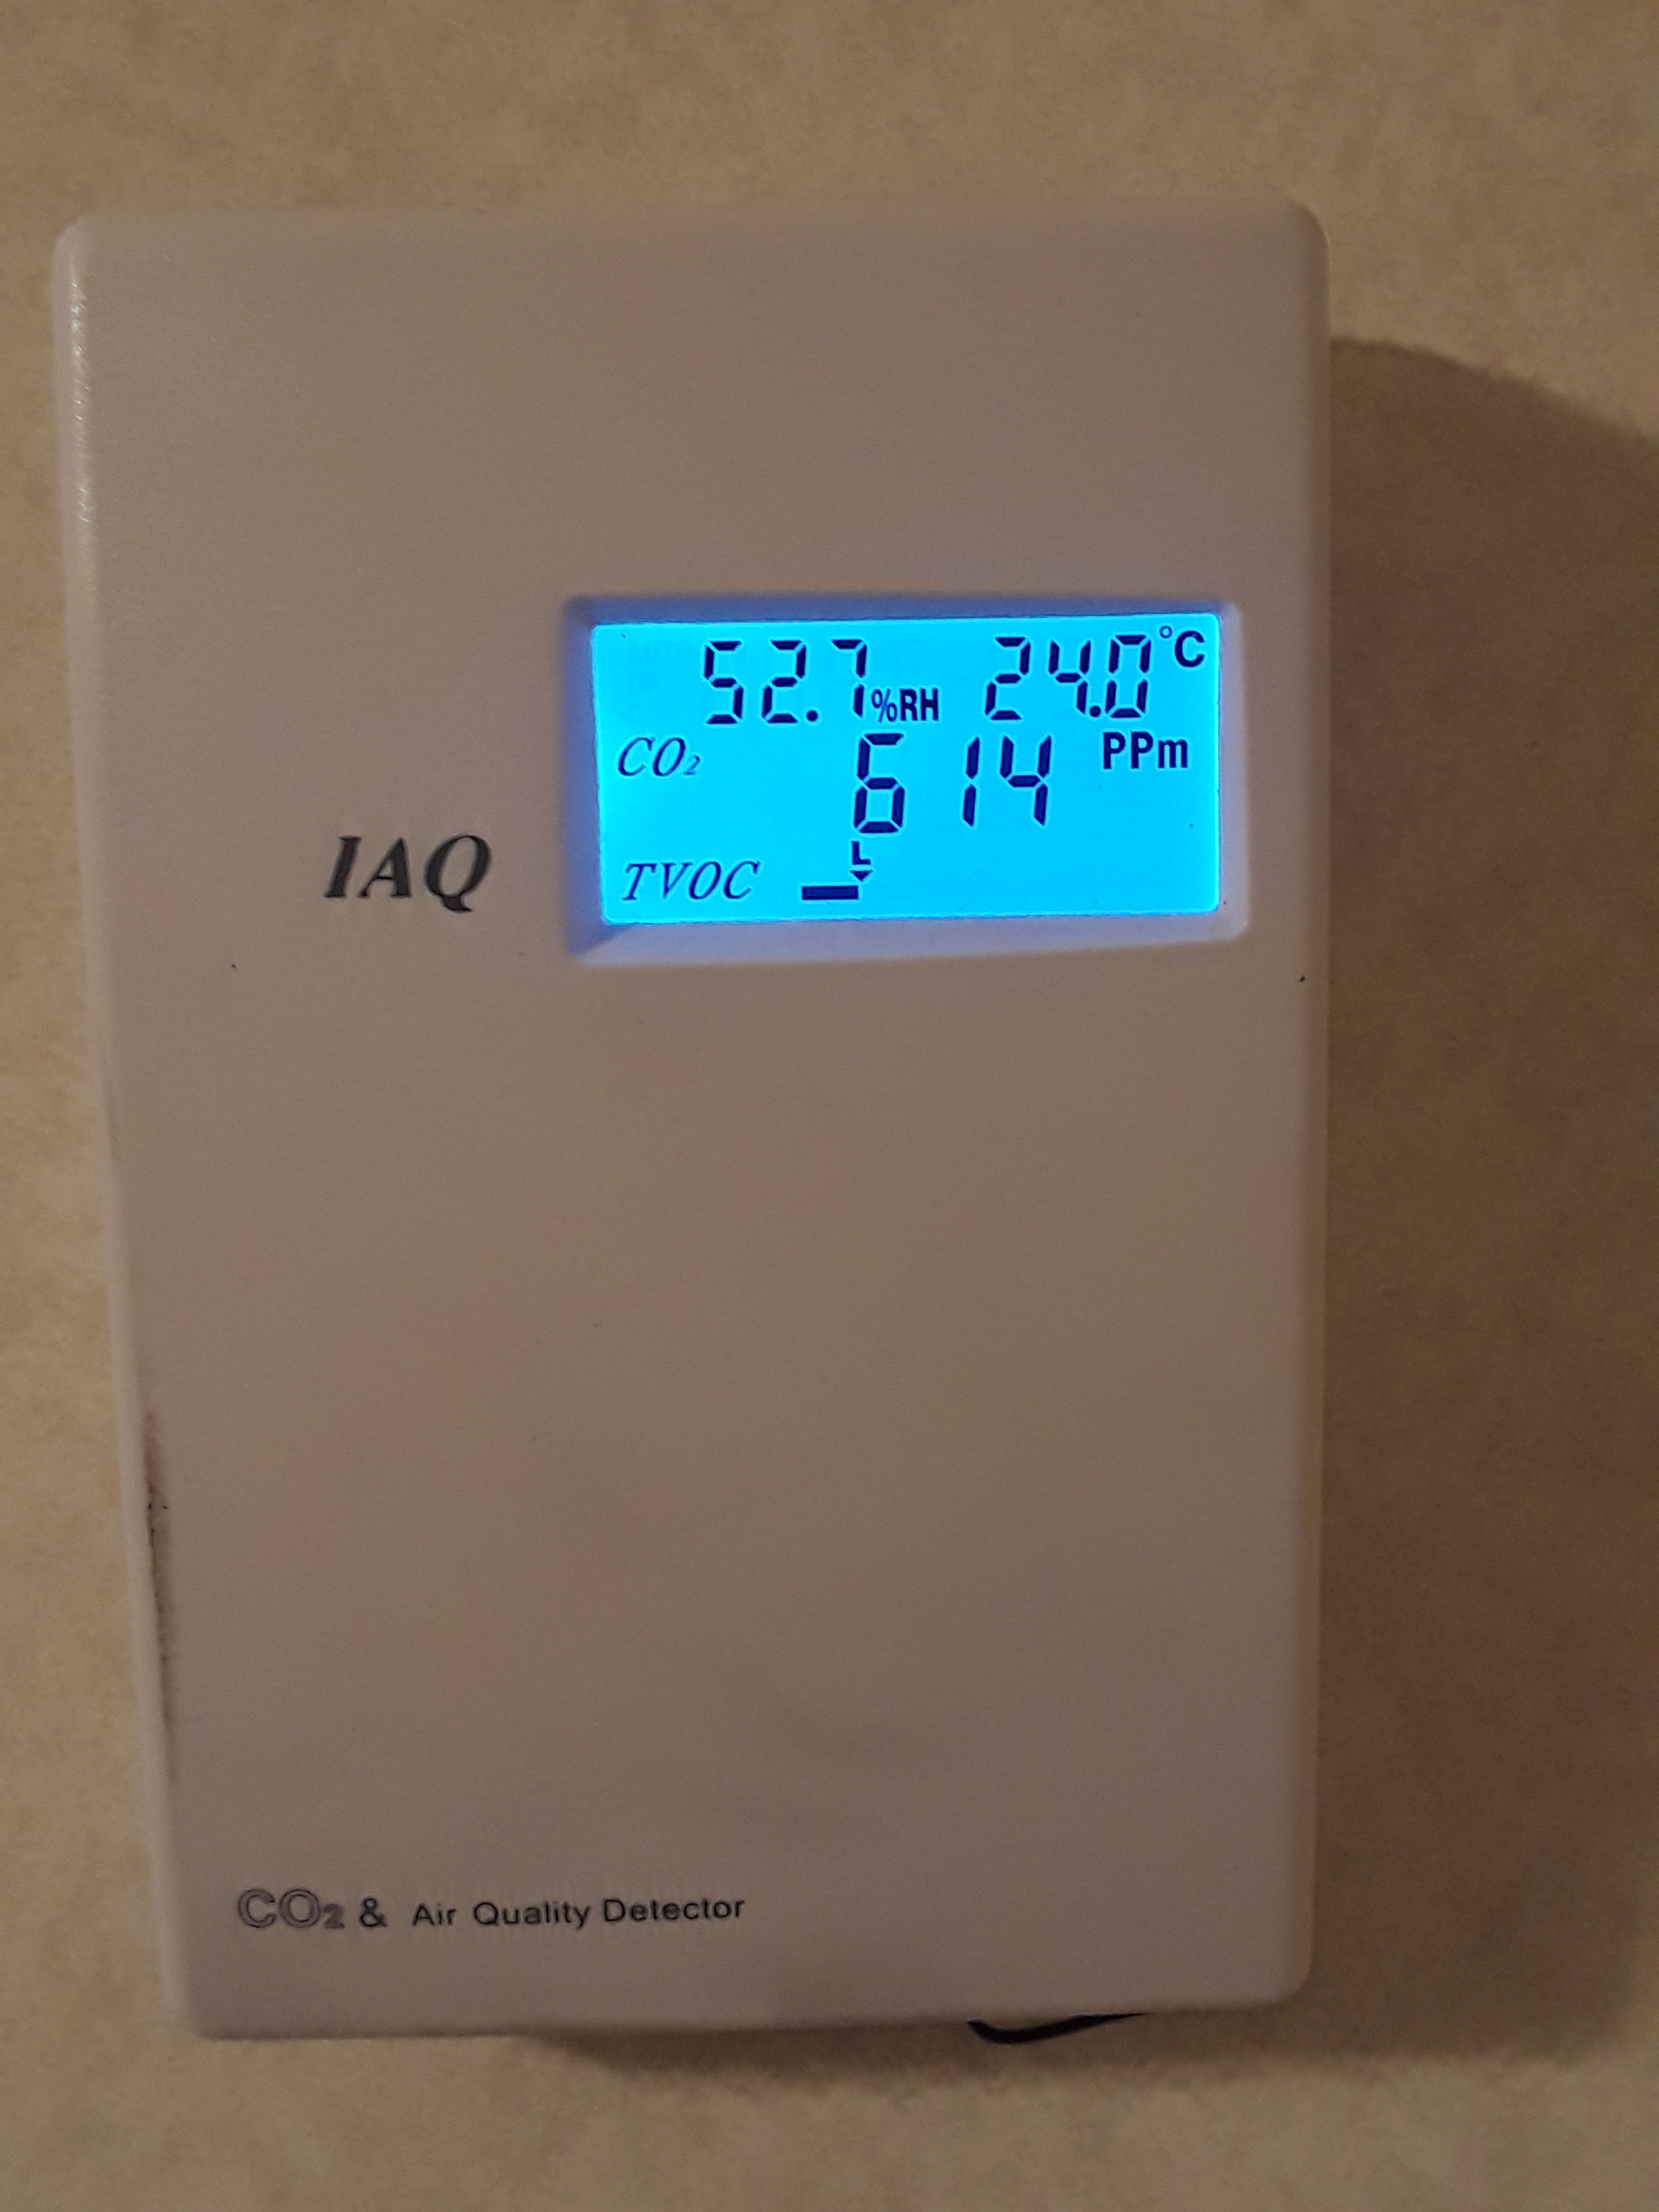
Idea #11 Control Ventilation by Electronic IAQ Controllers
Manual electronic adjustable ventilation rate
Adjustable by occupant
Automatically adjustable by Temperature / Humidity controller
Automatically adjustable by CO2 and/or IAQ controller to maintain ideal* 600 ppm CO2
* Harvard School of Public Health
Lawrence Berkeley National Laboratory

Slide 29

2019 International Radon Symposium Denver, Colorado

