Slide 1





By: Jan Compton, Office of External Affairs

Slide 2



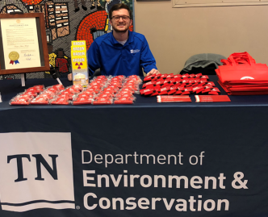

-
The Office of Policy and Sustainable Practices (OPSP) has managed the radon program since 2007.
The program is funded through a Federal grant- EPA State Indoor Radon Grant (SIRG).
The program is non-regulatory – it’s completely voluntary consisting primarily of education and outreach.
The only current state requirement is for disclosure of testing during real estate transactions.

Slide 3


The TN Radon Program began a fresh, innovative approach to outreach and partnerships in 2019 – 2020
There were three (3) primary components including:
  Teacher workshops
  Citizen science
  NRAM partnership

Slide 4

Teacher
Workshops
EPA Region 4 –
Chandler
Milhollin
Creative NRAM
Citizen Science
Training

Slide 5


Slide 6
Radon Teacher Workshop
Teacher
Workshops
Hosted the first teacher workshop in July, 2018, in Knoxville, TN
The primary goal was to educate teachers about radon while providing materials to assist teachers in developing curriculum – appropriate educational materials on radon for their classrooms.
The workshop helped our program build partnerships with certified radon professionals and Knoxville School leaders.
The original idea came from a teacher in Chattanooga, TN – Jim Watson.
Jim’s theory is that teachers respond best when away from their homes as they can better focus on learning.
Teachers earn CEUs and receive classroom materials for lesson plans.
The second workshop was held in July, 2019, in Knoxville, TN.

Slide 7
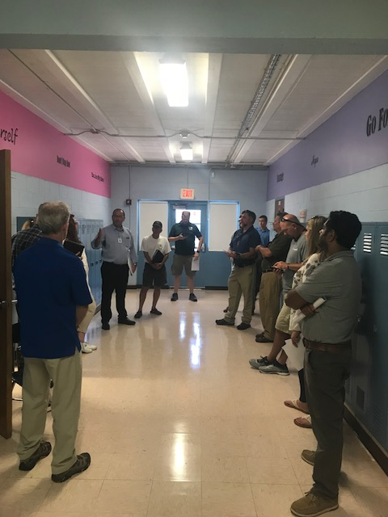
Radon Teacher Workshop
New Haven Elementary
Knoxville, TN

Slide 8
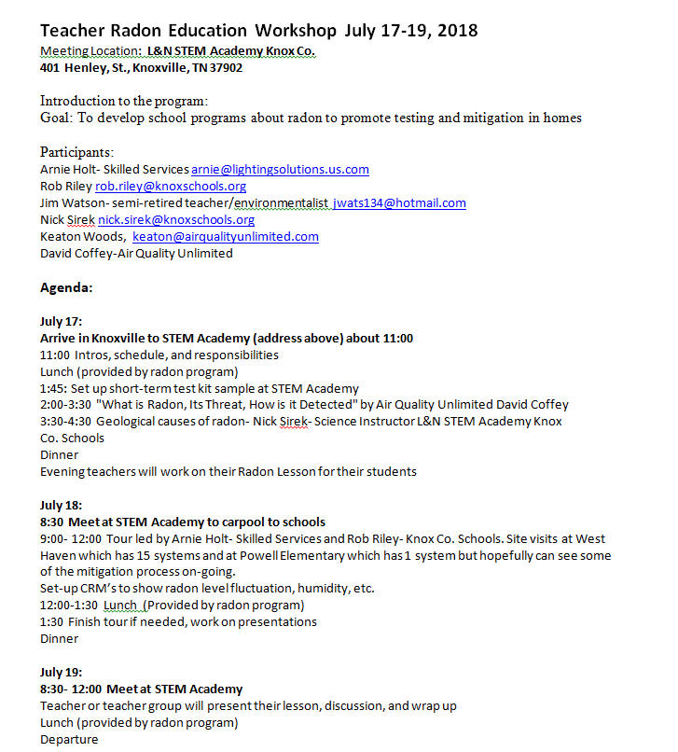
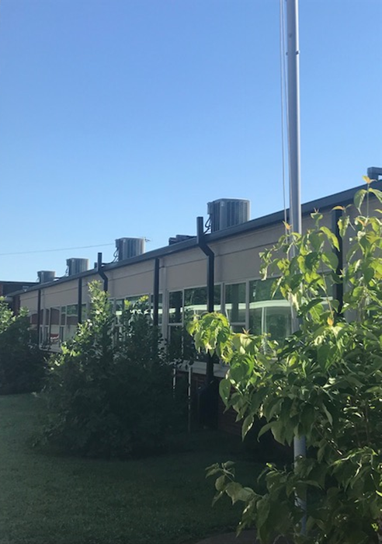
Radon Teacher Workshop
New Haven Elementary
Knoxville, TN

Slide 9
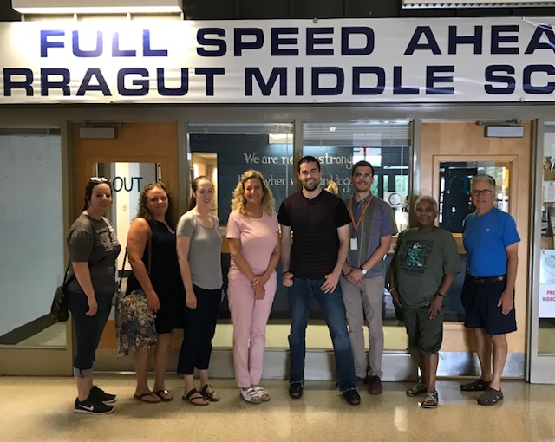
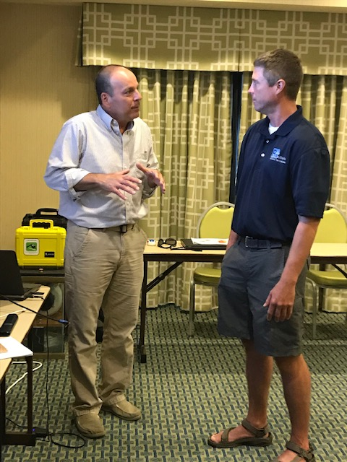
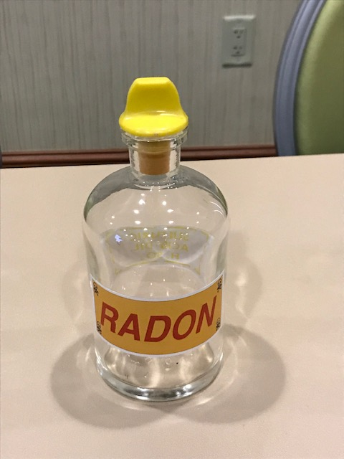
Radon Teacher Workshop
Farragut Middle School
Knoxville, TN

Slide 10
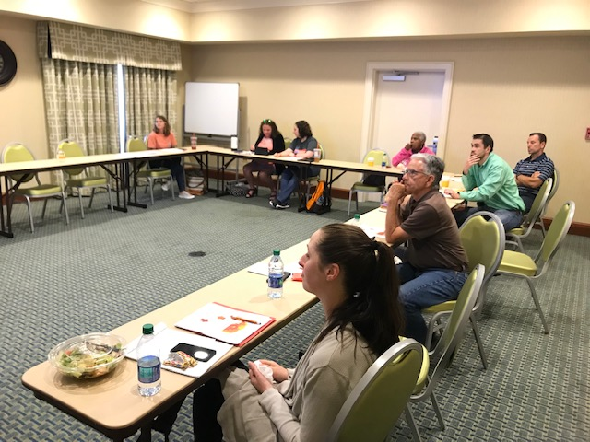
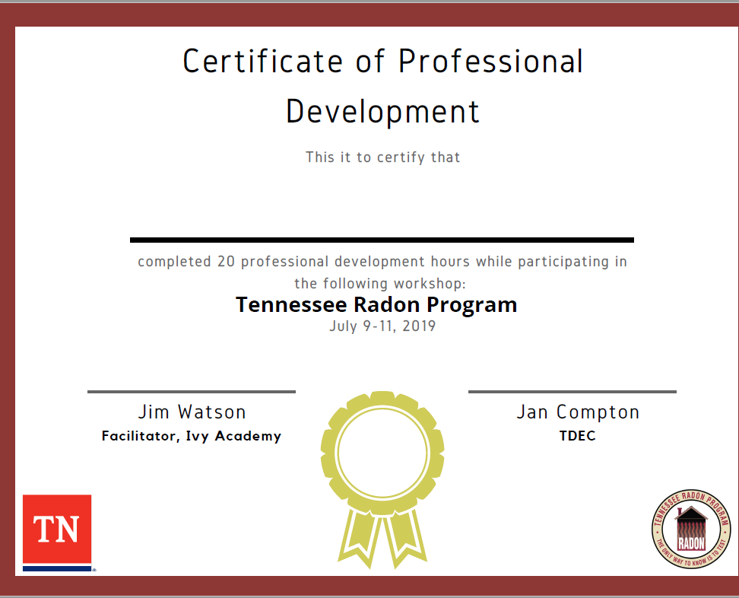
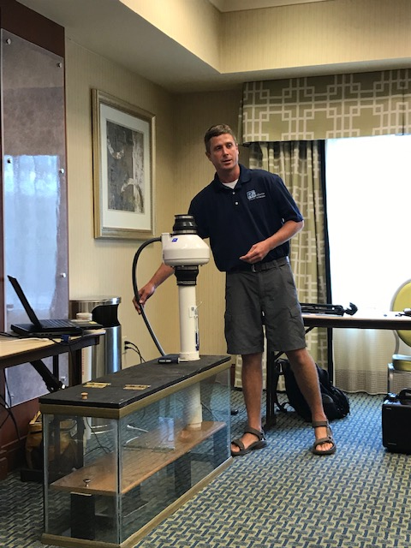
Radon Teacher Workshop

Slide 11
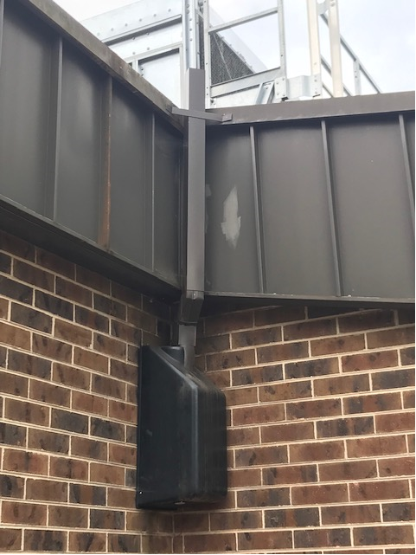
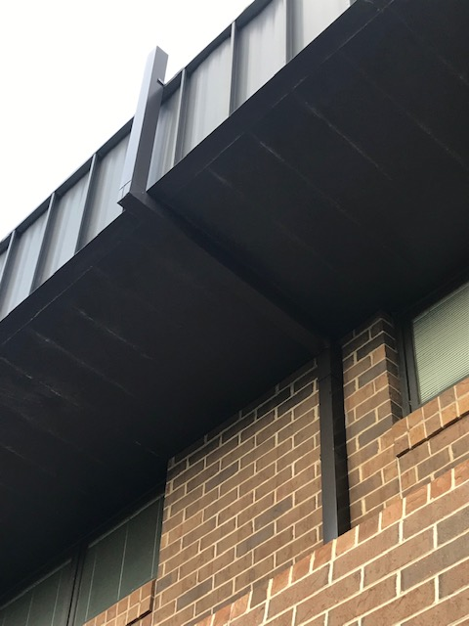
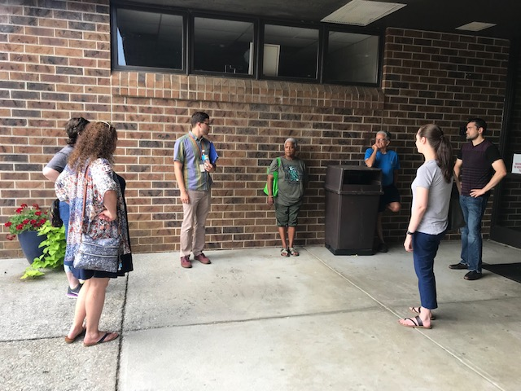
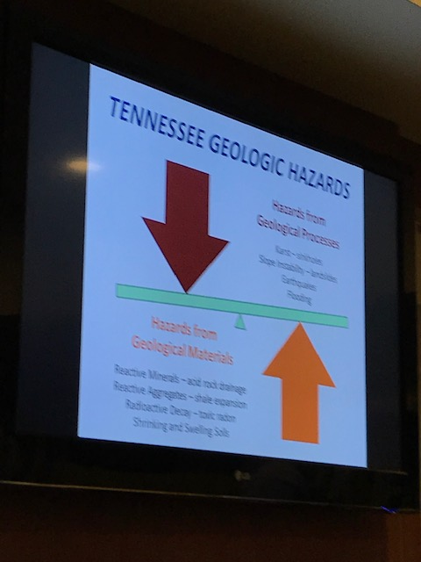
Radon Teacher Workshop

Slide 12
Radon Teacher Workshop
Teacher
Workshops
Other Workshop Outcomes:
The workshops help teachers develop classroom materials while promoting citizen science through parent and student participation when lesson plans are implemented.
The teachers build a network of contacts from other schools/regions who are also interested in environmental health factors.
At least one school system is looking at implementing testing in their district following the initial teacher workshop.
Efforts were focused on providing training for school personnel this year to accommodate anticipated interest.

Slide 13
Teacher
Workshops
EPA Region 4 –
Chandler
Milhollin
Creative NRAM
Citizen Science
Training

Slide 14


Citizen Science
Citizen science is the involvement of the public in scientific research. It mobilizes the public to participate in the scientific process to address problems.
Increasing radon testing through citizen science empowers citizens while increasing testing data points for mapping projects and decision- making processes.
It’s empowering for citizens to see their data published and promotes a lifetime learning experience.

Slide 15
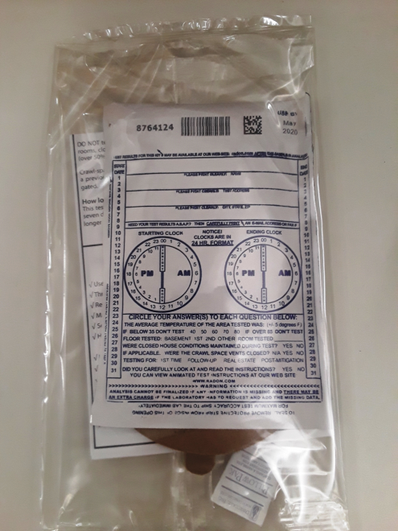
Ivy Academy student , Christian Spaide, decided to conduct radon testing of his school for his required senior project.
Ivy Academy is an environmental charter school in the Chattanooga region of Tennessee. They recently built a new addition to the school.
The TN Radon Program provided test kits (small school) for the project.
David Coffey is a certified professional who partnered to help Christian so the data obtained would be valid for large buildings.

Slide 16
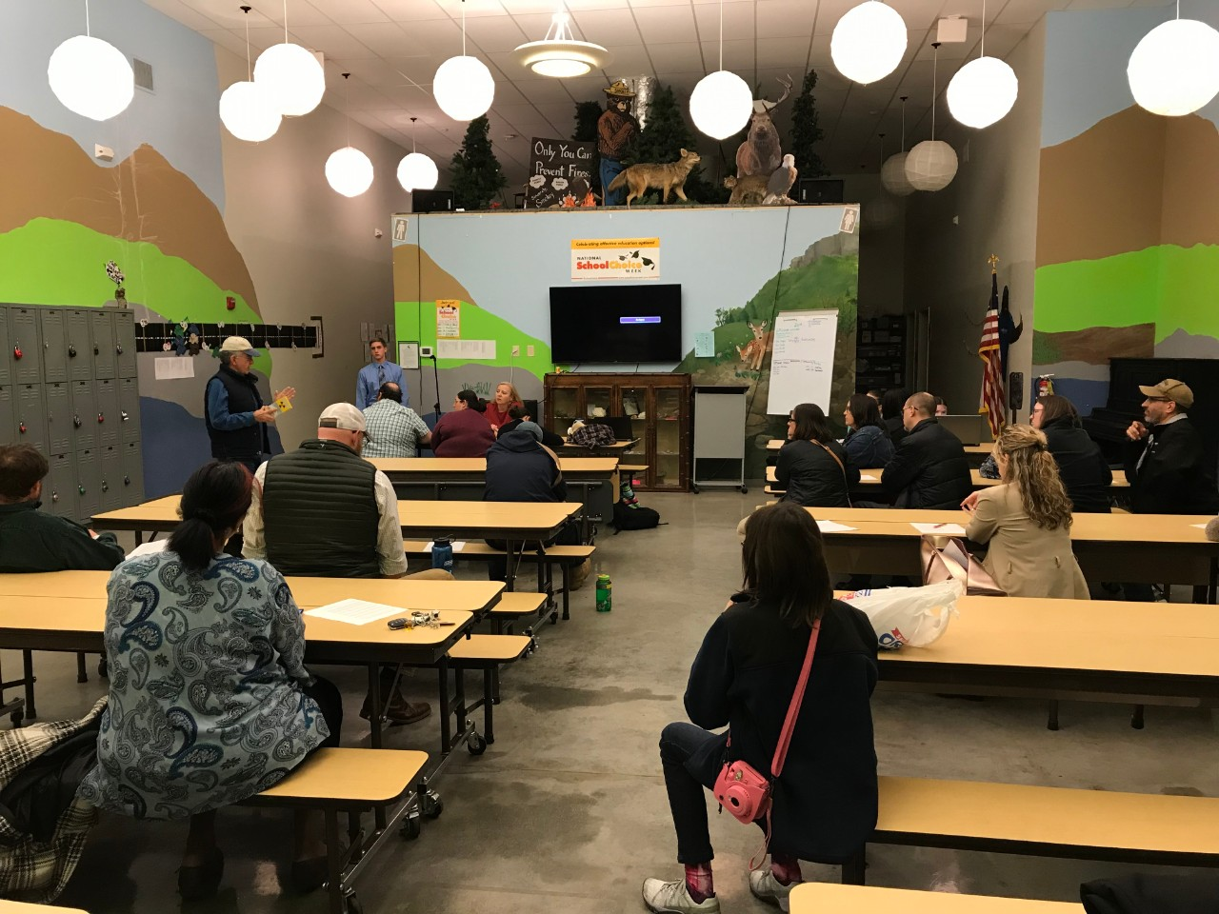
Citizen Science
Christian Spaide
presented his results
to PTA attendees.

Slide 17

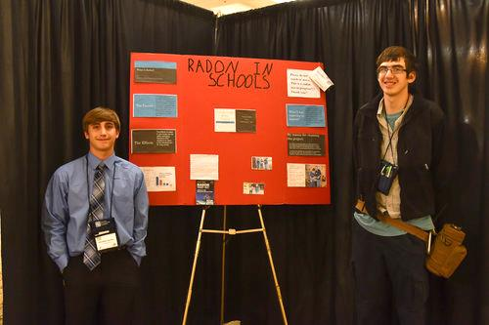
Citizen Science
Christian Spaide
presented his results
at the TN
Environmental
Conference – poster
session in March,
2019.

Slide 18
Teacher
Workshops
EPA Region 4 –
Chandler
Milhollin
Creative NRAM
Citizen Science
Training

Slide 19
Creative NRAM
Creative NRAM
OPSP worked with TDEC’s Communication team for a creative, new approach to NRAM in January, 2019.
We developed a partnership with health facilities and gyms across the state to promote radon testing as the new “resolution”.
The team developed a press release to engage our new audience.
Media across the state responded with increased and diverse coverage to promote our goals.
These activities resulted in record number of test kits distributed during the month of January and for the year.
In 2018, we distributed 3,546 test kits for the year while we had 5,345 requests in the one month of January, 2019!

Slide 20
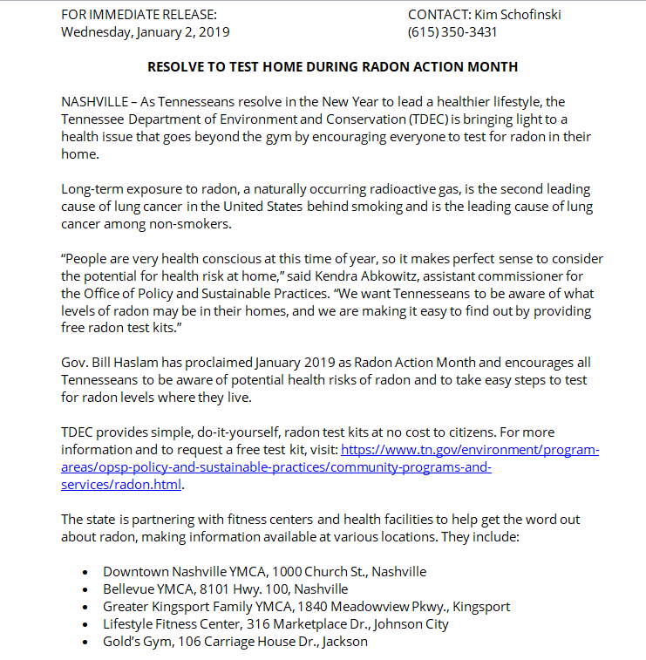
Creative NRAM
Creative NRAM

Slide 21
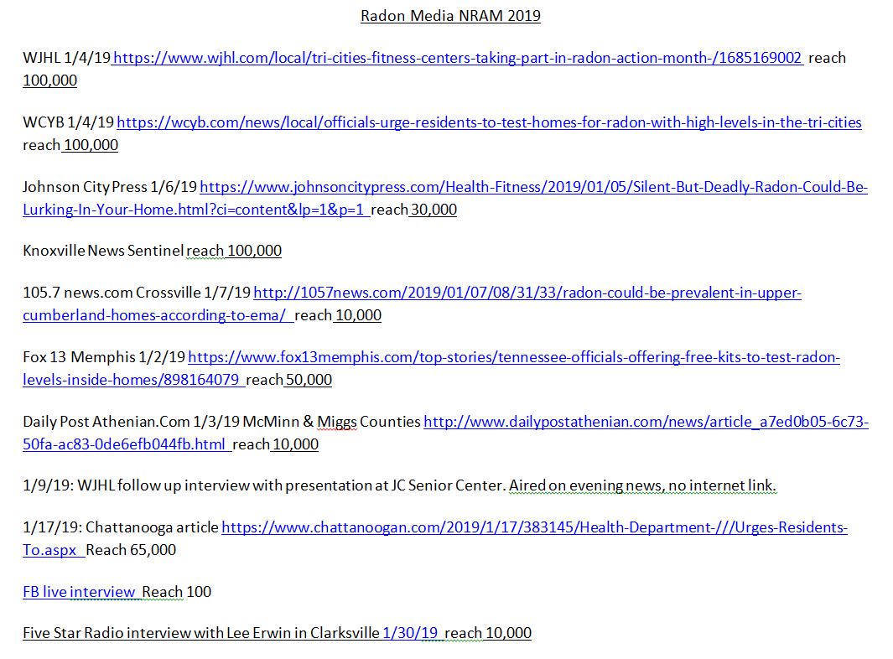
Creative NRAM
Creative NRAM

Slide 22

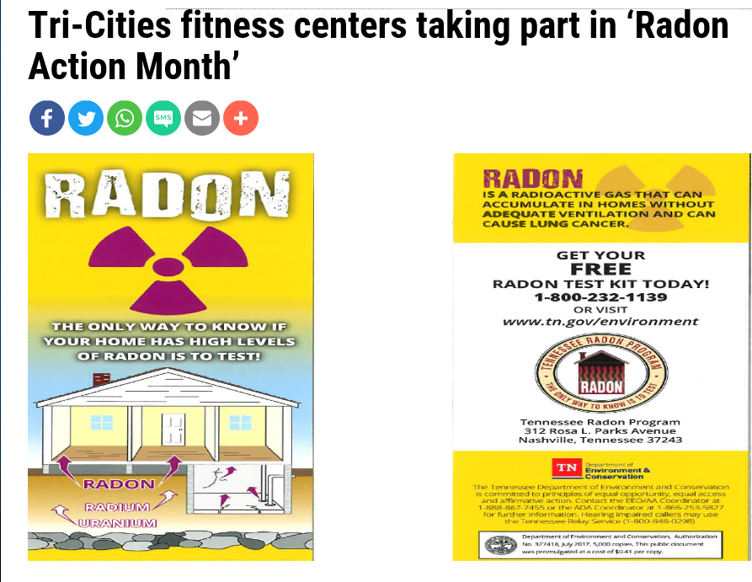
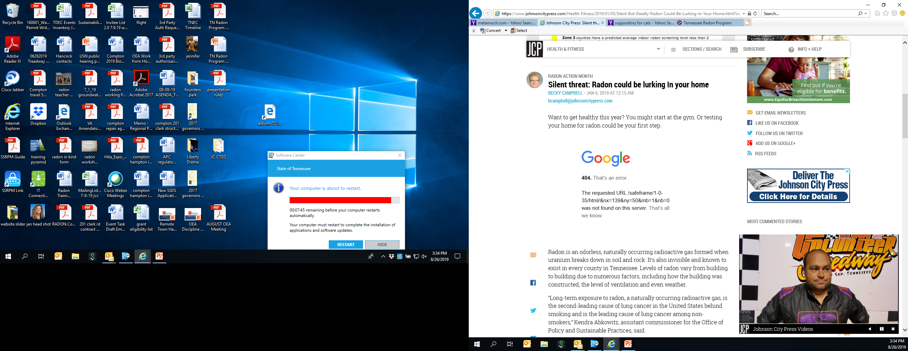

Creative NRAM
Creative NRAM

Slide 23
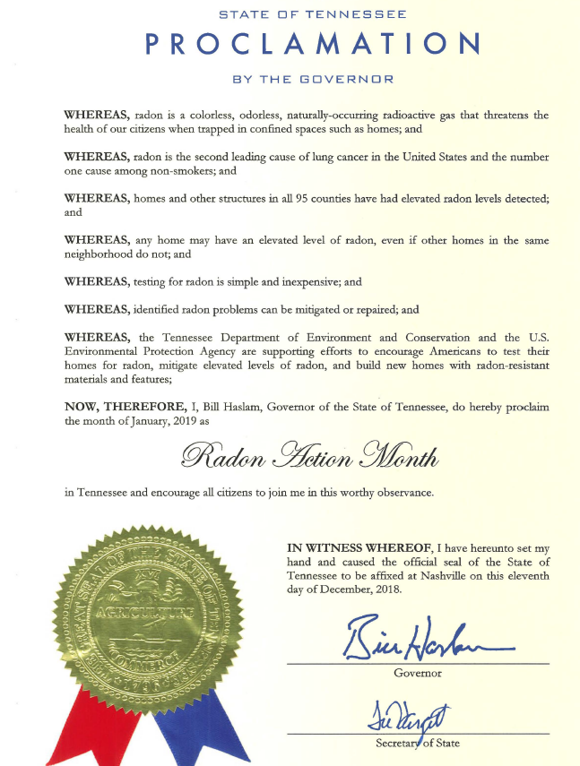
Creative NRAM
Creative NRAM

Slide 24
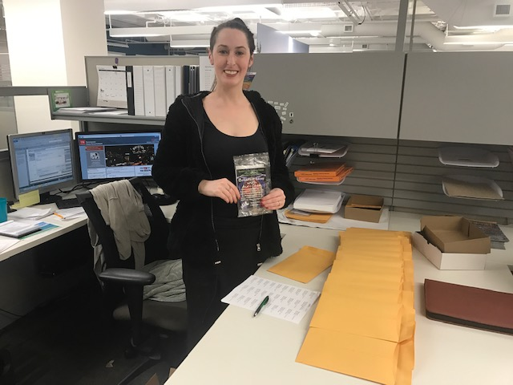
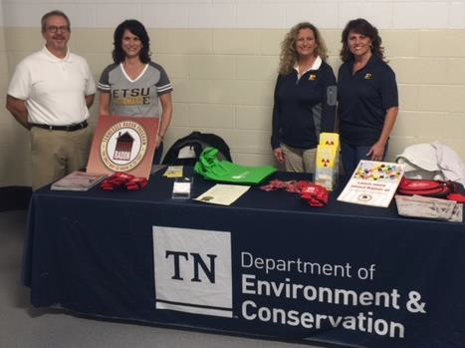
Creative NRAM
The TN Radon Program provides statewide coverage promoting radon testing and mitigation from Memphis to Johnson City.
Creative NRAM

Slide 25
TN Radon Program
Creative NRAM
Questions
Jan Compton
Office of External Affairs, Regional Director
Tennessee Department of Environment and Conservation
2305 Silverdale Dr.
Johnson City, TN 37601
423-854-5417
jan.compton@tn.gov

