Slide 1
The science behind your device
Jill Newton
Spruce Environmental Technologies
2019 International Radon Symposium Denver, Colorado

Slide 2
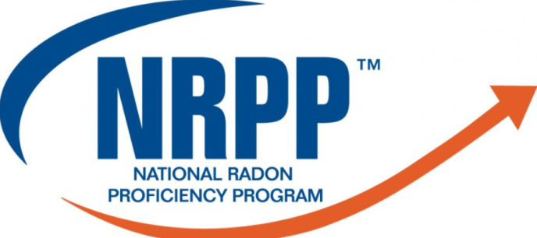

Device Listing
All listed devices chamber-tested
Must meet requirements in MS-PC
2019 International Radon Symposium Denver, Colorado

Slide 3
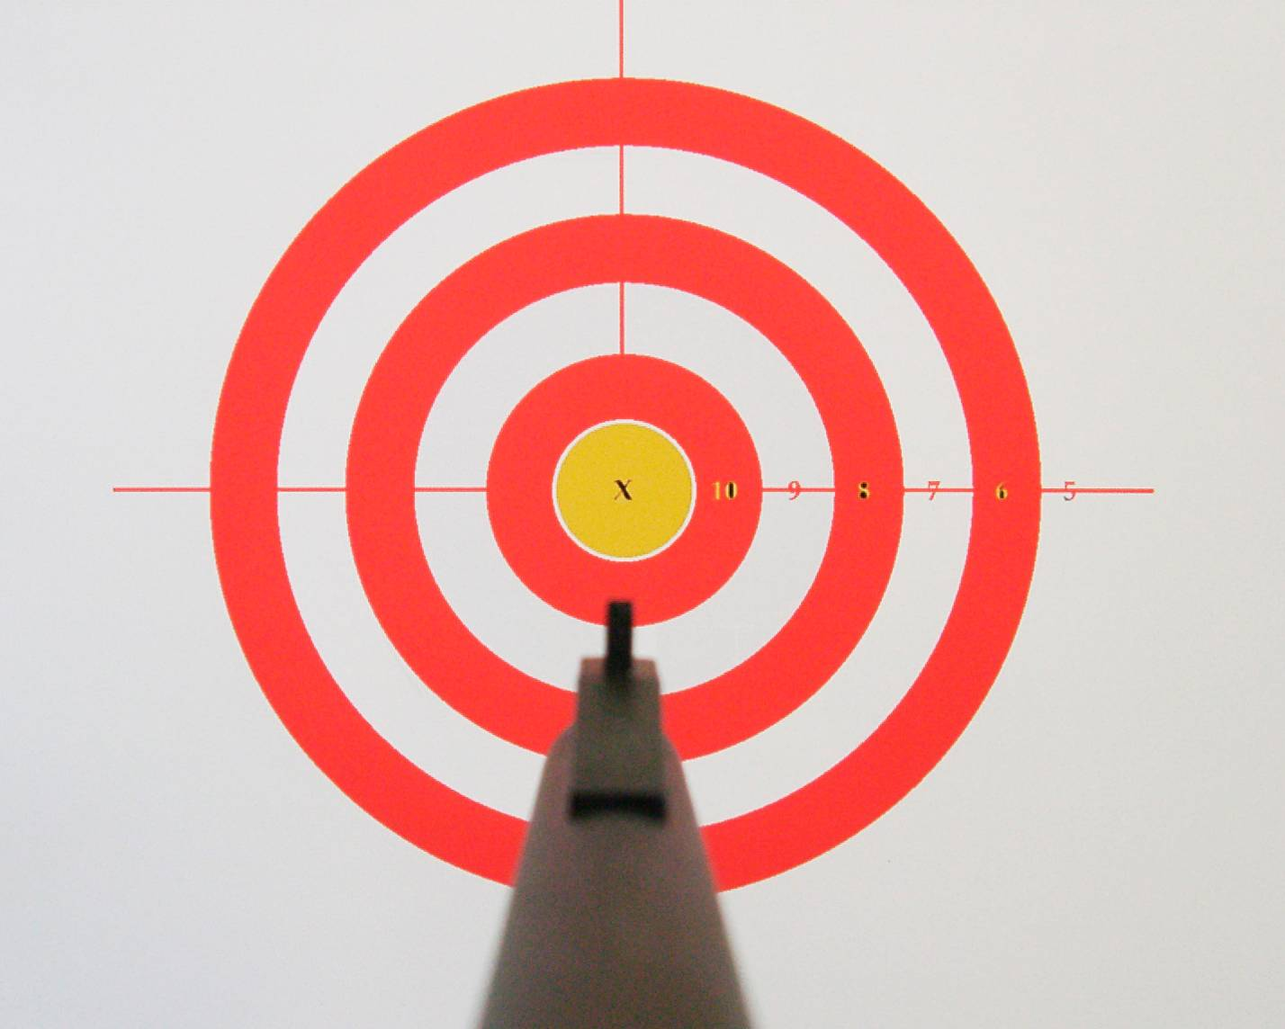
Accuracy = Precision and Bias
Poor precision
Poor bias
Good precision
Poor bias
Good precision is like having a good “group” of shots. That is, every-thing is consistent…but it can be off target.
Good bias is when the average of group is close to bullseye…but some hits may be off the mark
Poor precision
Good bias
Good precision
Good bias
X
Radon Level
2019 International Radon Symposium Denver, Colorado

Slide 4

Sensitivity
How many of the radon decay events are actually counted (and not other events)
The more data your device can collect, the more certain you can be it’s giving an answer you can use to make a mitigation decision
Device Sensor

Slide 5
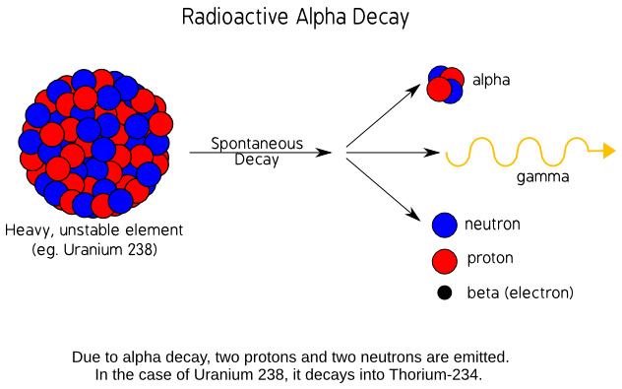
Radioactive Decay Reminder
Radon and decay products radioactively disintegrate
Emit radiation from nucleus
  Alpha α
  Beta β
  Gamma γ
Radon test devices count what these occurrences do
2019 International Radon Symposium Denver, Colorado

Slide 6
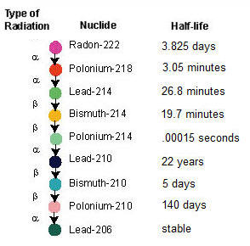
Radon Decay Reminder
α
Radon gas
α
α
β
β
α
β
β
α
γ
Solid decay products
2019 International Radon Symposium Denver, Colorado

Slide 7
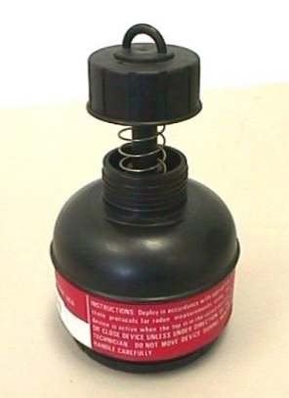
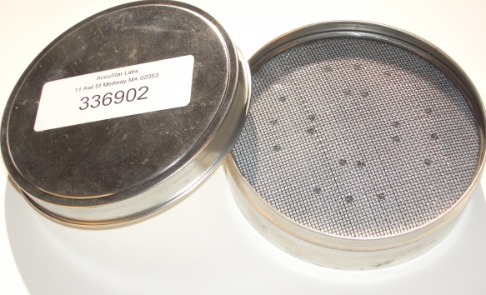
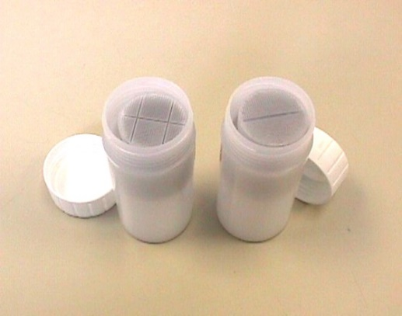
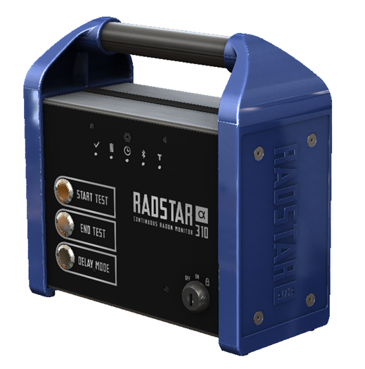
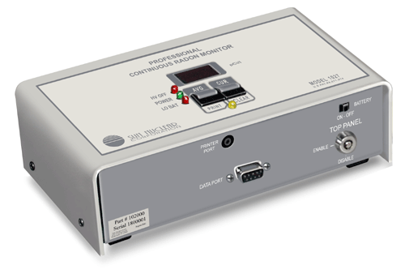
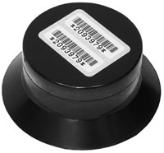
Common Radon Devices
Electret Ion Chambers
Charcoal Canisters
Liquid Scintillation
Continuous Monitors
Alpha Track

Slide 8
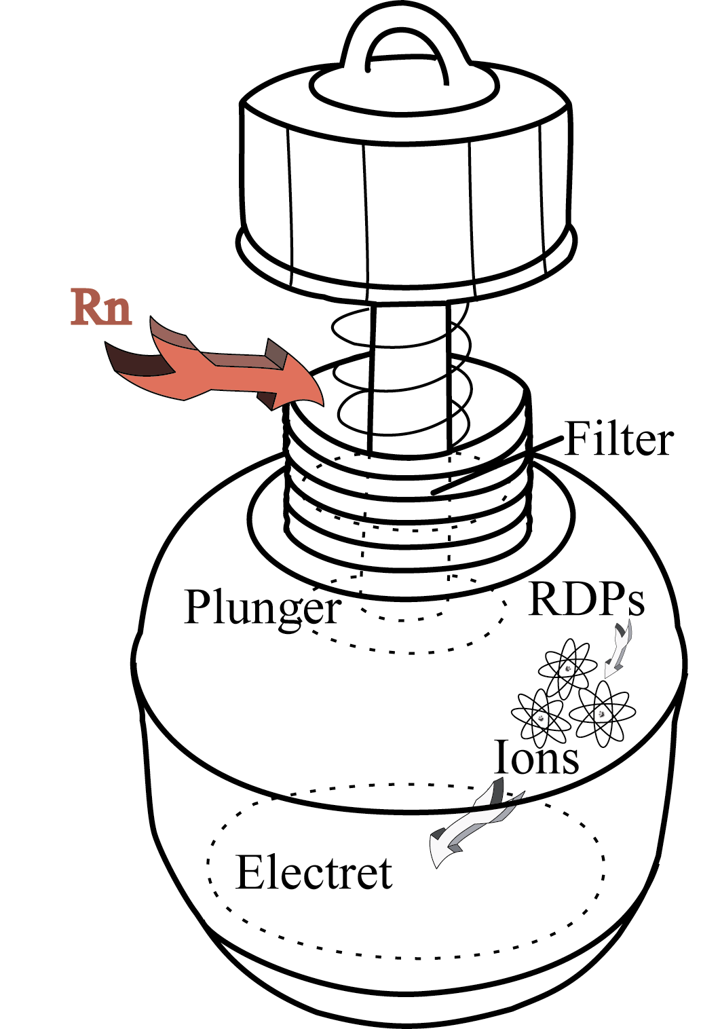
Electret Ion Chamber
2019 International Radon Symposium Denver, Colorado

Slide 9
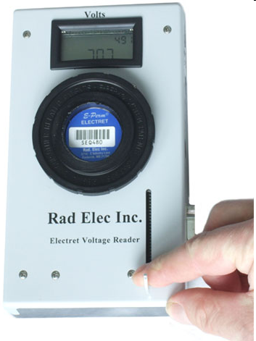

Reading Electrets
Specialized Teflon® plate electrostatically charged positive
Multiple configurations
+ + + + + +
2019 International Radon Symposium Denver, Colorado

Slide 10
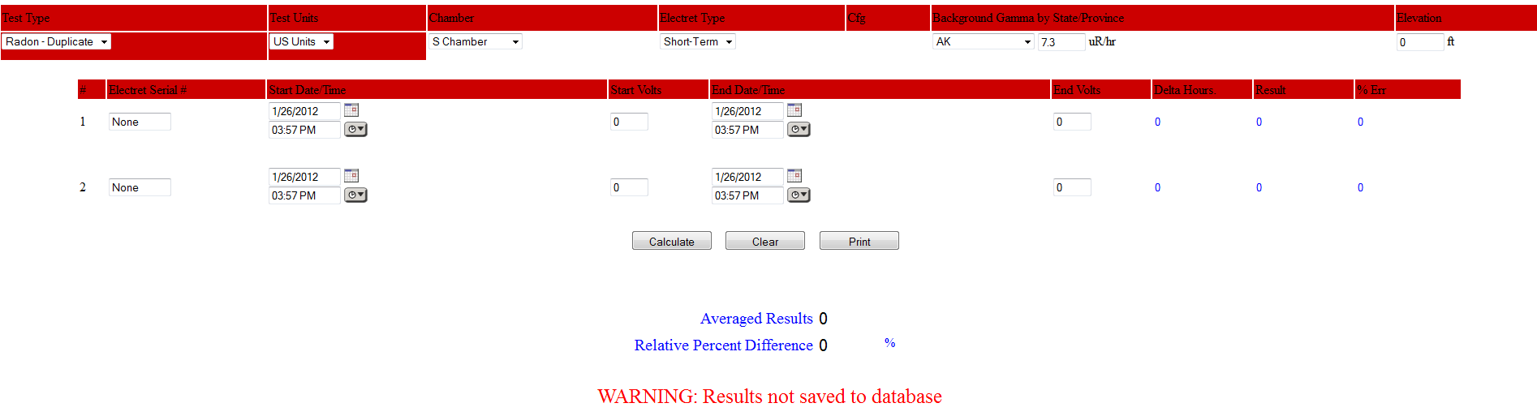
Calculate Radon Reading
2019 International Radon Symposium Denver, Colorado

Slide 11

Why Gamma Subtraction?
γ
2019 International Radon Symposium Denver, Colorado

Slide 12

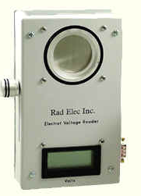
Device-Specific Cautions
γ
Dentist’s, doctor’s offices
Lab
Higher elevation
Sensitive to temperature & moisture
Leave in controlled setting
2019 International Radon Symposium Denver, Colorado

Slide 13


Device-Specific Cautions
Dust and fibers
Touch surface
2019 International Radon Symposium Denver, Colorado

Slide 14

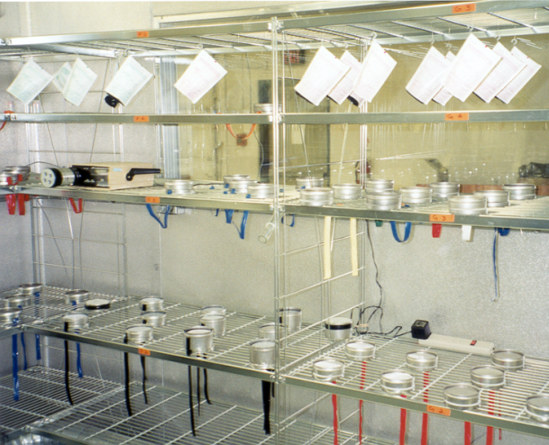

QA/QC Requirements
10% duplicates
5% blanks
3% spikes
2019 International Radon Symposium Denver, Colorado

Slide 15
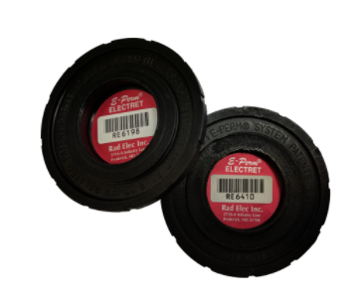
QA/QC (Continued)
Routine instrument checks
What does the manufacturer tell you to do?
Annual Calibration
Reference Electrets
2019 International Radon Symposium Denver, Colorado

Slide 16
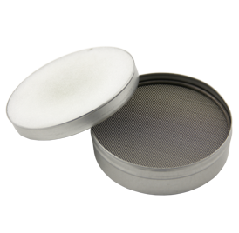
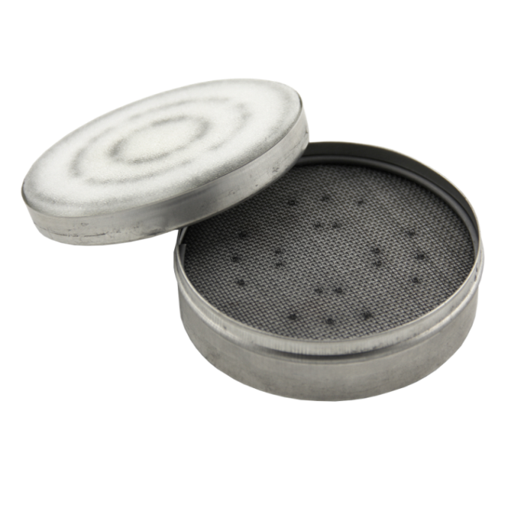
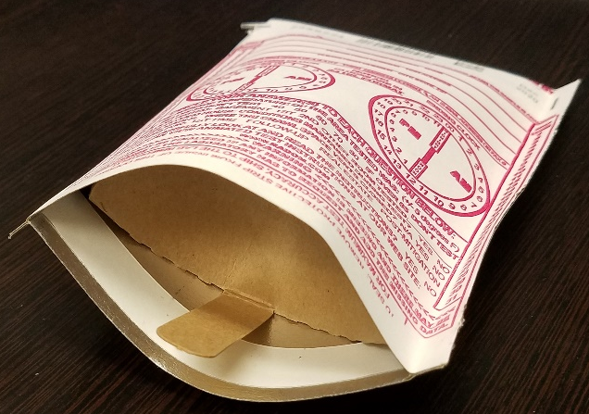
Charcoal Devices
Open face
Test kit
Diffusion barrier
2019 International Radon Symposium Denver, Colorado

Slide 17

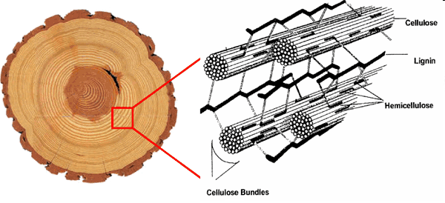
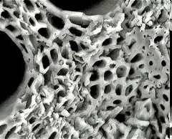
The Nature of Charcoal
Water
Structure of growing woody materials
Structure of Growing Woody Materials
Charcoal Structure
Charcoal Structure
2019 International Radon Symposium Denver, Colorado

Slide 18
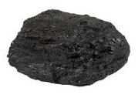
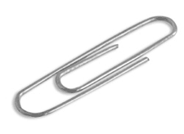
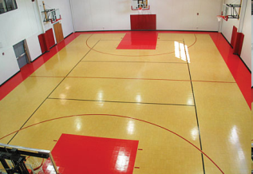
Activating Charcoal
Treated with heat and pressurized steam, oxygen, or other gas or with acids, bases or salts
Further opens pores gives greater surface area
=
=
One gram of charcoal
Weight of 1 Paperclip
Area of 1-3 basketball courts
2019 International Radon Symposium Denver, Colorado

Slide 19
Charcoal Sampling
Radon diffuses into tiny charcoal pores
Some radon will decay inside pores
Decay products ADsorb (i.e., stick to) onto the carbon surface (decay products electrostatically charged and slightly chemically reactive)
2019 International Radon Symposium Denver, Colorado

Slide 20
Humidity & Charcoal Caution
If water molecules block or fill the holes in the charcoal, the radon cannot diffuse into that space.
The more water vapor in the charcoal, the fewer holes there are for radon to get into and the fewer decay products that are left behind in the charcoal.
H₂O
H₂O
2019 International Radon Symposium Denver, Colorado

Slide 21

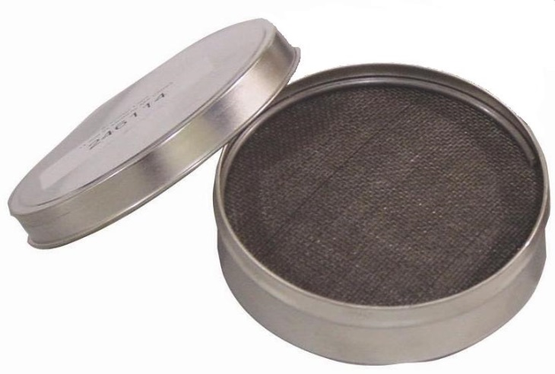
Device-Specific Cautions: Charcoal
Diffusion barrier
5 - 7 days
Open face
2 - 3 days
2019 International Radon Symposium Denver, Colorado

Slide 22
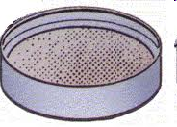
Heat & Charcoal
Radiator
Hot water heater
Electronic equipment
Sunshine
2019 International Radon Symposium Denver, Colorado

Slide 23
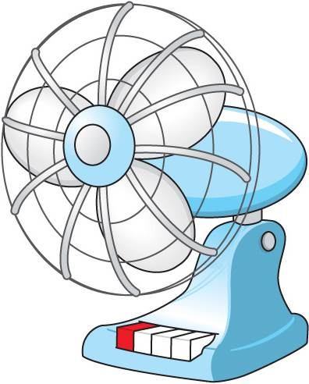
Air & Charcoal
Fan
Dehumidifier exhaust
HVAC vent
2019 International Radon Symposium Denver, Colorado

Slide 24
Charcoal Bias
Because of diffusion, adsorption and desorption, charcoal canisters may be slightly biased to the last 12 to 24 hours of the test period.
2019 International Radon Symposium Denver, Colorado

Slide 25
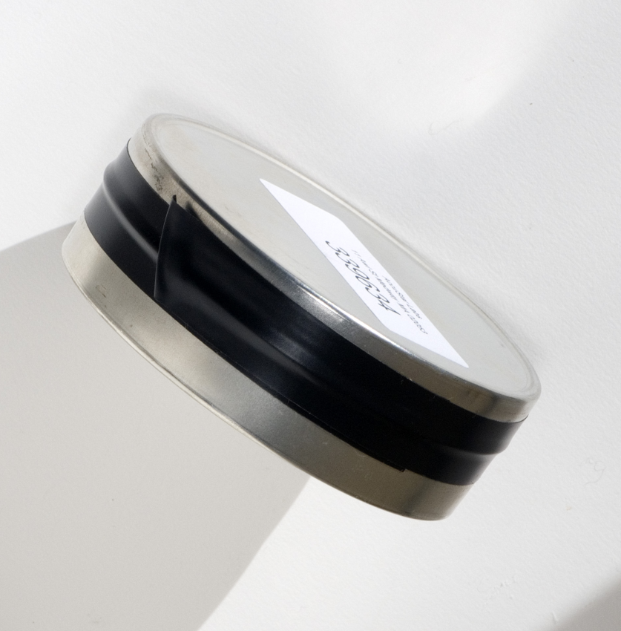
Tape Cautions
Securely replace tape after deployment
Use only tape lab has supplied
2019 International Radon Symposium Denver, Colorado

Slide 26
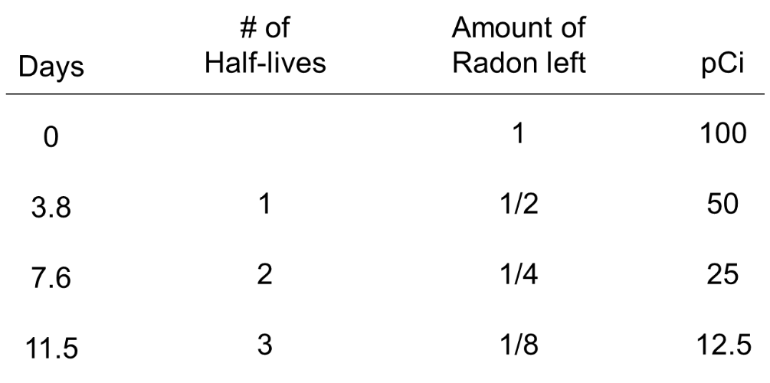
Shipping Charcoal Cautions
Return to lab immediately
Radioactive decay continues after device is retrieved
2019 International Radon Symposium Denver, Colorado

Slide 27
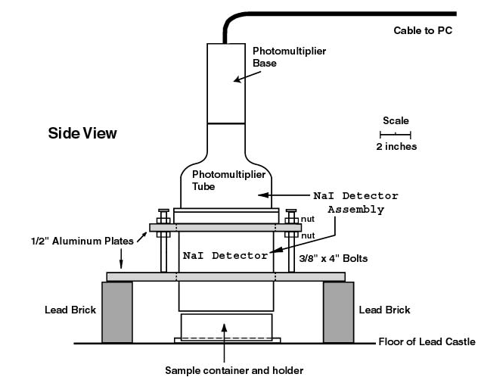
Lab Analysis
Gamma radiation from decay products
2019 International Radon Symposium Denver, Colorado

Slide 28
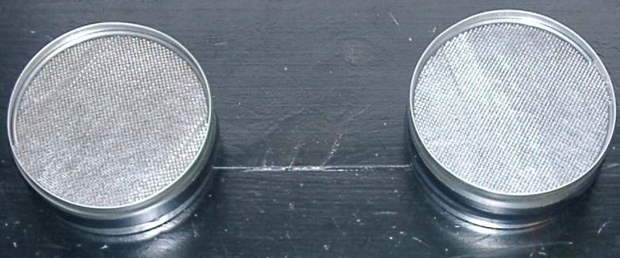
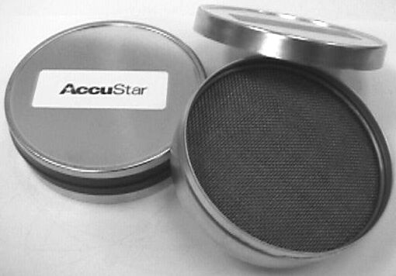

Charcoal QA/QC Requirements
10% duplicates
5% blanks
3% spikes
2019 International Radon Symposium Denver, Colorado

Slide 29
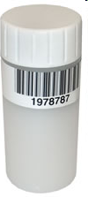
Liquid Scintillation
Sample as charcoal
Cautions same as charcoal canisters
Testing period 2-4 days
2019 International Radon Symposium Denver, Colorado

Slide 30
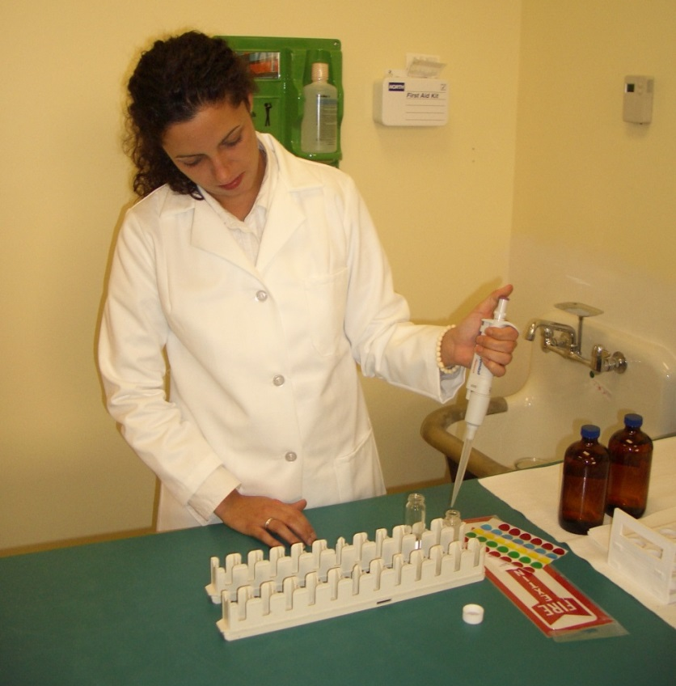
Lab Analysis
Liquid scintillant added to charcoal
Decay products DEsorb into liquid
2019 International Radon Symposium Denver, Colorado

Slide 31
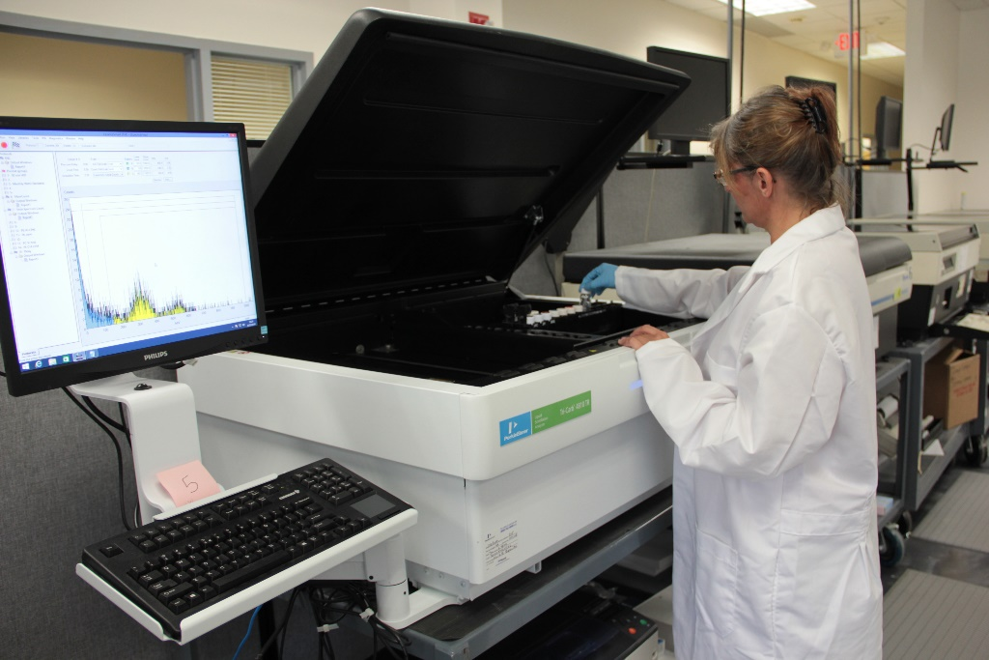
Lab Analysis (Continued)
Radioactive decay causes liquid to emit light pulses
Photomultiplier detects pulses
2019 International Radon Symposium Denver, Colorado

Slide 32
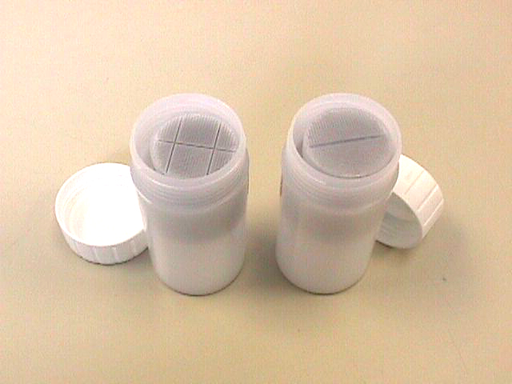
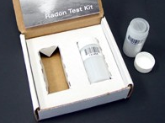

LS QA/QC
10% duplicates
5% blanks
3% spikes
2019 International Radon Symposium Denver, Colorado

Slide 33
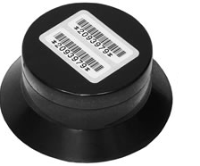
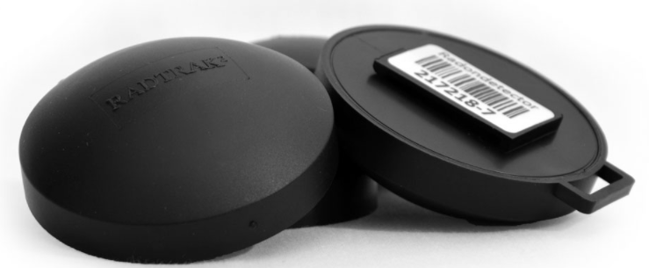
Alpha Tracks
2019 International Radon Symposium Denver, Colorado

Slide 34
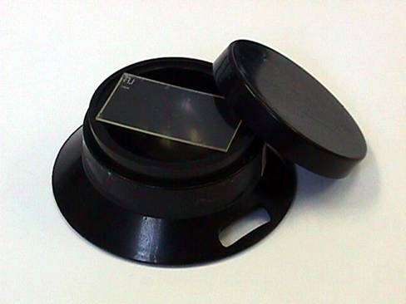
Coated Plastic
Plastic coated strip
2019 International Radon Symposium Denver, Colorado

Slide 35
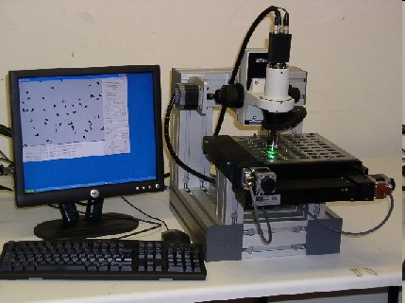
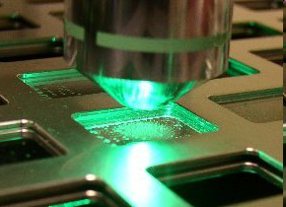
Lab Analysis
Track Analysis Systems
2019 International Radon Symposium Denver, Colorado

Slide 36
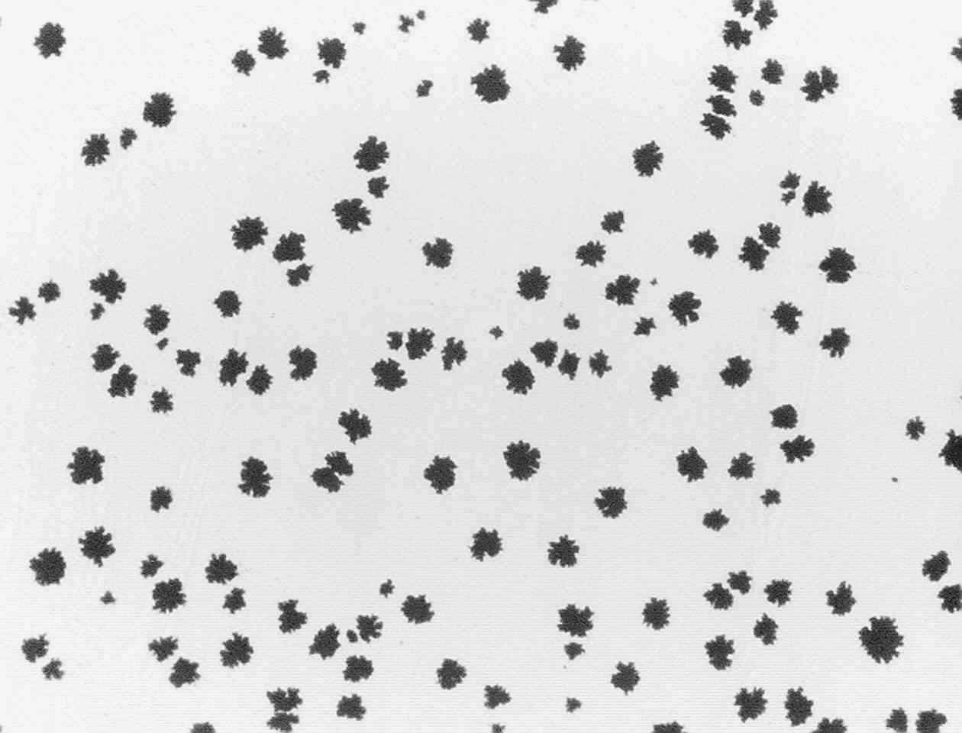
Tracks of Alpha Particles
Slide soaked in caustic solution to enlarge damage marks on film
Plastic coating pocked by alpha particles
2019 International Radon Symposium Denver, Colorado

Slide 37
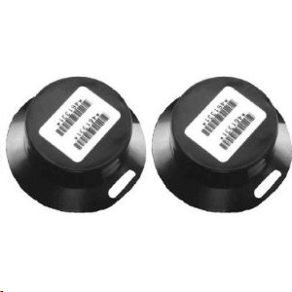
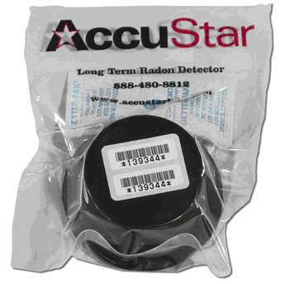

Alpha Track QA/QC
10% duplicates
3% spikes
5% blanks
2019 International Radon Symposium Denver, Colorado

Slide 38
Device- Specific Cautions
Long term
91 days to 1 year
2019 International Radon Symposium Denver, Colorado

Slide 39

You and Your Lab
Their End
  Rigorous QC
  Licensing & affiliations
  User friendly interfaces
  Timely turnaround
  Responsiveness
  Help
Your End
  Accurate chain of custody
  Complete chain of custody
  Timely and complete QC
  Following instructions
  Thorough record-keeping
2019 International Radon Symposium Denver, Colorado

Slide 40
Chain of Custody

Slide 41
Chain of Custody

Slide 42
Chain of Custody

Slide 43
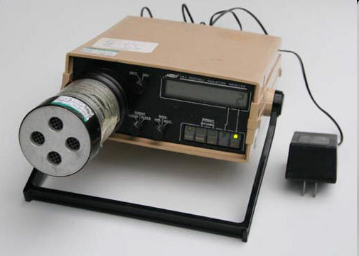
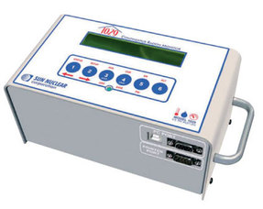
Continuous Radon Monitors
WPB Radon Testing Bethlehem, PA
Alpha scintillation
Pulsed ion
Solid state silicon
2019 International Radon Symposium Denver, Colorado

Slide 44
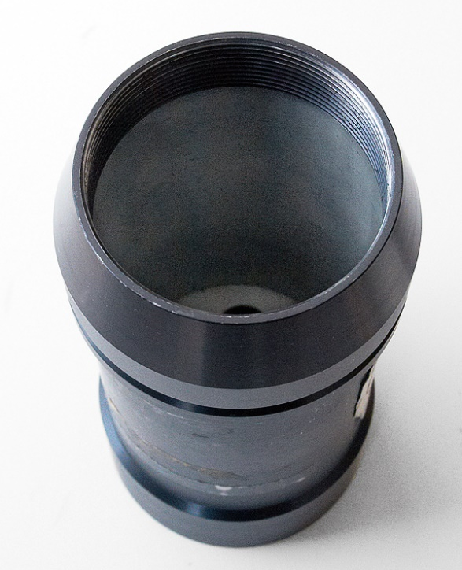
Zinc Sulfide- Lined Chamber
WPB Radon Testing Bethlehem, PA
Alpha scintillation
Cell lined with zinc sulfide
2019 International Radon Symposium Denver, Colorado

Slide 45
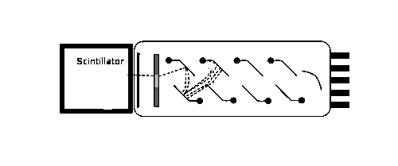
Pulses of Light
Scintillation cell
Zinc Sulfide
Radon nucleus
2019 International Radon Symposium Denver, Colorado

Slide 46
Continuous
Radon Monitor: Pulsed Ion Chamber
Positive
+
Electrometer counter
−
Negative
2019 International Radon Symposium Denver, Colorado

Slide 47
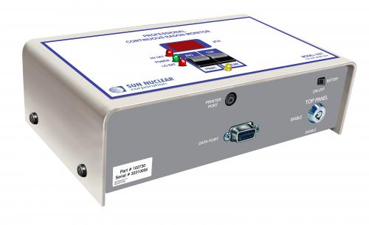
Continuous
Radon Monitor: Solid State Silicon Detector
Electrical
Pulse Counter
Silicon
Chip
2019 International Radon Symposium Denver, Colorado

Slide 48

Bells & Whistles
Temperature
Humidity
Barometric pressure
Tamper (movement)
AC Interrupt
2019 International Radon Symposium Denver, Colorado

Slide 49

Getting Results
Femtotech
Radon Level
Temperature
Hours
Barometric Pressure
Motion
Humidity
2019 International Radon Symposium Denver, Colorado

Slide 50

Results
2019 International Radon Symposium Denver, Colorado

Slide 51


CRM QA/QC
Self Check 10% Duplicates Annual Calibration
Cross Checks
2019 International Radon Symposium Denver, Colorado

Slide 52



Homeowner Devices
2019 International Radon Symposium Denver, Colorado

Slide 53
Strengths & Cautions
Measurement time period
Humidity, temperature, air movement
Sensitivity
Cost
Analysis – background subtractions & correction factors
2019 International Radon Symposium Denver, Colorado

Slide 54
What’s in Your Files?
Quality control measures
  Duplicates
  Field blanks
  Spikes
  Source checks
  Cross checks
  Background checks
  Routine instrument checks
  Calibration
Calculations
Control charts
2019 International Radon Symposium Denver, Colorado

Slide 55
Questions?
Jill Newton
jnewton@spruce.com
2019 International Radon Symposium Denver, Colorado

