Slide 1
THE NEW OSHA SILICA RULE
What You Need to Know
Copyright 2017 Spruce Environmental Technologies, Inc.

Slide 2
Where To?
What is Silica?
What is the new PEL (Permissible Exposure Limit)?
How does this affect me?
What can I do to limit my employees exposure?

Slide 3
What is Silica?
What are the dangers?

Slide 4
What is Crystalline Silica?
Crystalline silica is a common mineral found in many naturally occurring materials and used in many industrial products and at construction sites. Materials like sand, concrete, stone and mortar contain crystalline silica.

Slide 5
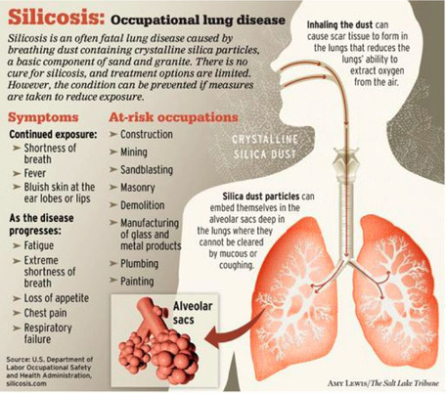
Silica Health Effects
Inhaling very small (“respirable”) crystalline silica particles, causes multiple diseases, including silicosis, an incurable lung disease that can lead to disability and death. Respirable crystalline silica also causes lung cancer, chronic obstructive pulmonary disease (COPD), and kidney disease

Slide 6
Silica and Lung Cancer?
WHO & National Institutes of Health’s National Toxicology Program have conducted extensive reviews of the scientific literature and have designated crystalline silica as a known human carcinogen.

Slide 7
Silica Exposures
At worksites without dust controls for these tools, studies have found that employee silica exposures can be as high as 20 times the Occupational Safety and Health Administration’s (OSHA) benchmark of 0.1 mg/m3 (milligrams per cubic meter of air) as an 8-hour time-weighted average (TWA), an exposure approximately equivalent to OSHA’s general industry permissible exposure limit (PEL) (OSHA Case Files). 1 Short-term exposures can be even higher.

Slide 8
The PEL Silica Standard

Slide 9
What is the New Permissible Exposure Limit (PEL)?
The PEL limits worker exposures to 50 micrograms of respirable crystalline silica per cubic meter of air (μg/m3 ), averaged over an eight-hour day
Roughly 20 percent of the original PEL

Slide 10
When Does Compliance Take Place?

Slide 11
When…
Construction employers were required to comply with all requirements of the standard by June 23rd, 2017, except requirements for laboratory evaluation of exposure samples, which begin on June 23, 2018.
Enforcement began on September 23rd 2017.

Slide 12
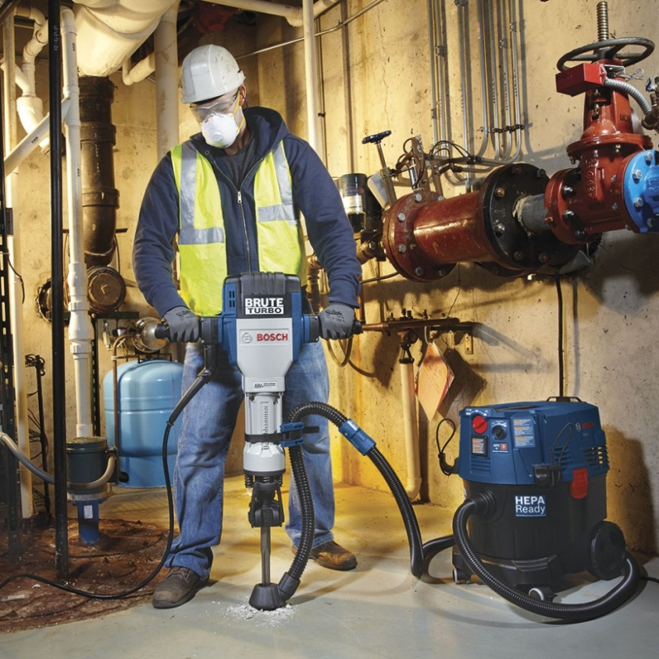
What Does the Standard Require?
The standard requires employers to limit worker exposures to respirable crystalline silica and to take other steps to protect workers.

Slide 13
Employers Requirements
All construction employers covered by the standard are required to:
Establish and implement a written exposure control plan that identifies tasks that involve exposure and methods used to protect workers, including procedures to restrict access to work areas where high exposures may occur.

Slide 14
Requirements (Cont.)
Designate a competent person to implement the written exposure control plan.

Slide 15
Requirements (Cont.)
Restrict housekeeping practices that expose workers to silica where feasible alternatives are available.

Slide 16
Requirements (Cont.)
Offer medical exams—including chest X-rays and lung function tests—every three years for workers who are required by the standard to wear a respirator for 30 or more days per year.

Slide 17
Requirements (Cont.)
Train workers on work operations that result in silica exposure and ways to limit exposure.

Slide 18
Required Cont.
Keep records of workers’ silica exposure and medical exams.

Slide 19
Control Methods

Slide 20
Flexibility
The standard provides flexible alternatives, especially useful for small employers. Employers can either use a control method laid out in Table 1 of the construction standard, or they can measure workers’ exposure to silica and independently decide which dust controls work best to limit exposures to the PEL in their workplaces.

Slide 21
Table 1: Exposure Control Methods

Slide 22
Table 1 (Cont.)

Slide 23
Table 1 (Cont.)

Slide 24
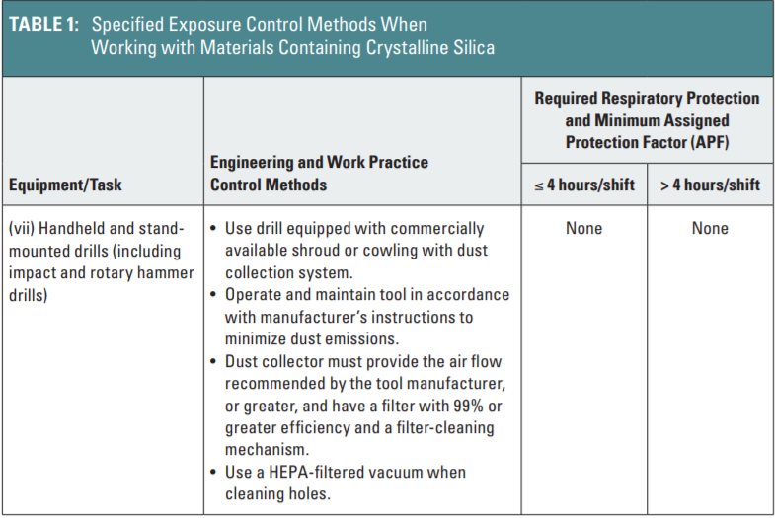
Table 1 (Cont.)

Slide 25
Table 1 (Cont.)

Slide 26
When Table 1 Is Not Used
Employers who do not use Table 1 control methods must:
Measure the amount of silica that workers are exposed to if it may be at or above an action level of 25 μg/m3 (micrograms of silica per cubic meter of air), averaged over an eighthour day.
Protect workers from respirable crystalline silica exposures above the permissible exposure limit of 50 μg/m3, averaged over an eight-hour day.
Use dust controls to protect workers from silica exposures above the PEL.
Provide respirators to workers when dust controls cannot limit exposures to the PEL.

Slide 27
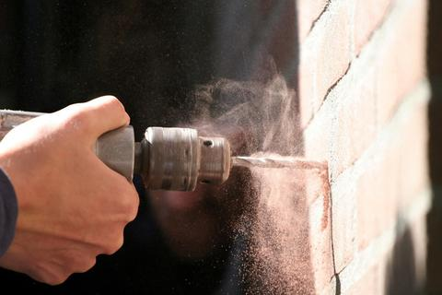
Visible & Respirable Silica Dust
Visible dust contains large particles that are easy to see. The tiny, respirable-sized particles (those that can get into the deep lung) containing silica pose the greatest hazard and are not visible. Most dust-generating construction activities produce a mixture of visible and respirable particles.

Slide 28
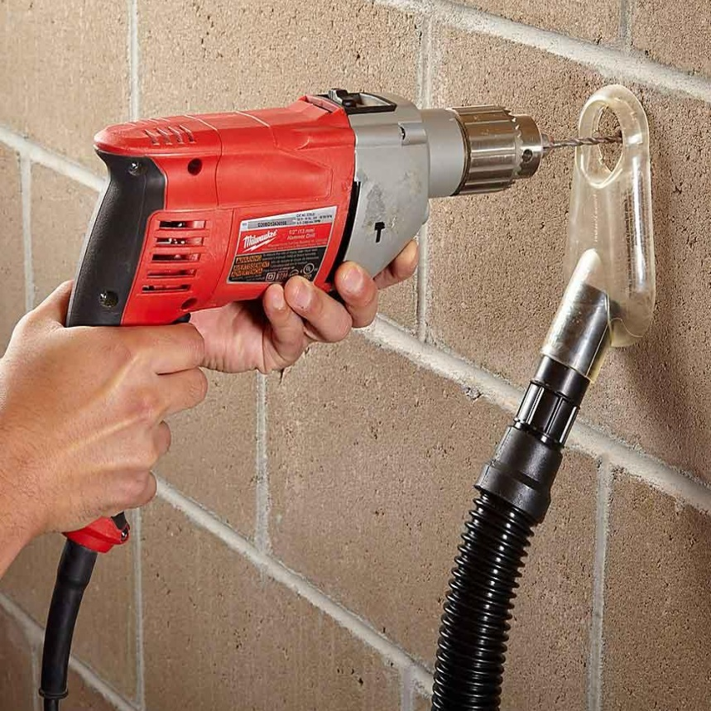
Visible Dust Guide
Do use visible dust as a general guide for improving dust suppression efforts. If you see visible dust being generated, emissions of respirable silica are probably too high. Measures that control tool-generated dust at the source usually reduce all types of particle emissions, including respirable particles.

Slide 29
Warning
Do not rely only on visible dust to assess the extent of the silica hazard. There may be more airborne respirable dust present that is not visible to the naked eye.

Slide 30
Silica Dust Control
Two primary methods exist to control silica dust while operating a stationary saw:
(1) wet cutting, and
(2) vacuum dust collection.
Ventilated booths, when properly designed, can also reduce silica dust exposure. All of these methods are easy to implement

Slide 31
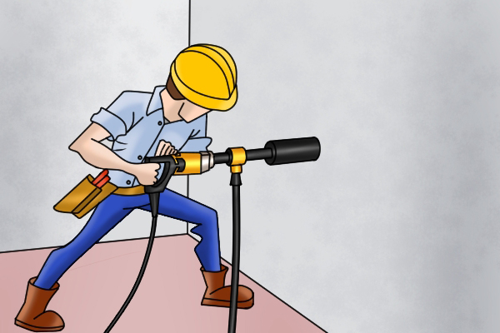
Wet Coring

Slide 32
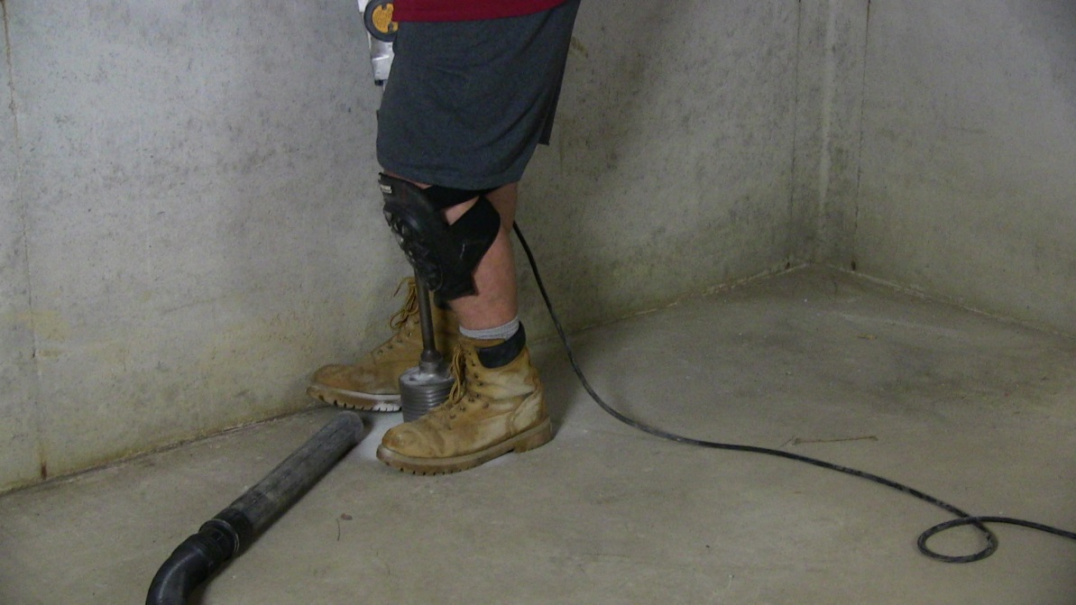
Wet Methods Alternative
Vacuum Dust Collection
When wet methods cannot be implemented, one alternative is the use of vacuum dust collection (VDC) systems. Stationary masonry saws with VDC systems are commercially available and have the ability to capture a substantial amount of dust.

Slide 33
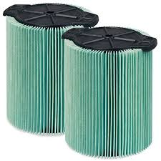
Vacuum Dust Collection
Tips for Operating a Vacuum Dust Collection System:
• Make sure that all hoses are clean and free of cracks.
• Ensure that appropriate filters and dust bags are in good
condition and changed or emptied as needed (may be
necessary several times per shift under some circumstances).
• Check the entire system daily for signs of poor dust capture
or dust leaks.
• Use high-efficiency (HEPA) filters for maximum dust control.
• Review manufacturers’ operating specifications

Slide 34
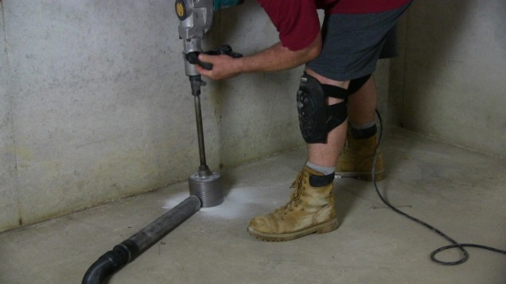
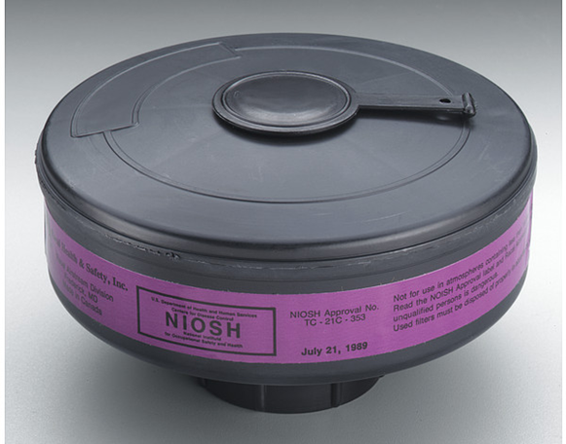
Vacuum Dust Collection Supplements
Data indicate that vacuum dust collection alone can only reduce exposures to 0.4 mg/m3 .
Therefore, to supplement this control option, employees need to wear a properly fitted, NIOSH-approved half-facepiece or disposable respirator equipped with an N-, R-, or P-95 filter.
A half-facepiece or disposable respirator can be used for exposures up to 1.0 mg/m3.

Slide 35
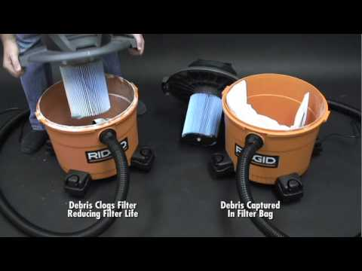
Filters
Double filtration is important. The use of a high-efficiency particulate air (HEPA) filter is critical to prevent the escape of respirable silica dust from the vacuum exhaust. HEPA filters are at least 99.97 percent efficient in removing fine dust particles from the air. A pre-filter or cyclonic separator in addition to a HEPA filter will improve vacuum efficiency and extend the service life of the more costly HEPA filter. A cyclonic separator removes large particles that are capable of overloading or clogging the filter.

Slide 36
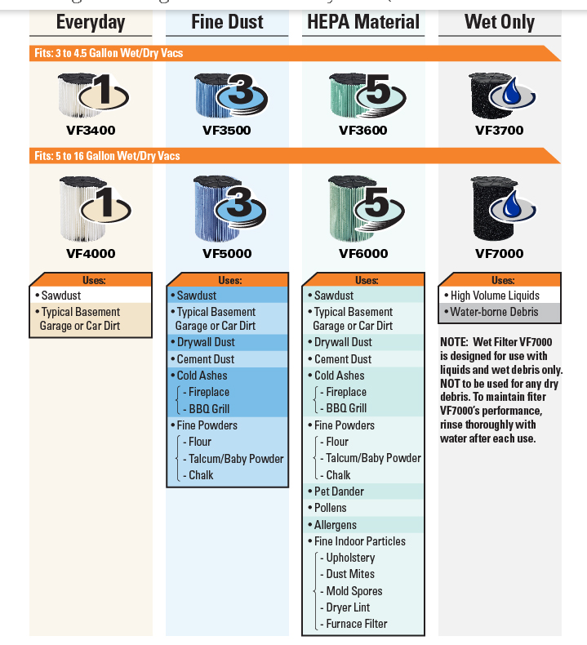
Filters

Slide 37
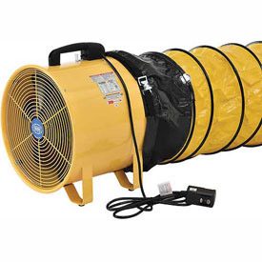
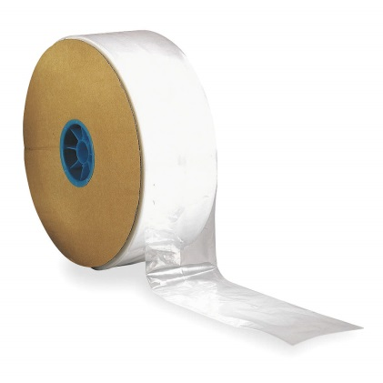
Fans
Fans are not effective dust control devices when used as the sole control method and should not be used as the primary method for managing dust.
For the best effect, set an exhaust fan (the bigger, the better) in an open window or external doorway. (Cross Ventilation with Radon)
An exhaust fan works best if a second window or door across the room is open to allow fresh air to enter.

Slide 38
Worker Protection Plan

