Slide 1
Radon Testing and the Liability of the Home Inspector
The 2017 International Radon Symposium™

Slide 2
What is the top reason for Home Inspectors to start offering radon testing as one of their services?
The 2017 International Radon Symposium™

Slide 3
What is the top reason for Home Inspectors to start offering radon testing as one of their services?
Additional Income
The 2017 International Radon Symposium™

Slide 4
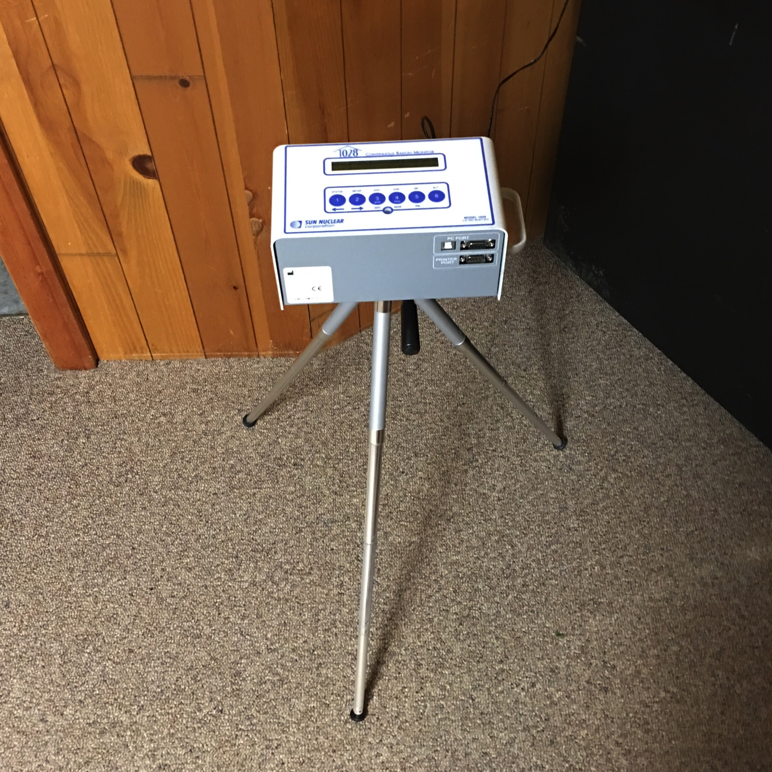
Know your testing procedures
Placement
Closed house conditions
Measurement Period
The 2017 International Radon Symposium™

Slide 5
Does your home inspection insurance policy cover radon measurement?
The 2017 International Radon Symposium™

Slide 6
Does your home inspection insurance policy cover radon measurement?
“Contact a physician if you or a loved one is experiencing respiratory problems you suspect may be due to radon poisoning. You should also consider contacting an experienced personal injury attorney who can help you determine who may be responsible for the radon exposure. You may be entitled to compensation.”
Quote from Personal Injury Law Website
If you are unsure, I recommend contacting your insurance company.
The 2017 International Radon Symposium™

Slide 7
Do you have a QA/QC plan?
If not…
Log onto aarst-nrpp.com
Sample QA Plans and QC Tracking Templates are Available in the Members Section
The 2017 International Radon Symposium™

Slide 8
Do you have a radon measurement contract?
The 2017 International Radon Symposium™

Slide 9
What should your contract cover?
Test results will reflect the radon levels in the home during the time and duration of the test only.
Radon levels may change in the future due to natural causes.
Closed house conditions must be maintained during the test.
The 2017 International Radon Symposium™

Slide 10
Most importantly…
1.) The client will not hold measurement company liable for differences between radon levels and other tests performed at the property or health problems that may have been aggravated or caused by radon.
2.) Recommend that the client re-test every 2 years as radon levels may change over time.
The 2017 International Radon Symposium™

Slide 11
Instructions for the Homeowner or Current Occupant
Keep all windows closed during the testing period
Exterior doors must remained closed with the exception of normal entry and exit
Humidifiers, Dehumidifiers and Air Purifiers should not be used
Air Conditioners that recycle interior air can be operated normally
Do not operate window or attic fans during the testing period
Fireplaces should only be used if they are the primary source of heat
Most importantly…Do not touch or move the testing device
The 2017 International Radon Symposium™

Slide 12
Dealing with the Realtor that Knows Everything About Radon
WHEN I OVERHEAR REALTORS
TALKING ABOUT RADON
The 2017 International Radon Symposium™

Slide 13
“It’s my understanding that the EPA is considering changing the radon levels to 10 rather than 4.”
“The thing about radon is that you would have to live in the house for something like 70 years in order to get lung cancer.”
“The reason the radon levels were so high is because the house has been unoccupied and the levels just kept building up.”
The 2017 International Radon Symposium™

Slide 14
One of our responsibilities as Radon Measurement Providers is to educate.
Don’t be afraid to speak up when you hear your client being misinformed about radon.
The 2017 International Radon Symposium™

Slide 15
Michael Talotta
mttalotta@gmail.com
The 2017 International Radon Symposium™

