Slide 1
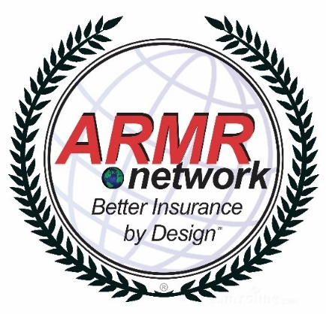
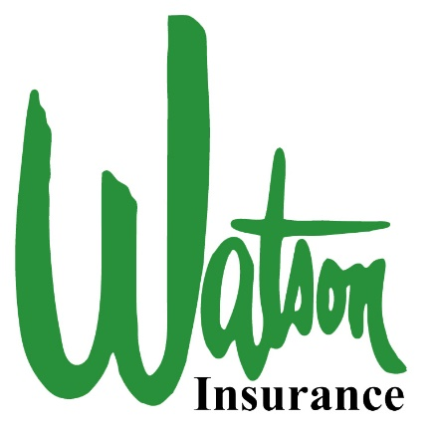
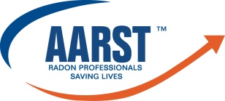
The Insurance Needs of Radon Inspectors Cutting through the Red Tape
Presenters:
Lori Waters
Environmental Insurance Producer
American Risk Management Resources Network, LLC
waters@armr.net
Brandy Brown, CIC, CISR
Small Business Agent
Watson Insurance
bbrown@watsoninsurance.com
The 2017 International Radon Symposium™

Slide 2
Why care about insurance?
The 2017 International Radon Symposium™

Slide 3
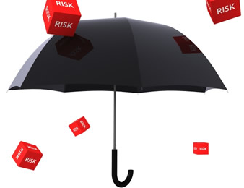
Why Insurance Is Important
Protects your business
Takes care of your employees
Encourages safe business practices
The 2017 International Radon Symposium™

Slide 4
Types of Business Insurance
Liability Coverages
Workplace Injury Coverage
Auto Coverage
Commercial General Liability (CGL)
Contractor’s Pollution Liability (CPL)
Commercial Auto Liability
Workers Compensation & Employers Liability
Professional Liability (aka Errors & Omissions Liability)
Excess/Umbrella Liability
Specialty Coverages
Property Coverages
Cyber Liability
Employment Practices Liability
Inland Marine/
Equipment Floater
Crime Coverage
Commercial Property Insurance
Bailee’s Customer coverage
The 2017 International Radon Symposium™

Slide 5
Specialty Coverage
Employment Practices Liability (EPLI)
Commercial Crime coverage
Cyber Liability
The 2017 International Radon Symposium™

Slide 6
Your Insurance: What to Watch For
Not all liability insurance policies are the same!
Three (3) big things to look for on your liability coverage policies:
Designated operations?
Is there a pollution exclusion on the Professional Liability coverage?
How does the Nuclear exclusion reads and/or what coverage is available for radioactive material?
The 2017 International Radon Symposium™

Slide 7
Designated Operations
Does your policy provide coverage for all services your provide?
The 2017 International Radon Symposium™

Slide 8
Pollution Exclusions and Professional Liability Coverage
Is there a pollution exclusion on your Professional Liability coverage?
The 2017 International Radon Symposium™

Slide 9
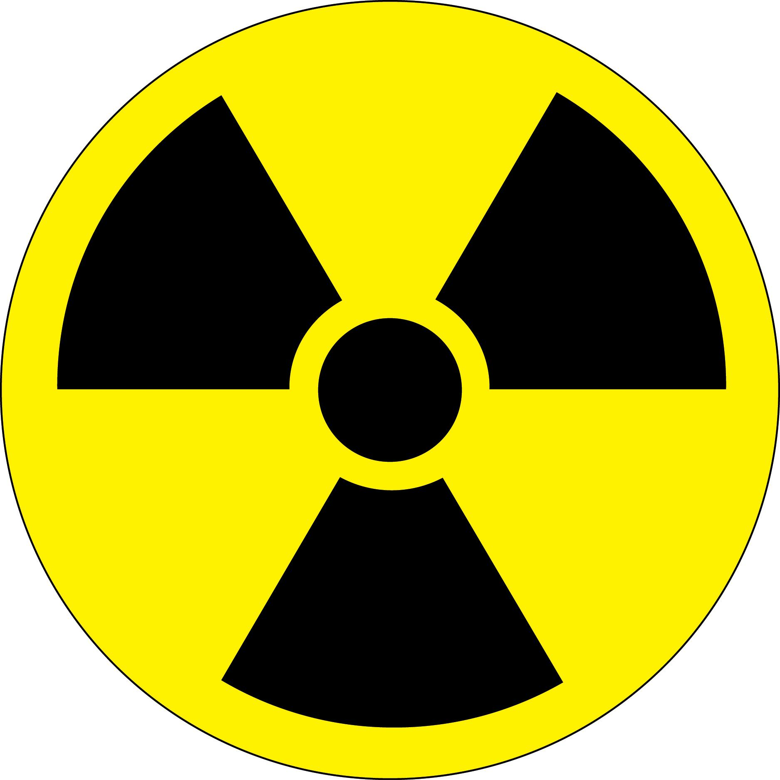
Nuclear Exclusion & Radioactive Material
How does the Nuclear Exclusion on your policy read?
How does your policy handle radioactive material?
The 2017 International Radon Symposium™

Slide 10
Why ARMR
We expose insurance policy coverage gaps created by complex pollution exclusions contained in all general liability and property insurance policies sold today.
We invented the 1st Contractor’s Environmental Liability (aka CPL) policy in 1986.
We are on the only environmental brokerage to work on $1.2 billion dollars of litigated environmental claims.
The 2017 International Radon Symposium™

Slide 11
Why Watson
Family business for 3 generations
Licensed to do business in 42 states
Full service agency with access to over 30 markets
Can tailor an insurance program to fit the needs and expectations of the insured
The 2017 International Radon Symposium™

Slide 12
Thank You!
Presenters:
Lori Waters
Environmental Insurance Producer
American Risk Management Resources Network, LLC
waters@armr.net
Brandy Brown, CIC, CISR
Small Business Agent
Watson Insurance
bbrown@watsoninsurance.com
The 2017 International Radon Symposium™

