Slide 1
Your Staff is a Technical Assistance Resource: How Do You Prepare Them?
Presented by
Brian Hanson
Midwest Universities Radon Consortium (MURC)
at Kansas State University
The 2017 International Radon Symposium™

Slide 2
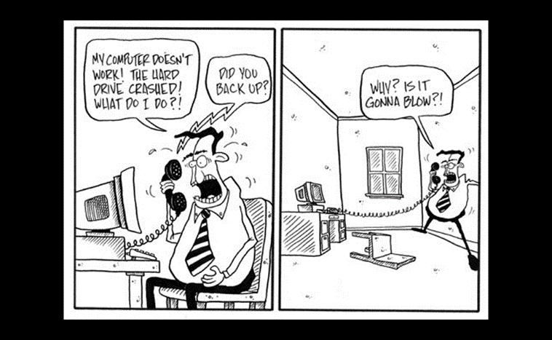
Your Staff as Technical Assistance
The Issue:
If you work in radon, regardless of your job position, you will be asked to provide radon technical assistance to your clients
The 2017 International Radon Symposium™

Slide 3
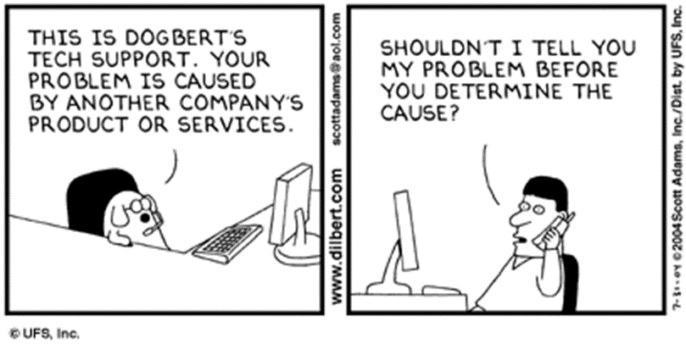
Your Staff as Technical Assistance
The Fix:
All staff in a radon business must have some degree of technical training in the basic science of radon in order to respond quickly (and accurately) to client questions
The 2017 International Radon Symposium™

Slide 4
Common Questions Posed by Clients
What IS radon?
Radon is
An inert, radioactive chemical gas generated in the soil from the ongoing radioactive decay of uranium
When radon gas becomes concentrated in homes, the increase radiologic exposure from radon increases long-term risk of developing lung cancer
The increased lung cancer risk comes from potential genetic mutations caused to cells in the lungs from that long-term radiologic exposure
Could your office staff provide this answer to a client in a quick, understandable way?
The 2017 International Radon Symposium™

Slide 5
Common Questions Posed by Clients
Lets talk about real estate:
The home inspector reported the radon in the home I’m selling is 4.0 pCi/L. What is the cheapest way to get my house to 3.9 pCi/L?
How would the staff person in your office answering this call respond?
The 2017 International Radon Symposium™

Slide 6
Common Questions Posed by Clients
Lets keep talking about real estate:
The house I’m purchasing tested 12.8 pCi/L. The seller put in a radon mitigation system. My home inspector retested the house and reported a radon concentration of 3.7 pCi/L. Should the mitigation system have reduced the radon further than that?
How would the staff person in your office answering this call respond?
The 2017 International Radon Symposium™

Slide 7
Common Questions Posed by Clients
Other common questions you and your staff WILL be expected to answer:
What is the REAL risk at 4.1 pCi/L?
Am I SAFE if the radon level is 3.9 pCi/L?
Why should I BELIEVE that the radon test you conducted was accurate?
How do we KNOW our system was installed correctly?
The 2017 International Radon Symposium™

Slide 8
Uncommon Questions Posed by Clients
Clients will continually test your capacity to respond intelligently:
Uh, will marijuana smoke affect the results of a radon test?
The house I’m purchasing had a high radon test. We mitigated the radon in the home. Do we need to worry about radon exposure to my kids while they’re playing in the yard?
Do I need to worry about the radon having accumulated on the furniture and clothes I had stored in the basement?
The 2017 International Radon Symposium™

Slide 9
Preparing Your Staff to be Technical Resources
Train ALL your staff
AARST allows all certified professionals to take the intro training course ONCE for CE: DO IT
Every certified professional reports learning something (often many somethings) that they missed first time around
Consider having your support staff take either the intro measurement or a radon in real estate course from an approved NRPP provider
The measurement course provides the background science for radon
The 2017 International Radon Symposium™

Slide 10
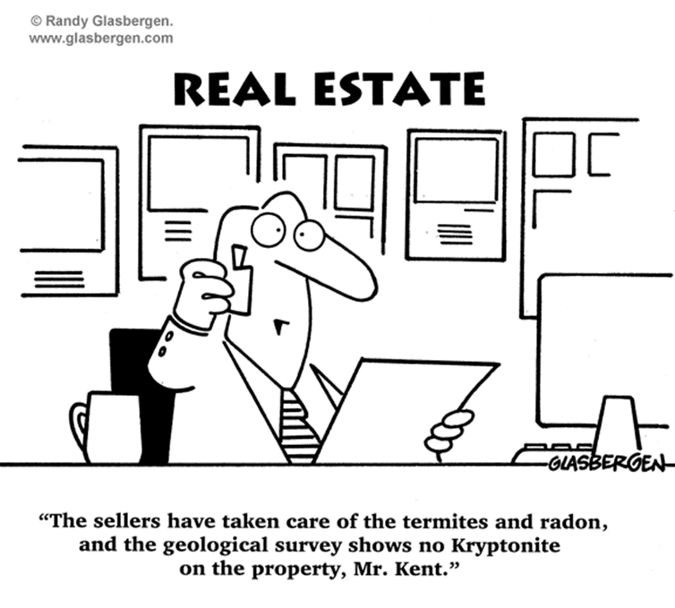
Preparing Your Staff to be Technical Resources
Prepare a WRITTEN response to common questions
Standardized responses used by your staff reduce the chance of staff members contradicting each other
The 2017 International Radon Symposium™

Slide 11
Preparing Your Staff to be Technical Resources
And when in doubt…
Send your clients to the National Radon Program Services (NRPS)!!
(800) SOS-RADON (767-7236)
(800) 55-RADON (557-2366)
(800) 644-6999
NRPS is hosted at K-State and funded by EPA to provide direct radon technical assistance to U.S. residents
When clients start asking minutia that are beyond your staff’s technical capacity, make us figure it out
The 2017 International Radon Symposium™

Slide 12
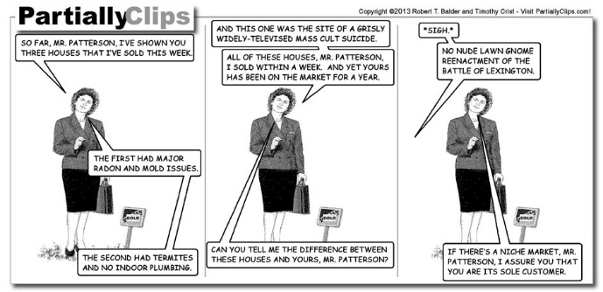
Questions?
The 2017 International Radon Symposium™

Slide 13
Contact Info
Brian Hanson
bhanson@ksu.edu
785-532-4996
MURC K-State
785-532-6026
Websites
www.sosradon.org
www.radoncoursesonline.org
The 2017 International Radon Symposium™

