Slide 1

Radon Exposure at Workplaces and Public Buildings –
Experience and Future Challenges
Dr. Valeria Gruber
Austrian Agency for Health and Food Safety (AGES)
Radon and Radioecology, National Radon Centre of Austria
The 2017 International Radon Symposium™

Slide 2
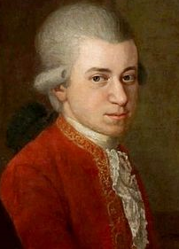

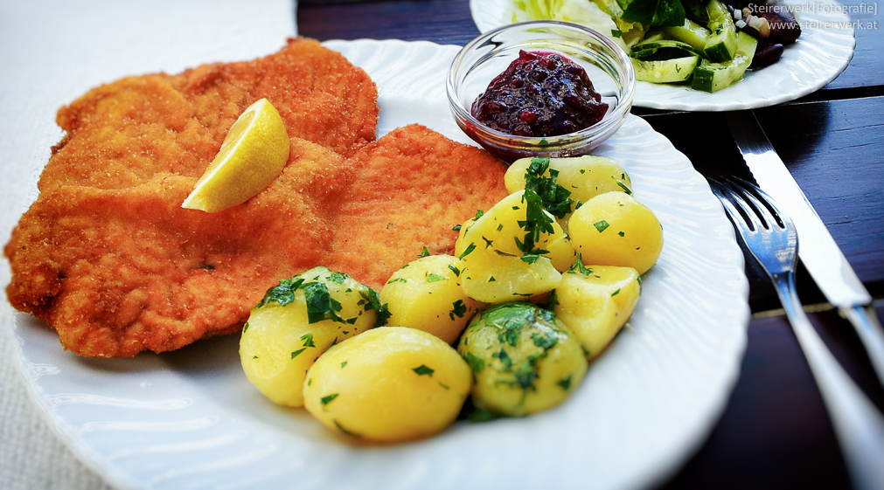
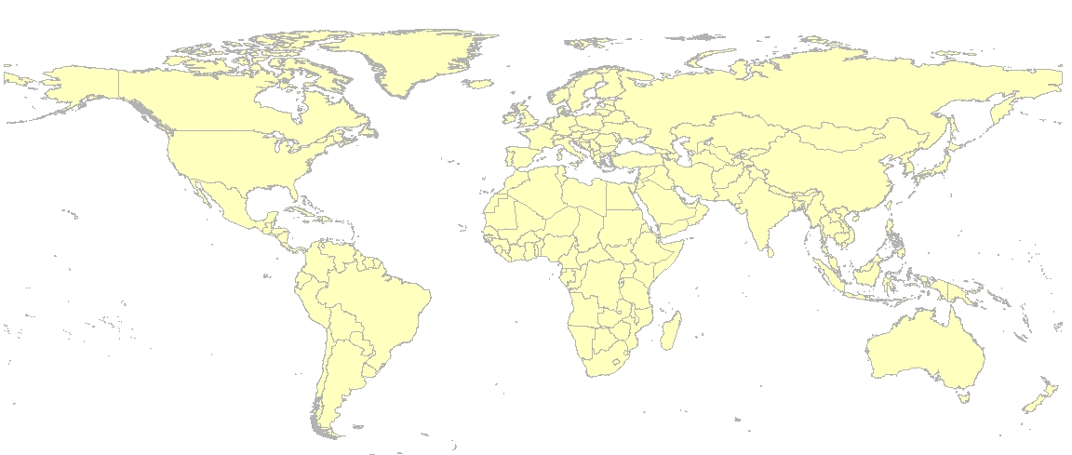
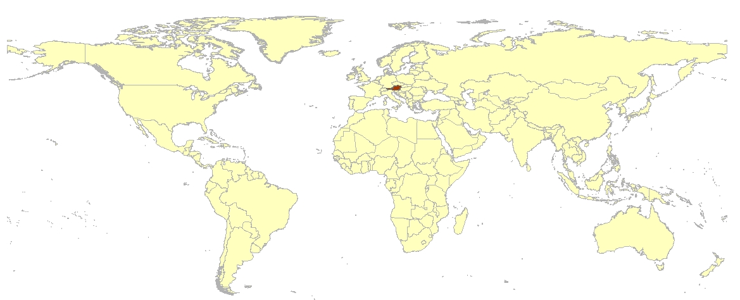
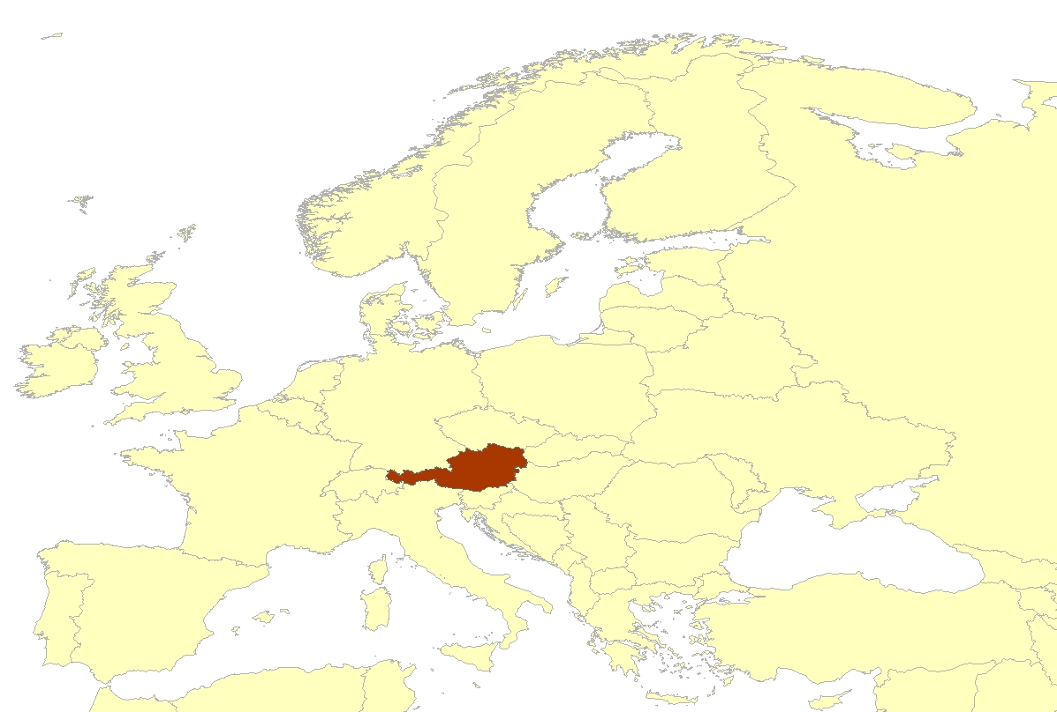
About us…
Austria, Europe
The 2017 International Radon Symposium™

Slide 3
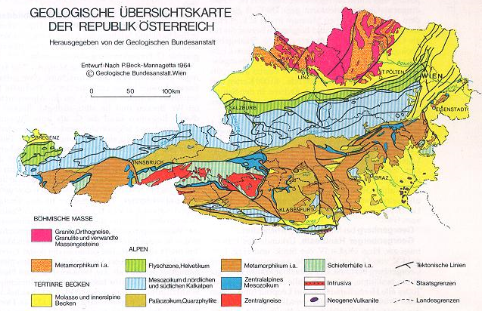
About us…
Radon situation in Austria
Population: 8.8 mio
Area: 83.879 km²
9 federal states -
Radon situation diverse
(geology dependent)
Bq/m³
Austria
USA
Ref.: WHO
The 2017 International Radon Symposium™

Slide 4
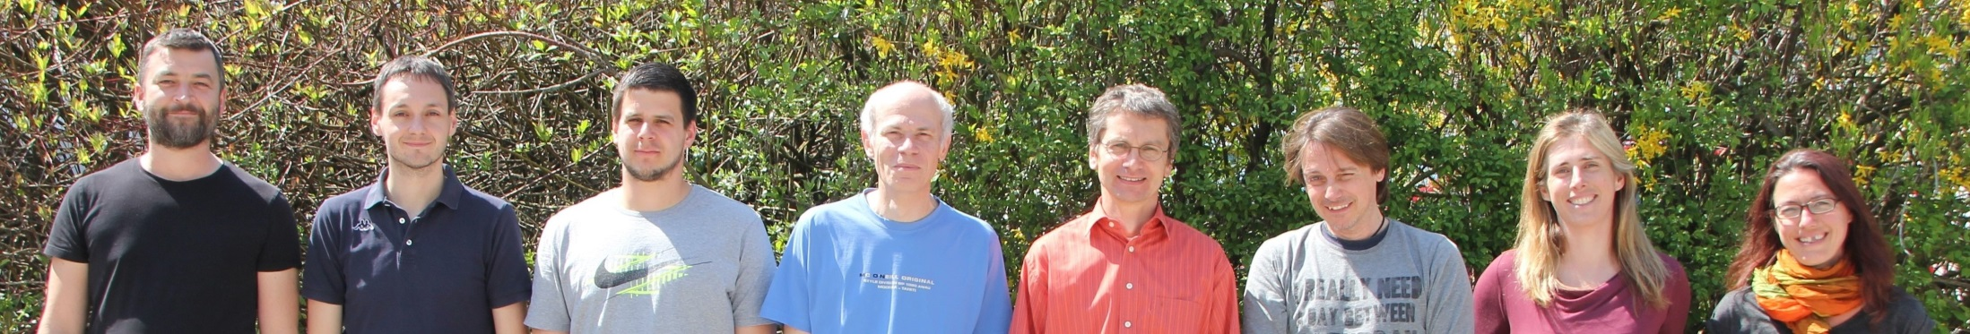
About us…
National Radon Centre of Austria
Embeded in the Austrian Agency for Health and Food Safety (AGES)
Financed by the Austrian Ministry of Environment
Responsible for national radon work in Austria
  Advicing MoE (implementation new EU-directive)
  Preparing and monitoring national radon action plan
  Austrian radon map, delineation of „radon areas“
  Radon awareness, risk communication, training, education
  Pilot studies on specific questions
The 2017 International Radon Symposium™

Slide 5
Radon and Workplaces
Legal Background - Austria
Current recommended levels for indoor radon concentration (since 1992):
  400 Bq/m³ action level for existing buildings (~ 11 pCi/l)
  200 Bq/m³ target level for new buildings (~ 5 pCi/l)
No legal obligation to measure radon in “general” workplaces
Obligation to measure “Workplaces with potentially elevated radon exposures” (since 2008, NatStrV)
  waterworks, underground workplaces, show mines and caves, radon spas
Future: European Basic Safety Standards (implementation by EU-MS by 2018)
  Reference level for dwellings and workplaces not higher than 300 Bq/m³ (~ 8 pCi/l)
  Obligation to measure radon in
        „General“ workplaces in basement and groundfloor rooms in „radon areas“
        Specific workplaces with potentially elevated radon exposures
The 2017 International Radon Symposium™

Slide 6
Experience in Austria
Radon at workplaces and public buildings
General workplaces, Public buildings (no legal obligation yet)
  Kindergartens and childcare centers (~ 800; regional) – 1999-2003
  Schools (~ 350, Upper Austria) – 2002
  Administrative buildings – town halls (~ 440, Upper Austria) – 2008
Specific workplaces – Pilot studies
  Pilot study waterworks (45, Upper Austria) – 2004-2006
  Pilot study spas (3, Upper Austria) – 2005-2006
  Pilot study visitor mines and show caves (9, Austria) – 2008-2010
Specific workplaces – implementation of NatStrV („Authorized laboratory“)
  water supplies (~ 40, Austria)
  visitor mines (3, Austria)
  radon spas (~ 5, Salzburg)
The 2017 International Radon Symposium™

Slide 7
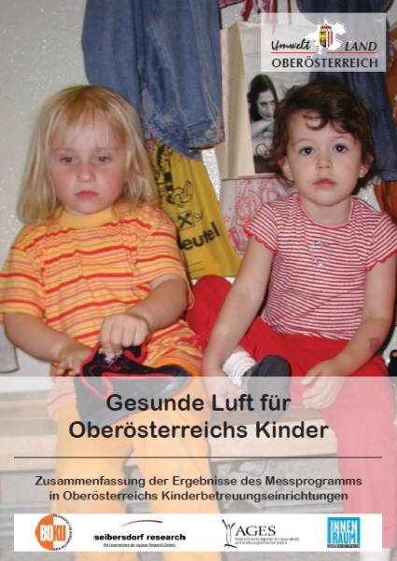

„Healthy Air for Upper Austria‘s Kids“
Include Radon in Indoor Air programmes
Radon
Chemical indoor parameters (formaldehyde, VOC, PCP, PCB)
Smell
Mould
Acoustics
Tightness of building, draught
The 2017 International Radon Symposium™

Slide 8
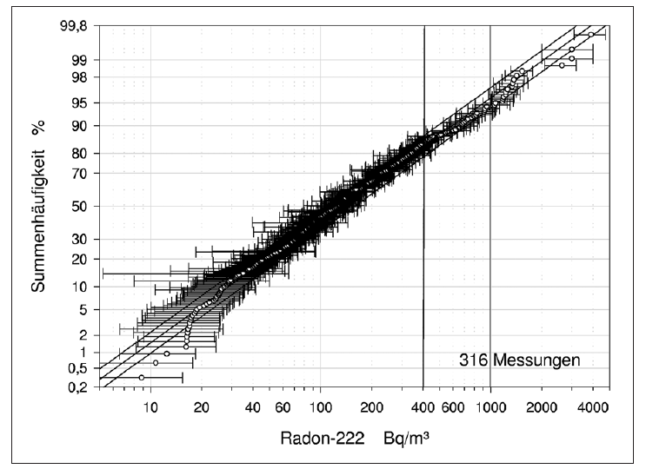
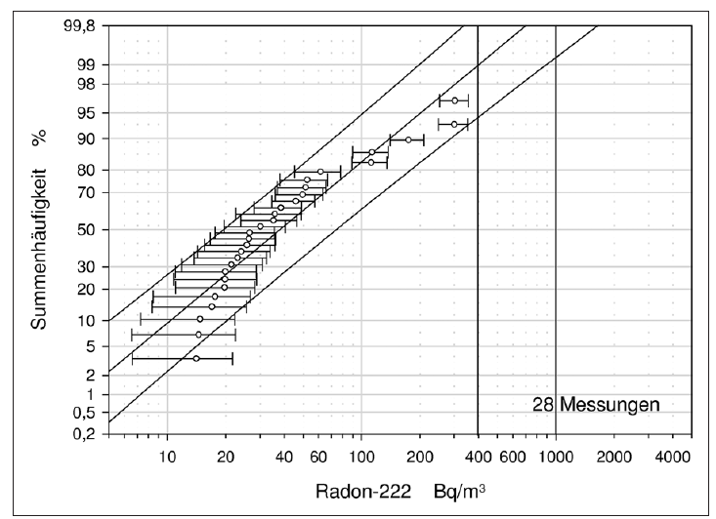
Results
Radon in schools
Schools, radon areas
Schools, control group
64 (20%) schools > 400 Bq/m³
23 (6%) schools > 1000 Bq/m³
The 2017 International Radon Symposium™

Slide 9
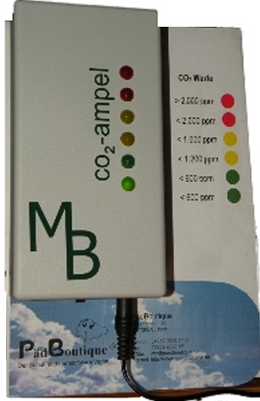
CO₂ and Radon
In schools and kindergartens
Students in the room:
CO₂
Radon
Temperature
Air humidity
During class, CO₂ ↑, Radon ↓
Conclusion:
Solving the CO₂ problem in schools and kindergartens would (mostly) also solve the radon problem!!
CO₂ meter
The 2017 International Radon Symposium™

Slide 10

Time sensitive Radon testing
How well do continous measurements reflect radon concentration during working hours?
 | Mean ratio opening hours / all day (24/7) | Variation
Kindergartens (n=50) | 0.90 | 0.27 – 2.03
Schools (n=44) | 1.20 | 0.20 – 3.72
  Mean radon concentrations reflect the radon exposure during operating hours on average quite well, however, deviations by a factor of 3 are possible (in both directions)
  Ventilation habits
  Operating hours (only mornings or all day long)
  Generally higher radon concentrations at weekends
The 2017 International Radon Symposium™

Slide 11
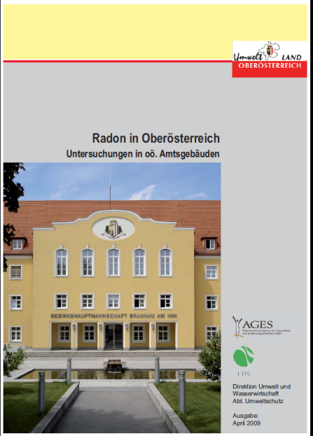
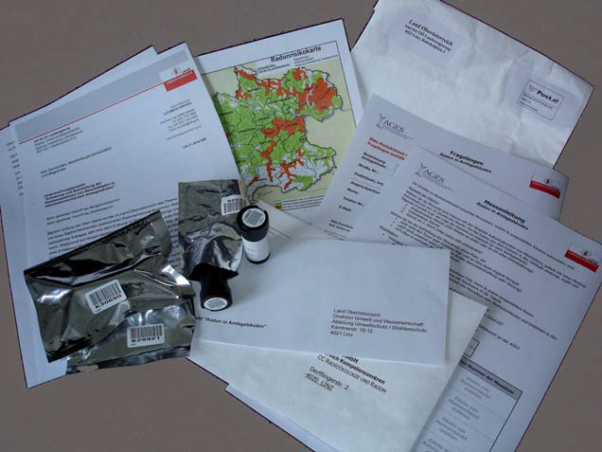
Radon in Administrative Buildings
Raising Radon Awareness for Regulators!
Measurements for 6 months, passive detectors
Max. Radon concentration | Number of Buildings | %
< 400 Bq/m³ | 370 | 87
400 – 1000 Bq/m³ | 46 | 11
> 1000 Bq/m³ | 7 | 2
Measures necessary
The 2017 International Radon Symposium™

Slide 12
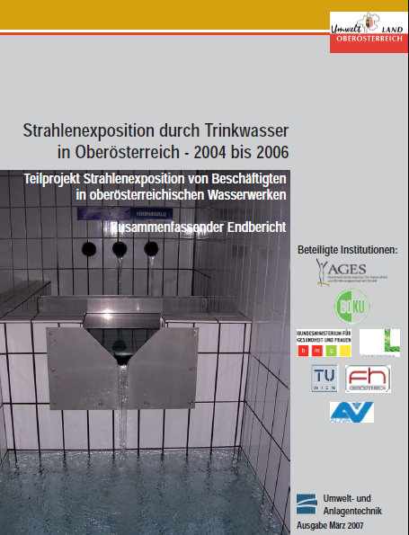
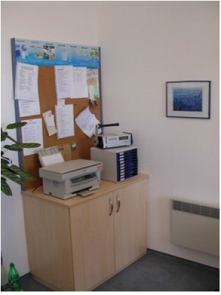
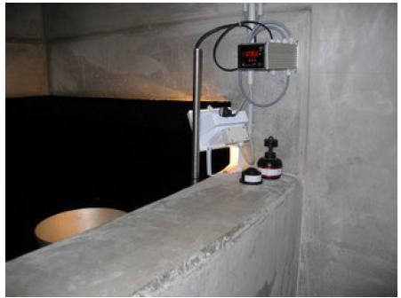
Radon in waterworks
Rn-exposed workers in Austria
45 waterworks (selected according to geology and water volume)
142 measurements, active, Electret
All areas in waterworks (well houses, water storage basins, treatment facilities, offices)
The 2017 International Radon Symposium™

Slide 13
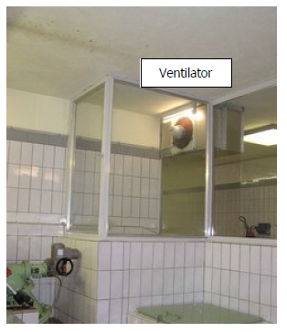
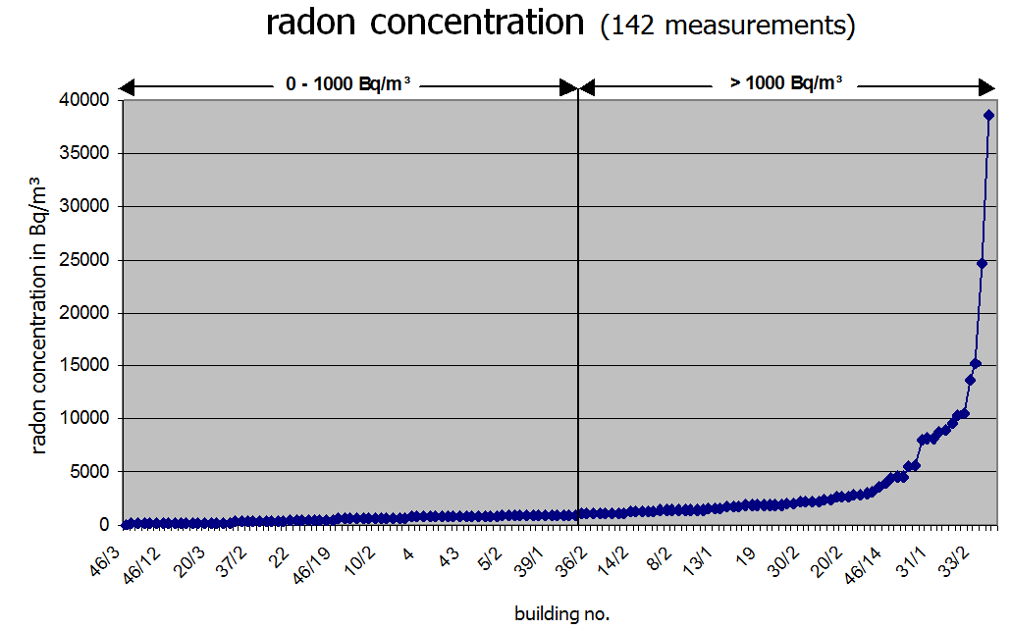
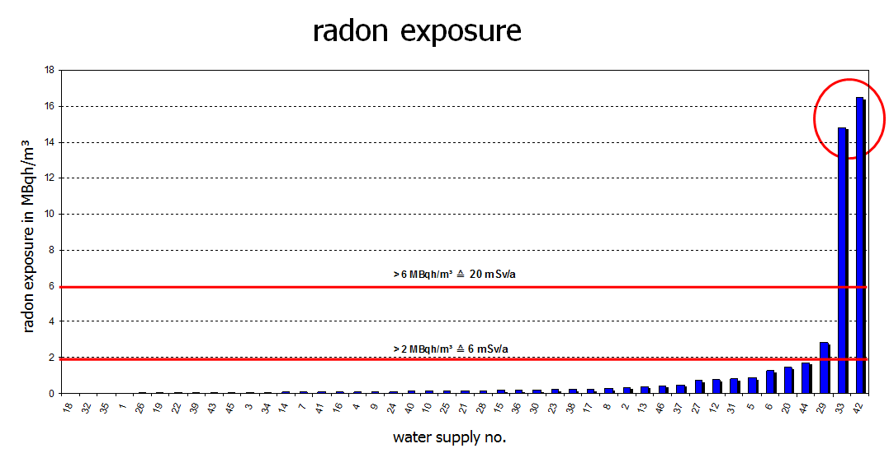
Radon in waterworks
Results
55% < 1.000 Bq/m³
99% < 10.000 Bq/m³
Ringer, W. et al.: Mitigation of Three Water Supplies with High Radon Exposure to the Employees; Radiat Prot Dosimetry, 2008; 130 (1): 26-29
The 2017 International Radon Symposium™

Slide 14
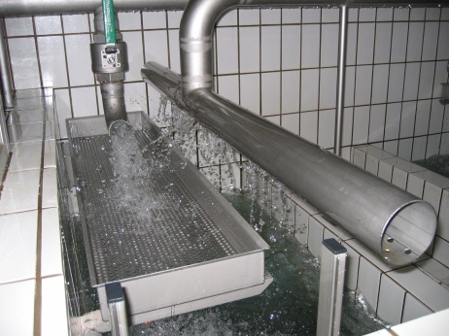
Experience in waterworks
Some conclusions
Mitigation is (usually) quite cost-effective
Identification of radon source(s) before mitigation (radon diagnosis), e.g. water treatment techniques like vaporizer, cascade etc.
No employee above 6mSv/a after some remedial measures
(reduce occupancy hours in relevant building!, ventilation)
Highest doses during (annual) cleaning of reservoirs –> Measures: more workers for less time; increase ventilation; remove source!
Familiarize the workers with “radon measures” - include in work instructions, regular information and reminders
The 2017 International Radon Symposium™

Slide 15
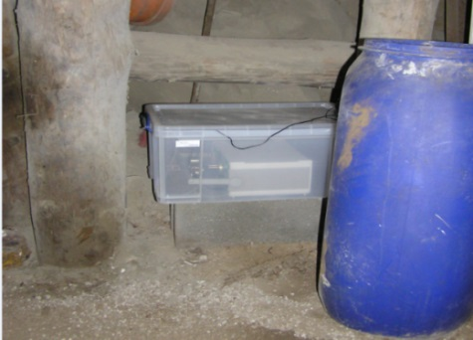
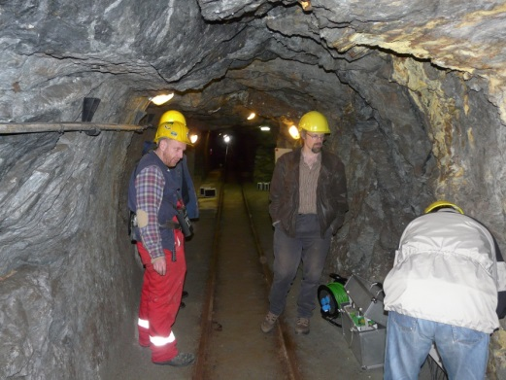
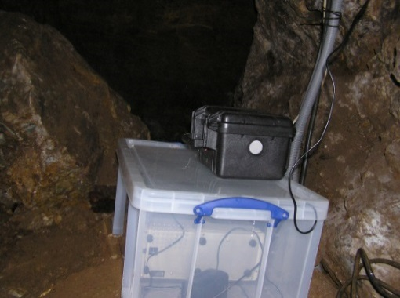
Radon in visitor mines and show caves
Pilot study
6 visitor mines, 3 caves (selected by geology, raw material, number of visitors, opening hours)
active measurements for 1 year (several locations within mine/cave)
radon, thoron, equilibrium factor, air pressure, temperature
Gruber, V., Ringer, W., Gräser, J., Aspek, W., Gschnaller, J.: Comprehensive investigation of radon exposure in Austrian tourist mines and caves, Radiat Prot Dosimetry, 162(1-2), 78-82 (2014)
The 2017 International Radon Symposium™

Slide 16
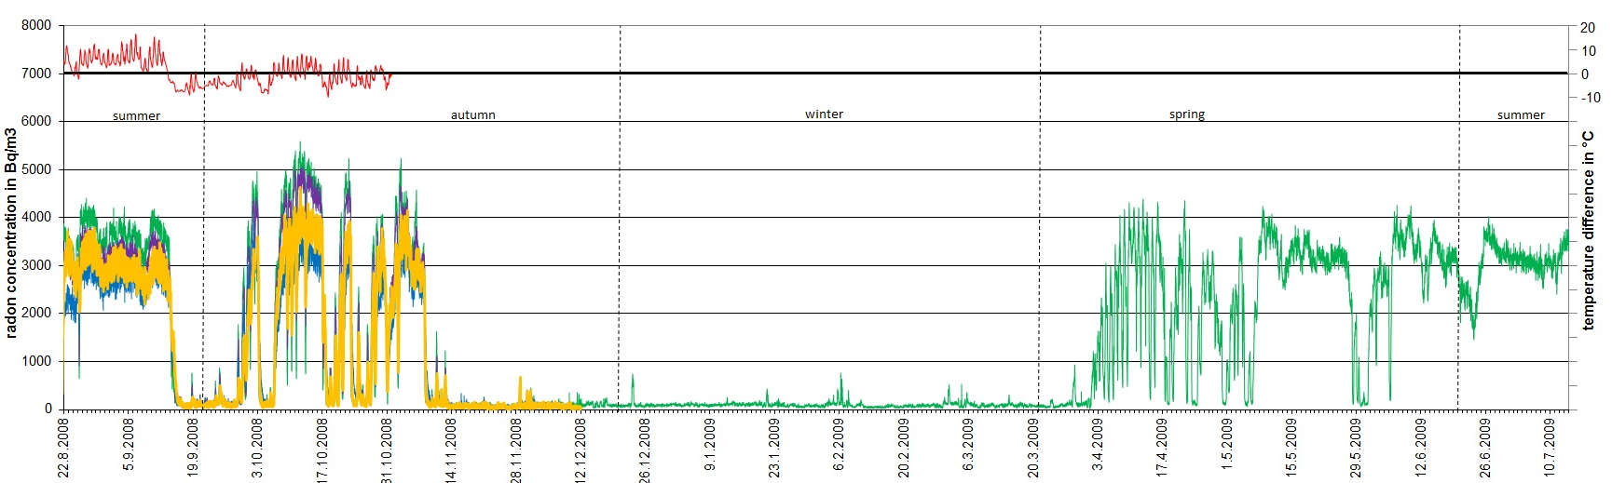
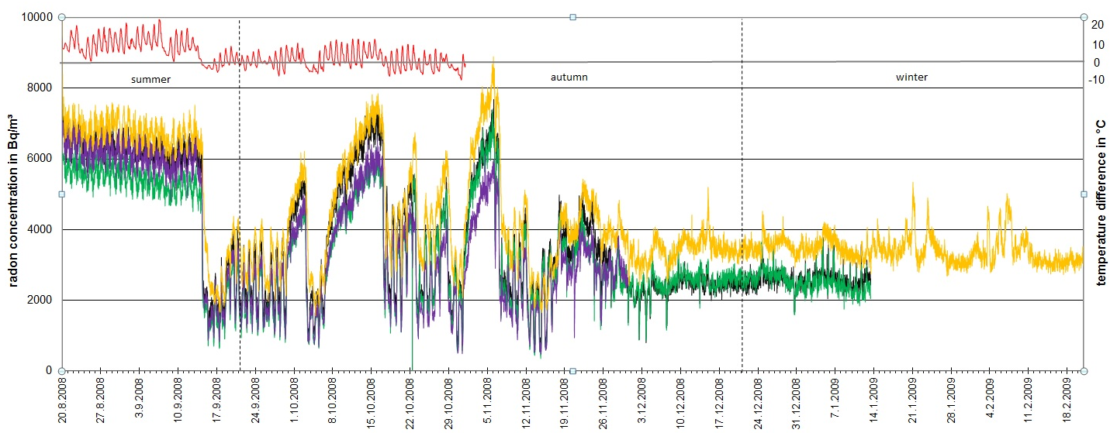
Examples
Radon concentrations in visitor mines
Iron-ore mine, 1 year measurement
constant temperature about 8°C
Silver mine,
6 months measurement
constant temperature
about 9°C
Closing of gallery door during winter, to prevent cooling of the mine
The 2017 International Radon Symposium™

Slide 17
Rn concentration and doses
In mines higher than in caves
Object | Mean Rn222-conc. [Bq/m³] without winter
Show caves | 960
Salt mine | 1300
Iron ore mines | 3000
Silver mines | 4200
Copper Mine | 4900
Range of average Rn-conc.:
200 – 16.000 Bq/m³
Max. conc.:
60 kBq/m³ in silver mine
 | mean annual dose [mSv/a]
Show caves | 0,9
Salt mine | 1,1
Iron ore mines | 1,9
Silver mines | 3,3
Copper mine | 5,4
Main impact factors:
Geology („mining product“)
Structure of cavities
Temperature difference
outside/inside (seasonal variations)
- Artifical ventilation
The 2017 International Radon Symposium™

Slide 18
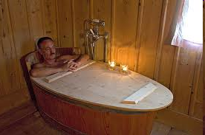
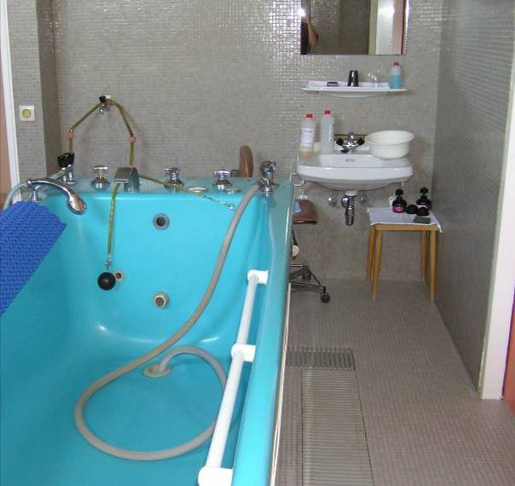
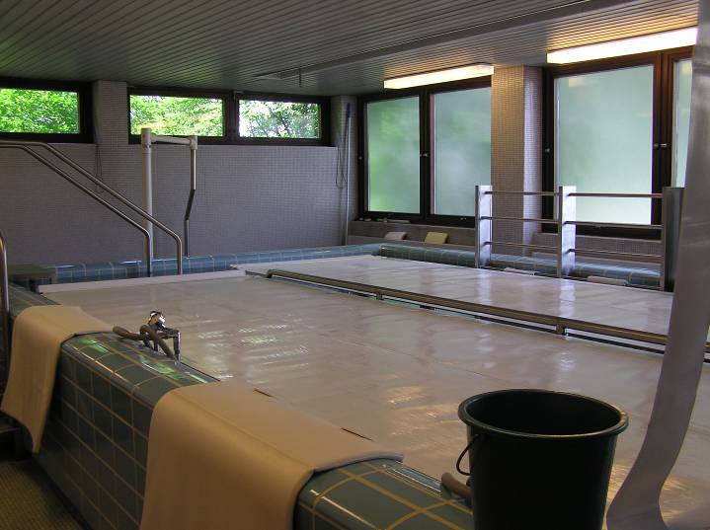
The „Good Radon“
Situation of workers in radon spas in Austria
Radon spas included in legislation -> employees in radon spas controlled
Most of employees < 6 mSv/a (radon concentration not too high due to mechanical ventilation systems (moisture))
Some workers permanently controlled with personal dosimeters (> 6 mSv/a, but < 20 mSv/a) (technicians - baths, radon water treatment) – measures recommended (reduce time, tightness of doors, ventillation etc.)
Problem: Water supplies for radon spas: very high radon concentrations can occur (> 2 MBq/m³) -> cleaning of water storage basins !!!
The 2017 International Radon Symposium™

Slide 19
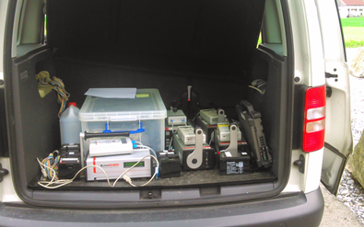
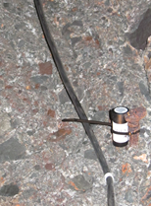
Future Challenge
Implementation of EU Basic Safety Standards
Reference value → 400 Bq/m³ ↓ (most probably 300 Bq/m³)
Implementation of EU-BSS for buildings with public access and „general“ workplaces
  Define „radon areas“
  „Exclude“ specific workplaces from mandatory measurements according to other criteria (e.g. mechanical ventilation system, preventive measures carried out, occupancy time, other building characteristics)
  Establish guidelines how to measure and evaluate workplaces/big buildings
  Install/promote measurement and dose evaluation services – certification, quality assurance
Carry out the mandatory radon
measurements in workplaces!
The 2017 International Radon Symposium™

Slide 20
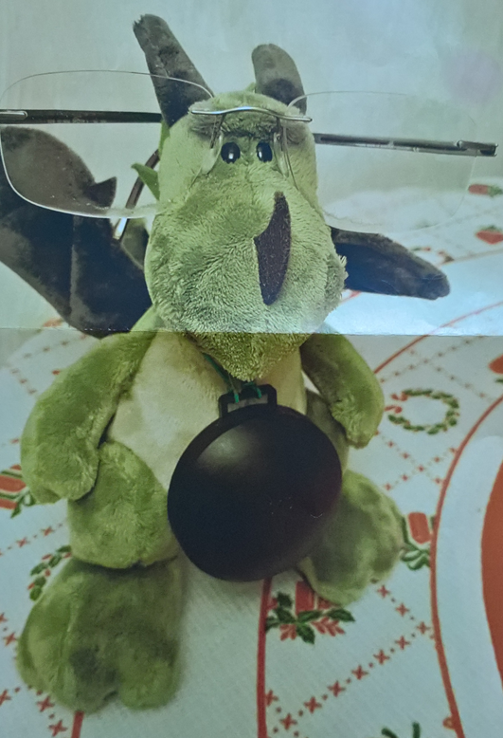
Thank you for your attention!
Dr. Valeria Gruber
National Radon Centre
Austrian Agency for Health and Food Safety (AGES)
Radiation Protection
Department for Radon and Radioecology
Wieningerstrasse 8
A-4020 Linz, Austria
Tel. ++43-(0)50555-41906
Fax ++43-(0)50555-41915
valeria.gruber@ages.at
www.ages.at
The 2017 International Radon Symposium™

