Slide 1



A Comparison of Various Factors Affecting Analysis of Radon in Water by Liquid Scintillation Counting
Uttam Saha, Leticia Sonon, Michael Kitto¹, Pamela R. Turner, Dana Lynch, and Gabrielle Walters
The University of Georgia Cooperative Extension, Athens, GA
¹Laboratory of Inorganic & Nuclear Chemistry, Wadsworth Center, New York State Department of Health, Albany, NY
sahau@uga.edu
The 2017 International Radon Symposium™
October 1-4, 2017; New Orleans, LA, USA

Slide 2
OUTLINE
Introduction:
    Importance of Radon in Household Water Testing and Education Program.
    Rationale and objectives of this study.
Materials and Methods:
    What were the compared variables with regards to:
        Methods of Sampling, Sample Preparation, Type of Scintillation Fluids and LSC Assays?
    How those variables were created and compared.
Results: Present and Interpret.
Concluding Remarks
Questions, Comments, Suggestions
The 2017 International Radon Symposium™

Slide 3
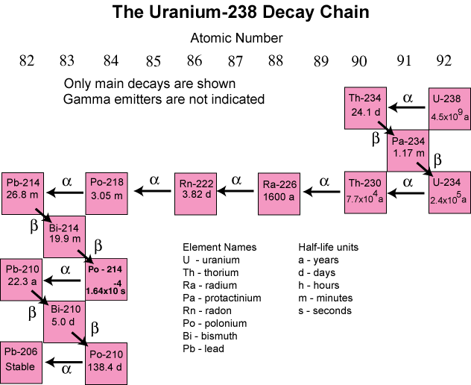
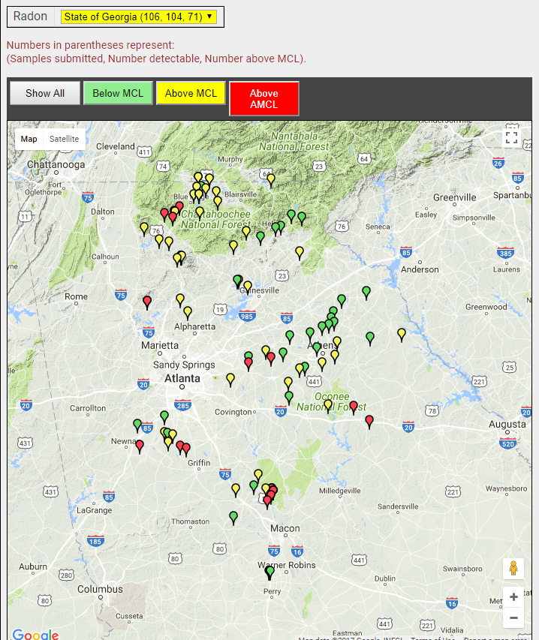
Introduction
How is Radon Formed?
Does it Exist in GA Well Waters?
The 2017 International Radon Symposium™

Slide 4
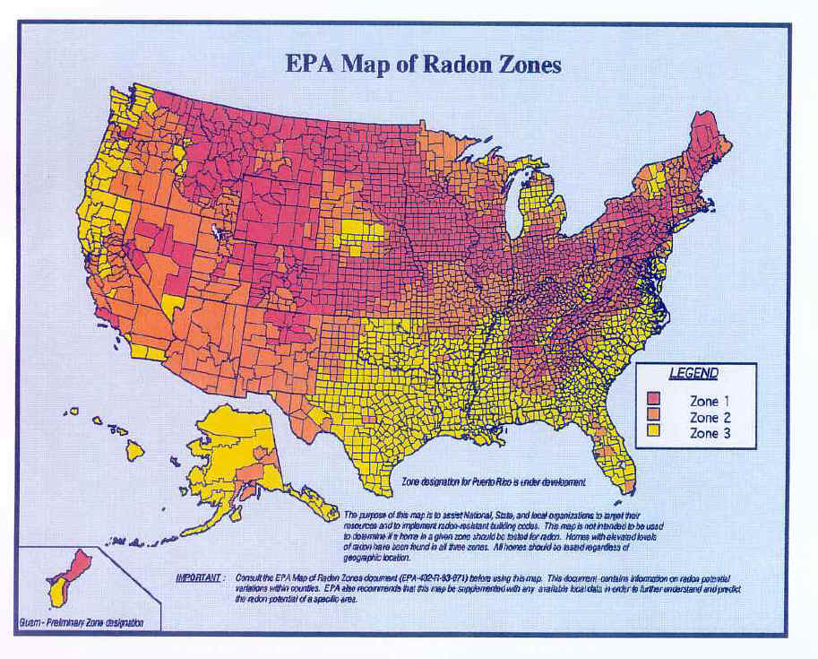
Radon in Indoor Air: Selected State Risk Estimates
Introduction
South Eastern United States | Radon-Induced Lung Cancer Deaths per Year | Rank
Georgia | 822 | 1
Tennessee | 693 | 2
Florida | 668 | 3
Kentucky | 600 | 4
North Carolina | 435 | 5
Alabama | 391 | 6
South Carolina | 221 | 7
Mississippi | 113 | 8
The 2017 International Radon Symposium™

Slide 5
Introduction
Health Effects of Radon in Drinking Water
Can Cause Both Lung and Stomach Cancer
In the US, 168 deaths are due to radon in water. Of the 168 deaths:
89% is due to lung cancer!
11% is due to stomach cancer
Action Levels
Radon in Indoor Air: 4 pCi/L
Radon in Water:
Proposed MCL: 300 pCi/L
Proposed AMCL: 4000 pCi/L
The 2017 International Radon Symposium™

Slide 6

Radon in Water Can Enrich Radon Level in Indoor Air
Introduction
A very rough rule of thumb:
Household water with 10,000 pCi/L of radon contributes about 1 pCi/L to the level of radon in the indoor air.
The 2017 International Radon Symposium™

Slide 7


Introduction
Health Risks from Radon in Drinking Water
Radon in Indoor Air in a GA Home with:
Uranium in Water: 629 ppb
Radon in Water: 79,012 pCi/L
Radium (Ra-226+Ra-228 in Water: 3.8 pCi/L)
Average: 5.8±0.2 pCi/L
Showering and/or Laundering
The 2017 International Radon Symposium™

Slide 8
Introduction
The AESL-UGA launched a new Radon in Household Water Testing and Education program from August, 2015.
However, developing a proper method for “Analysis of Radon in Water” is still an important research task.
Various empirical methods of sampling, Sample preparation, Type of scintillators, Volume ratios of Scintillator : Sample, and Type counting assays on a LSC are practiced by different. laboratories testing radon in water across the United States.
Besides, there are different views regarding the effect of air-bubbles when present in the sample bottle.
The objective: Compare a selected set of these variables on the recovery of radon from:
Two “Radon in Water” standard samples, and
A few household well water samples from Georgia.
The 2017 International Radon Symposium™

Slide 9
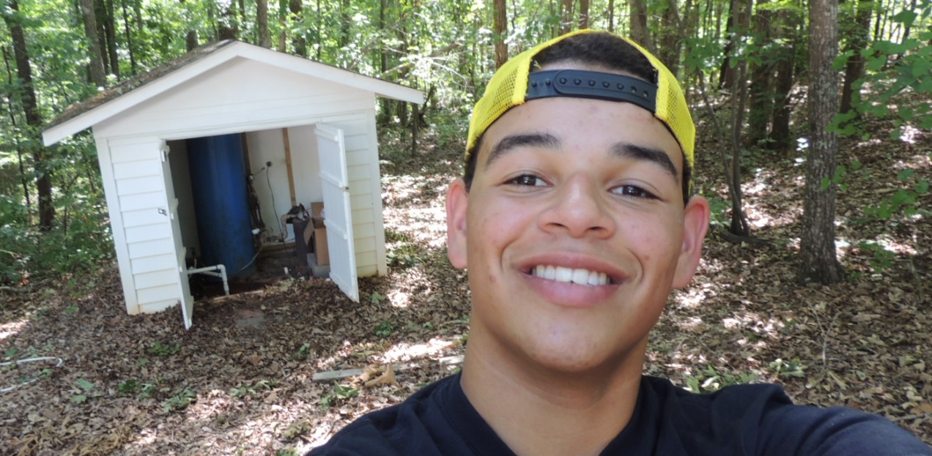
MATERIALS AND METHODS
4 Private Well Water Samples:
  Well-1: 6090DFR
  Well-2: 711JP
  Well-3: 715JP
  Well-4: 578TR
Three contained elevated levels of uranium.
“Well-1: 6090DFR” water revealed 629 ppb uranium, 3.8 pCi/L radium (²²⁶Ra + ²²⁸Ra), and 79,000 pCi/L radon.
The 2017 International Radon Symposium™

Slide 10
MATERIALS AND METHODS
Uranium Concentration in the Wells
Well | Date | Uranium Conc. (ppb)‡ | Comment | Date | Uranium Conc. (ppb)
Well-6090DFR | 3 March, 2016† | 542 | Sampled by U. Saha | 14 June, 2011§ | 629
Well-711JP | 20 June, 2016† | 22.6 | Sampled by D. Lynch
Well-715JP | 16 June, 2016† | 407 | Sampled by U. Saha
Well-578TR | 16 June, 2016† | 4,939 | Sampled by U. Saha | 15-June, 2011§ | 1,549
Well-1: 6090DFR; Well-2: 711JPR; Well-3: 715JPR; Well-4: 578TR
†Sampled and analyzed as part of this study.
‡EPA’s MCL for drinking water is 30 ppb.
§Voluntary submission by the well owner.
The 2017 International Radon Symposium™

Slide 11
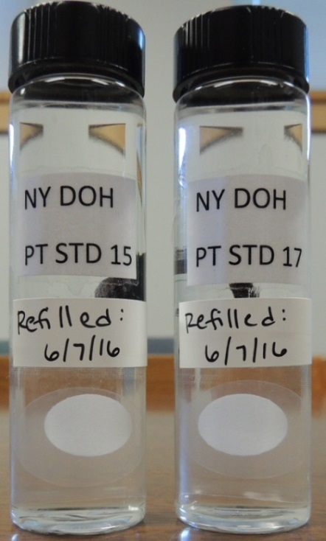
MATERIALS AND METHODS
Standard Samples: 2 radon in water standard samples (or PT samples) from NYDOH
The 2017 International Radon Symposium™

Slide 12
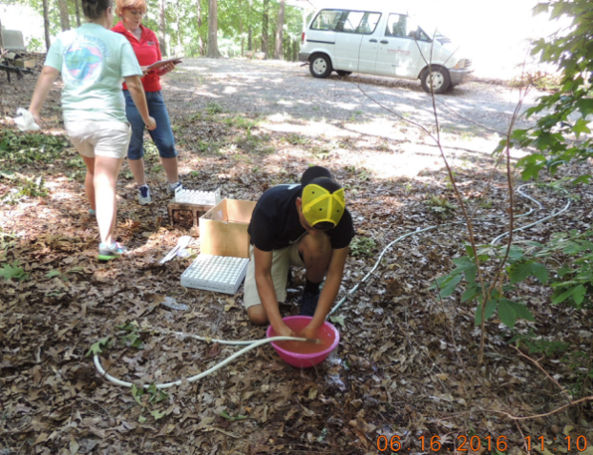
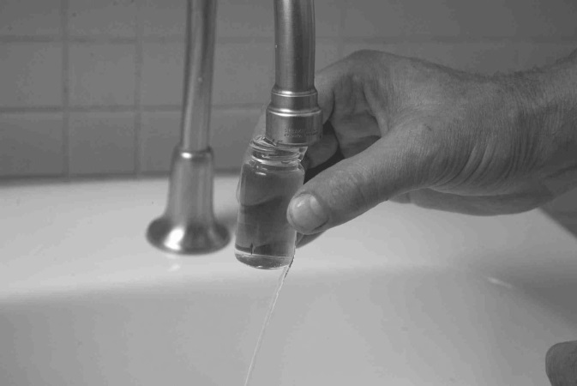
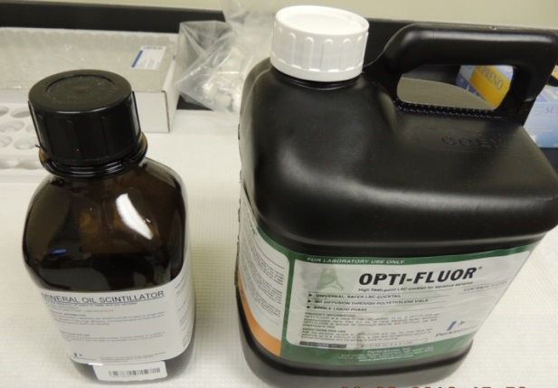
MATERIALS AND METHODS
Variables Compared:
Two Sampling Methods: Direct-Fill versus Submerged Bottle Method.
Two Different Scintillation Fluids: Mineral Oil versus Opti-Fluor.
The 2017 International Radon Symposium™

Slide 13
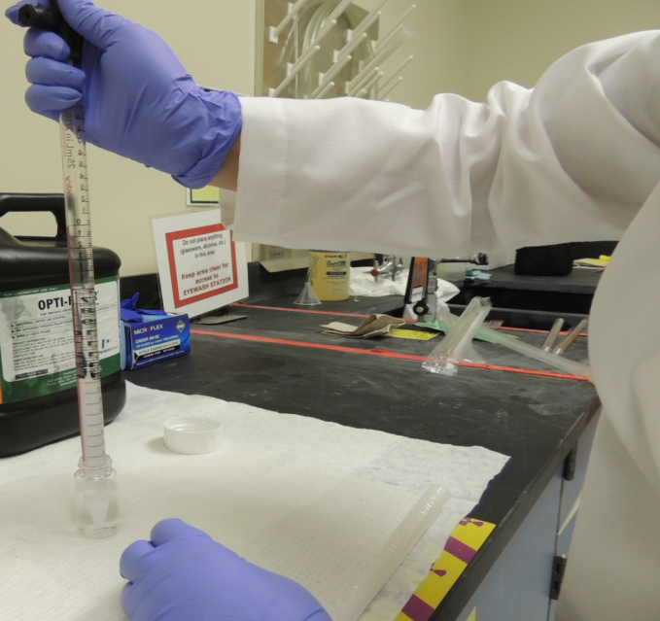
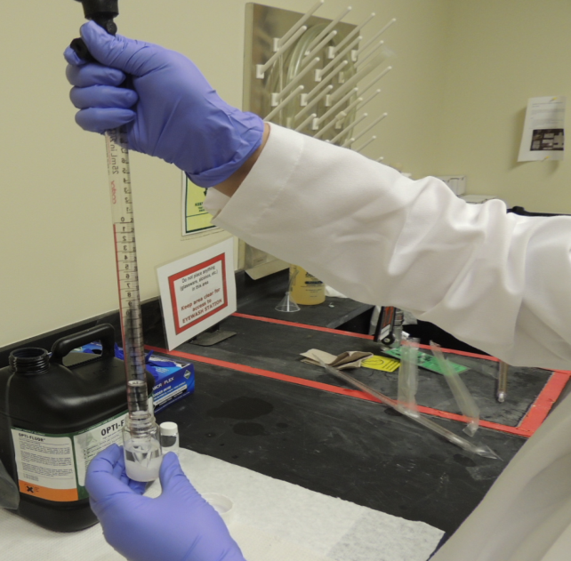
MATERIALS AND METHODS
Variables Compared:
Two Sample Preparation Methods: “Simultaneous Drawing” versus “Separate Drawing”
The 2017 International Radon Symposium™

Slide 14
MATERIALS AND METHODS
Variables Compared:
Two Different Volume Ratios in Making the Cocktail:
10 mL Scintillator + 10 mL Water
8 mL Scintillator + 8 mL Water
Location of Making the Cocktail:
On-site, Immediately After Sample Collection
In the Laboratory, 5-8 h (up to 24 h) After Sample Collection
The 2017 International Radon Symposium™

Slide 15
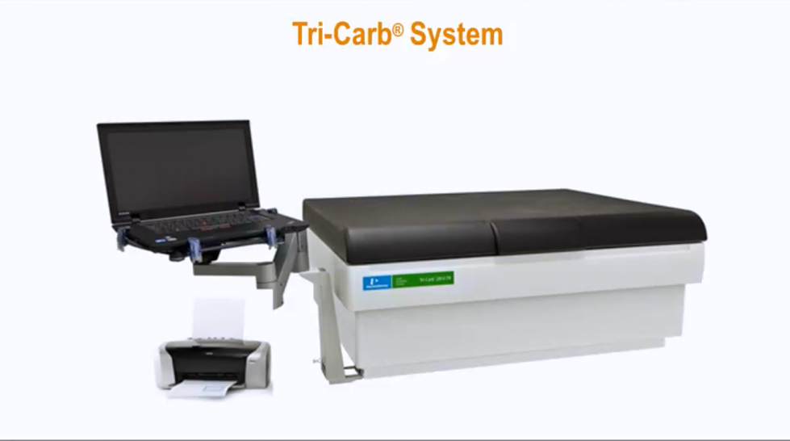
MATERIALS AND METHODS
Two Different LSC Assays: Full spectrum (0 to 2000 keV) versus ROI of ²²²Rn (130-700 keV)
Regions | Assay-1 |  |  | Assay-2
 | Lower Limit (keV) | Upper Limit (keV) |  | Lower Limit (keV) | Upper Limit (keV)
A | 0 | 2000 |  | 130 | 700
B | 0 | 2000 |  | 150 | 1800
C | 0 | 2000 |  | 0 | 2000
The 2017 International Radon Symposium™

Slide 16
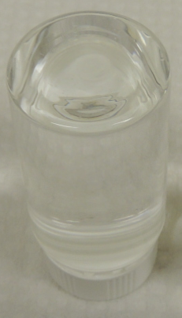
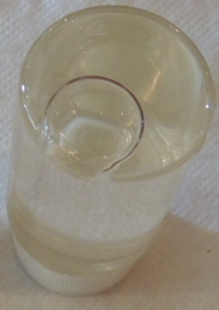
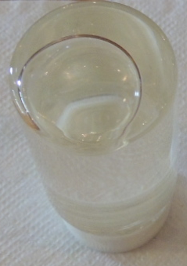
MATERIALS AND METHODS
Variables Compared:
Effects Air Bubble: 0cc 0.5cc and 1.0cc
Statistic: Standard Error of Duplicate Measurements for Each Contrasting Variables
The 2017 International Radon Symposium™

Slide 17
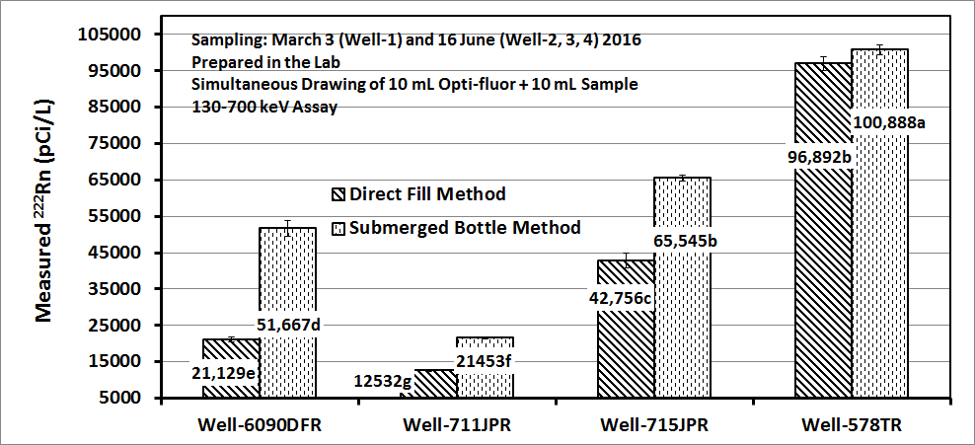
RESULTS
Sampling Methods: Direct-Fill versus Submerged Bottle
Well-1: 6090DFR; Well-2: 711JPR; Well-3: 715JPR; Well-4: 578TR
The 2017 International Radon Symposium™

Slide 18
RESULTS
Two Scintillation Fluids: Mineral Oil versus Opti-Fluor
Well-1: 6090DFR; Well-2: 711JPR; Well-3: 715JPR; Well-4: 578TR
The 2017 International Radon Symposium™

Slide 19
RESULTS
Two Prep. Methods: Separate Drawing versus Simultaneous Drawing
Well-1: 6090DFR
Well-1: 6090DFR
The 2017 International Radon Symposium™

Slide 20
RESULTS
Scintillator and Water Sample Mixed Onsite versus in the Laboratory
Well-1: 6090DFR; Well-2: 711JPR; Well-3: 715JPR; Well-4: 578TR
The 2017 International Radon Symposium™

Slide 21
RESULTS
Volume Ratios:
Mineral Oil : Water; 10 mL : 10mL versus 8 mL : 8 mL
Well-1: 6090DFR; Well-2: 711JPR; Well-3: 715JPR; Well-4: 578TR
The 2017 International Radon Symposium™

Slide 22
RESULTS
Volume Ratios: Opti-fluor : Water
10 mL : 10mL versus 8 mL : 8 mL
Well-1: 6090DFR
The 2017 International Radon Symposium™

Slide 23
RESULTS
LSC Assay Types:
Assay-1 (Full Spectrum: 130-700 keV) versus Assay-2 (ROI: 130-700 keV)
The 2017 International Radon Symposium™

Slide 24
RESULTS
Temporal Variation in Radon Concentration in 3 Wells
Well-2: 711JPR; Well-3: 715JPR; Well-4: 578TR
The 2017 International Radon Symposium™

Slide 25
RESULTS
Effect of Air-Bubble in the Sample
Well-3: 715JPR; Well-4: 578TR
The 2017 International Radon Symposium™

Slide 26
RESULTS
Known: 3840 pCi/L
~75% of the known: 2880 pCi/L
~125% of the known: pCi/L
With Standard Samples
The 2017 International Radon Symposium™

Slide 27
RESULTS
With Standard Samples
8 consecutive measurements at University of Georgia laboratory
Two different LSC assays: 0-2000 keV versus 130-700 keV
Two different scintillation fluids: Mineral oil versus Opti-fluor
The 2017 International Radon Symposium™

Slide 28
Conclusions
Sampling Methods: Direct-Fill Method is susceptible to significant Loss of Radon gas, submerged bottle method should be used.
Counting Assays: The Assay-2 (130-700 keV) is better than the full spectrum assay (0-2000 keV).
Effects of Air Bubbles: Air Bubble in the samples results in significant Loss of Radon gas; such loss becomes greater as the size of the air bubbles becomes larger.
Scintillation Fluids: Mineral oil generally gives higher radon counts than Opti-fluor. However, the results of PT or Standard samples showed that Mineral oil Clearly over estimates the actual Radon concentration, whereas Opti-oluor always gave the results close to the True value.
As a scintillator for radon in water, it is widely believed that Mineral oil is a better than Opti-fluor. However, our results show that the opposite is indeed true!
The 2017 International Radon Symposium™

Slide 29
Conclusions
Volume Ratio: A 10 mL scintillator + 10 sample combination is better than 8 mL scintillator + 8 mL sample combination for a liquid scintillation cocktail.
Sample Prep. Method: “Separate Drawing” of scintillator and sample may result in significant loss of Radon; So, “Simultaneous Drawing” should be adopted when laboratories use open pipettes. However, this effect may be insignificant if a closed-top (no headspace) sampling syringe is used.
Making Cocktail by mixing scintillator and sample in the laboratory is better than making the cocktail on-site for both better results and practicality of testing Radon in private well waters.
There were Noticeable Temporal Variation in both radon and uranium concentrations in the study wells.
Use of uranium concentration over 30 ppb (the MCL of uranium in drinking water) as a Trigger for recommending test for radon in well water remains questionable because there may be safe level of uranium but unsafe level of radon, and vice versa in a given well water.
The 2017 International Radon Symposium™

Slide 30

URANIUM AND RADON IN INDOOR AIR AND DRINKING WATER TESTING AND EDUCATION PROGRAM
The 2017 International Radon Symposium™

Slide 31



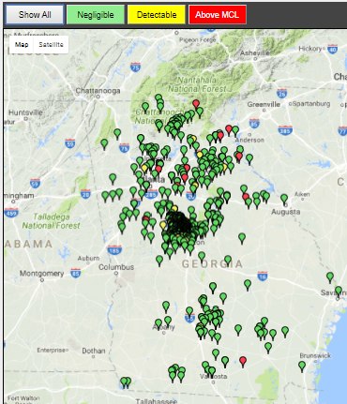
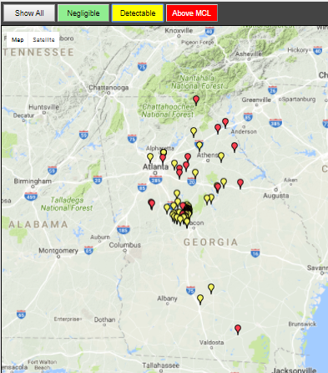
UGA WATER MAP
http://aesl.ces.uga.edu/water/map/
URANIUM
Updated: 8/31/2017
The 2017 International Radon Symposium™

Slide 32
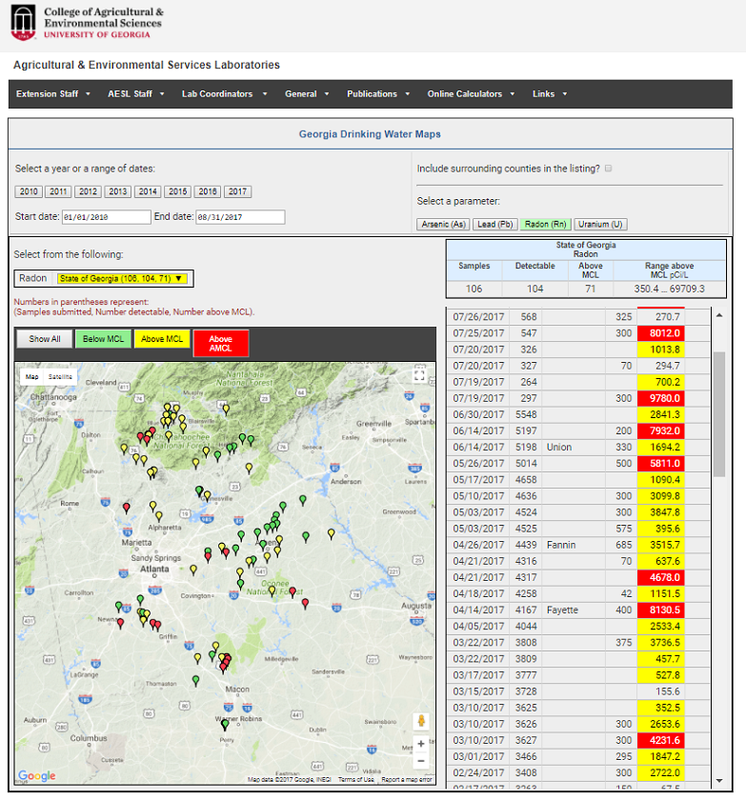
UGA WATER MAP
http://aesl.ces.uga.edu/water/map/
RADON
Updated: 8/31/2017
Radon in Water:
Proposed MCL: 300 pCi/L
Proposed AMCL: 4000 pCi/L
The 2017 International Radon Symposium™

Slide 33
THANK YOU VERY MUCH!!!
QUESTIONS, COMMENTS……….
Contact:
Uttam Saha, PhD
Public Service Associate & Program Coordinator
Agricultural and Environmental Services Laboratories
The University of Georgia, Athens, GA
706-542-7690
sahau@uga.edu
The 2017 International Radon Symposium™

