Slide 1
Design and Development of a New Radon Calibration Chamber
Curtis Caldwell, PhD, Jason Sadowski MSc, and Octavian Mavrichi MSc
The 2017 International Radon Symposium™

Slide 2
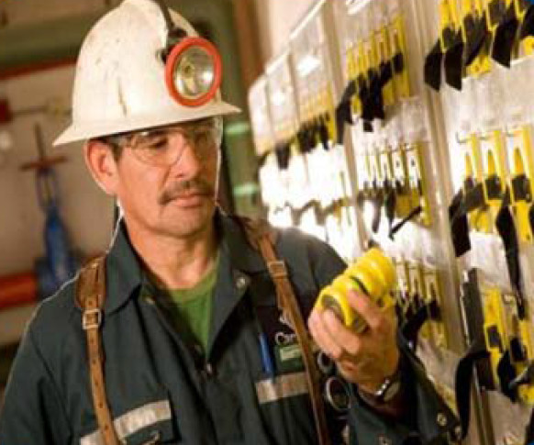
Radiation Safety Institute of Canada
Founded in 1980 directly as a result of the Elliot Lake uranium mine experience
Independent
Not-for-profit
Mission:
Prevention of cancer, occupational illness and injury from unacceptable exposure to radiation.
The 2017 International Radon Symposium™
Notes:
Mandate. PAD service. Radon chamber for testing of PADS. Came from Elliott lake.

Slide 3
Canada Needed a Chamber
Canadian National Radon Proficiency Program (C-NRPP) launched in 2012 to fulfill need for certification program for Canadian Professionals
Increasing numbers of radon measurement/mitigation professionals
No certified radon test chamber in Canada
The 2017 International Radon Symposium™
Notes:
Increasing numbers of radon professionals. No access to a Canadian Laboratory.
RSIC has a laboratory for testing our PADs. In 2014 began discussion with Health Canadato modernize the RSIC chamber to provide a service for Canadians.

Slide 4
What the heck would you do with a radon chamber?
Spike testing (compare your reading of radon detected with known exposure in chamber)
Performance testing (blind)
Verification of calibration for Continuous Radon Monitors
Verification of calibration for scintillation ZnS (Lucas) cell

Slide 5
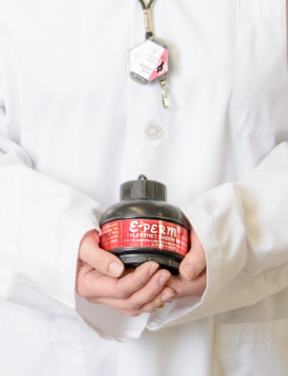
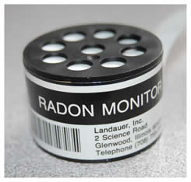
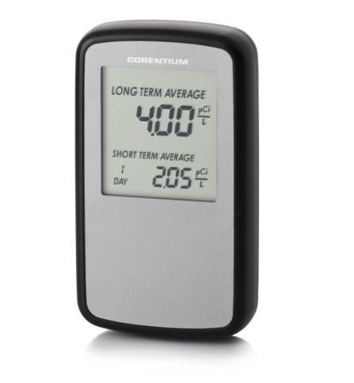
Radon Chambers
Need arises for a reference atmosphere for standardized testing, under controlled conditions, of measuring instruments
C-NRPP -> Calibration/Performance/Spike Testing
The 2017 International Radon Symposium™

Slide 6
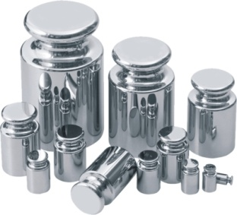
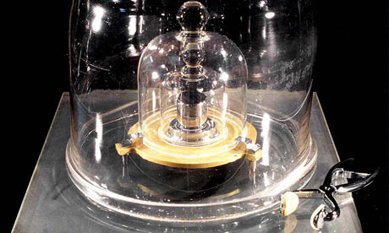
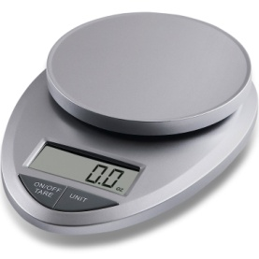
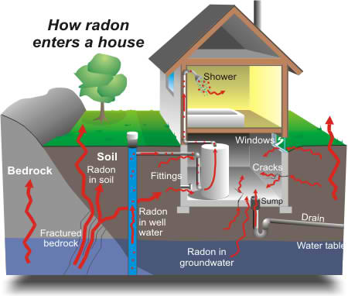
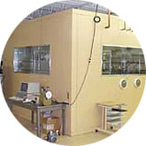
Traceability for Radon
Something to be
measured
Measurement
Device
Secondary
Standard
Primary
Standard
The 2017 International Radon Symposium™
Notes:
Primary standard: Standard that is designed or widely acknowledged as having the highest metrological qualities and whose value is accepted without reference to other standards

Slide 7
Components of a Radon Chamber
How do we know this is accurate?!
Equipment for producing radon
Equipment to contain it inside a volume
Equipment to monitor the radon inside
Equipment to control the concentration
3
1
Reference Instruments
Radon Source
Reference Atmosphere
Control Circuit
Instrument Under Test
4
Container
2
The 2017 International Radon Symposium™

Slide 8
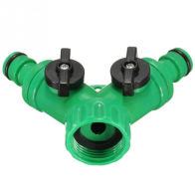
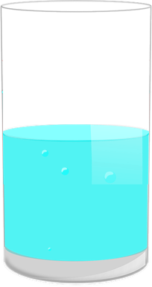
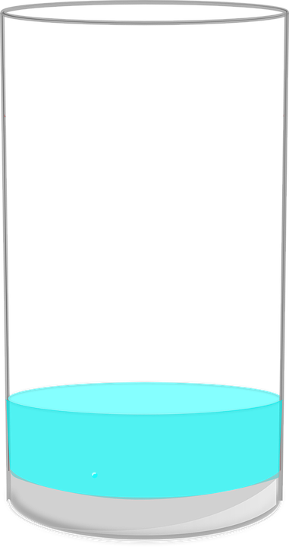
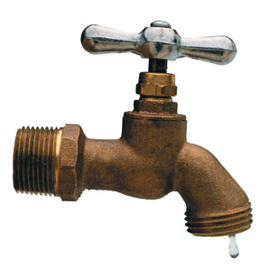
Controlling Radon Concentrations
$$ε$$
The 2017 International Radon Symposium™

Slide 9
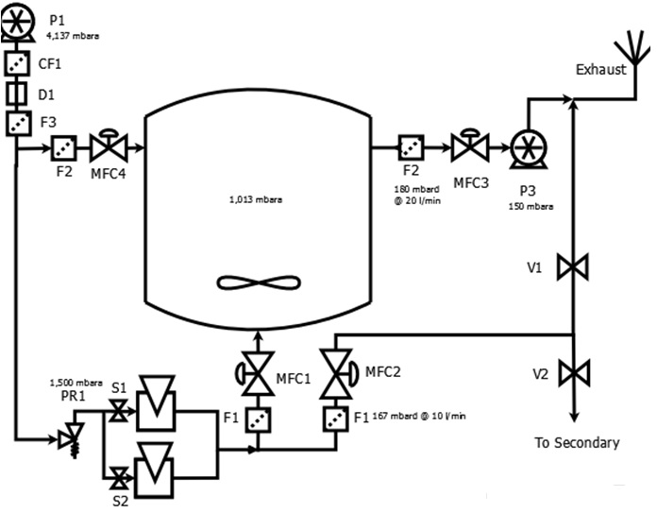
Radon Control System
The 2017 International Radon Symposium™

Slide 10
Radon Injection
The 2017 International Radon Symposium™

Slide 11
Exhaust
The 2017 International Radon Symposium™

Slide 12
The 2017 International Radon Symposium™

Slide 13
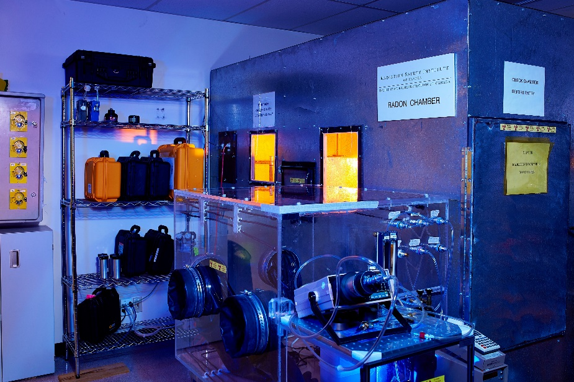
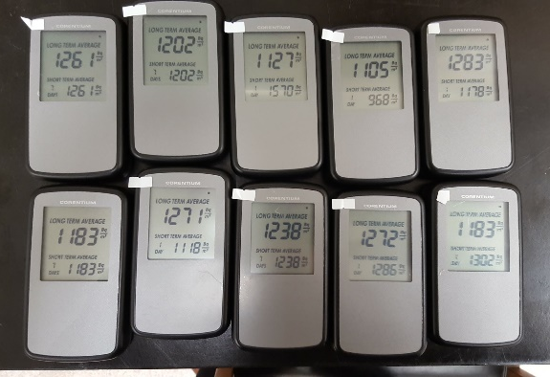
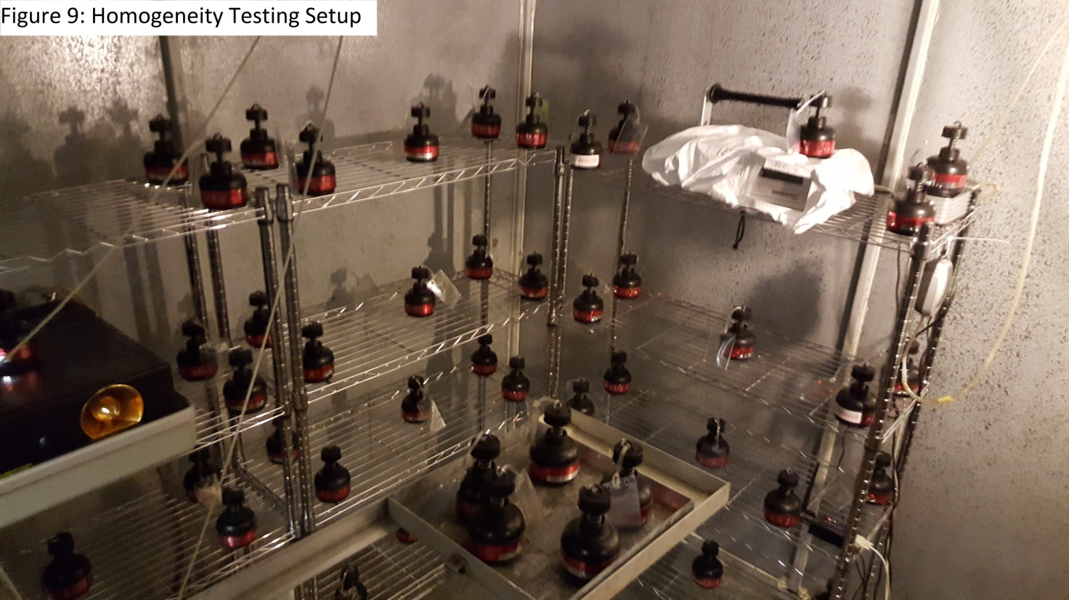
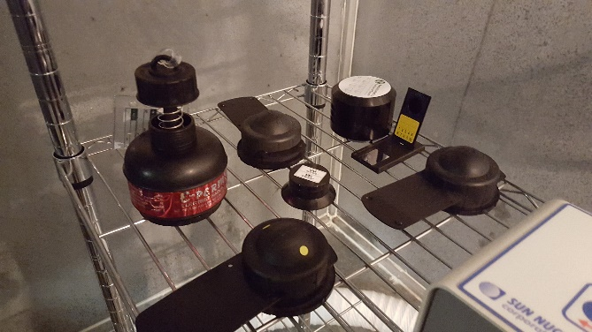
Chamber Parameters
Chamber Element
Concentration | 148 Bq/m³ – 500 kBq/m³
Size | 12 cubic meters + small glove box for experiments
Reference Instrument | AlphaGuard DF2000
Traceability | 4 Pylon 300A Cells at Bowser-Morner
The 2017 International Radon Symposium™

Slide 14
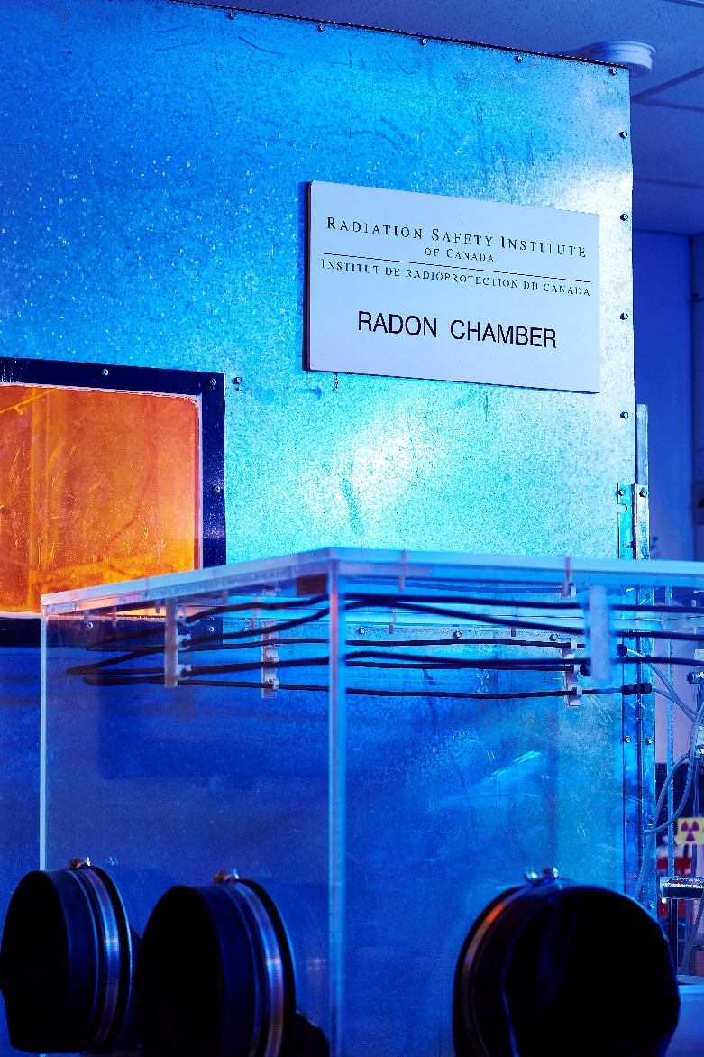
Summary
Radon chambers must maintain traceability in measurement
RSIC with support from Health Canada have introduced first AARST-NRPP certified facility in Canada!
Now serving Canadian and US customers
March 2017
The 2017 International Radon Symposium™
Notes:
Special thank to jeff, deepti, and renato for advice and support throughout the project.

Slide 15
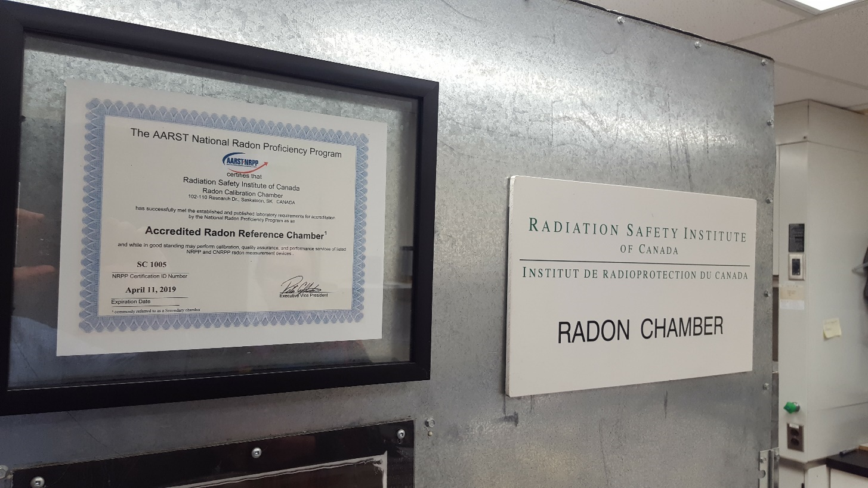
Questions?
Contact: Curtis Caldwell 416-660-9090 ext 25
ccaldwell@radiationsafety.ca
The 2017 International Radon Symposium™

