Slide 1
Creating a National Radon Database
Colorado Environmental Public Health Tracking
Eric Brown

Slide 2
Introduction The net keeps getting wider!
CDC Environmental Public Health Tracking
EPA Radon program
EPA Exchange Network
State, Local, Tribal partners
Universities
Radon testing labs
Instrument manufacturers

Slide 3
Last year-
Updating the national map
Brainstorming-connected with Dallas via Chrys early 2017
Only had about 6 months to symposium
Thought we could get a new national map up by now
Planned on using the same method as original map (EPA 1993)
This year-
Moving toward a national database
Tracking launched radon page & Fall data call
Exchange Network grant updating an EN data flow
~350k new data points

Slide 4
Process
2017
We needed to do a lot of outreach
Really needed address level data
Really needed pre/post mitigation flags
Sent out data sharing agreements
Received some data (5 / 8 returned data)
Geomasked & geocoded as needed
2018
Continued outreach to potential partners
Still have labs collecting data w/o addresses or pre/post
Data sharing agreements strengthened
Received only 2 datasets
Geocoding donated this year and commitment for future

Slide 5
Data
2017-Received approximately 3 M results
2018-Received approximately 350k new results
2017-342 counties w/ no data
2018-267 counties w/ no data

Slide 6
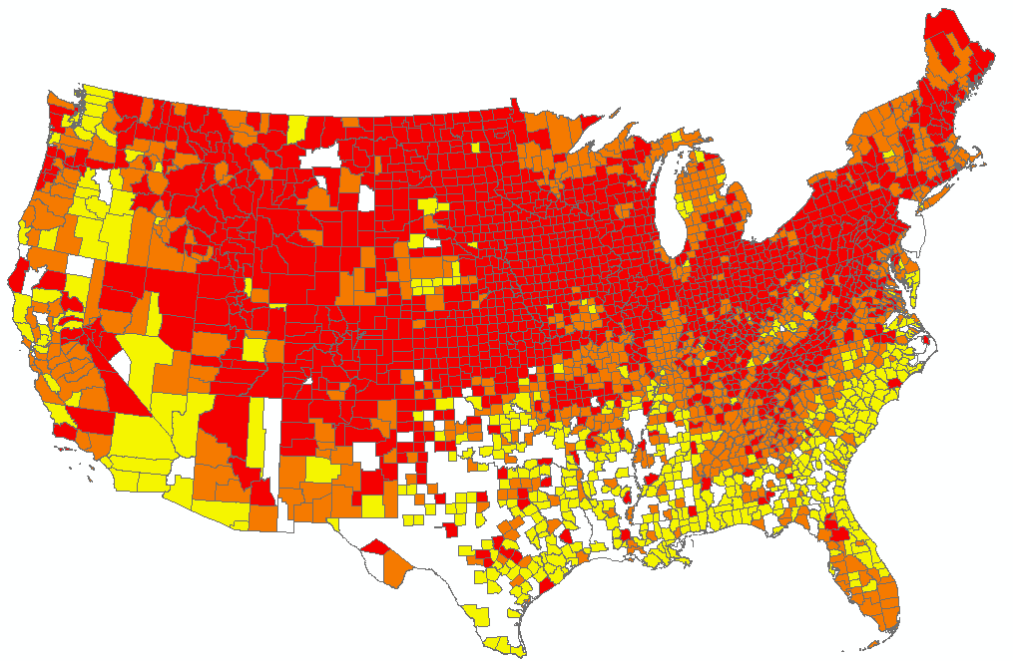
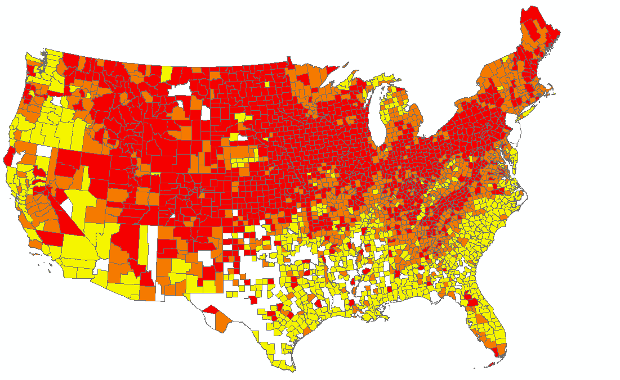
Data in 75 additional counties where we had none a year ago!
DRAFT
2017 - 342 counties w/ no data*
2018 - 267 counties w/ no data*
*Small numbers, i.e. too few samples, likely cause the shift in measure values in areas where observed.

Slide 7
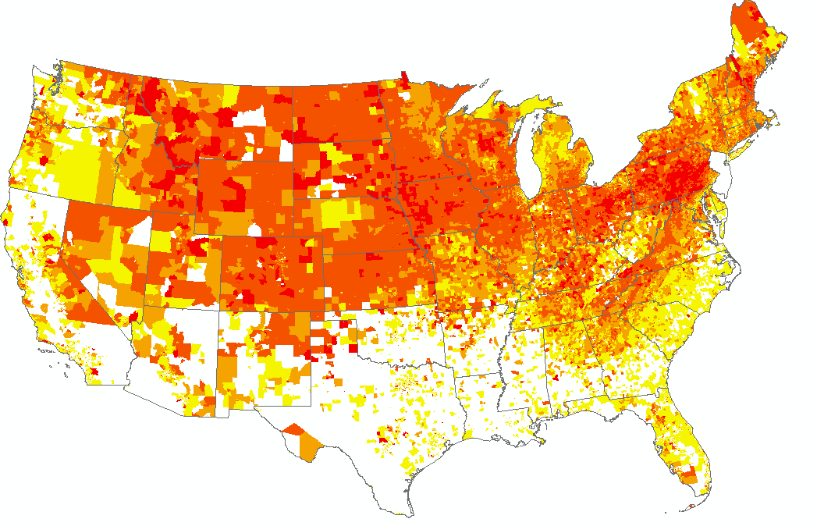
Census Tracts – higher resolution w/ same data
DRAFT

Slide 8
Recommendations
Start collecting and providing pre-mitigation flag data right away.
Provide address data in a secure way to Colorado DPHE or CDC.
Work with accrediting state agencies to ensure everyone is happy.

Slide 9
Lessons Learned
Be aware of partners interests, put them first if possible
Be cognizant of other states statutes and program needs
Data sharing agreements are stronger than ever and have been adapted by other programs
Patience (see number 1 above)

Slide 10
Acknowledgements
2017 Partners for getting this started
Alpha Energy & AirChek for providing 2018 updates
SmartyStreets for providing free geocoding software
Future partners with whom we’ve spoken but haven’t yet been able to commit resources
CDC, EPA, AARST, State, Local, Tribal partners
Chrys Kelly and Andy Putnam

Slide 11
Thanks!
Questions?
Contact Info:
Eric Brown
ericm.brown@state.co.us
(303) 692-3630

