Slide 1

Homebuyer Awareness
Dallas Jones

Slide 2
Radon Awareness /Notification
  Mandatory notification about radon risk / importance of testing:
    Real estate agent conveys info to the buyer
    State Real Estate body oversees it per statute
Present in nine states (DE FL IL IA KS MN MT NH RI)
Key Elements
  Radon Awareness - a standard warning statement
  Recommendation to test
  Pamphlet/brochure - state-specific
  Disclosure of property-specific test results and mitigation
Two states’ awareness laws have demonstrated success in terms of increased radon testing and mitigation
2018 International Radon Symposium™

Slide 3
Radon Awareness/Notification Policies - Summary
POLICY ELEMENT | DE | FL | IL | IA | KS | MN | MT | NH | RI
Signed Warning Statement |  |  | X | X |  | X | X | X
Warning Statement | X | X |  |  | X |  |  |  | X
Testing Recommended | X |  | X | X | X | X |  |  | X
Qualified Tester Recommended |  | X | * | X | X |  |  | X* | *
Prior Tests Disclosed | X | X | X’ | X | X’ | X | X | X | X
Applies to Rental Agreements |  | X
Mitigation System Info |  |  |  |  |  | X | X |  | X
Pamphlet Provided | X |  | X | X |  | X
* state law requires certification or license ‘ elevated radon level only

Slide 4
Awareness/Notification
As Alternative to Testing
More acceptable to realtors
  Virtually no cost
  Lower risk to seller
  Unlikely to impede timing of transaction
Assures every buyer some level of information
Allows buyer to choose method / testing professional

Slide 5
Awareness/Notification vs. Disclosure
Disclosure involves revealing property-specific knowledge
  32 states specify radon tests shall be revealed
    Implicit duty to reveal any know defects in all states
  Radon is included on a long form listing multiple disclosures
Disclosure is disincentive to property owner getting test
    “why discover a property defect if you must reveal it?”
Awareness requirement complements disclosure
  Level playing field - all buyers are getting some info on radon
  Corrects false impression when disclosure checkbox marked “no”
Awareness law can expand what is already disclosed

Slide 6

Home Buyer Protections – Map

Slide 7
Illinois Radon Program 20 and 10
20 Years of Licensing
10 Years of Radon Awareness
Patrick Daniels
2018 International Radon Symposium™

Slide 8
Radon Industry Licensing Act - 1998
Requires individuals providing radon measurement or mitigation services to be licensed.
Identifies IEMA as the lead agency and required IEMA to promulgate regulations.
2018 International Radon Symposium™
Notes:
In the fall of 1996 the leadership of Midwest AARST came to IEMA at the time IDNS) and asked that the state consider a requirement to license and regulate the radon industry in Illinois.
There primary concern was the untrained and unqualified work being performed by individuals throughout the state but specifically in the metropolitan areas.
Large corporations like State Farm Insurance, Country Companies Insurance, Allstate Insurance, Bridgestone, Firestone, IBM, Motorola and Caterpillar were all concerned with radon as a liability issue when transferring employees and taking their homes into their corporate inventory for resale.
The Real Estate industry was educated on the need to test and mitigate , however they did not know what was substandard and incorrect measurement and mitigation was making it hard to compete for those individuals who were trying to follow the EPS protocols at the time.
The radon Industry Licensing Act passed the legislature , was signed by the Governor and became effective in in July 1997.

Slide 9
32 Illinois Administrative Code 422
Regulations for Radon Service Providers
Emergency Rule was adopted on January 1, 1998.
Regulations for Radon Service Providers was adopted on July 1, 1998.
2018 International Radon Symposium™
Notes:
An emergency rule was enacted in accordance with Illinois Administrative Procedures on 1/1/1998 and only required individuals who were currently listed in the EPA proficiency program to document their certification to receive a provisional license.
The Agency wrote and had approved by the Joint Committee for Administrative Rule sin Illinois the Illinois regulation , Regulations for Radon Service Providers on July 1, 1988 requireing all provisional and new licensees to submit new applications including their Quality Assurance Programs and Standard Operating Procedures.
The regualtion was incorrectly called for years the “Adopted Rule.”

Slide 10
Illinois Licensee Growth
Radon Awareness Act
2018 International Radon Symposium™

Slide 11

Radon Awareness Act - 2008
Mandated disclosure of radon risks and measurement information by a seller to a buyer prior to the buyer making an offer to purchase a home.
2018 International Radon Symposium™

Slide 12
Awareness Act Effects
2018 International Radon Symposium™

Slide 13
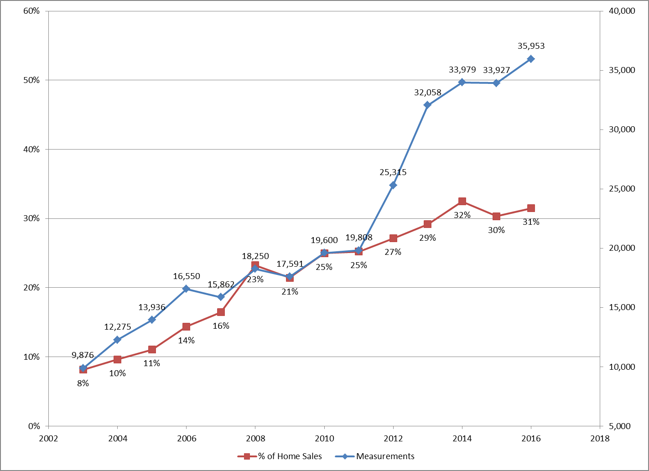
Measurements as a Percent of Sales

Slide 14
Illinois Radon Industry Growth
2018 International Radon Symposium™

Slide 15
Josh Kerber
State of Minnesota

Slide 16
Effects of a Radon Awareness Law in a Non-Regulated State
Joshua J. Kerber, MS
Research Scientist
Minnesota Department of Health

Slide 17
The Minnesota Radon Awareness Act
  Passed in 2013 Legislative Session, Effective January 1, 2014.
  Before signing a purchase agreement to sell or transfer residential real property, the seller shall disclose in writing to the buyer any knowledge the seller has of radon concentrations in the dwelling. The disclosure shall include:
    whether a radon test or tests have occurred on the property;
    the most current records and reports pertaining to radon concentrations within the dwelling;
    a description of any radon concentrations, mitigation, or remediation;
    information regarding the radon mitigation system, including system description and documentation, if such system has been installed in the dwelling; and
    a radon warning statement developed by MDH
    a copy of the Minnesota Department of Health publication entitled "Radon in Real Estate Transactions."
2018 International Radon Symposium™

Slide 18
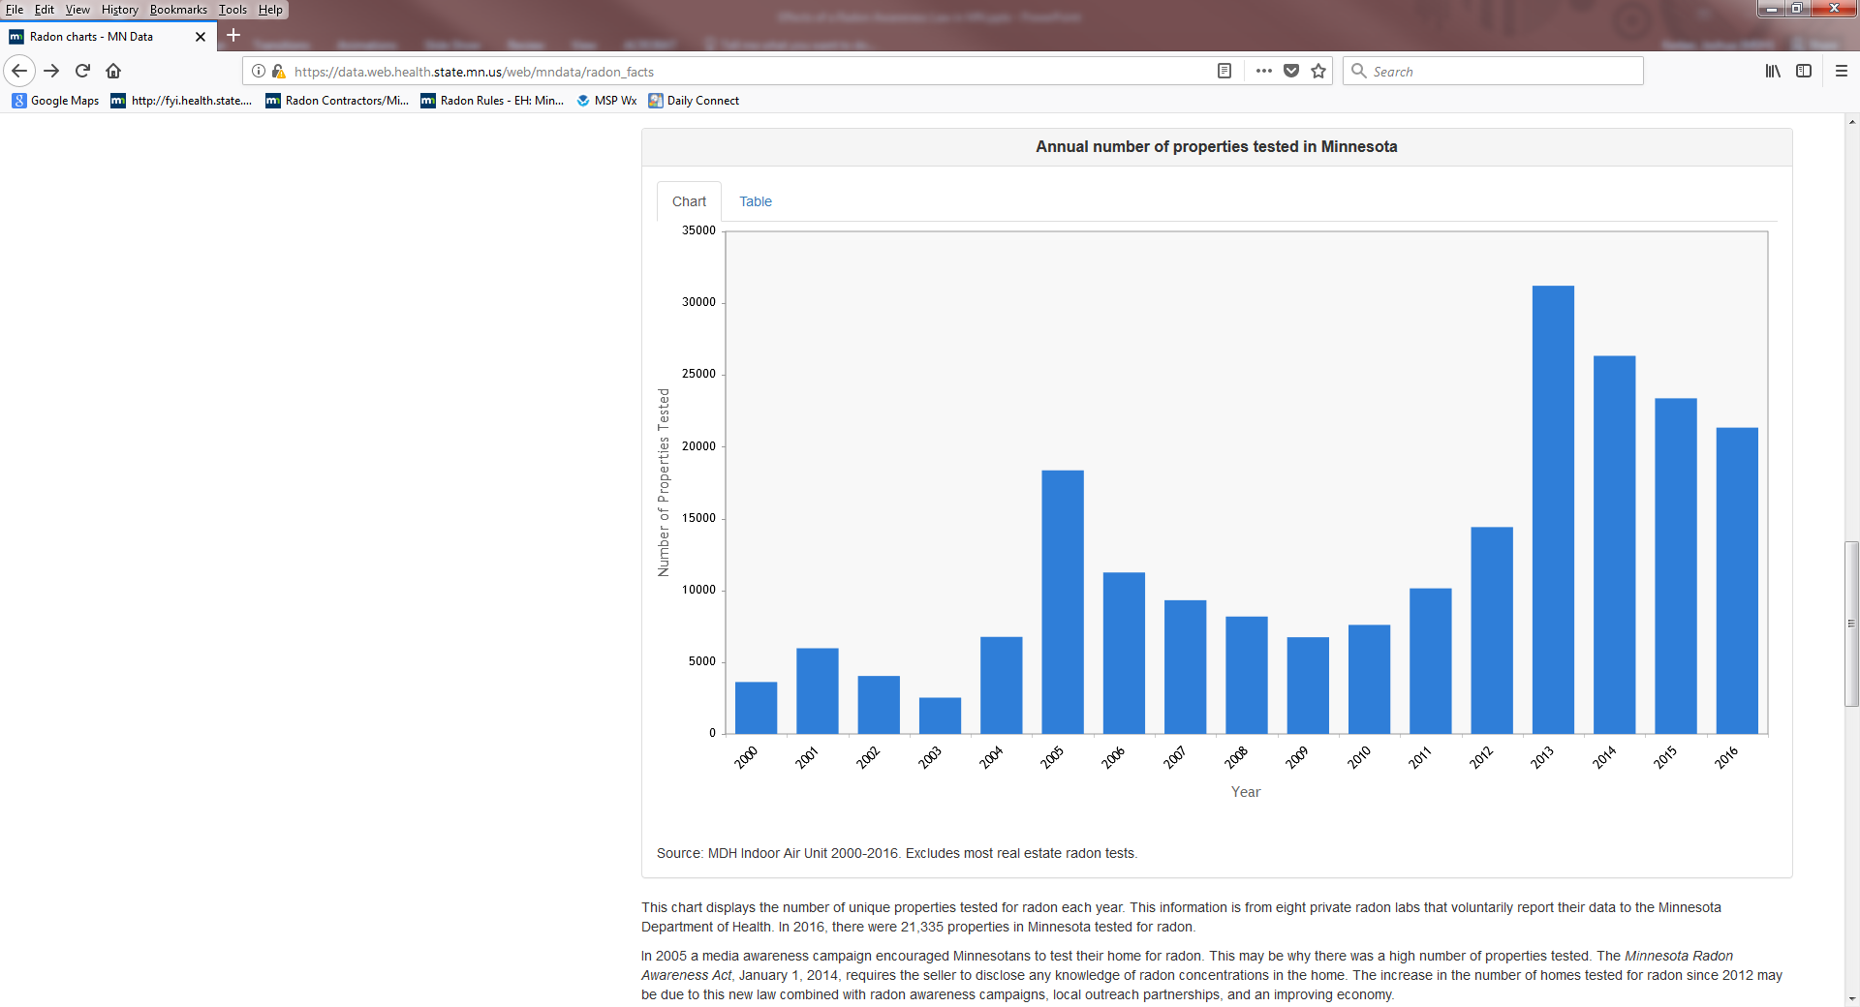
Increase in Radon Testing – Homeowner Data
2018 International Radon Symposium™

Slide 19
Growth of Minnesota Radon Industry
2018 International Radon Symposium™

Slide 20
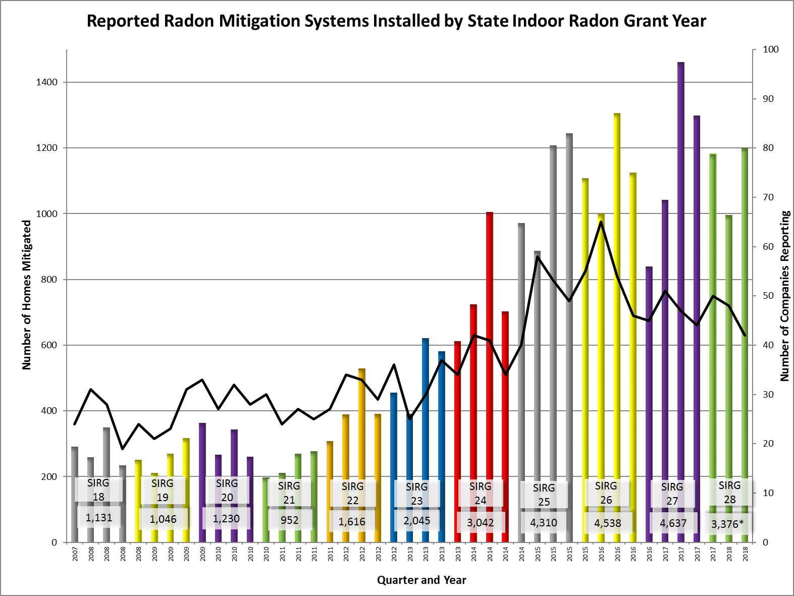
Increase in Mitigations
2018 International Radon Symposium™

Slide 21
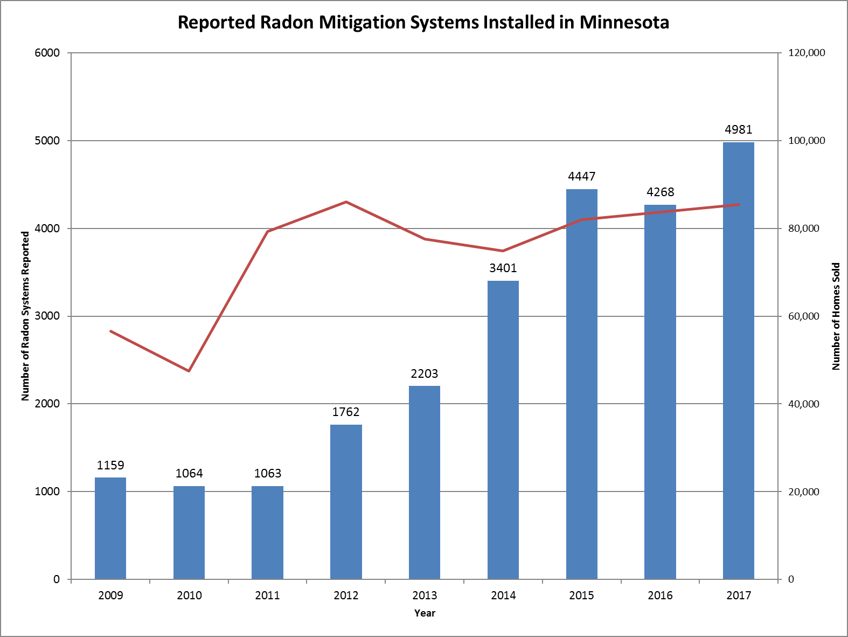
Mitigations Reported vs Home Sales
2018 International Radon Symposium™

Slide 22
Advice and Lessons Learned
Radon results will increase
  Estimated 4-8x increase in testing – 52% of sales have a test now
  Measured 4x increase in mitigation
Be prepared to handle the additional load
Make partners out of adversaries
Get the real estate industry on your side or at least not opposing you
Be prepared with your facts: unbiased and non-partisan data
Know the difference between “Educating” and “Lobbying”
  Educating = neutral informing/education: “Radon causes lung cancer.”
  Lobbying = influencing legislation: “Sponsor or pass this bill.”
2018 International Radon Symposium™

Slide 23


Slide 24

Strategy: Homebuyer Notification/Awareness Policy-How to Guide
Presented by:
Shad Evans - President OARP & Jessica Karns - Treasurer OARP

Slide 25
Radon Awareness Act
Regulation Drives OUR Industry!
Illinois – Radon Awareness Act
  Not a mandate
  Disclosure form that must be given to all homebuyers in the state.
  Disclosure states what radon is and why it’s dangerous and that it is commonly found at high levels in our area.
  After passing, the state of Illinois experienced a significant increase in testing and mitigation.
2018 International Radon Symposium™

Slide 26


Radon Awareness Act: Strategy for Success
Step 1 – Do your research
Meet with other radon professionals who have attempted this to get strategy and action plan.
Decide who will be the point person for the action plan
Research
Pitch person
Legislative liaison –follow up
2018 International Radon Symposium™

Slide 27




Identify Your Bill Sponsor
Start in your backyard
Constituency first
Review voting record
Look for Reps with history of sponsoring bills or voting on bills with similar language –Environmental impact /Public Health
Democrat vs Republican?
Attend party fundraisers or candidate events
Chance to meet key people – Kirk Shirring Fund Raiser
Initial contact phone vs email?
2018 International Radon Symposium™

Slide 28
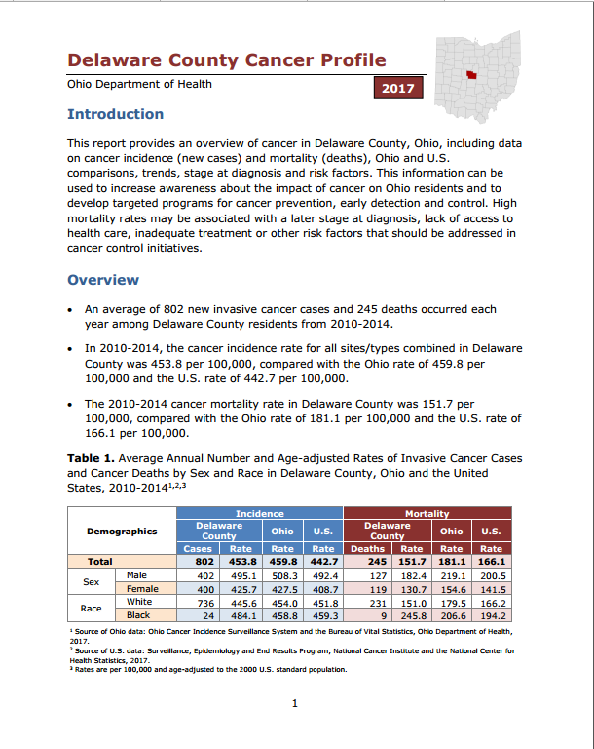
Preparing For the Meeting
Prepare a packet of useful information for the meeting
  Resources- Health Department, Lung Association, EPA, AARST
  Personalize everything to their district – personal stories
  Included in your Packet:
  Local health department data
  State cancer rates
  Legislative bill language – very important
  Data on other states that have passed the bill
2018 International Radon Symposium™

Slide 29
Key Points to Emphasize
Emphasize not a mandate- Consumers making an informed decision.
Many real estate companies have a sign off for radon built into their contract but offer no credible information about what it is- relies on realtors for information.
Effect on their district
Personal stories from the field
2018 International Radon Symposium™

Slide 30

Advocacy vs. Education
Know who you represent and what you are allowed to say- Private Business vs non-profit organization. 501c3/501c6
Non Profit- Education
Private Business – Advocacy
2018 International Radon Symposium™

Slide 31
Follow up
Very important since most likely no decisions will be made during the meeting.
A follow up email and call to emphasize the points made in the meeting and ask respectfully for a commitment.
Patience- some reps will take months to consider the information.
  Important to follow up periodically
Don’t runout and approach every rep – this could cause unnecessary issues.
2018 International Radon Symposium™

Slide 32


Questions?
Shad Evans
Radon Be Gone
OARP President
shad@radonbegone.net
Jessica Karns
A-Z Solutions, Inc
OARP Treasurer
Jessicakarns@vaporremoval.com
2018 International Radon Symposium™

