Slide 1

National Research Council Canada and Radon Control Technologies
Prepared by: Dr. Liang Grace Zhou, Gang Nong, and Ethan Li
National Research Council Canada - Construction Research Centre
For: AARST 2018 International Radon Symposium™
October 2, 2018
Notes:
Good afternoon everyone, my name is Grace Zhou and I’m a researcher from the National Research Council. Today my topic is about controlling radon gas in buildings.

Slide 2
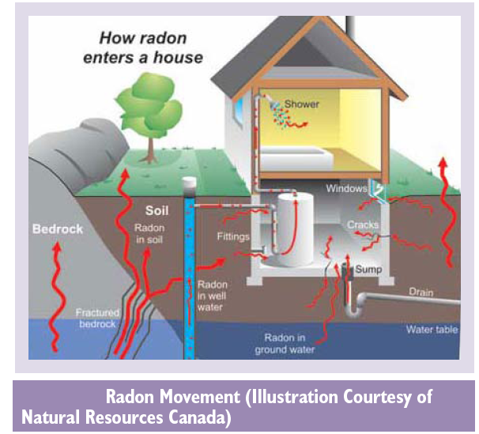
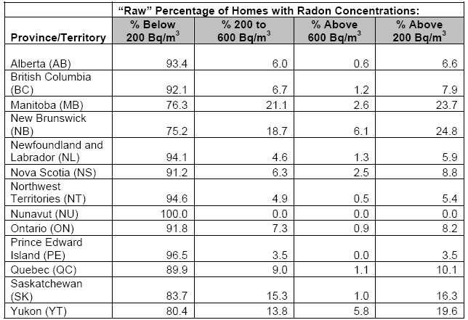
Background
HC-RPB cross-Canada survey of 14,000 homes: ~7% of Canadians living in homes with a radon level >200 Bq/m³
16% lung cancer deaths attributable to radon exposure 3,200/yr in Canada
Notes:
Slide2. Radon is a naturally occurring radioactive gas that is colorless and odorless, and is found in varying amounts in all types of soil and bedrock. When the air pressure in a building is lower than that in the surrounding soil, soil gas including Rn will enter the building through openings and cracks in the foundation and the concrete walls, or through any underground water being used by the household.
It is acknowledged that long term exposure to high level of Rn increases the risk of developing lung cancer, and the risk is considerably higher for smokers. Health Canada estimates approximately 16 per cent of lung cancer deaths in Canada each year are attributable to radon exposure (Chen et al., 2012).
A cross-Canada survey was conducted by Health Canada in 2009 and 2010, the results indicate that 6.9% of Canadians are living in homes with radon levels above the current radon guideline of 200 Bq/m3.
Manitoba, New Brunswick, Saskatchewan, and the Yukon had the highest percentages of participant homes which tested above the radon guideline. There are no areas of the country that are ‘radon free’. The only way to know if a home has an elevated level of radon is to test, regardless of location.
Currently, Rn mitigator usually take active measures to reduce Rn level in a house, for example, installation of a active sub-soil depressurization system, sealing radon entry route, or increasing the ventilation in a house.

Slide 3
NRC’s Radon Research
  Why
    Mission-driven channel for federal investment in R&D
    Technical inputs for regulators, standards committees, and radon practitioners
    Emerging “radon industry”
    Public awareness and verified solutions
  Funding sources
    Federal Funding-Taking Action on Air Pollution
    Interdepartmental agreement with Health Canada Radiation Protection Bureau
    Fee for Service contracts with industrial clients
  How
    NRC’s multidisciplinary expertise, unique facilities, and links to industry
    Canadian Construction Material Centre and National Building Code Committees
Notes:
NRC’s multidisciplinary expertise, unique facilities, and links to industry
Building engineer, building scientist, mechanical engineer, ionizing radiation scientist, concrete and structural engineer, electrical engineer, chemists
Radon Infiltration Building Envelop Test System, Radon Diffusion Test Chamber, fan leakage test rig, Canadian Centre for Housing Technology, Indoor Air Research Lab, etc.
Canadian Construction Material Centre and National Building Code Committees
3

Slide 4
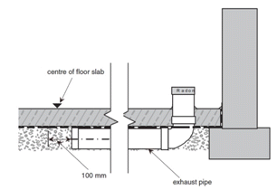
Radon in the National Building Code of Canada: Housing and Small Buildings
2015 NBC Part 9
  Sealed soil gas barrier (e.g. 6 mil polyethylene based on CAN/CGSB-51.34-M86)
  100 mm Gas permeable layer (e.g. gravel) beneath air barrier
  Sump pit cover required to be airtight
  Consistent requirements for ground cover
  Sealed, capped, and labeled rough-in pipe
  with inlet near centre of slab
  and top end ready for Active Soil Depressurization
Notes:
Here are some of the changes to the basic protection in a little more detail:
The air barrier requirements are moved to a more relevant section
A polyethylene soil gas barrier is not optional anymore now required under slabs for all buildings
Sump pit covers are now required to be airtight
The requirements for ground cover are more consistent
The exemption from fill under slab was deleted because it was incorrect

Slide 5
Radon in the National Building Code of Canada: Large Buildings & Optional for Small non-Residential Buildings
2015 NBC Part 5 – Environmental Separation
Control of Air Leakage
  Minimize the ingress of airborne radon from the ground with an aim to controlling the indoor radon concentration to an acceptable level
2015 NBC Part 6 – HVAC
Good HVAC Engineering Practice
  EPA/625/R-92/016, “Radon Prevention in the Design and Construction of Schools and Other Large Buildings” Ventilation and ASD
Appendix Guidance
    Health Canada Guide for Radon Measurements in Public Buildings
Notes:
The change in the body of Part 5 of the NBC, introduces a performance target specific to radon that you see in blue and
it states
“ Minimize the ingress of airborne radon from the ground with an aim to controlling the indoor radon concentration to an acceptable level”

Slide 6
Radon Control Research Activities at NRC
Active soil depressurization (ASD) in labs/test facilities
  Leakage through radon control fans
  Energy penalty and impact on soil temperature
  Insulation of stacks in unheated attic space
  Backdrafting from combustion appliances
  Sub-slab gas permeable layer and air barrier systems
A combination of strategies
Air tightness, air change rate, HRV, and radon concentration
Field studies of passive soil depressurization (PSD)
Notes:
In some cases, the client developed new product for radon prevention and control and come to us to verify the effectiveness, sometimes the client had an existing product which was not designed for radon prevention or control, and due to the improving awareness of radon issue, they realized the certain features of their products may be suitable for solving radon problem..
Location of supply and return grills;
Initial radon level vs. flow rate;
Pressure in the BSMT and beneath the slab.

Slide 7
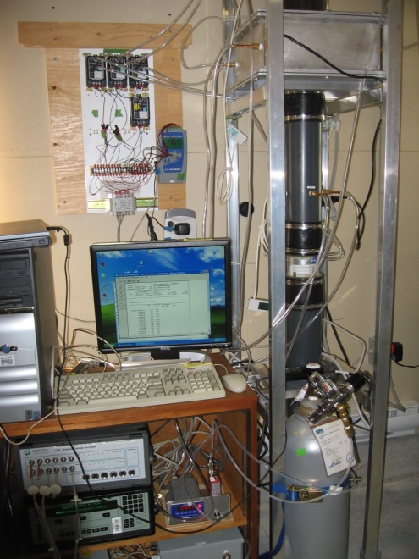
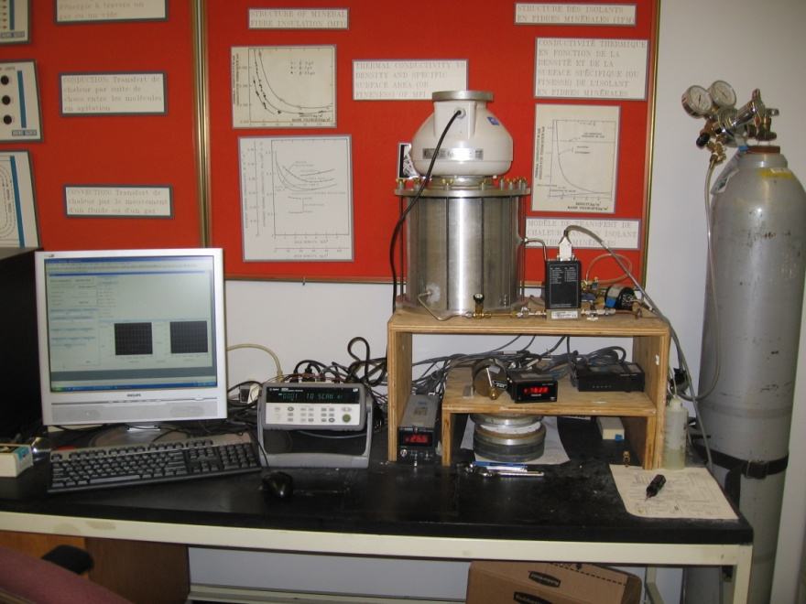
ASD: Radon Fan Enclosure Leakage Test Rig
(Illustration courtesy of Health Canada)
Canada US
  Why: Radon control fans are located in the basements of Canadian homes
  How: NRC’s air permeability test apparatus and tracer gas leakage test rig
  What: Test 5 models/8 fans from 4 manufacturers
  Outcomes: Radon fan criteria- Canadian General Standard Board CAN/CGSB-149.12-2017 Radon Mitigation Options for Existing Low-Rise Residential Buildings
Notes:
For radon fan selection, currently there is no standard or guideline. We also conducted radon fan leakage tests using our air permeability test apparatus and the fan leakage test rig by using tracer gases. The results we obtained from such tests enabled the CGSB standard technical committee to set the radon fan selection leakage criteria. We received the endorsement and contribution from 4 radon fan manufacturers, and these 4 companies make up more than 95% of the market.

Slide 8
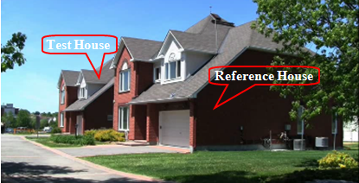
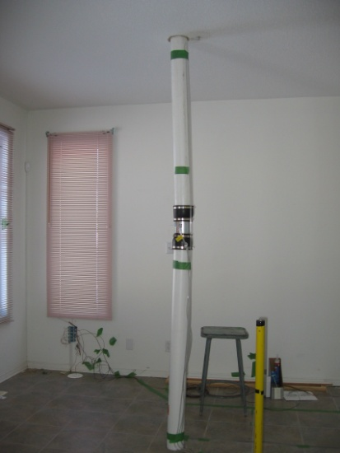
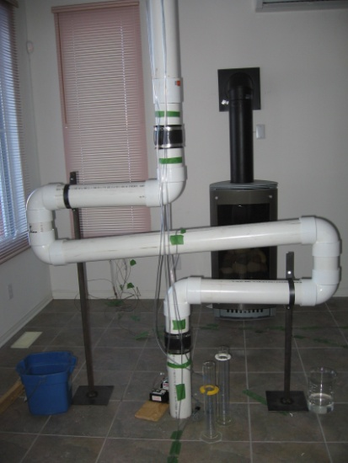
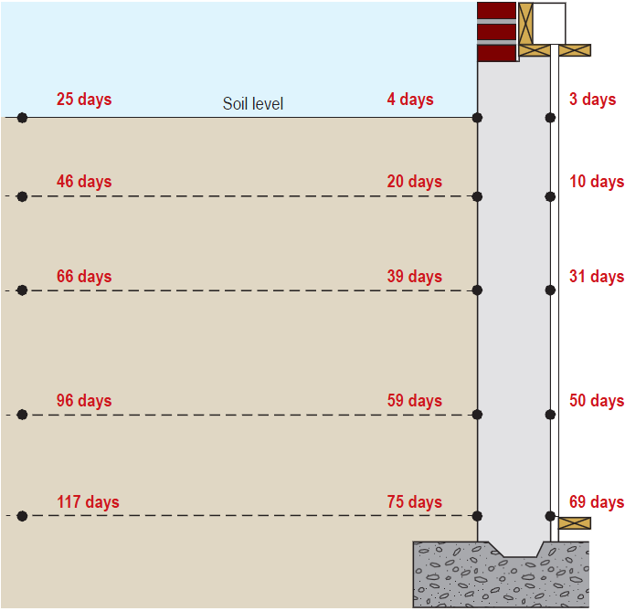
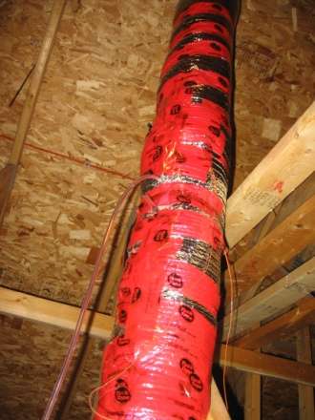
ASD: Impact on Heating Energy Use and Soil Temperature
Performance of Passive Radon Stack
Canadian Centre for Housing Technology
 | ASD with Ground Exhaust (2012) | ASD with Roof Line Exhaust (2012)
Expected Test House Daily Energy Consumption (MJ) | 309.9 | 360.4
Increased Daily Consumption (MJ) | 20.2 | 15.3
Increase, % | 6.5% | 4.2%
Notes:
The CCHT features twin research houses to evaluate the whole-house performance of technologies in side-by-side assessment.
Before and in between the four test cases, the energy consumed by the furnaces (which include furnace fan electrical consumption and furnace natural gas consumption) in twin houses of the CCHT were recorded and a benchmark analysis were performed, in order to correlate the heating energy usage of the test house to that of the reference house. As a result, the furnace energy usage in the test house can be predicted by inputting the furnace energy usage in the reference house into a liner equation. In benchmarking configuration, the two houses are almost identical – as indicated by the slope (1.0028) and intercept (-6.3747) of the benchmark trend line. The four experiment periods T1, T2, T3 and T4 are plotted as separate trends on this graph. In all instances, the experiment data lies slightly above the benchmark trend line, indicating a slight increase in total furnace consumption for heating in the Test House, due to the operation of the Rn ASD fan.
Then the daily energy usage in reference house were used to calculate the “Expected Test House Consumption in Benchmark Configuration” for the test house (as shown in the 1st column of the table), the 2nd column of table presents the difference between the actual energy consumptions in the test house and the values in the 1st column (the predicted baseline values). The 3rd column indicates by how much the ASD system increased the heating energy use in the test house for every test day—(2nd column/1st column).
The daily impact on heating energy consumption is presented in the Table. On average during the experiment, ASD system with ground level exhaust produced a daily increase of 20.2 MJ/day (6.5%), while ASD system with above roof exhaust produced a daily increase of 15.3 MJ/day (4.2%). Since two points in the Experiment Test 4 trend line lie outside the range of the benchmark trend line, the benchmark trend had to be extrapolated for this analysis.
8

Slide 9
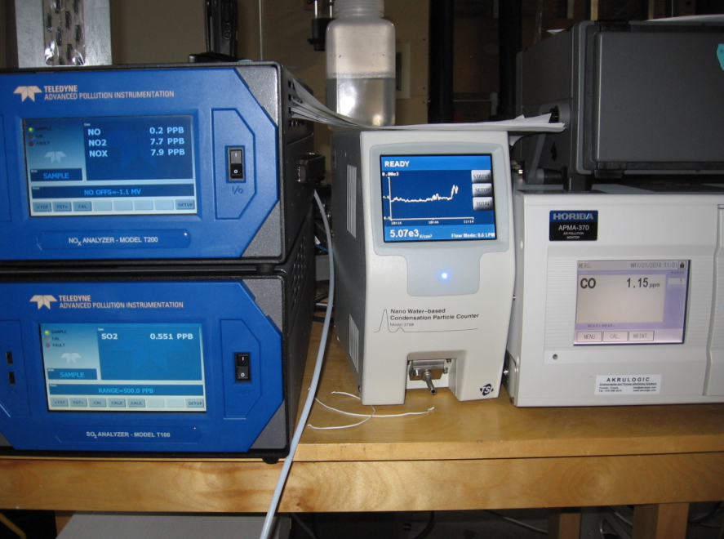
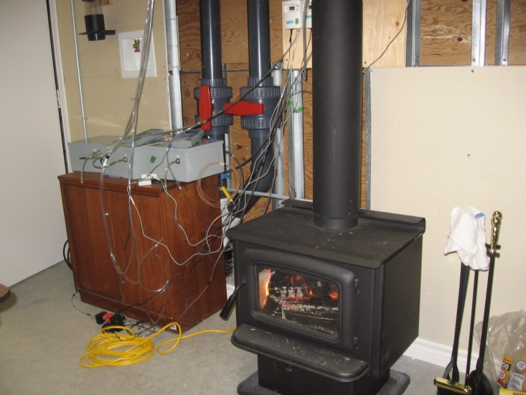
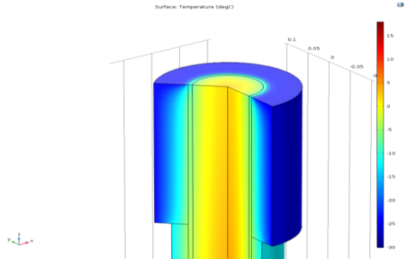
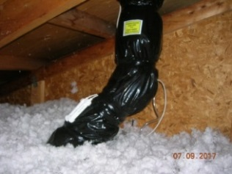
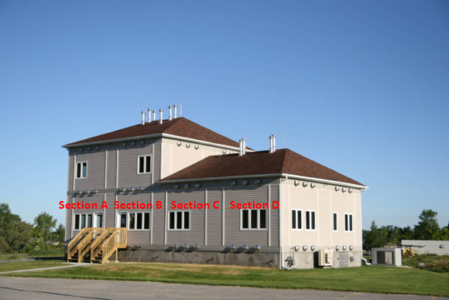
ASD: Stack Insulation, Backdrafting from Combustion Appliances
Indoor Air Research Laboratory
ASD causes insignificant risk of backdrafting from combustion appliances
Gable-ended discharge is a viable routing for ASD
R7 in unheated attic and R14 above roofline
CGSB149.11 and 149.12 Radon Standards
“Radon-Reduction Guide for Canadians”, Health Canada-Radiation Protection Bureau
“Illustrated User’s Guide to Part 9 of the National Building Code 2010”
Notes:
The CCHT features twin research houses to evaluate the whole-house performance of technologies in side-by-side assessment.
In recent years, passive radon stack has been adopted by BC building code and LEED building rating system for radon reduction; however the performance of such technique under various climate conditions need to be understood further. Some local builders in Ottawa have already included this practice in their new build, but the passive stacks are often detoured to stay invisible or for convenience.. Therefore, we installed passive radon stacks with alternative configurations in the CCHT and the IARL last fall, and long term monitoring are on going. The tests results would be reported to CHBA, builders and radon contractors, in order to confirm how effective such a system is and how to guide the practice on site.
9

Slide 10
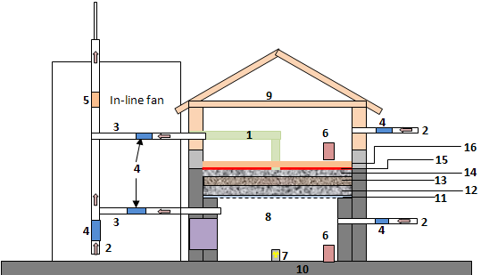
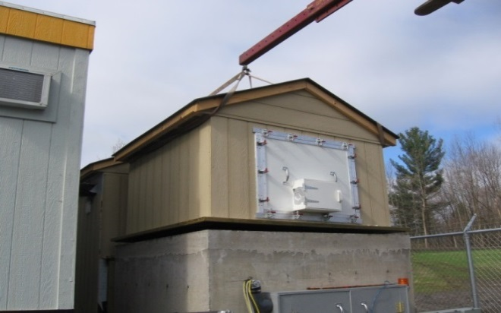
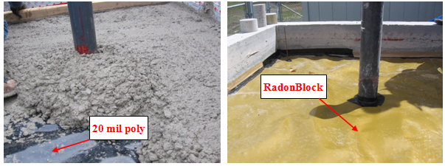
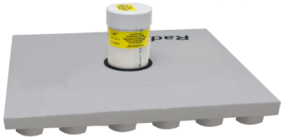
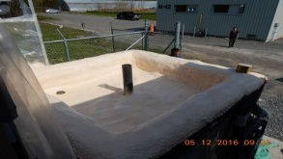
Prevent Soil Gas Entry:
Radon Infiltration Building Envelope Test System (RIBETS)
  Floor assemblies with gas permeable layer and air barrier
  Membrane
  Special property concrete
  Sub-slab ventilation panel
  Sub-slab spray foam
  HVAC components (HRV/ERV) and demand control
Notes:
we developed a radon infiltration building envelope test system. This facility consist of a small scale house and we dose radon gas into the sub-slab area of the facility to created soil gas of high radon concentration. Innovative construction material test samples such as membrane, under-slab ventilation panel, concrete forming and drainage, etc are installed in the floor assembly between the radon dosing compartment and the small scale house. And the radon infiltration and sub-slab pressure communication can be measure using this system.
In addition, we developed a radon diffusion coefficient test apparatus inside a glove box with environment control. This system complies with the newly developed ISO standard. And we are using it to test radon membrane, concrete of alternative composition, and sub-slab spray foam product for radon control.

Slide 11
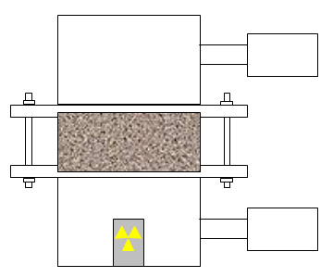
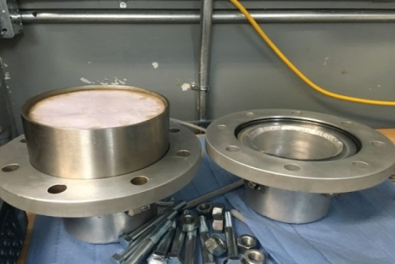
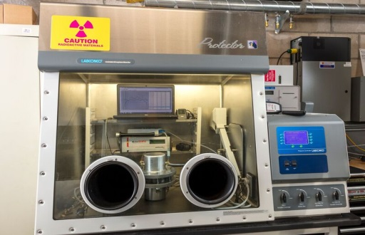
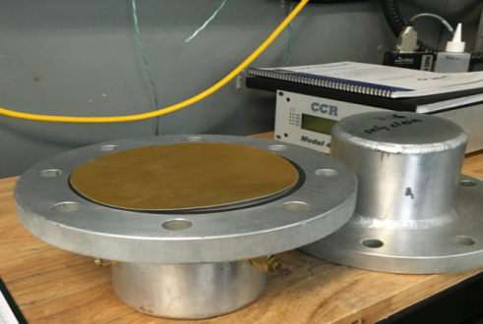
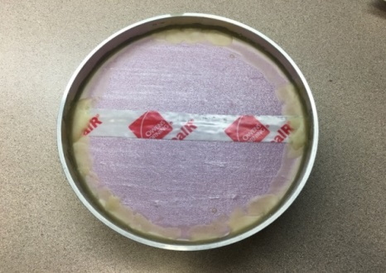
Prevent Soil Gas Entry:
Radon Diffusion Test Chamber
  Material evaluation ISO/TS 11665-13: 2017
  Special property concrete
  Membrane
  Sub-slab spray foam
  Foam board and tape
  Sealant
CCMC Technical Guide for “Medium Density (MD) Spray Polyurethane Foam Insulation (SPUF) for Soil Gas (Radon) Control beneath Concrete Slabs-on-Ground” 2017
Notes:
In addition, we developed a radon diffusion coefficient test apparatus inside a glove box with environment control. This system complies with the newly developed ISO standard. And we are using it to test radon membrane, concrete of alternative composition, and sub-slab spray foam product for radon control.

Slide 12
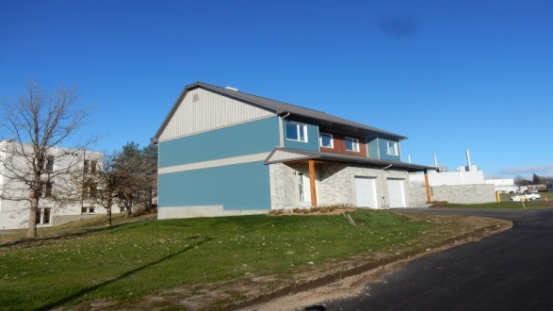
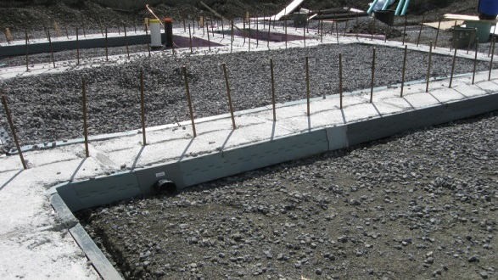
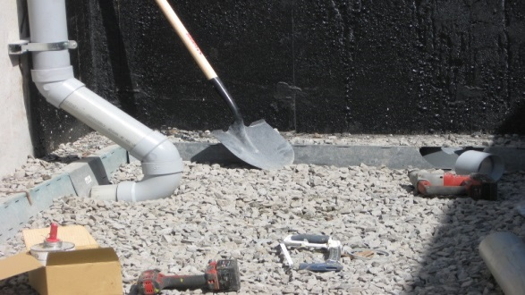
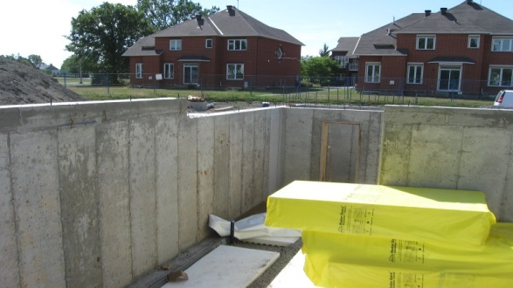
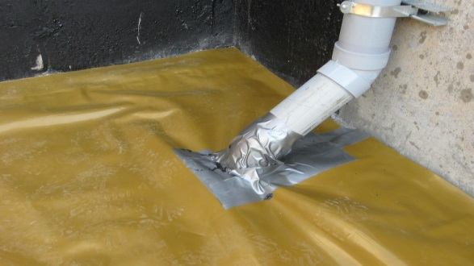
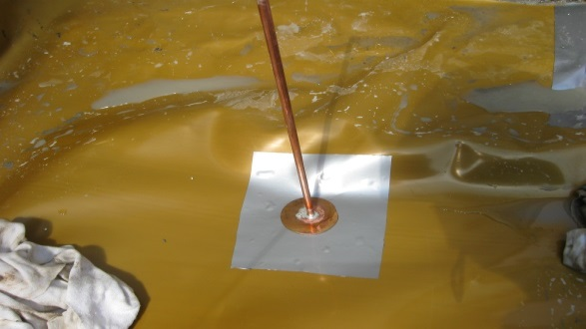
A Combination of Strategies:
CCHT Semi-Detached Net-Zero Energy-Ready Smart Home
A verified sub-slab ventilation panel, a verified radon prevention membrane, an integrated drainage system, 4 radon stacks
Extensive sensors for monitoring sub-slab pressure, soil temperature, stack flow/RH/T/V.
Notes:
Foundation solution that forms footings, provides an integrated drainage system, and can be easily adapted to vent radon where needed.

Slide 13
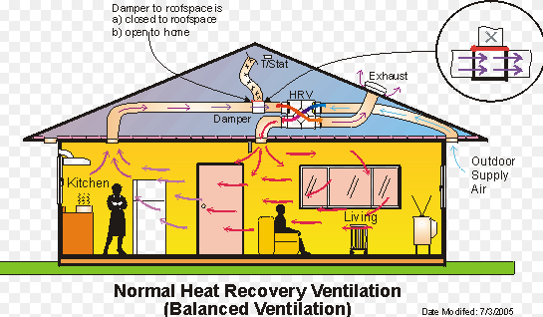
Indoor Radon Dilution: Air Tightness, Air Changes per Hour, and Heat Recovery Ventilator
A two-storey single house of 1450 ft² with 2 HRV units
Tracer gas decay test
HRV#1 Off and HRV#2 Off, ACH =0.045
HRV#1 On and HRV#2 Off, ACH =0.244
HRV#1 On and HRV#2 On, ACH =0.404
Blower door test
0.79 ACH @-50 Pa
Notes:
Heat recovery ventilation (HRV), is an energy recovery ventilation system using equipment known as a heat recovery ventilator, heat exchanger, air exchanger, or air-to-air heat exchanger which employs a cross flow or counter-flow heat exchanger (countercurrent heat exchange) between the inbound and outbound air flow.[1]

Slide 14
Indoor Radon Dilution:
Air Tightness, Air Changes per Hour, HRV, and Radon
A two-storey single house of 1450 ft² with 2 HRV units
HRV#1 On and HRV#2 Off, [Rn] range between 17 and 74 Bq/m³, average 43.7 Bq/m³
HRV#1 Off and HRV#2 Off, [Rn] increased from 16 Bq/m³ to 222 Bq/m³ within 18 hours
HRV#1 On and HRV#2 On, [Rn] decreased from 120 Bq/m³ to 33 Bq/m³ within 4 hours

Slide 15
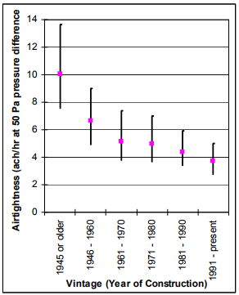
Indoor Radon Dilution: HRV for Radon Control
According to the Cross-Canada survey, >90% of Canadian homes with radon issues have radon concentrations between 200 Bq/m3 and 600 Bq/m³.
HRVs suitable for houses which are airtight and with moderate levels of radon
Illustration courtesy of Natural Resources Canada (left) and data from Health Canada cross-Canada radon survey (right)

Slide 16
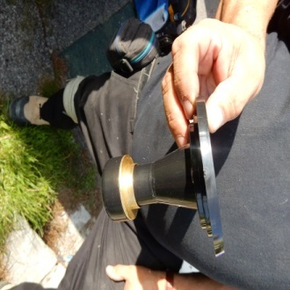
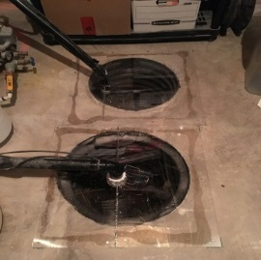
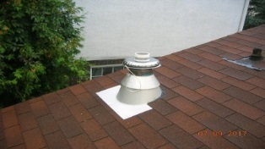
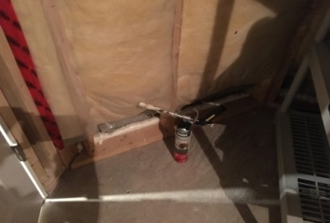
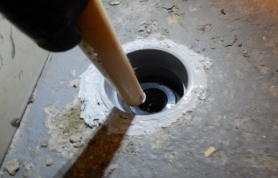
Full Height Passive Radon Stack:
A Field Study in the National Capital Region
December 2014, the British Columbia Building Code provisions for Area 1 (radon-prone areas).
3 National Building Code change requests to standing committee on housing and small buildings.
Study 2017-2018:
5 homes in Ottawa-Gatineau, >30 day stack open, >30 day stack closed, Fall&Winter
Measurements: radon concentration (indoor, soil, and stack); sub-slab pressure; P/T/RH flow rate and air speed in the stack; tracer gas test for air exchange rate; blower door test.

Slide 17
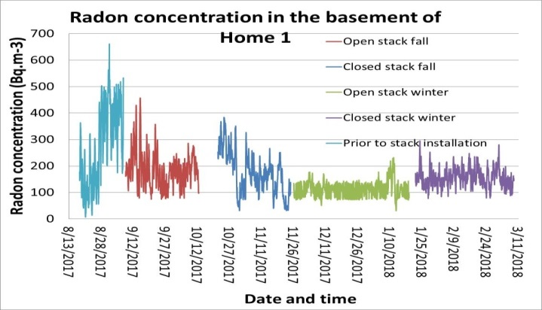
Full Height Passive Radon Stack Field Study:
Basement Radon Concentrations Home 1
Before sealing radon entry points: 310 Bq/m³
Closed stack: 150 Bq/m³
Open stack: 110 Bq/m³ (36% reduction)

Slide 18
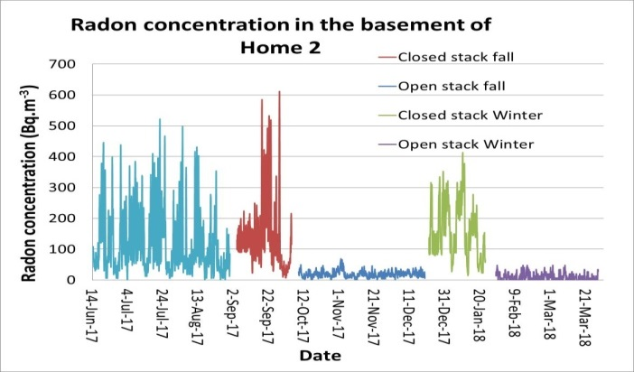
Full Height Passive Radon Stack Field Study:
Basement Radon Concentrations Home 2
Before sealing radon entry points: 200 Bq/m³
Closed stack: 165 Bq/m³
Open stack: 12 Bq/m³ (92% reduction)

Slide 19
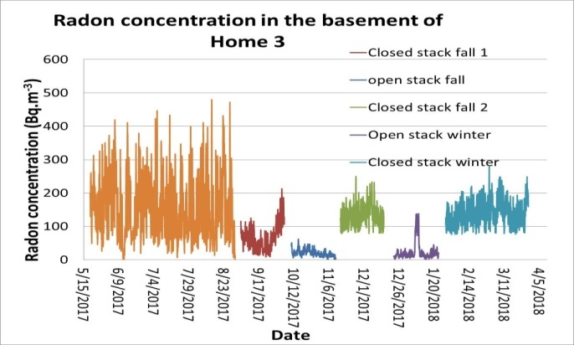
Full Height Passive Radon Stack Field Study:
Basement Radon Concentrations Home 3
Before sealing radon entry points: 196 Bq/m³
Closed stack: 117 Bq/m³
Open stack: 22 Bq/m³ (81% reduction)

Slide 20
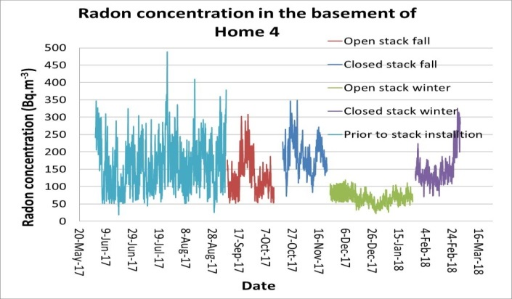
Full Height Passive Radon Stack Field Study:
Basement Radon Concentrations Home 4
Before sealing radon entry points: 161 Bq/m³
Closed stack: 140 Bq/m³
Open stack: 68 Bq/m³ (51% reduction)

Slide 21
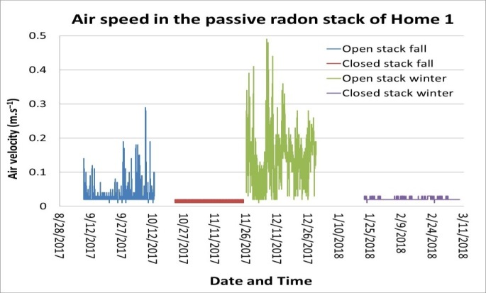
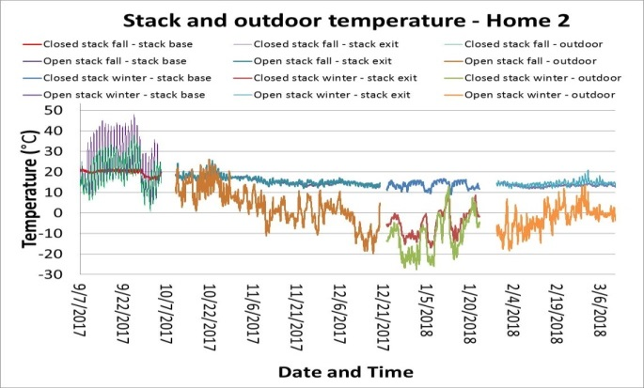
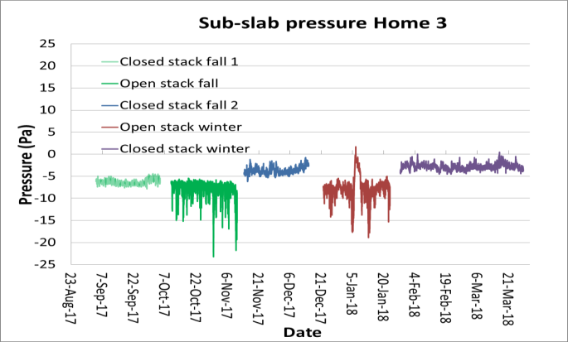
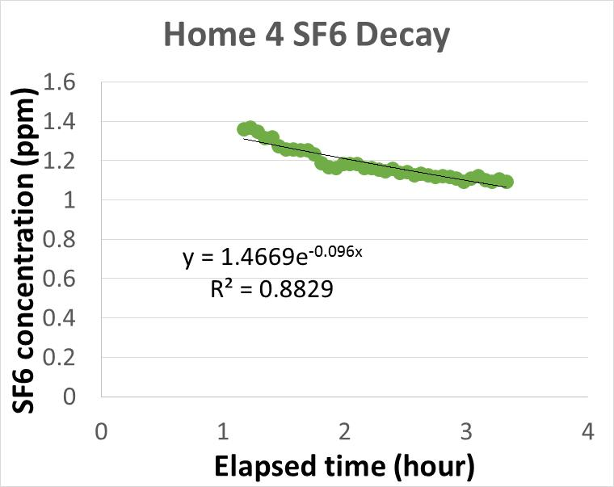
Full Height Passive Radon Stack Field Study:
Other Measured Parameters

Slide 22
Future Work: 2018 and Beyond
Database of building materials for radon control
Phase II of Field study of full size passive radon stack in BC (15 homes): design/installation guide and changes to existing NBC
A field study of HRV for indoor radon control
Radon cross-contamination through ERV core unit
Discharged radon dispersion (measurement from mitigated homes and CFD)
Radon measurement and intervention in daycares/schools and workplaces
Soil gas sampling + indoor air/radon monitoring + building study
Applying verified radon control products in new construction
Notes:
In some cases, the client developed new product for radon prevention and control and come to us to verify the effectiveness, sometimes the client had an existing product which was not designed for radon prevention or control, and due to the improving awareness of radon issue, they realized the certain features of their products may be suitable for solving radon problem..

Slide 23


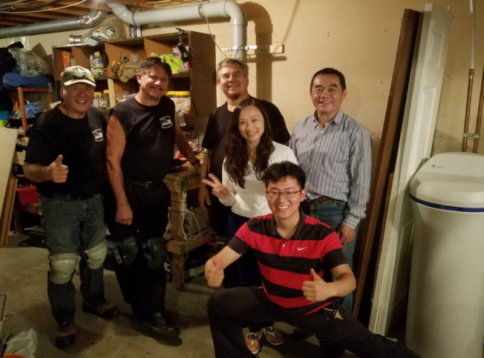
Thank you
Dr. Liang Grace Zhou
Senior Research Officer
613-990-1220
Liang.Zhou@nrc-cnrc.gc.ca
www.nrc-cnrc.gc.ca
November is Radon Action Month in Canada!
23

